Slide 1
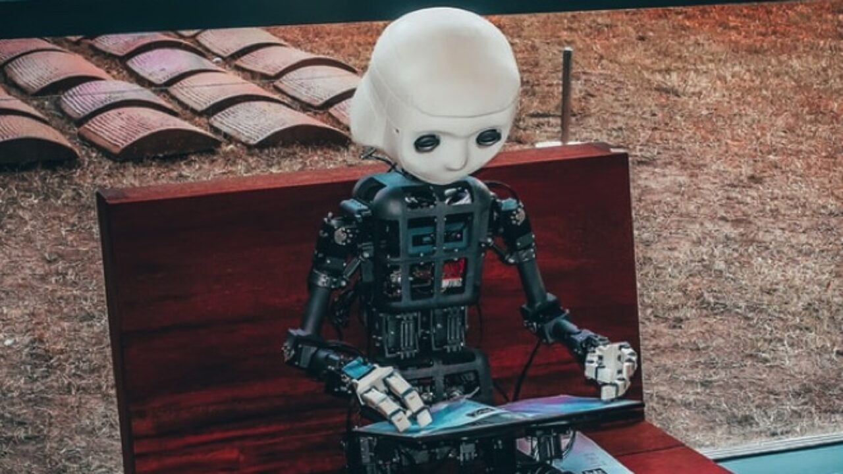
“The Lifecycle of Software Objects”
Ted Chiang

Slide 2

Free Write- 15-20 minutes
Pick two theories and apply them to the text by considering how they work together in the text to do something specific:
Goss – Levels of awakening are demonstrated by both the creation and the creator that challenge what consciousness is
Haraway - The cyborg as a vehicle to destabilize and challenge the longstanding, European, patriarchal social hierarchy
Olsen - Posthuman trauma
Hayles - The impact of the existence of thinking machines on our conception of “human” and the importance of embodiment
Ferrando- Qualities of a posthuman aesthetic, hybridity, boundary crossing/altering, structural hybridity in medium (use of emails in the text), are used to destabilize the human
Mori- The uncanny Valley

Slide 3
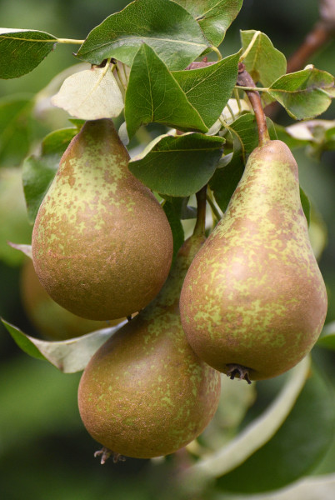
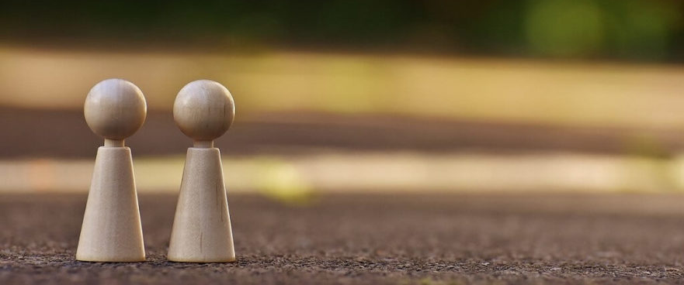
Pair- Groups of 3
Share what you wrote with each other and discuss how the theories apply to the short story.

Slide 4
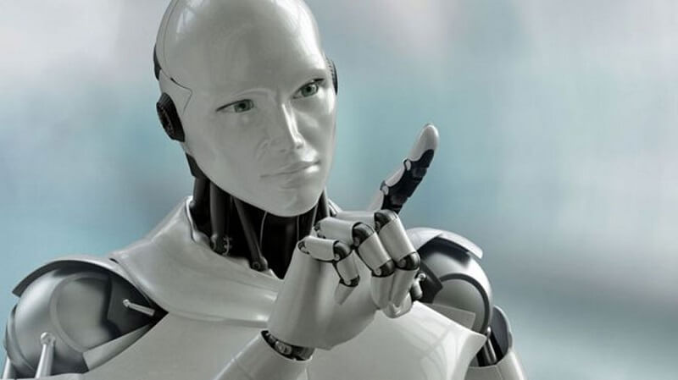
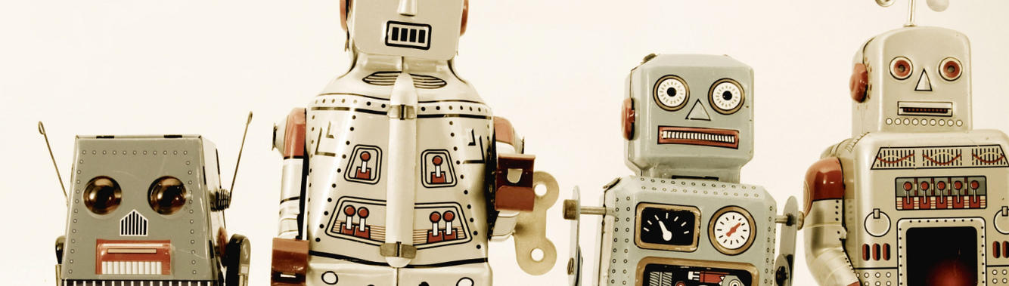
Share

Slide 5

Essay 3- Synthesis
MLA, 12 pt font
4-5 pages
Take 2 theories and use them together to analyze 1-2 works we discussed this semester
Must focus primarily on the work analyzed
Like a lens paper in focus, but synthesizes the theories to come up with a new way of viewing

