Slide 1
Post Human & AI Generated Art

Slide 2
Posthuman Aesthetic = Decentering the “Human”
Hybridity
  Divine/Human/Animal/Plant/Machine
Boundary Crossing or Boundary Altering
  Real/Imaginary/Dream/Virtuality
  Material Embodiment/ Disembodied
  Cultural
  Nature/Culture
  Time/Space
Structurally Hybrid in Medium
  Collage
  Assemblage
  Digital Generation
    Augmented reality
    Virtual reality
    Digital manipulation

Slide 3
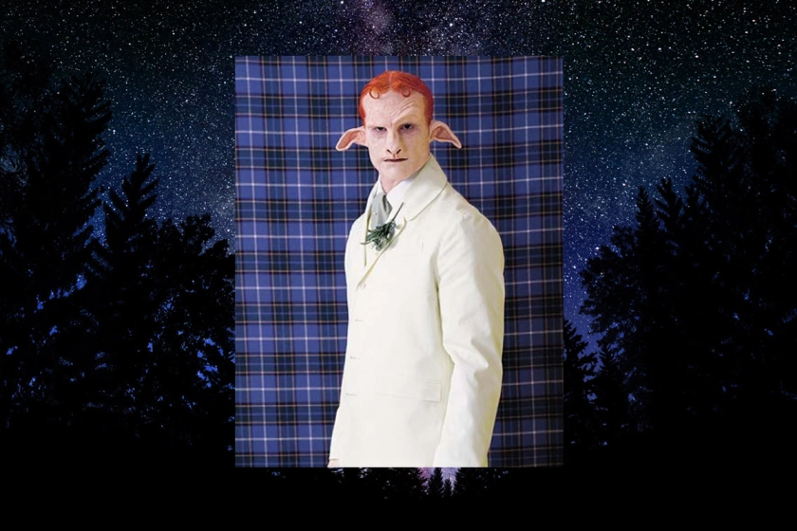
Mathew Barney “Cremaster Cycle”

Slide 4
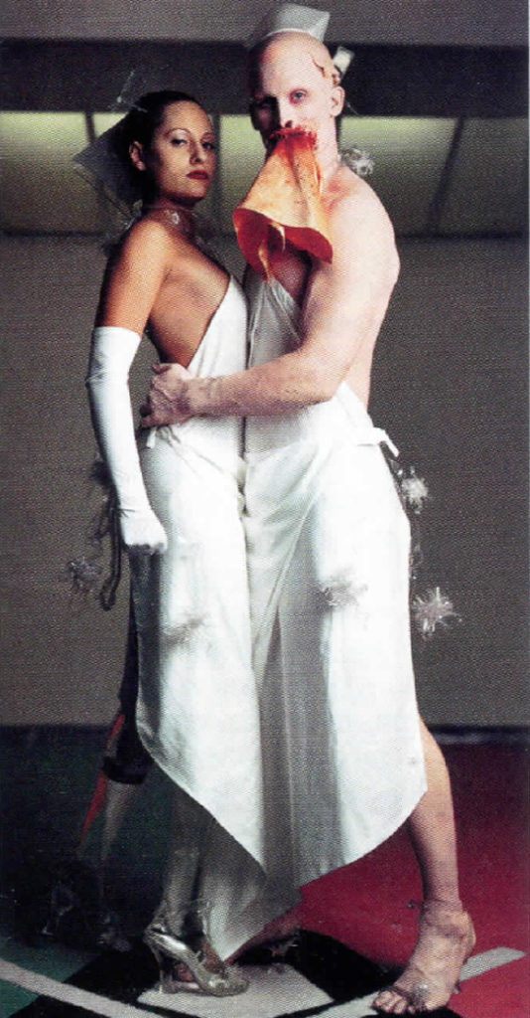
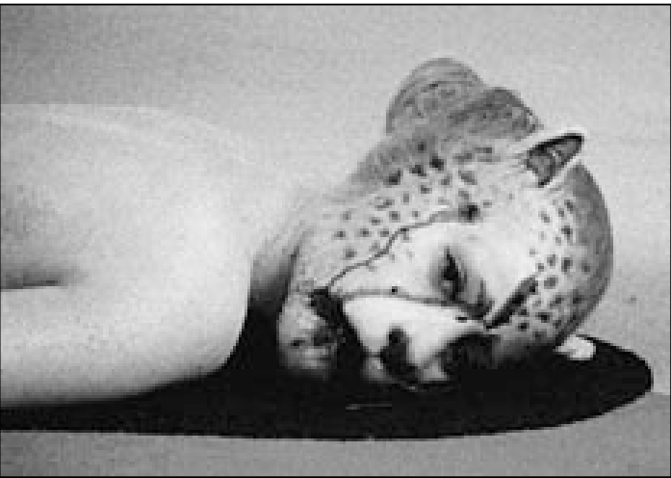
Aimee Mullins as “Legs” And “Cheetah Woman”
Mathew Barney “Cremaster 3”

Slide 5
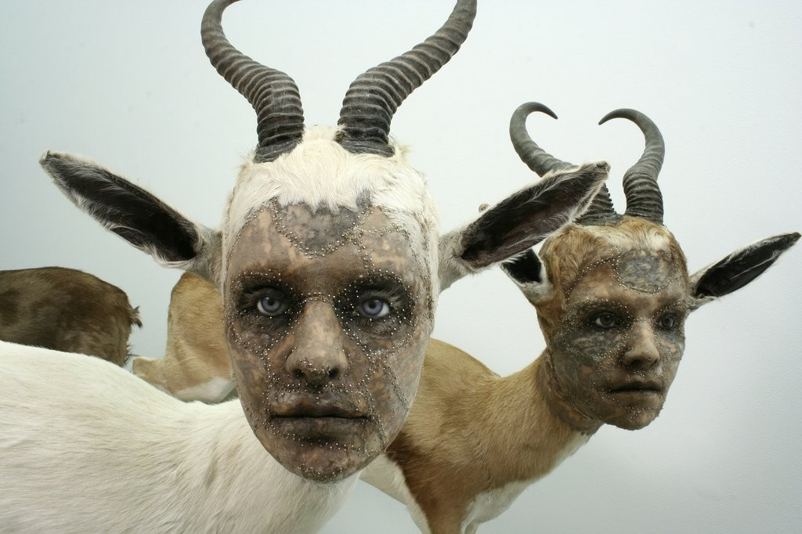
Kate Clark
"Lit from Within"

Slide 6
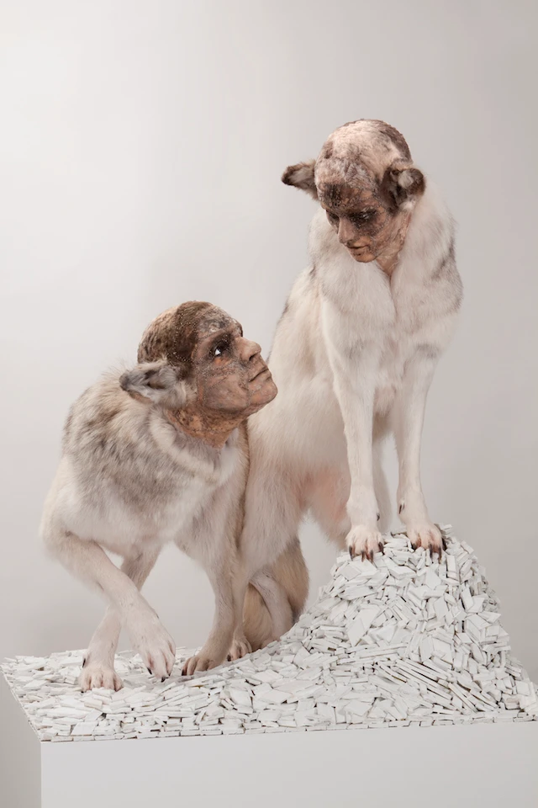
Kate Clark “Bully”
“Initially this piece looks like a romance between male and female,” Clark says, “but in fact the piece is titled ‘Bully’ as the female is positioned in a dominant stance with a stern expression, and the male is below her with his ears turned back.”

Slide 7
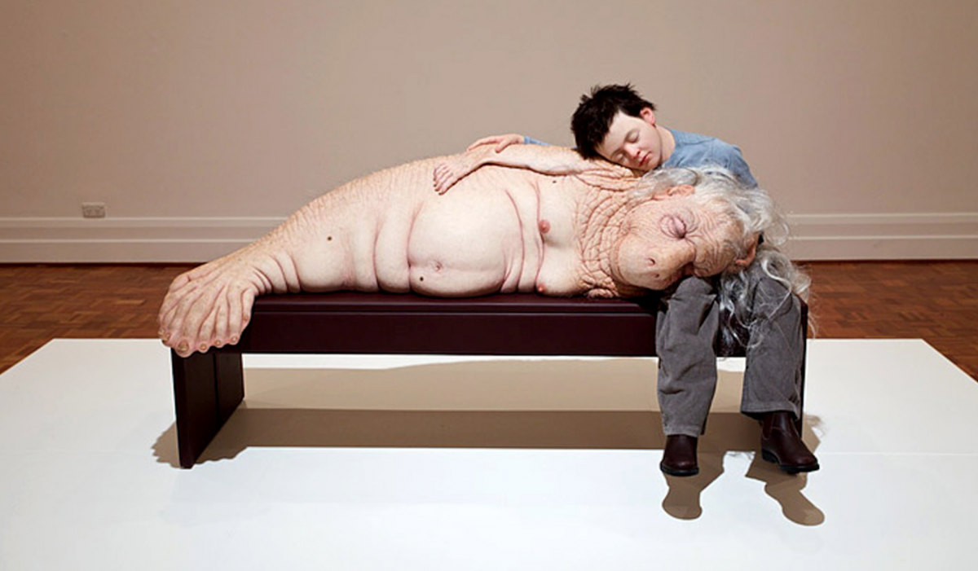
Patricia Piccinini, The Long Awaited, 2008
“Piccinini is an artist who creates compelling works of chimera sculptures of animals and humans that examine the ethical implications of biotechnology. Using sculpture and digital media, her works oscillate between the natural and the artificial and present the uncanny in their anthropomorphic materializations. Piccinini echoes the concerns by authors such as Yoshihiro Francis Fukuyama, C.S. Lewis, and Shelley who criticized the technological and scientific instrumentalization of subjects”
“Post-Humanist Art and Speculative Realism” Sandes
https://interartive.org/2018/04/post-humanism-speculative

Slide 8
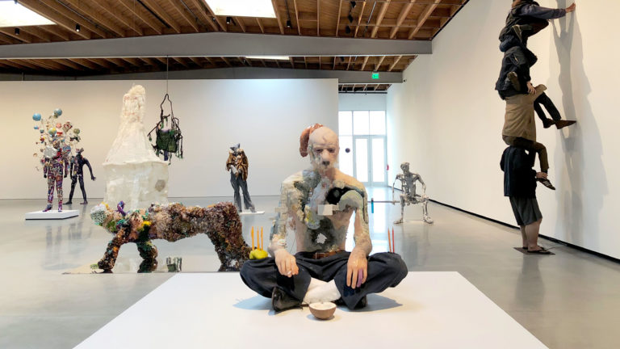
Jeffrey Deitch People 2019

Slide 9
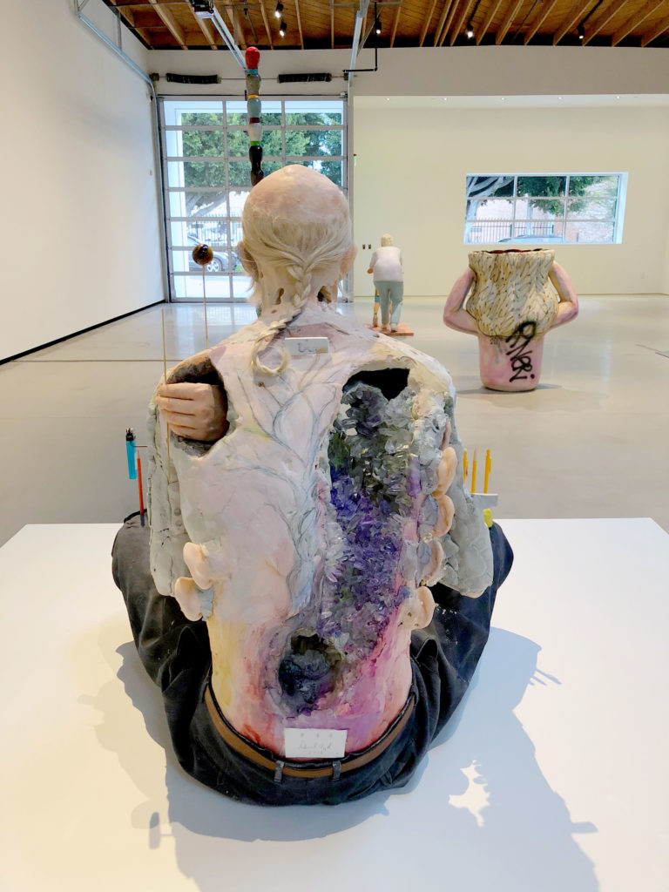
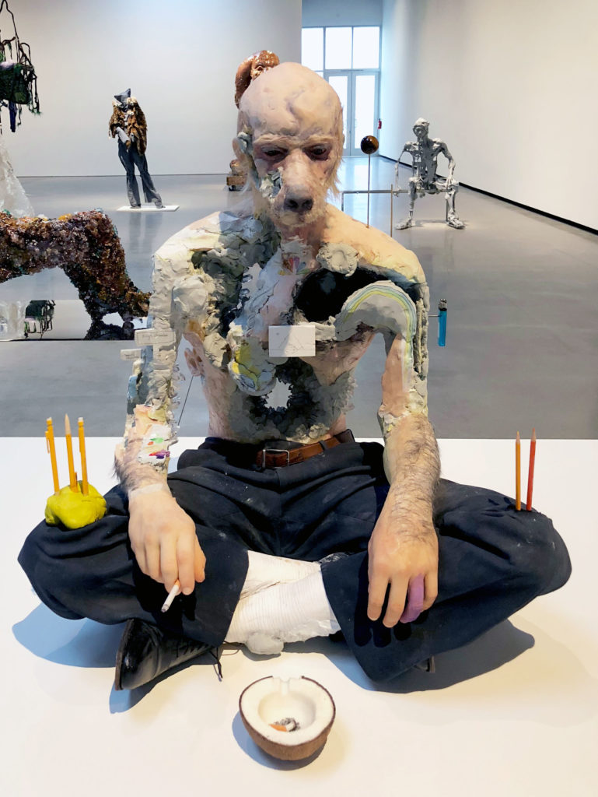
People (Detail)

Slide 10
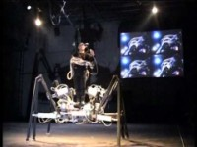
Stelarc “ExoSkeleton” 1999

Slide 11
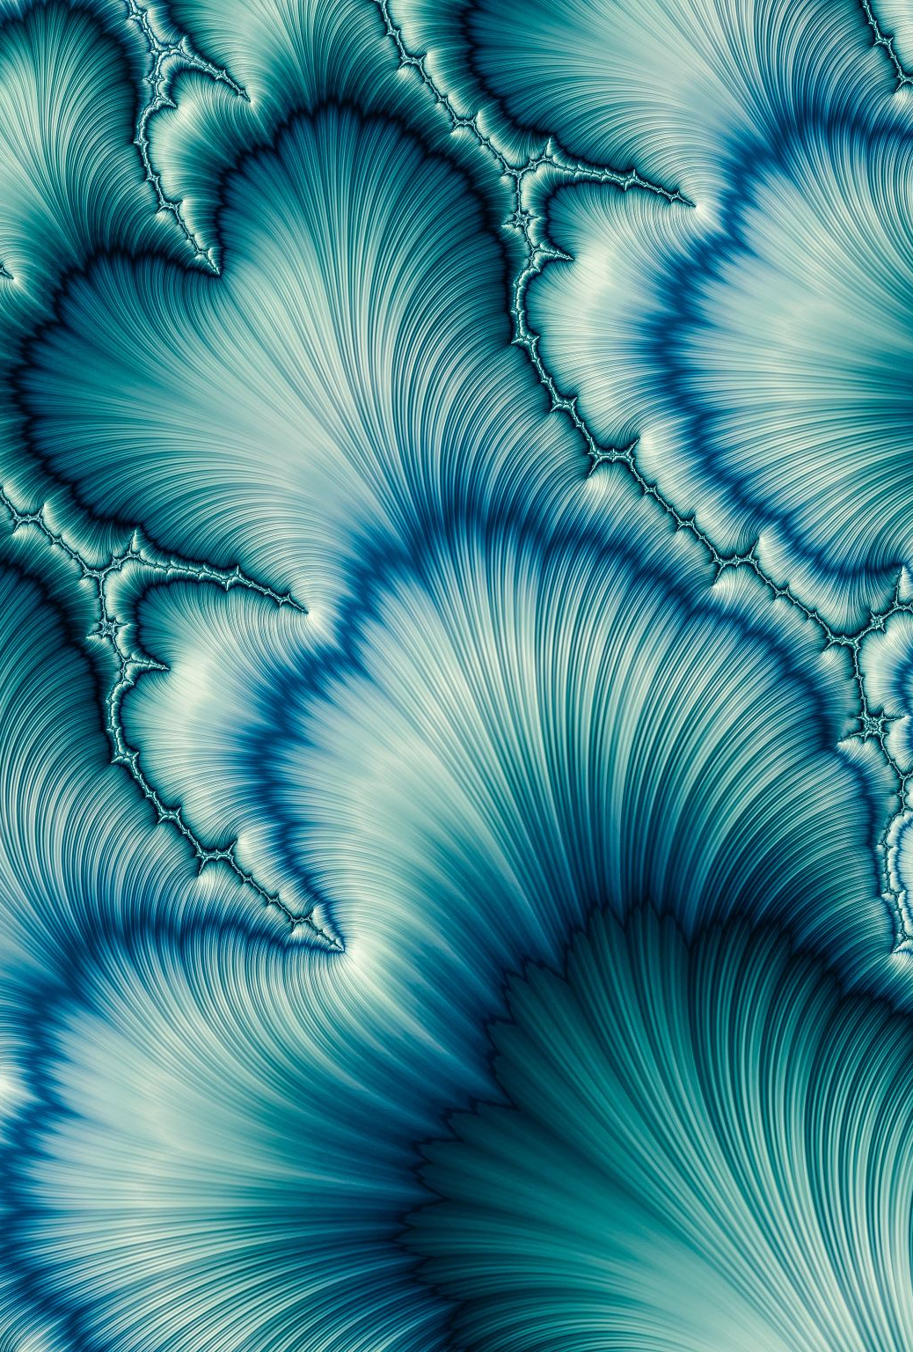
AI Generated Art

Slide 12
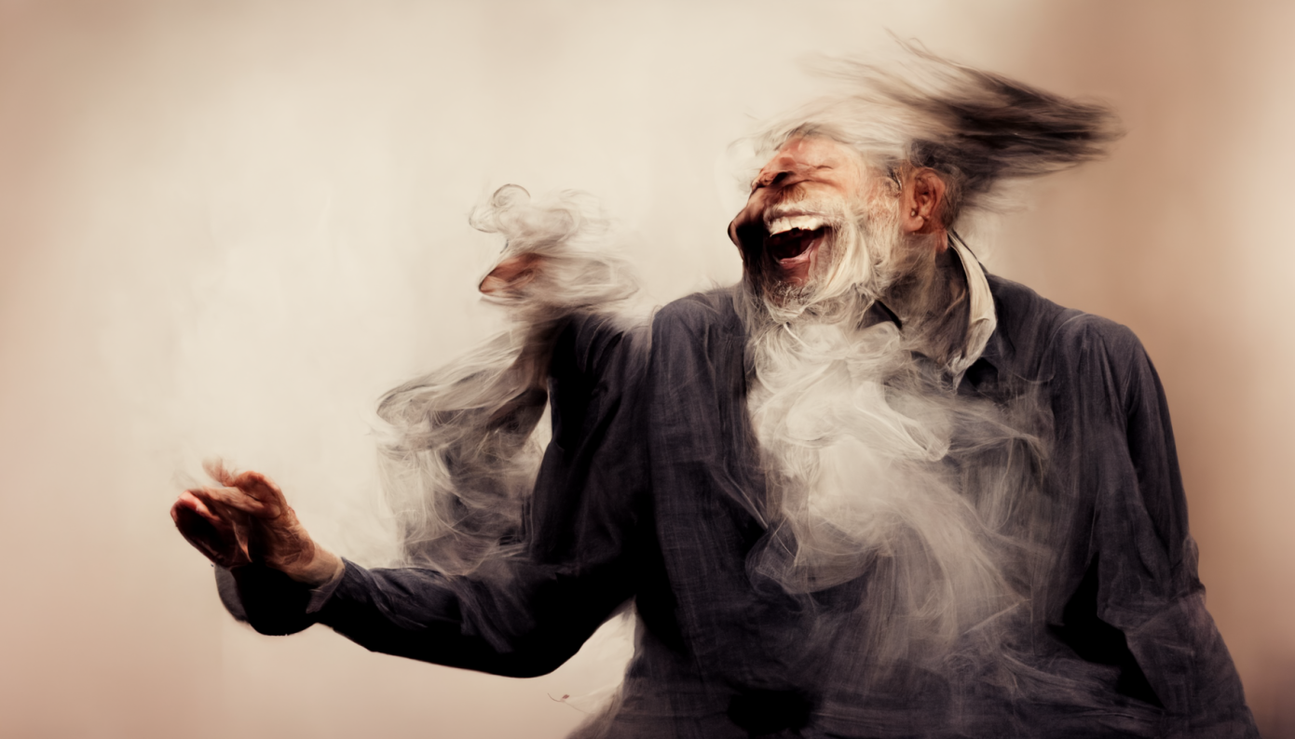
Prompt: “A man dances as if Prozac was a cloud of laughter.”
Generator: MidJourney Artist: Hage https://techcrunch.com/2022/08/02/ai-art-generated/

Slide 13
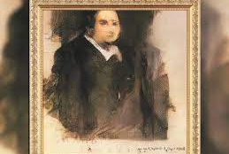
“Portrait of Edmond Belamy”
Artist: Obvious
Generated Using Robbie Barrat’s Algorithms

Slide 14
“Portrait of Edmond Belamy”
Artist: Obvious
Generated Using Robbie Barrat’s Algorithms

Slide 15
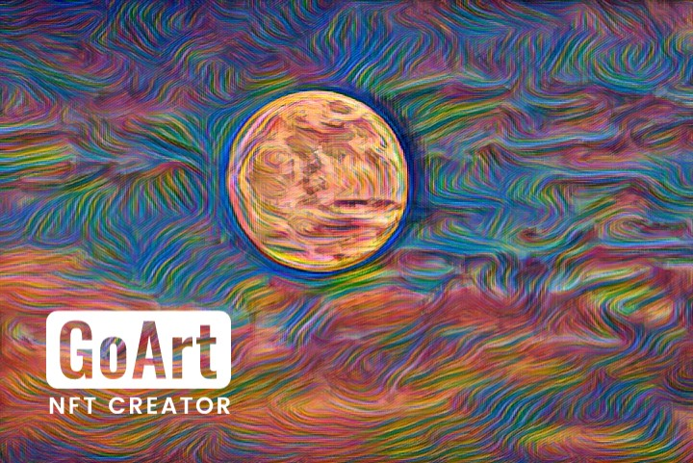

Slide 16
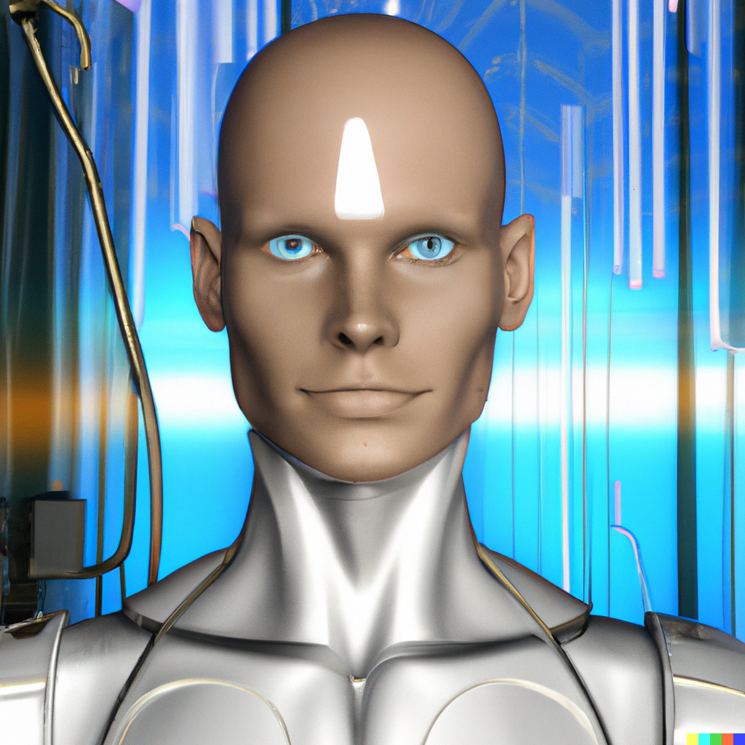

Slide 17
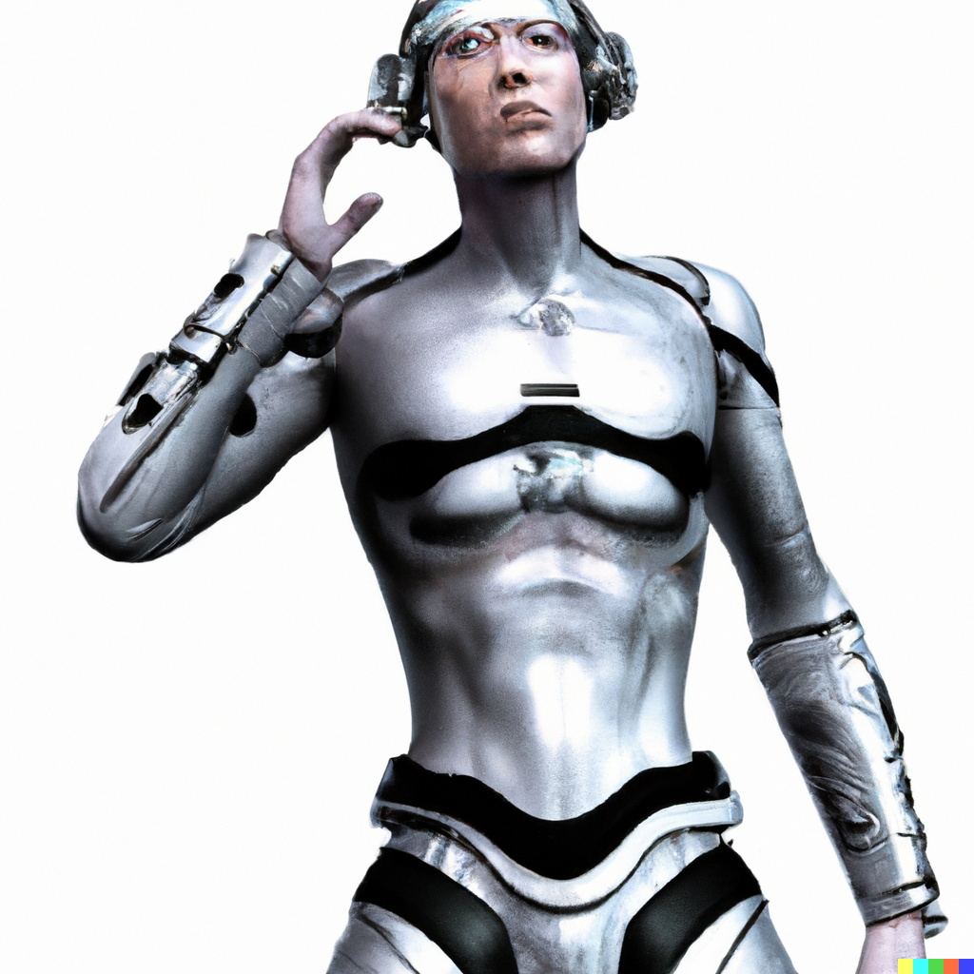

Slide 18
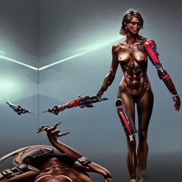

Slide 19
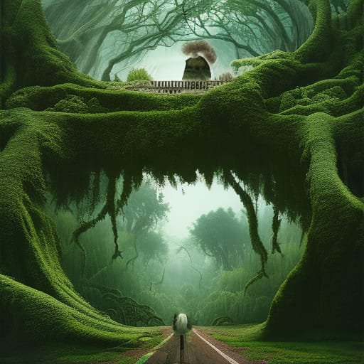

Slide 20
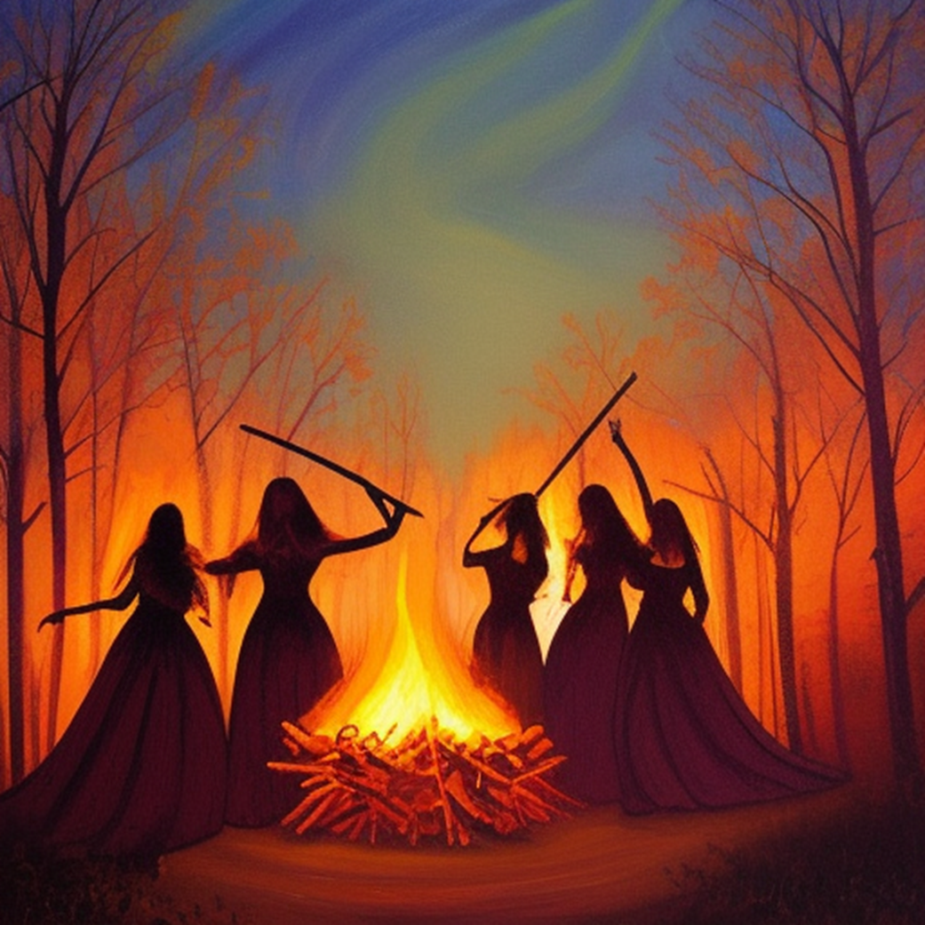

Slide 21
