Slide 1

Peer Review
General Guidelines
Essay #3: Synthesis Paper

Slide 2

Read Through 1: General Grammar
Highlight or circle errors you notice in:
Grammar
Word choice
Punctuation
Also highlight or circle:
Any form of the word YOU
Clichés
Broad Generalizations

Slide 3

Intro Paragraph: Context and Key Terms
Does the paper clearly introduce background information relevant to the Topic?
Is the critical theory through which the paper is being read clearly introduced?
Is synthesis of both critical theories present?
For both the primary text and the critical texts:
Are the Authors’ full names used the first time they are mentioned?
Are the full article titles and full book, short story titles present in that sentence also?
Are there any terms that still need to be defined? Which ones?
Are the definitions that are present clear and easy to follow? If not, what is confusing?
Is there any background or context missing that would help lead you into the conversation?

Slide 4
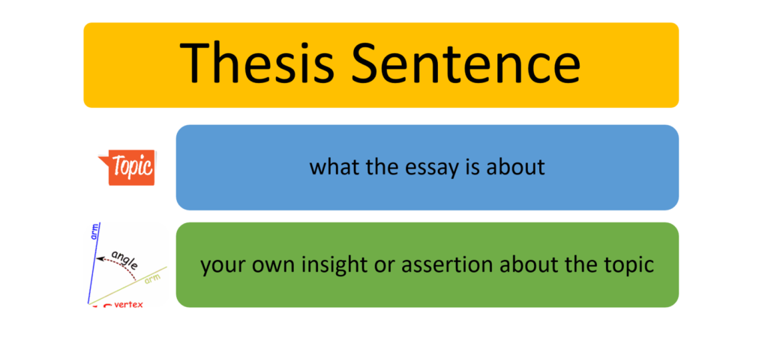
Thesis Statement
Underline or highlight what you believe to be the Thesis Statement
Make any comments you feel necessary to improve Thesis:
Is the topic clear?
Is the direction the paper proposes to explore the topic in clear?
Do the questions make sense? What needs clarification?
Are there any questions that might add depth or nuance?

Slide 5

Body Paragraphs
Is it clear how each body paragraph supports the claim?
Do these direct claims flow in a logical order?
Is the evidence relevant?
Is the evidence accurate?
Is MEAL used?
Main Idea
Analysis
Evidence
Link

Slide 6
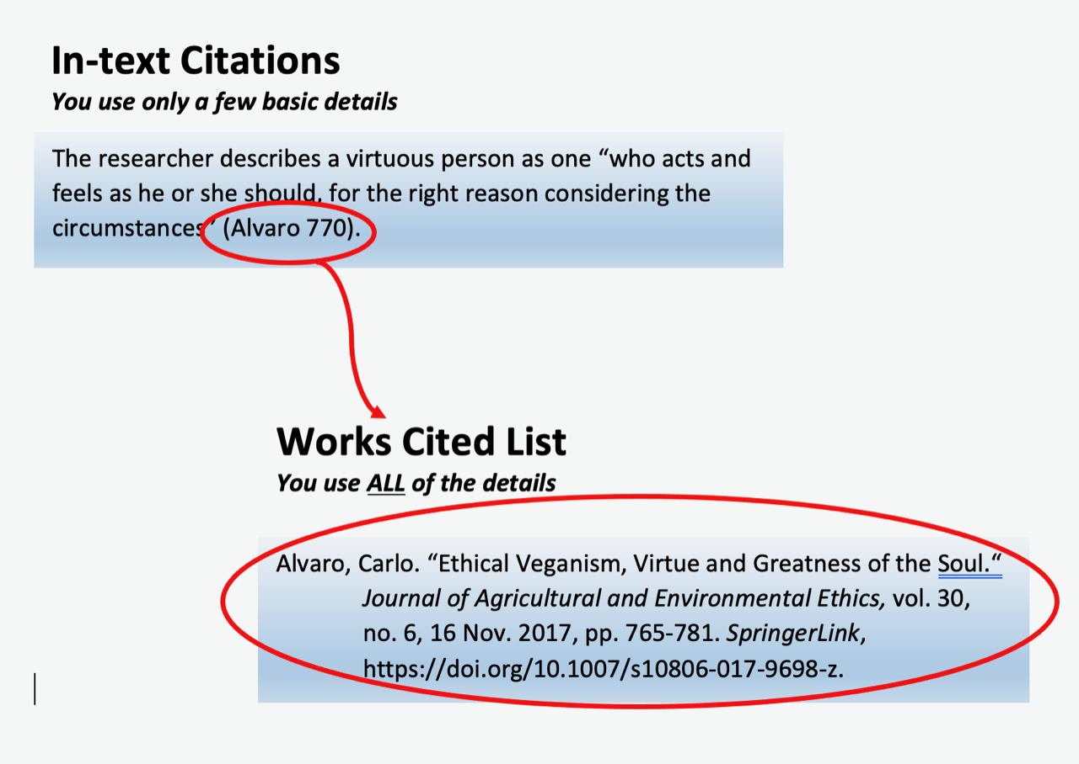
Citation
Check for:
Quotes that are not immediately followed by an in-text citation
Quotes that do not have a signal phrase or are not introduced
Any in-text citation that is not done correctly
Any source not introduced the first time it is used with the title of article and the author’s first and last name (because the first time a source is used the full name must use)

Slide 7

MLA
Are the works cited citations alphabetized?
Do all of the works cited citations have a hanging indent?
Are the Database and the Journal listed?
Have all of the minor typos, weird capitals, spacing errors, & missing page ranges been corrected?
Is the heading present?
Is the header present?
TNR 12 pt font?
Double spaced?

