Slide 1
Course Introduction
Electrophilic Aromatic Substitution (EAS)
1/18/2023

Slide 2

Syllabus & Course Resources
Syllabus link
“Living” course calendar link
Office hours (in Park 169): Wednesday, 11:00am-12:30pm
Friday, 11:00am-1:00pm
or by appointment (email me)
TA hours: TBD (will be shared ASAP)
All of this is on Moodle!

Slide 3
Tips for success
Know how to do every assigned homework problem.
  Unassigned problems are good extra practice (i.e. #54 is assigned, #55 is most likely helpful too).
  “Second Language” textbook companion also has extra practice problems.
Use all the resources at your disposal.
  Office hours, TA’s, textbook, email/talk to me!
Study with others.
Practice consistently & effectively.
  “Retrieval Practice” versus re-reading/reviewing
Come to class prepared.
Be active in class.

Slide 4


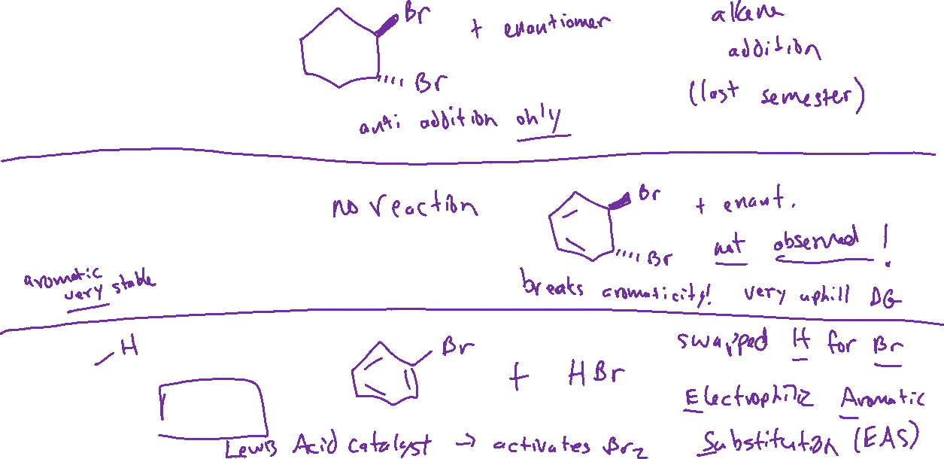





Electrophilic Aromatic Substitution (EAS) Text: 18.1

Slide 5


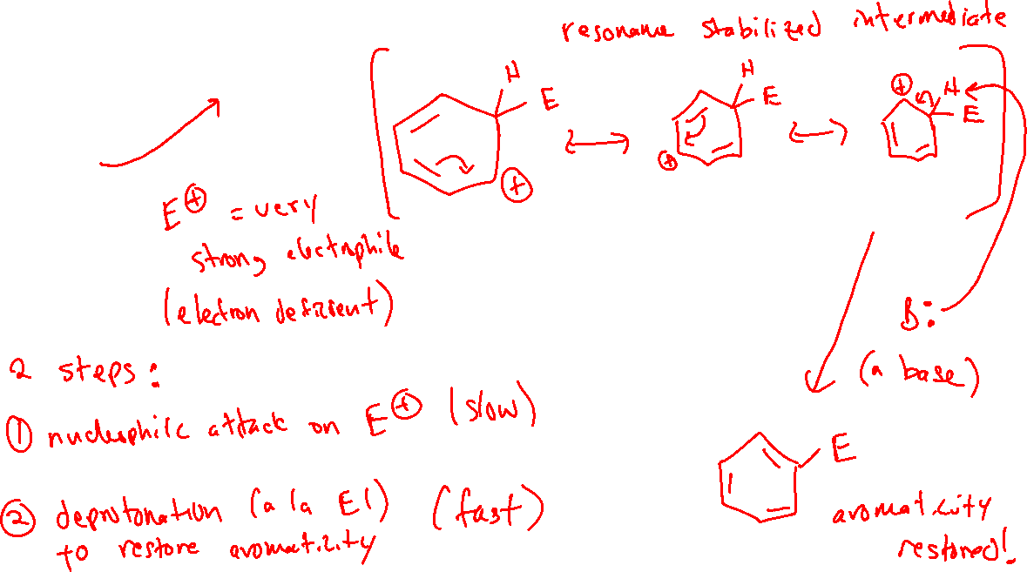


Electrophilic Aromatic Substitution (EAS): Mechanism

Slide 6


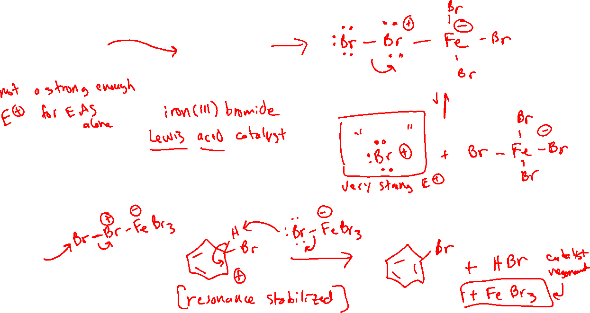
Halogenation of Benzene Text: 18.2

Slide 7




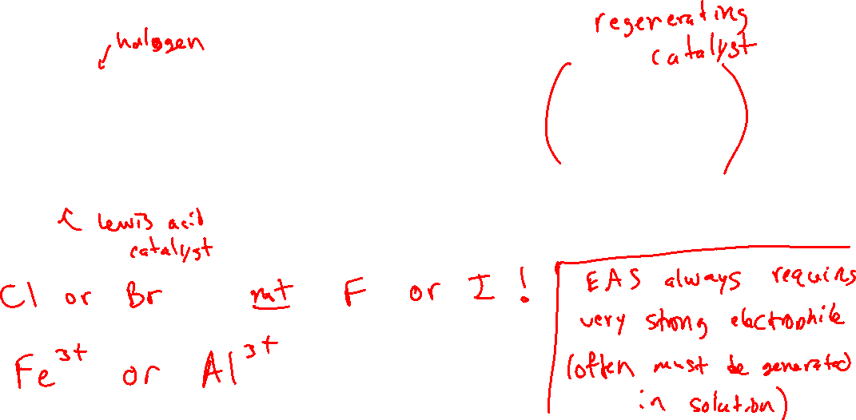






Halogenation of Benzene

