Slide 1
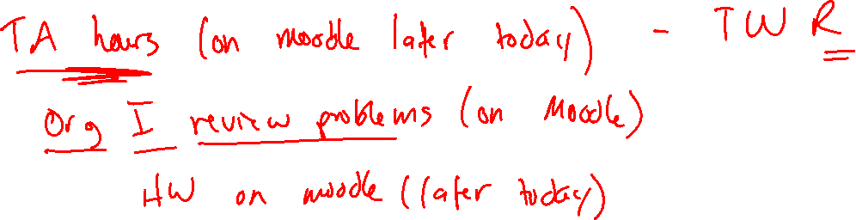
EAS (continued)
Friedel-Crafts Alkylation and Acylation
1/20/2023

Slide 2


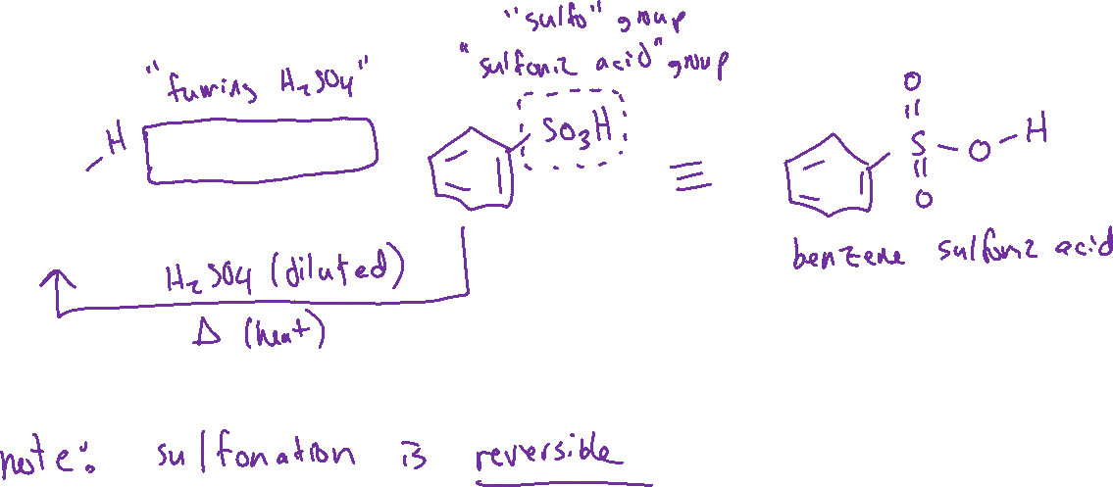
Sulfonation of Benzene Text: 18.3

Slide 3



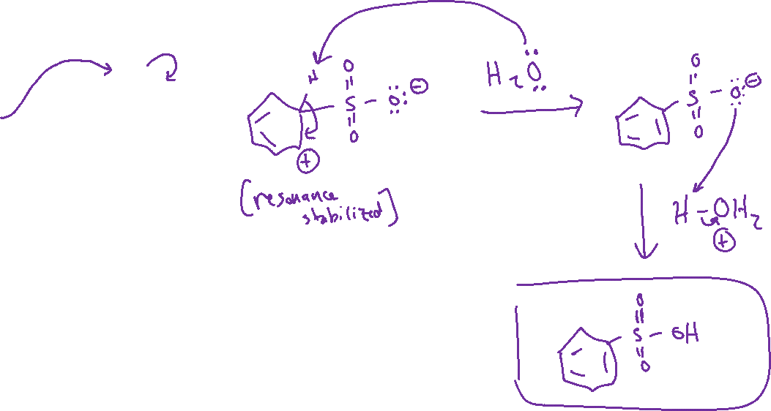
Sulfonation of Benzene: Mechanism Text: 18.3

Slide 4
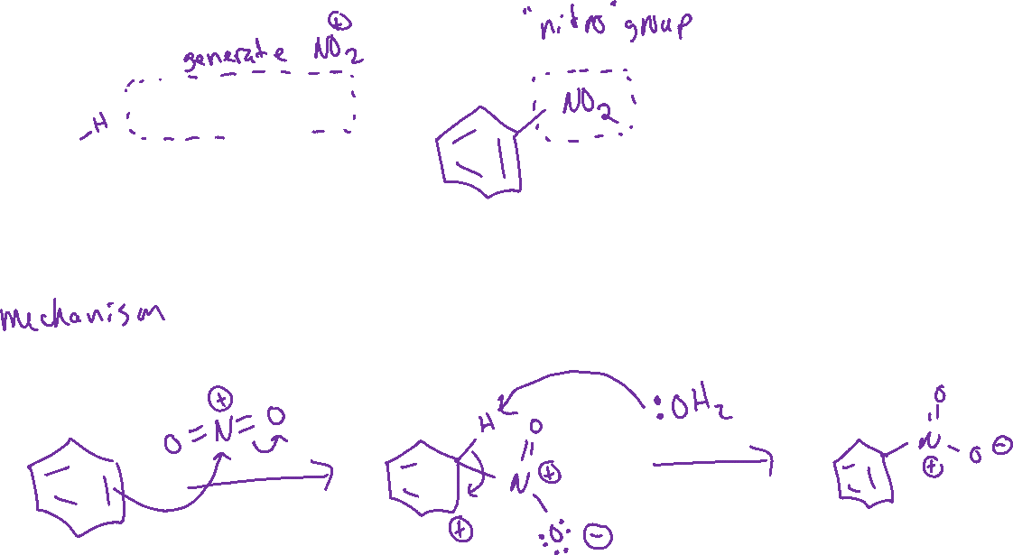


Nitration of Benzene Text: 18.4

Slide 5

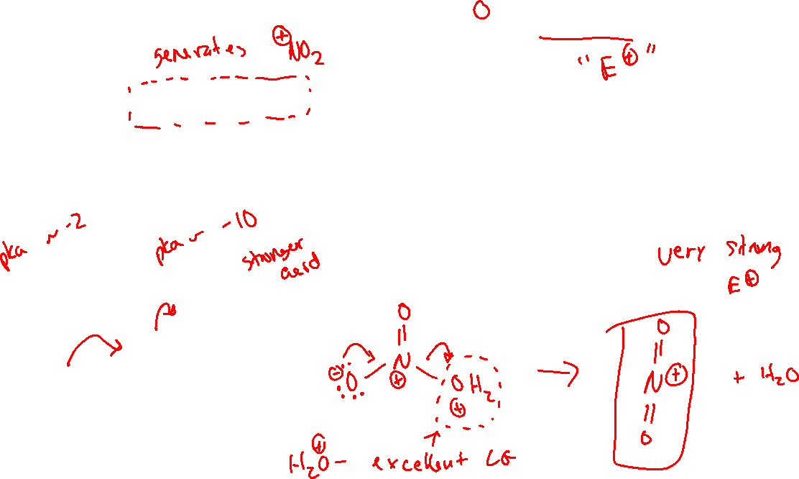


Nitration of Benzene: mechanism - generating ⁺NO₂ electrophile

Slide 6







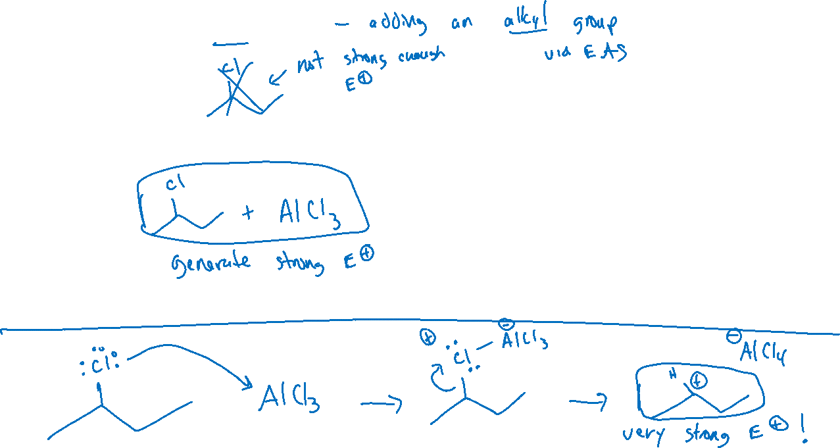
Friedel-Crafts Alkylation Text: 18.5

Slide 7





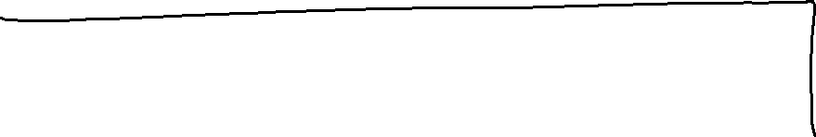

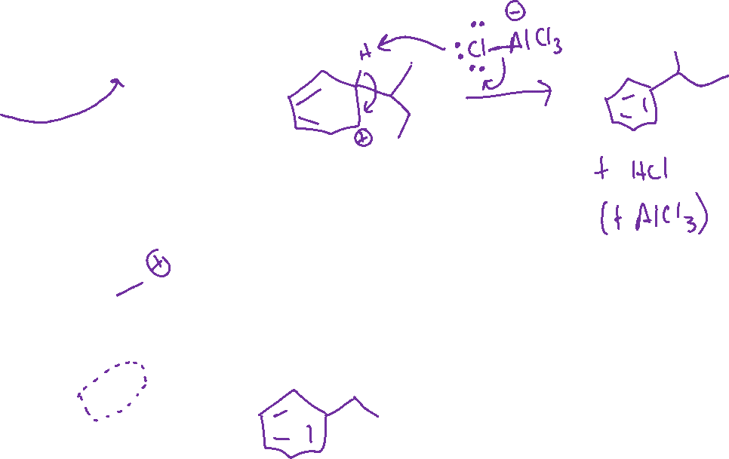


Friedel-Crafts Alkylation: Mechanism

Slide 8



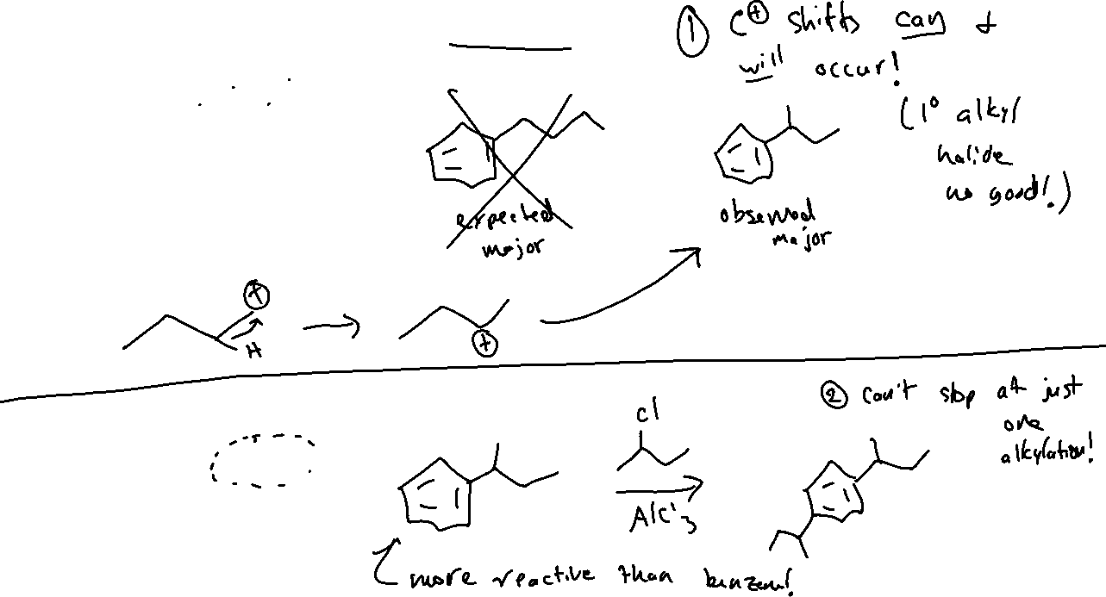



Friedel-Crafts Alkylation: Limitations

Slide 9
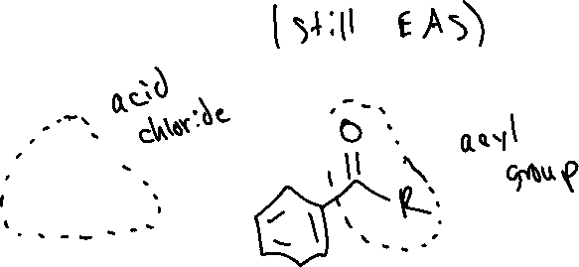



Friedel-Crafts Acylation Text: 18.6

