Slide 1
Friedel-Crafts Acylation
Substituted Benzenes and EAS
1/23/2023

Slide 2



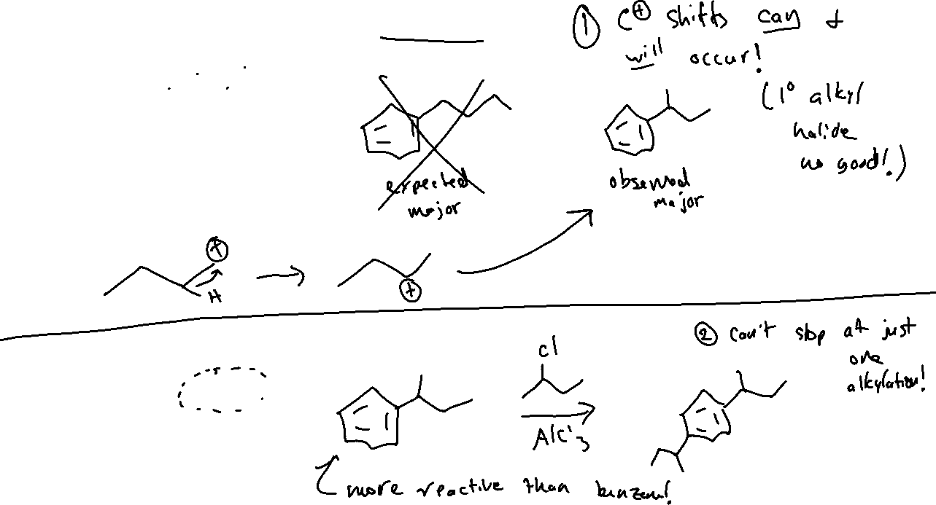



Friedel-Crafts Alkylation: Limitations

Slide 3
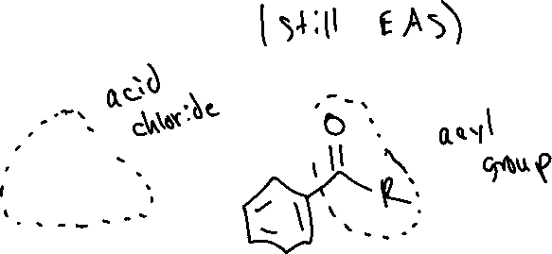

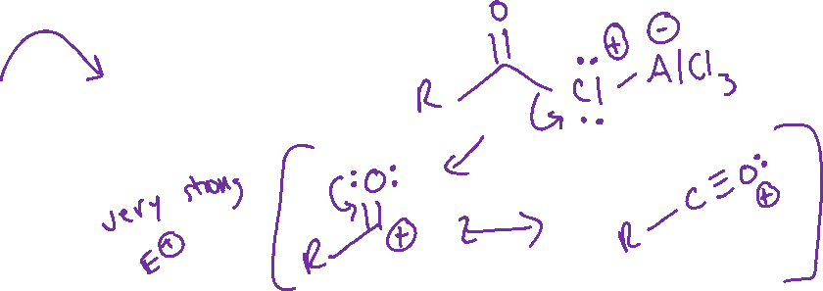


Friedel-Crafts Acylation Text: 18.6

Slide 4


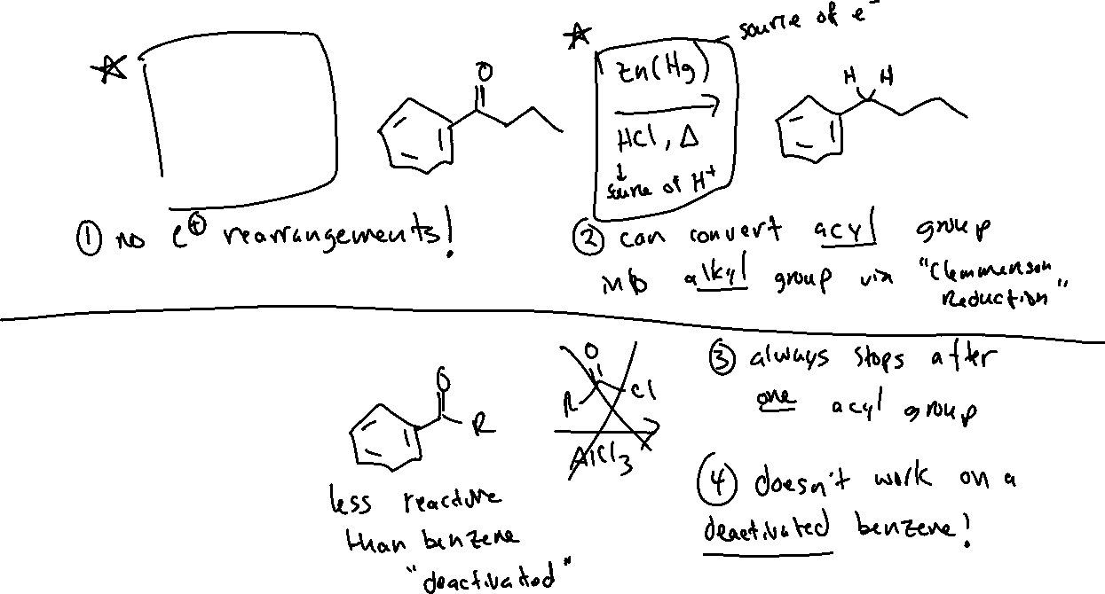


Friedel-Crafts Acylation: Differences vs. Alkylation

Slide 5



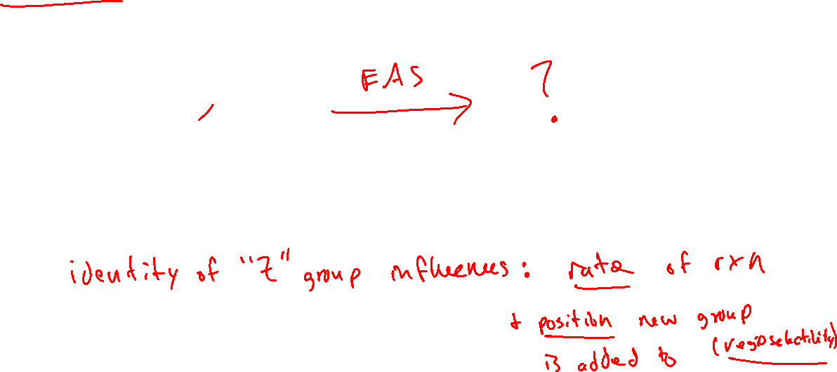
EAS with Substituted Benzenes
EAS reactions are more interesting when we use derivatives of benzene
BUT….reactivity changes significantly depending on the substituent!

Slide 6


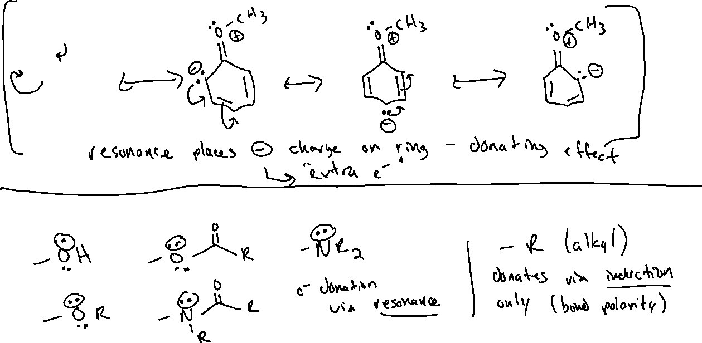
Electron Donating Groups (EDG) Text: 18.7

Slide 7

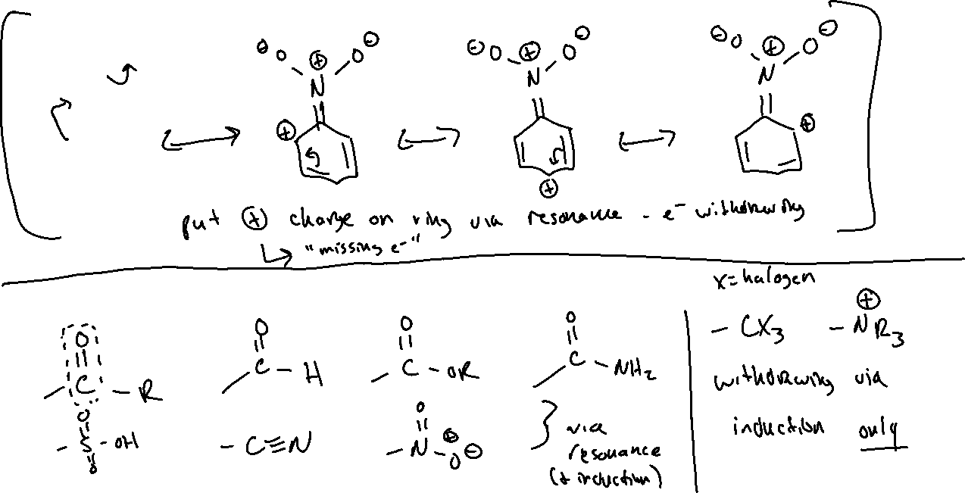

Electron Withdrawing Groups (EWG) Text: 18.8

Slide 8



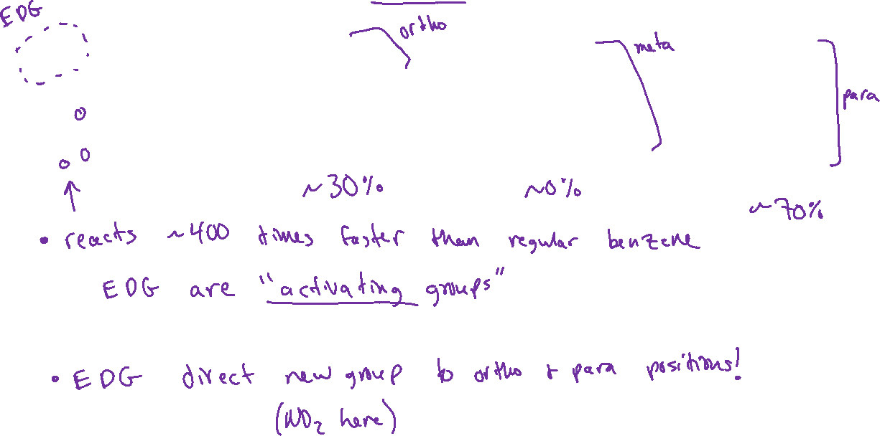



Electron Donating Groups: “Directing” EAS Regioselectivity

Slide 9

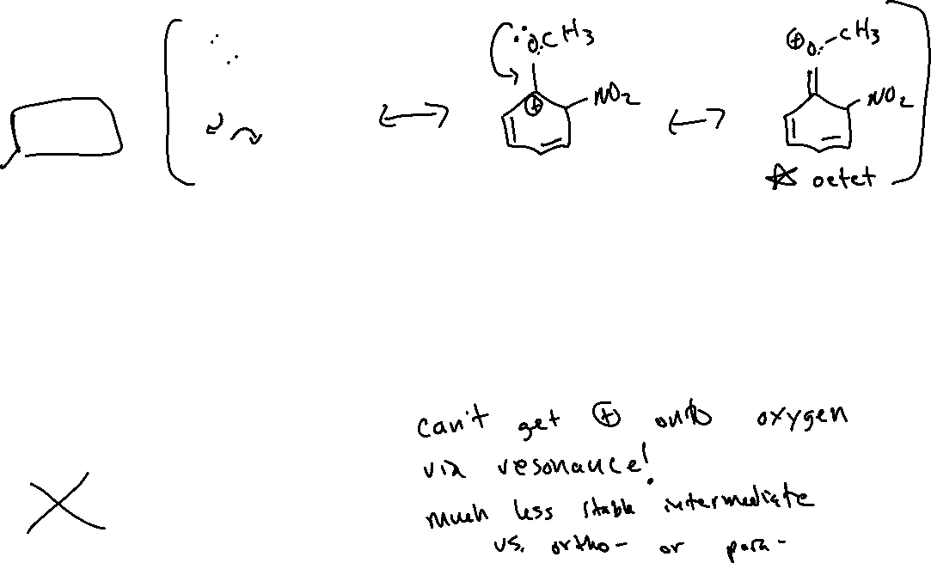






Electron Donating Groups: “Directing” EAS Regioselectivity

