Slide 1
Friedel-Crafts Acylation
Substituted Benzenes and EAS
1/23/2023

Slide 2



Friedel-Crafts Acylation Text: 18.6

Slide 3




Friedel-Crafts Acylation: Differences vs. Alkylation

Slide 4



EAS with Substituted Benzenes
EAS reactions are more interesting when we use derivatives of benzene
BUT….reactivity changes significantly depending on the substituent!

Slide 5


Electron Donating Groups (EDG) Text: 18.7

Slide 6


Electron Withdrawing Groups (EWG) Text: 18.8

Slide 7






Electron Donating Groups: “Directing” EAS Regioselectivity

Slide 8







Electron Donating Groups: “Directing” EAS Regioselectivity

Slide 9







Electron Withdrawing Groups: “Directing” EAS Regioselectivity

Slide 10





Electron Withdrawing Groups: Directing EAS Regioselectivity

Slide 11

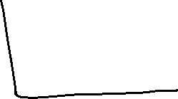

Halogens: Directing EAS Regioselectivity Text: 18.9

