Slide 1

Substituted Benzenes and EAS
Synthesis Strategies
1/25/2023

Slide 2
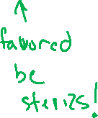
Electron Donating Groups: “Directing” EAS Regioselectivity

Slide 3
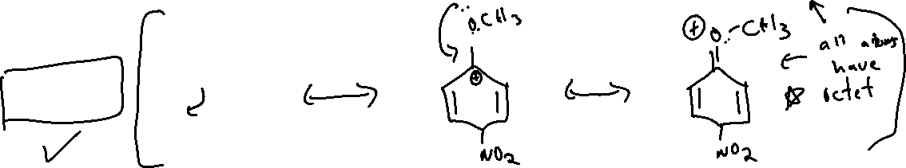
Electron Donating Groups: “Directing” EAS Regioselectivity

Slide 4

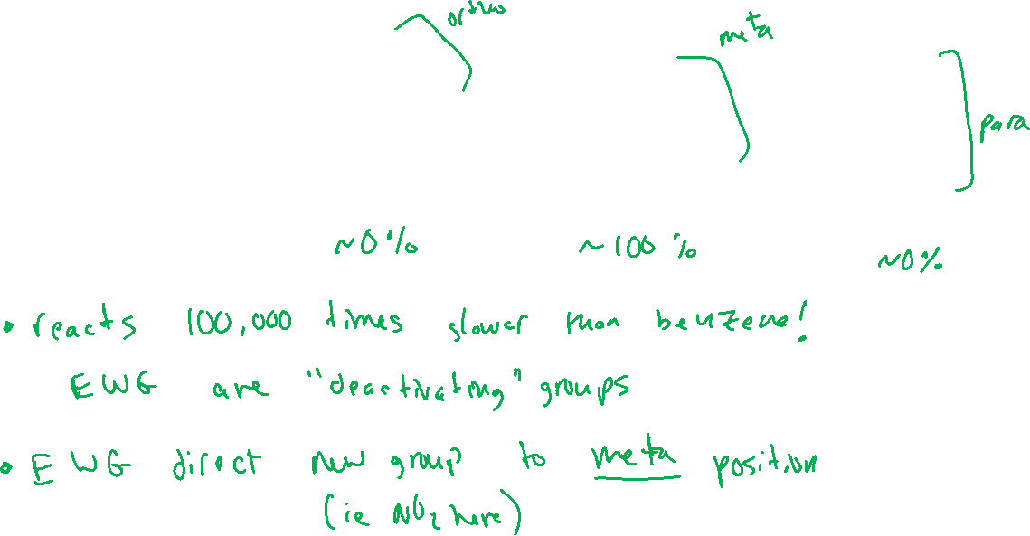






Electron Withdrawing Groups: “Directing” EAS Regioselectivity

Slide 5


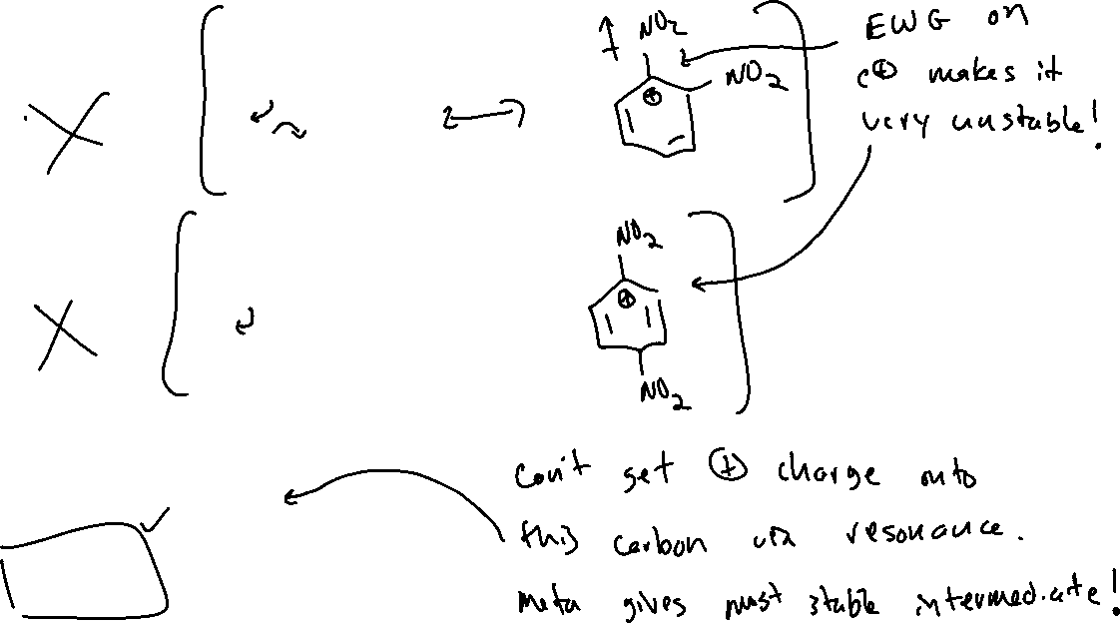




Electron Withdrawing Groups: Directing EAS Regioselectivity

Slide 6



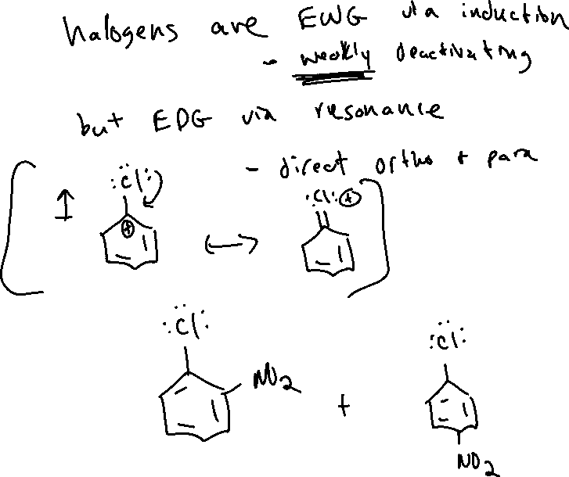
Halogens: Directing EAS Regioselectivity (18.9)

Slide 7


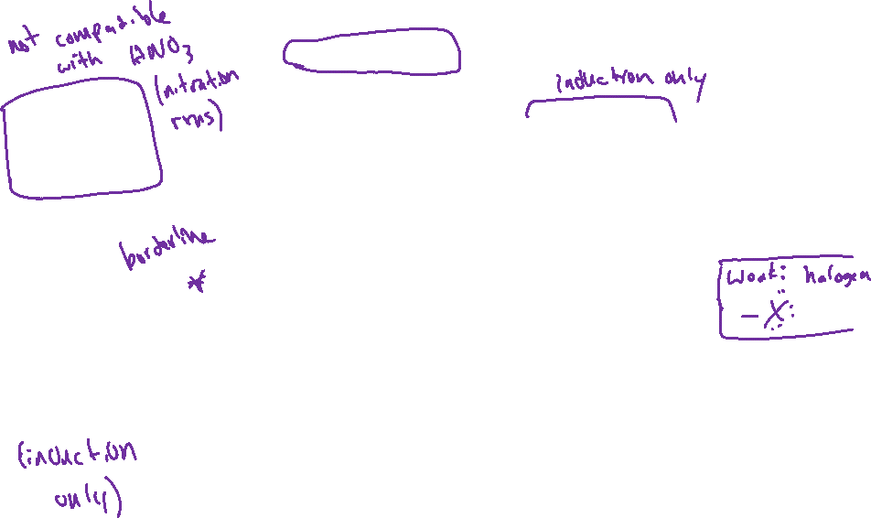
Strengths of Activating/Deactivating Groups
Activating Groups:
Strong:
Moderate:
Weak:
Deactivating Groups:
Strong:
Moderate:

Slide 8
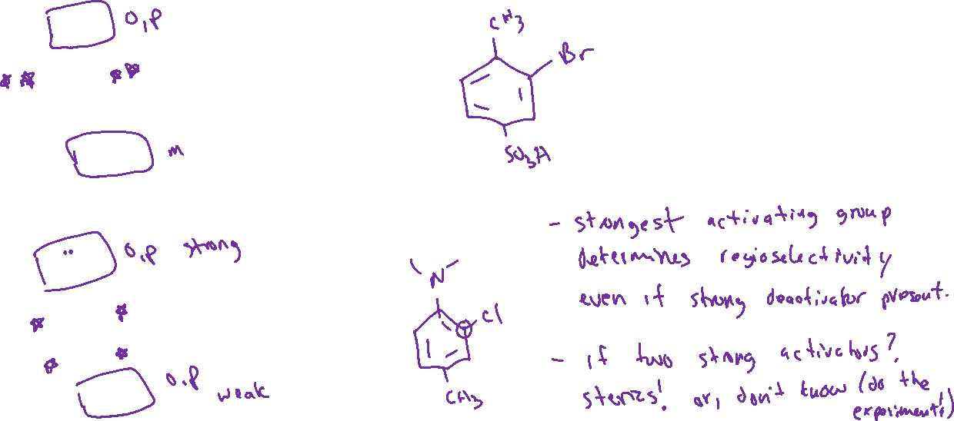


Multiple Substituents & Regioselectivity (18.11)
Case #1: Multiple directing effects “agree with” (or reinforce) each other
Case #2: Multiple directing effects compete.

Slide 9
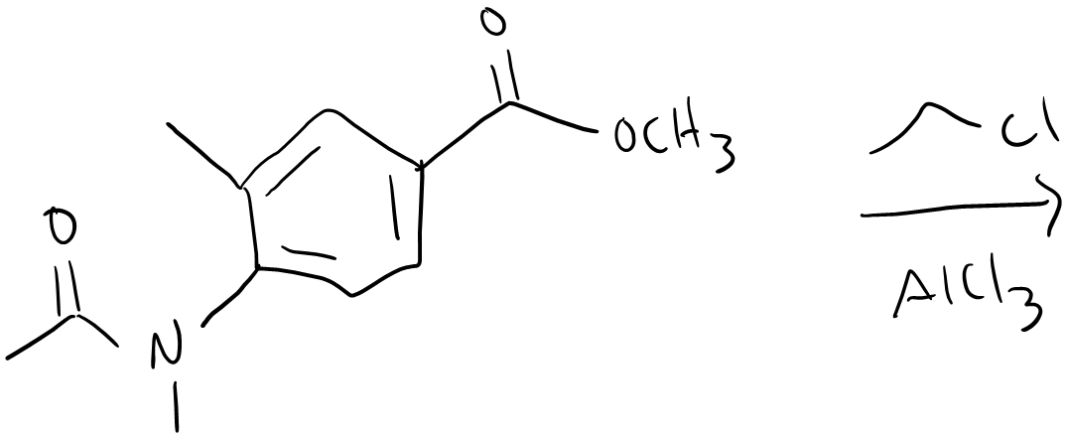
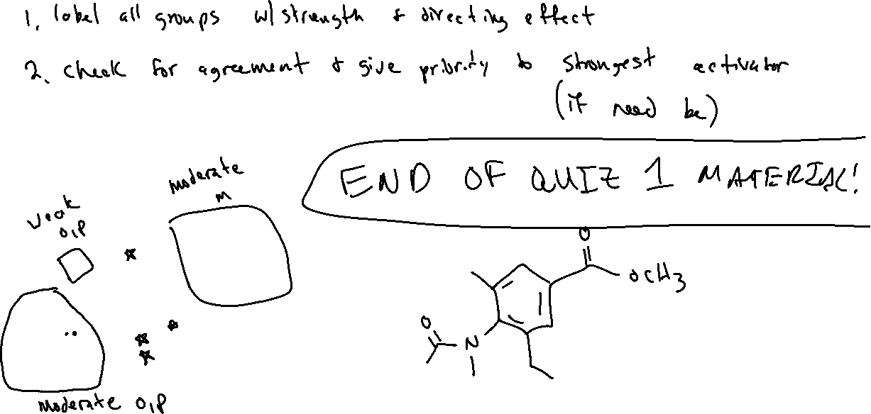
EAS with Multiple Substituents: Example

Slide 10





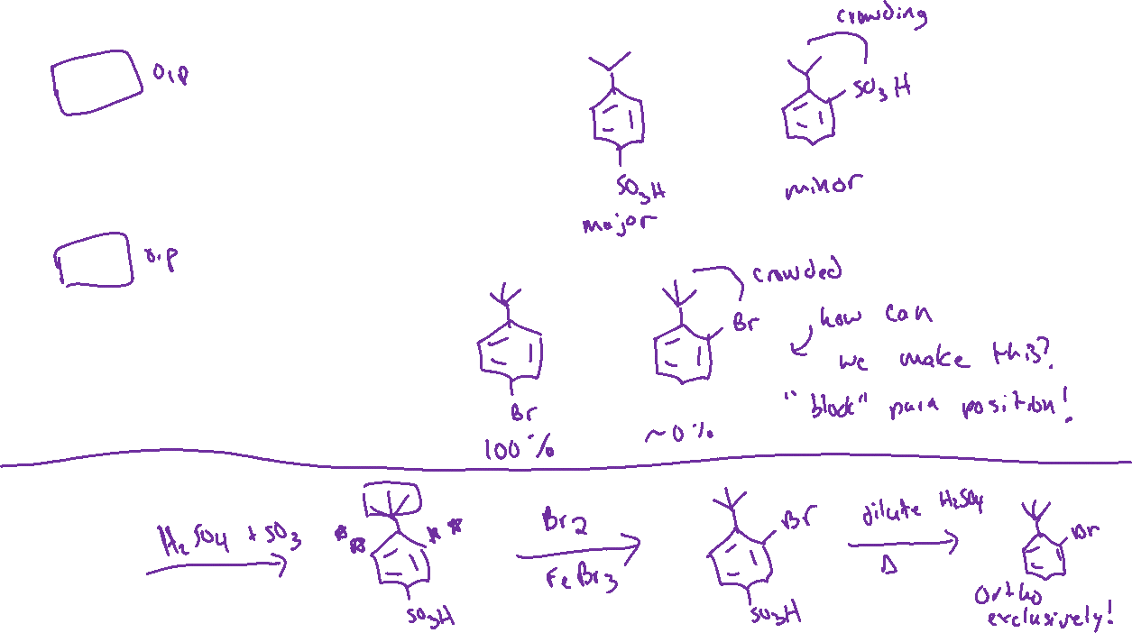


Steric Effects and “Blocking” Groups (18.11)

Slide 11




EAS Synthesis Strategies (18.12)

Slide 12









Some Useful Transformations *KNOW THESE RECIPES*

Slide 13




EAS Synthesis Strategies (18.12)

