Slide 1
EAS Synthesis Strategies
Nucleophilic Aromatic Substitution (S_{N}Ar)
Alcohols
1/27/2023

Slide 2
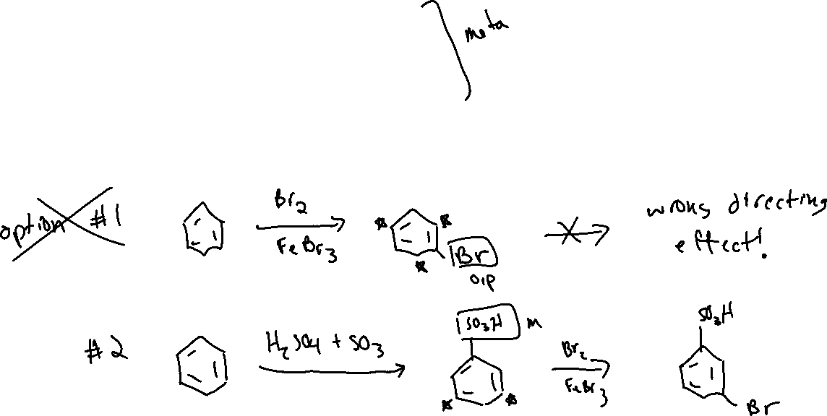




EAS Synthesis Strategies (18.12)

Slide 3







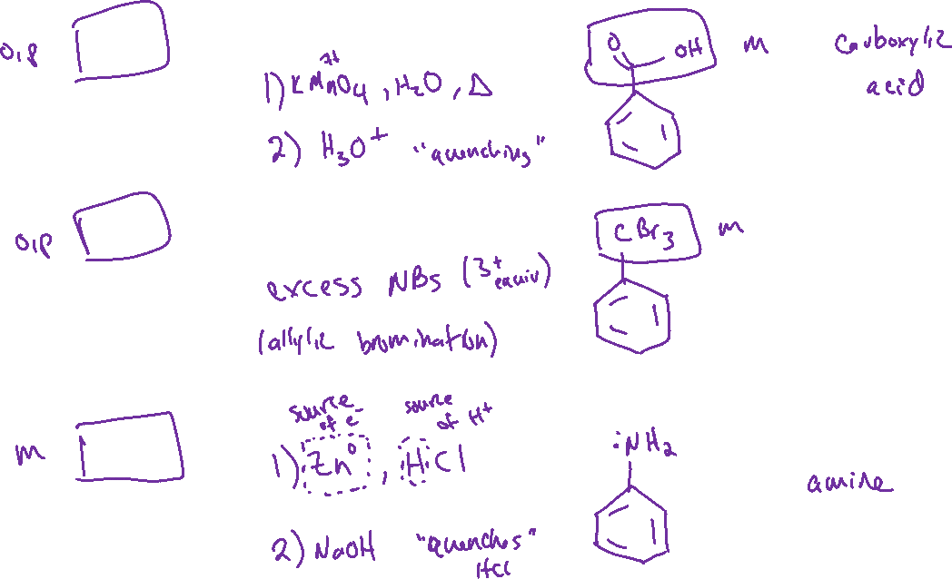


Some Useful Transformations *KNOW THESE RECIPES*

Slide 4

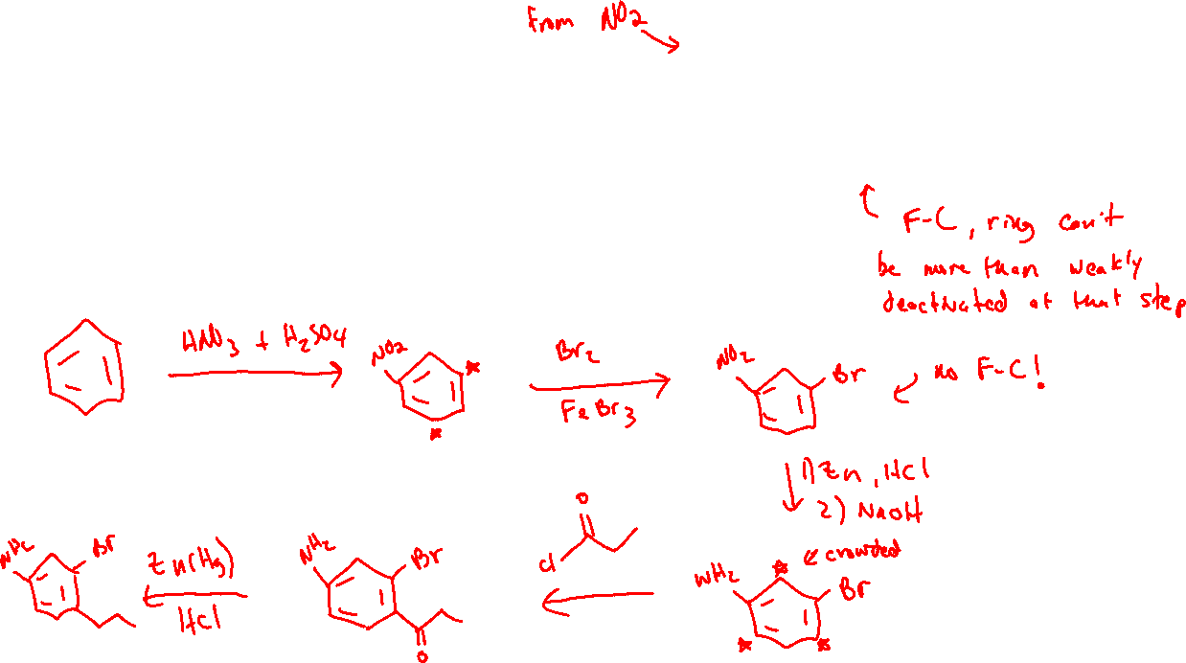



EAS Synthesis Strategies (18.12)

Slide 5

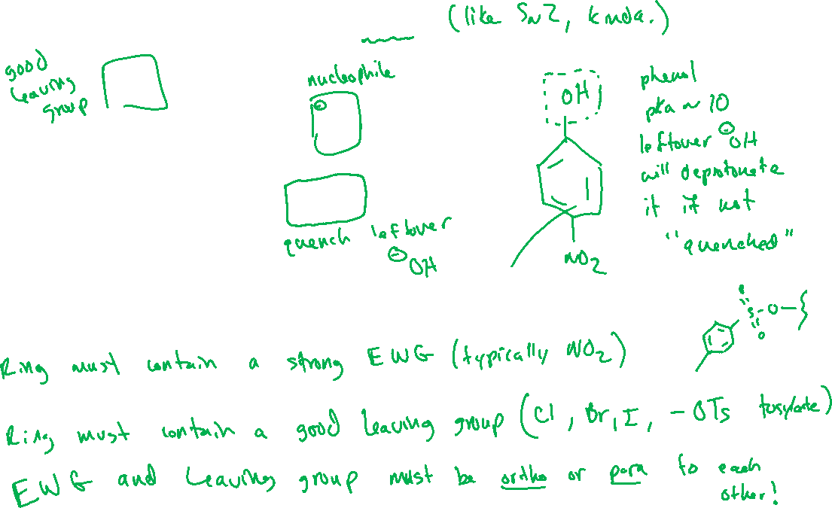

Nucleophilic Aromatic Substitution (S_{N}Ar) (18.13)

Slide 6
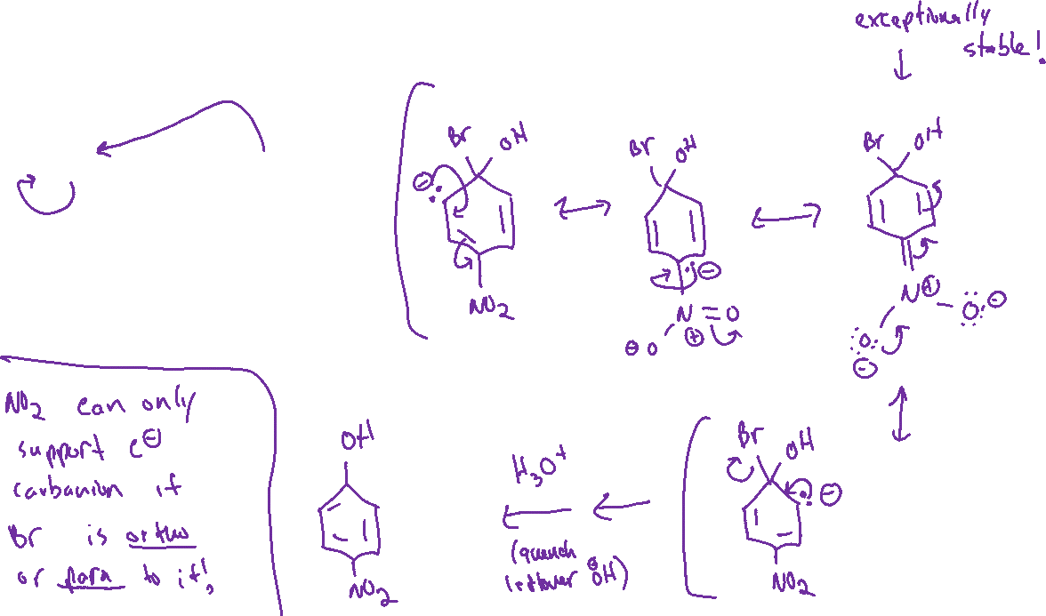

Nucleophilic Aromatic Substitution (S_{N}Ar): Mechanism

Slide 7





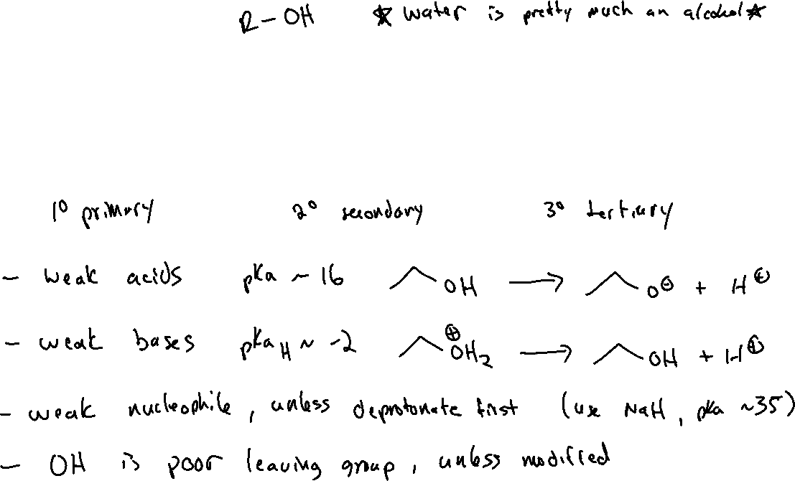


Chapter 12: Alcohols

