Slide 1
EAS Synthesis Strategies
Nucleophilic Aromatic Substitution (S_{N}Ar)
Alcohols
1/27/2023

Slide 2




EAS Synthesis Strategies (18.12)

Slide 3









Some Useful Transformations *KNOW THESE RECIPES*

Slide 4




EAS Synthesis Strategies (18.12)

Slide 5


Nucleophilic Aromatic Substitution (S_{N}Ar) (18.13)

Slide 6

Nucleophilic Aromatic Substitution (S_{N}Ar): Mechanism

Slide 7







Chapter 12: Alcohols

Slide 8





Alcohols: Naming (12.1)
Identify the parent chain – the longest carbon chain containing the –OH group as a substituent, and change the suffix from –ane to -ol
Add the locant # of the carbon bearing the -OH before the parent chain name. Number the chain so that the -OH locant # is as small as possible.
Name the rest of the substituents, chiral centers, etc. as usual.

Slide 9
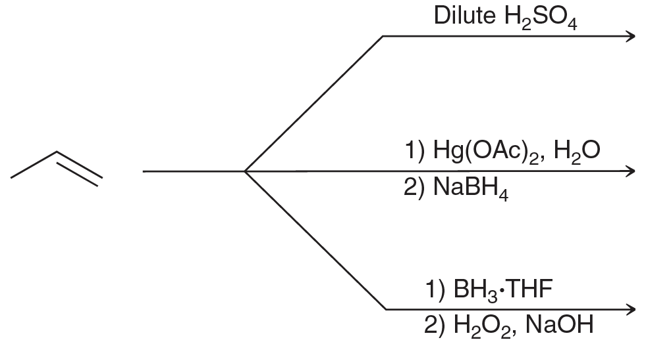


Preparation of Alcohols (Chapter 8, Che 211) (12.3)
via alkene addition:

Slide 10







Preparation of Alcohols (Chapter 8, Che 211) (12.3)
Or, via substitution:

