Slide 1
Alcohols:
Naming, Preparation, and Reactivity
1/30/2023

Slide 2
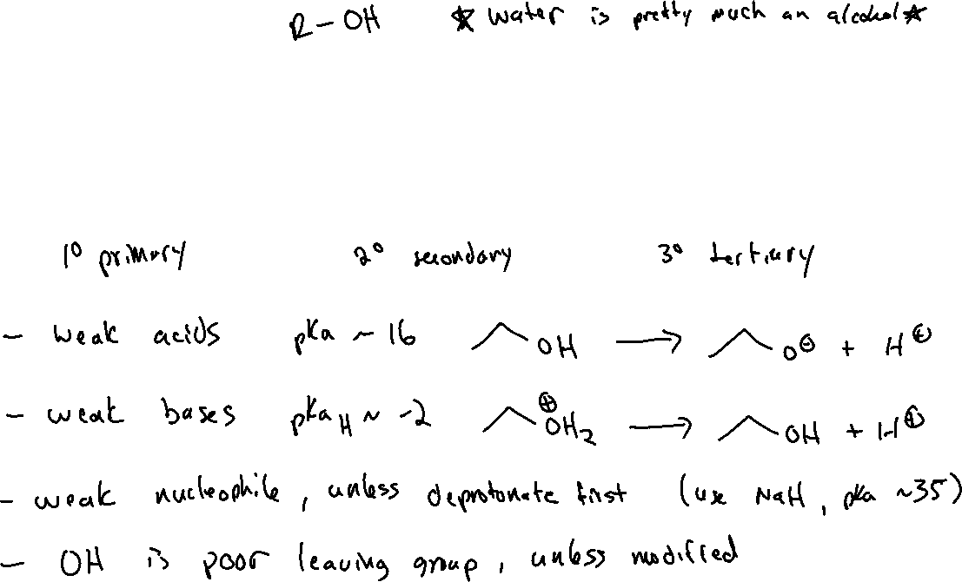
Chapter 12: Alcohols

Slide 3





Alcohols: Naming (12.1)
Identify the parent chain – the longest carbon chain containing the –OH group as a substituent, and change the suffix from –ane to -anol
Add the locant # of the carbon bearing the -OH before the parent chain name. Number the chain so that the -OH locant # is as small as possible.
Name the rest of the substituents, chiral centers, etc. as usual.

Slide 4
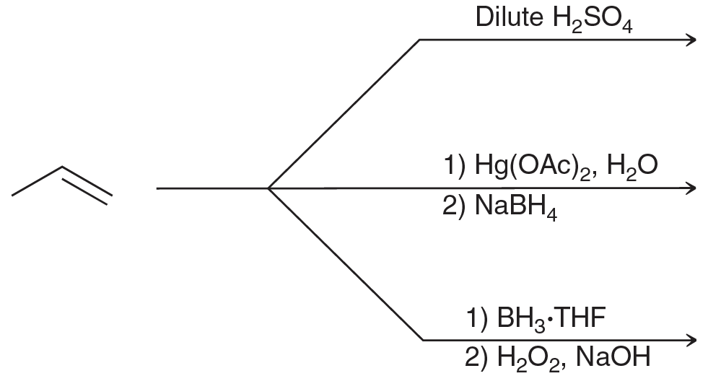






Preparation of Alcohols (Chapter 8, Che 211) (12.3)
via alkene addition:

Slide 5












Preparation of Alcohols (Chapter 8, Che 211) (12.3)
Or, via substitution:

Slide 6
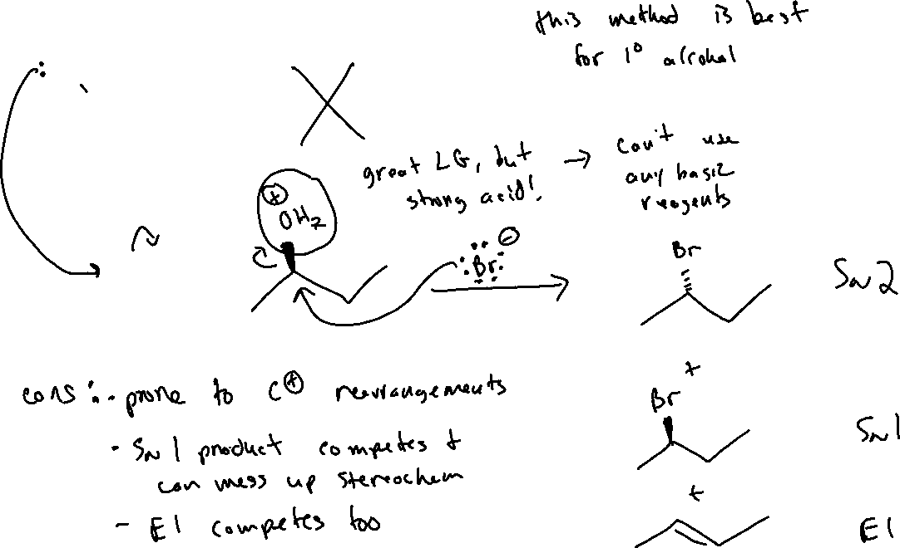


Converting –OH to a leaving group (12.9)

Slide 7
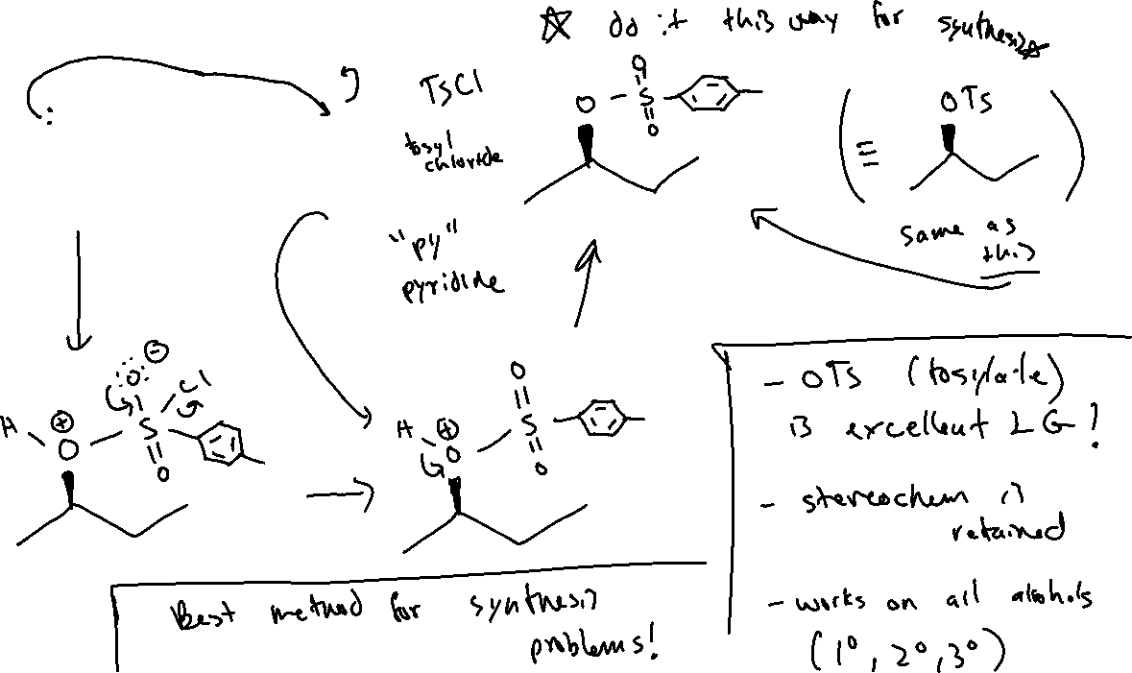
Converting –OH to a leaving group (12.9)

Slide 8
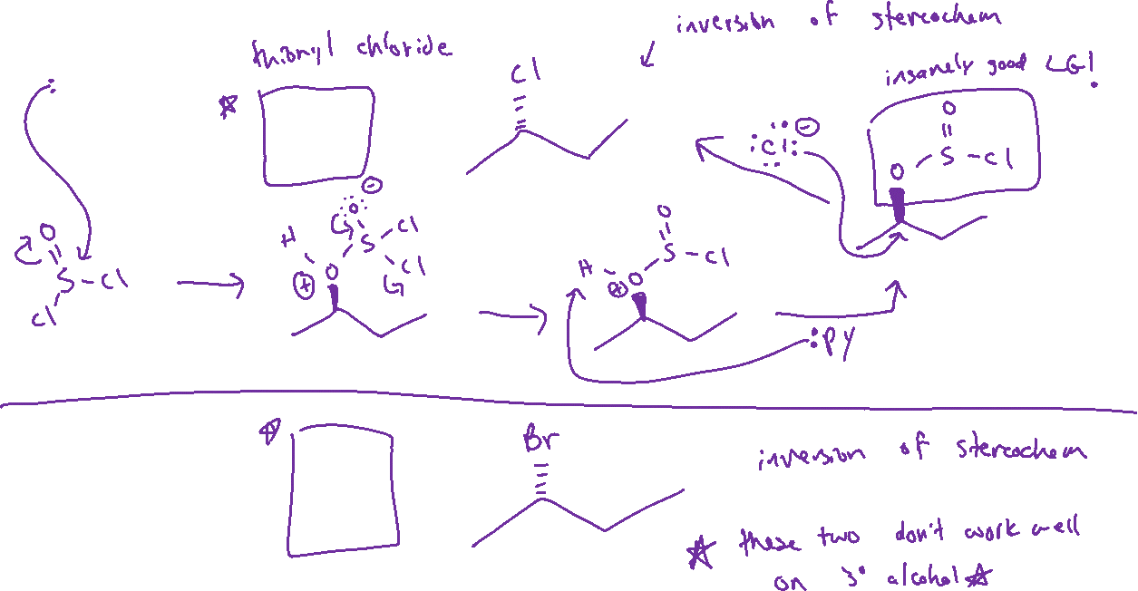


Converting –OH to a leaving group (12.9)

Slide 9



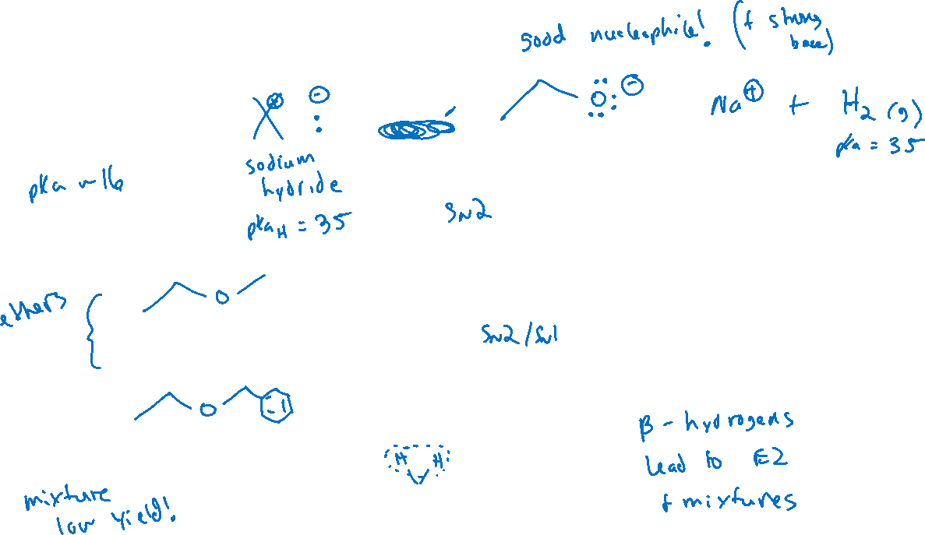

Converting –OH to a nucleophile (13.5)

