Slide 1
Oxidation State & Oxidation of Alcohols
2/1/2023

Slide 2
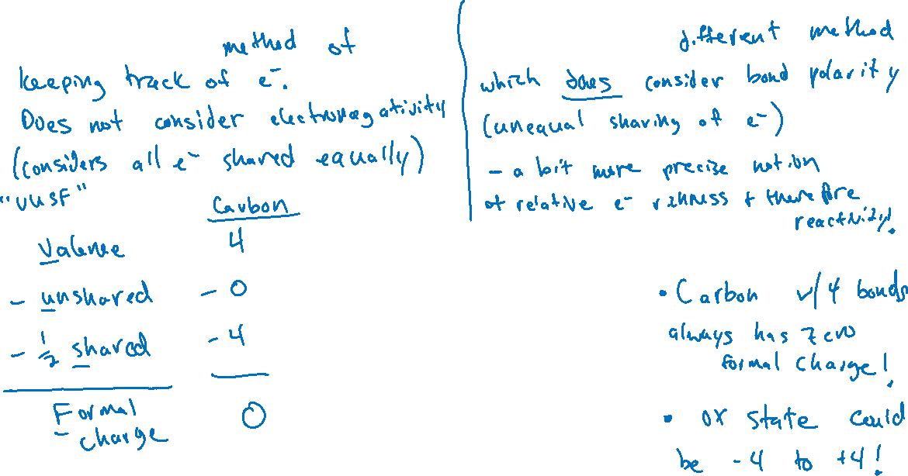

Calculating Oxidation States (12.4)
Formal charge: Oxidation state:

Slide 3
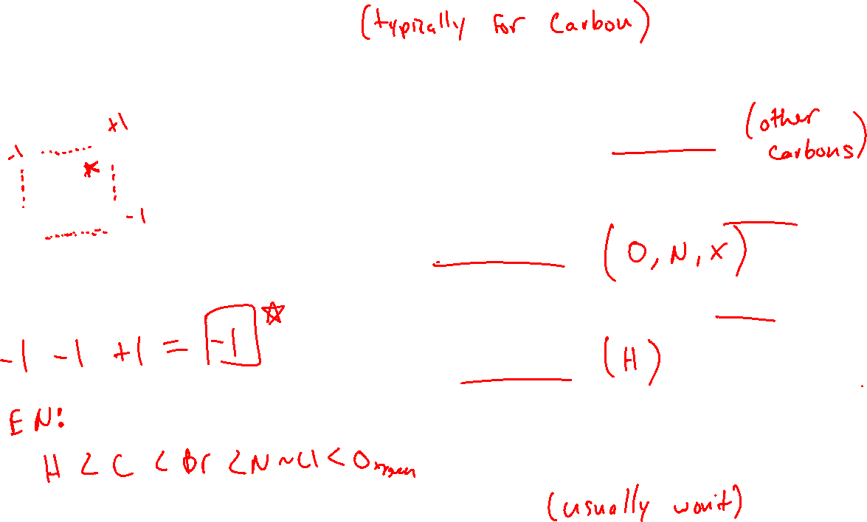

Calculating Oxidation States (12.4)

Slide 4
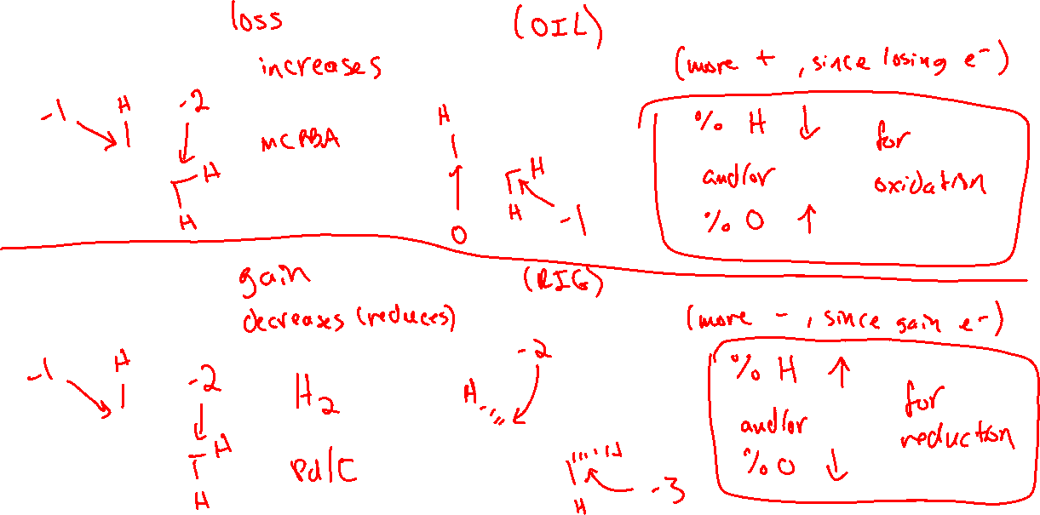





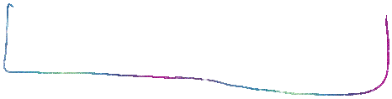







Oxidation and Reduction (of Hydrocarbons)
Oxidation is the _________ of electrons.
Oxidizing an atom _______________ its oxidation state.
Reduction is the __________ of electrons.
Reducing an atom ________________ its oxidation state.

Slide 5

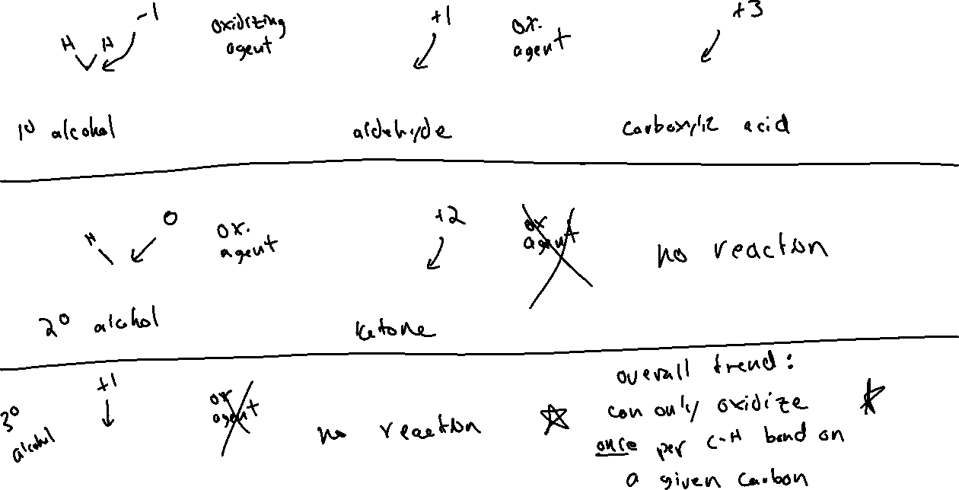












Oxidation States and Functional Groups (12.10)

Slide 6


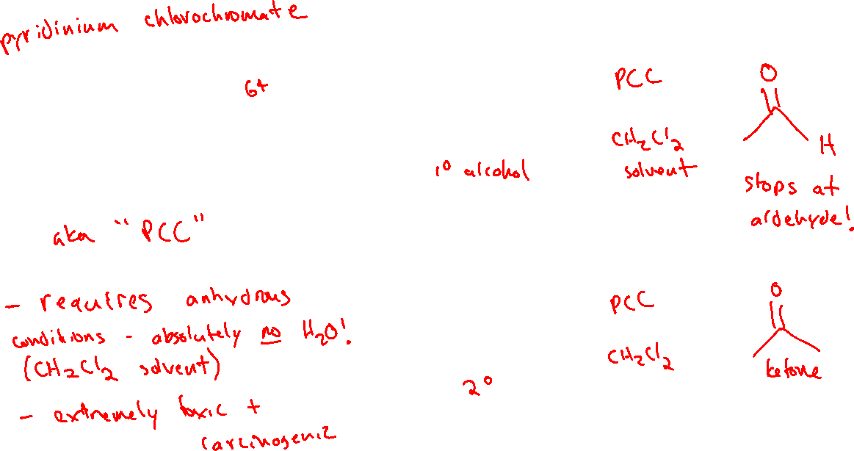
Chromium-based Reagents for Oxidizing Alcohols (12.10)

Slide 7



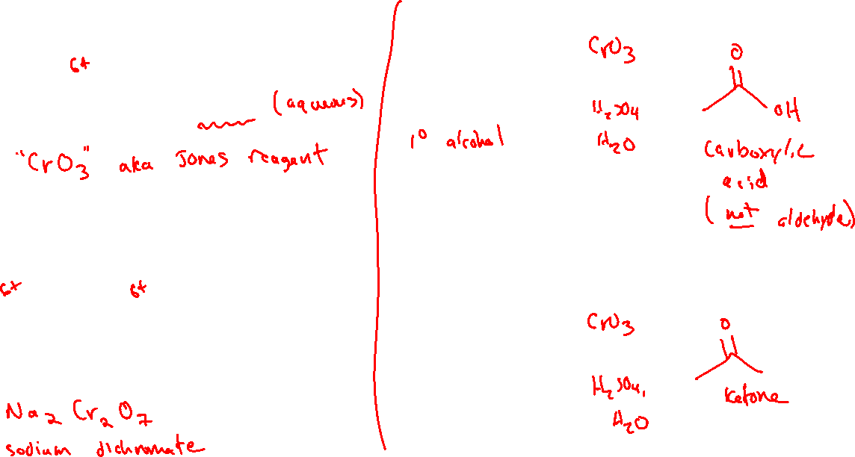
Chromium-based Reagents for Oxidizing Alcohols (12.10)

Slide 8
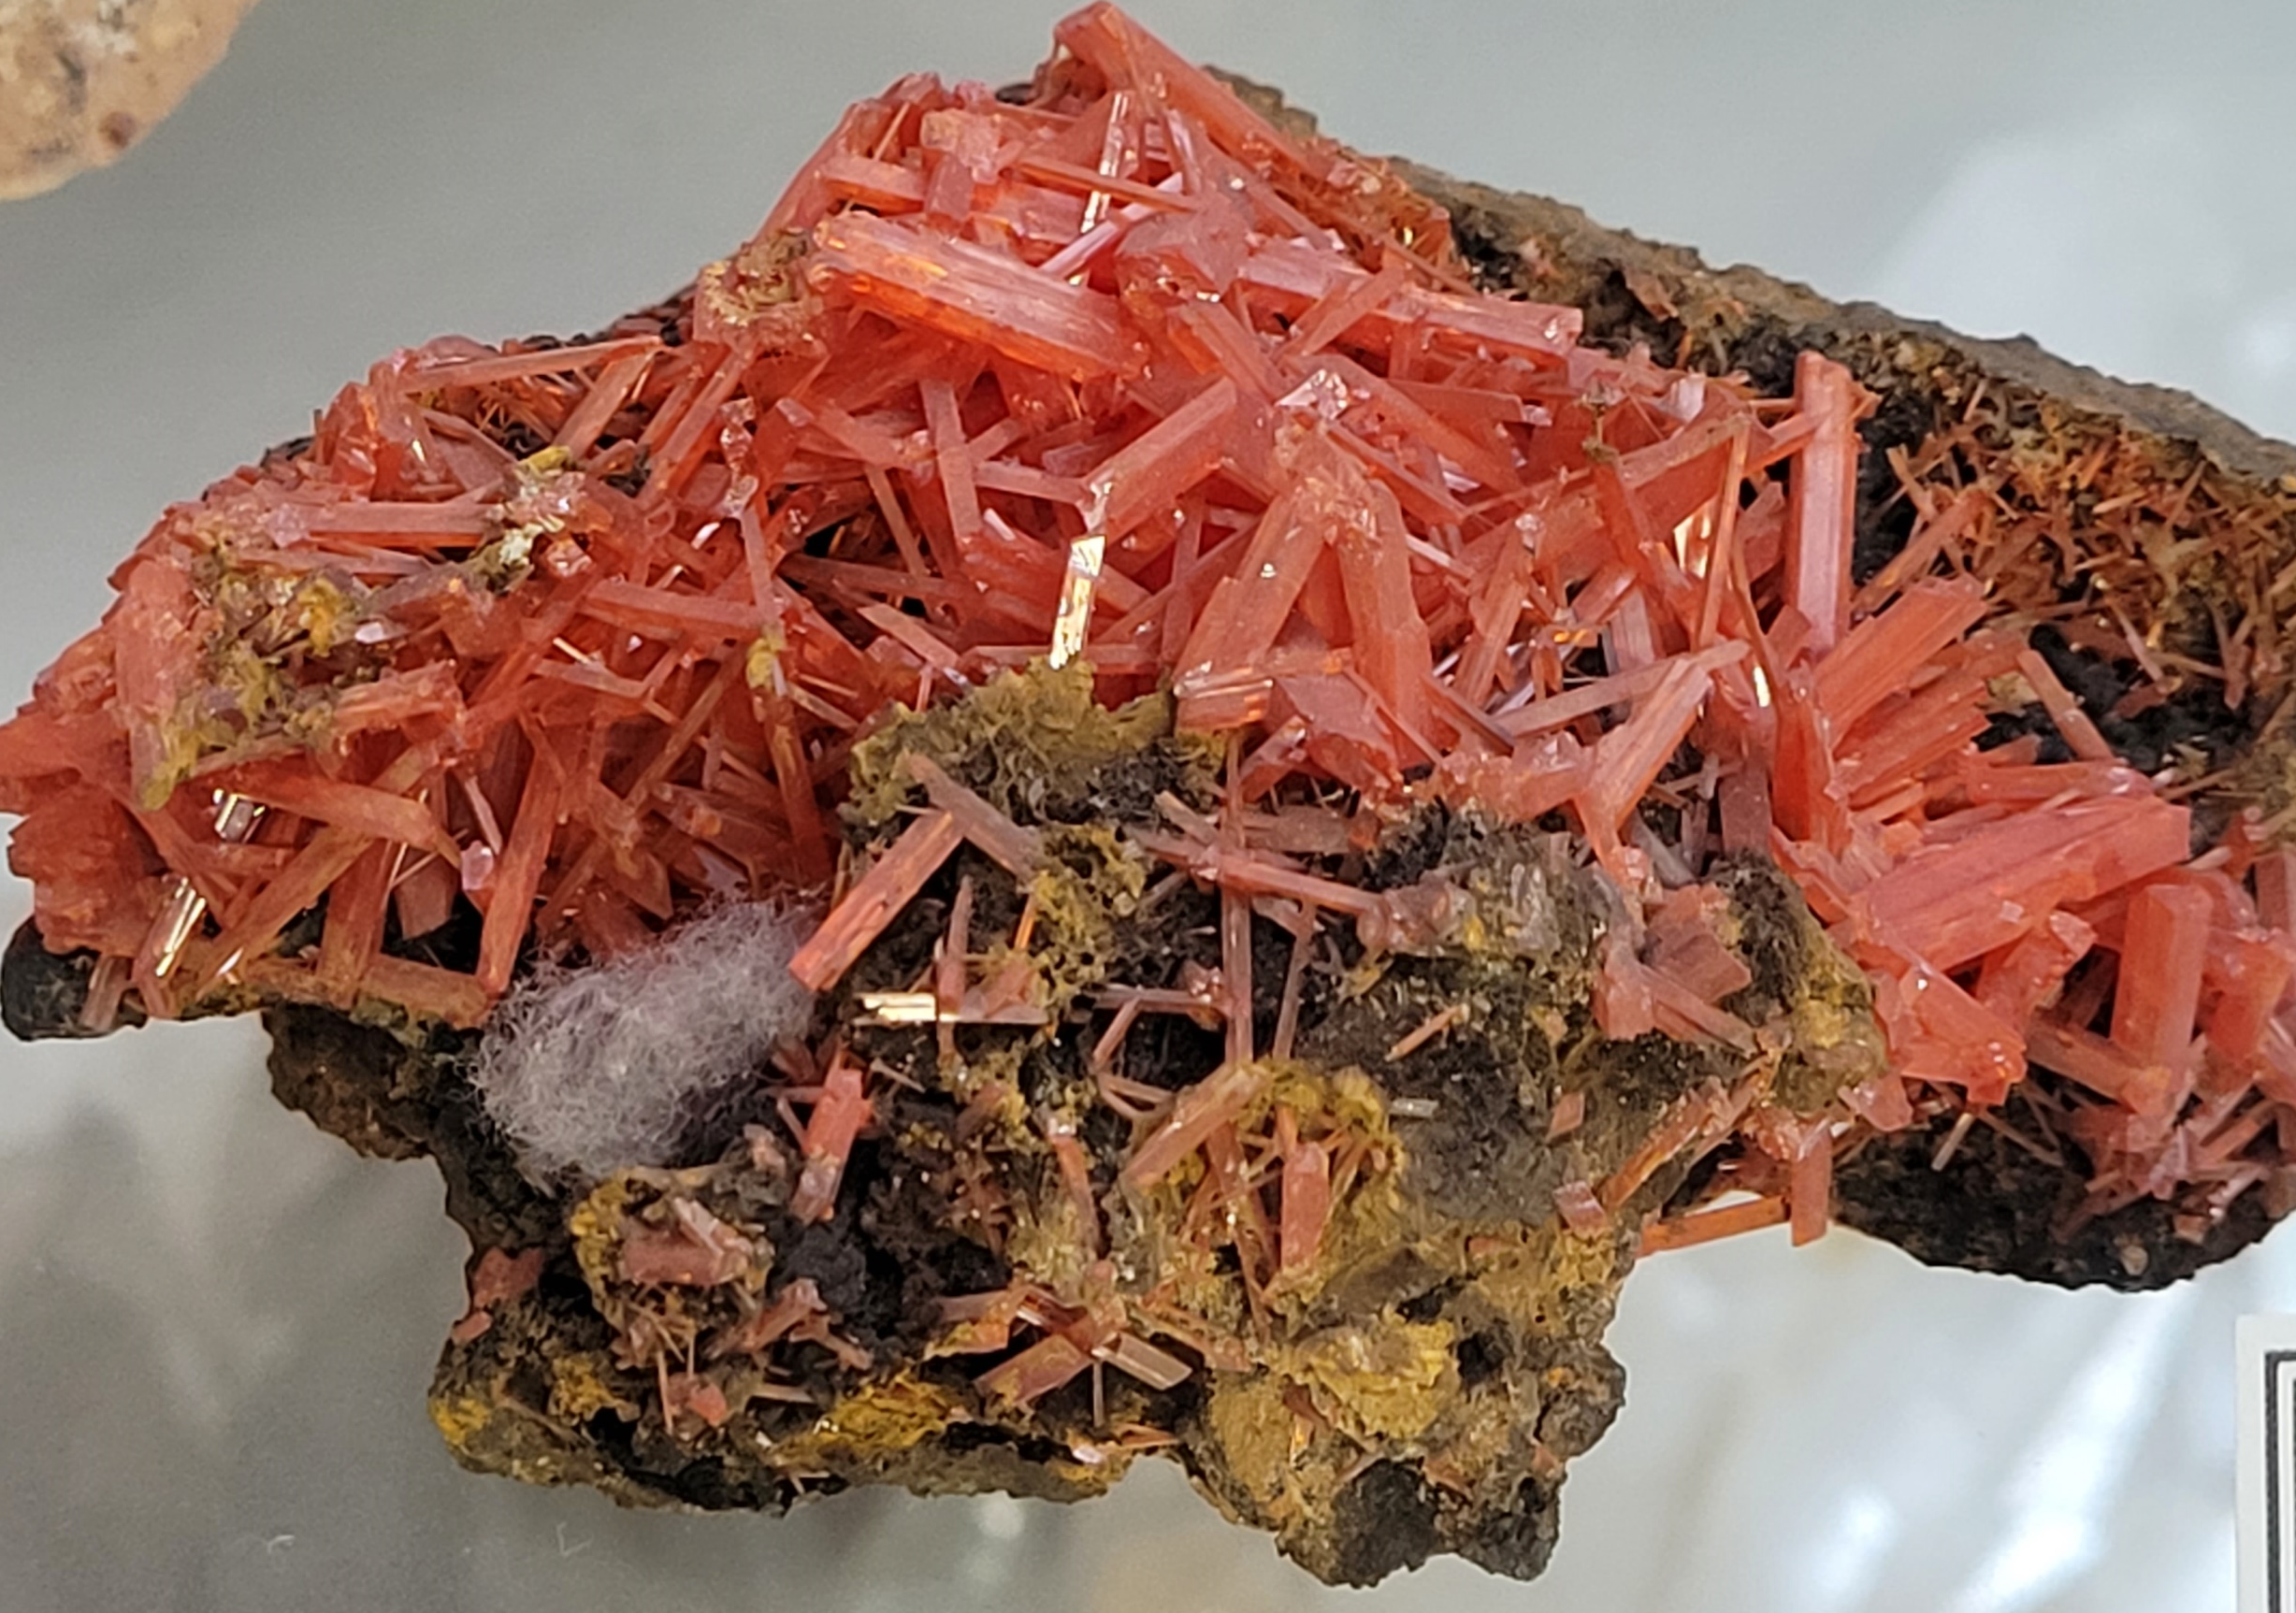
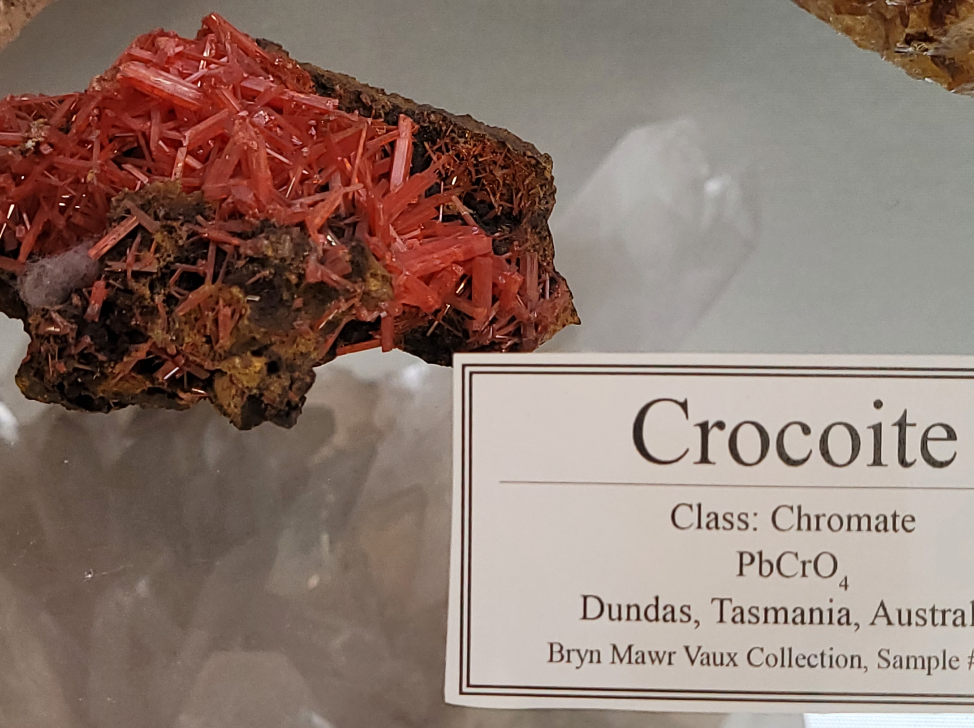
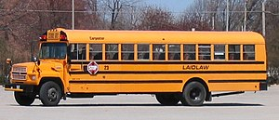
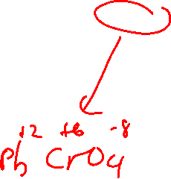
Crocoite – natural source of Cr⁶⁺ (not on exam)
The original “schoolbus yellow” paint pigment was also PbCrO₄ 😬
(but not anymore)

Slide 9



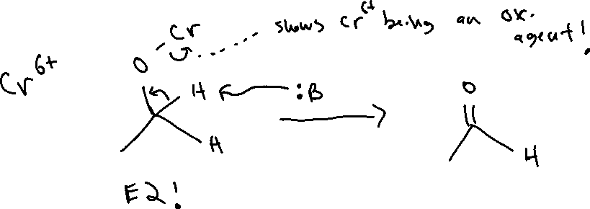
Oxidizing Alcohols with Chromium: Mechanism

Slide 10
Oxidizing Alcohols with Chromium: Mechanism

