Slide 1
Oxidation State & Oxidation of Alcohols
2/3/2023

Slide 2


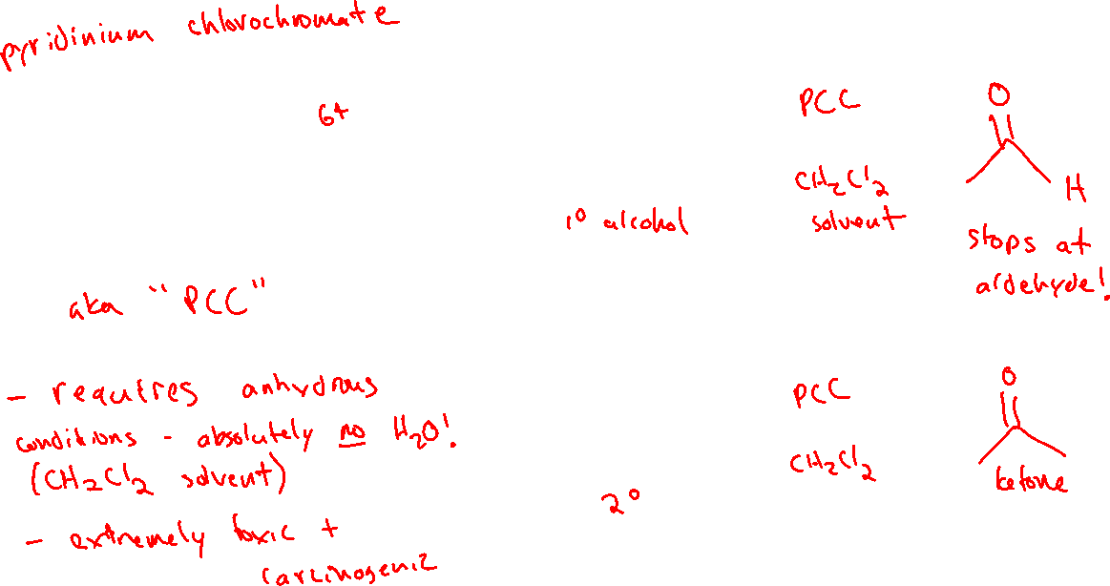
Chromium-based Reagents for Oxidizing Alcohols (12.10)

Slide 3

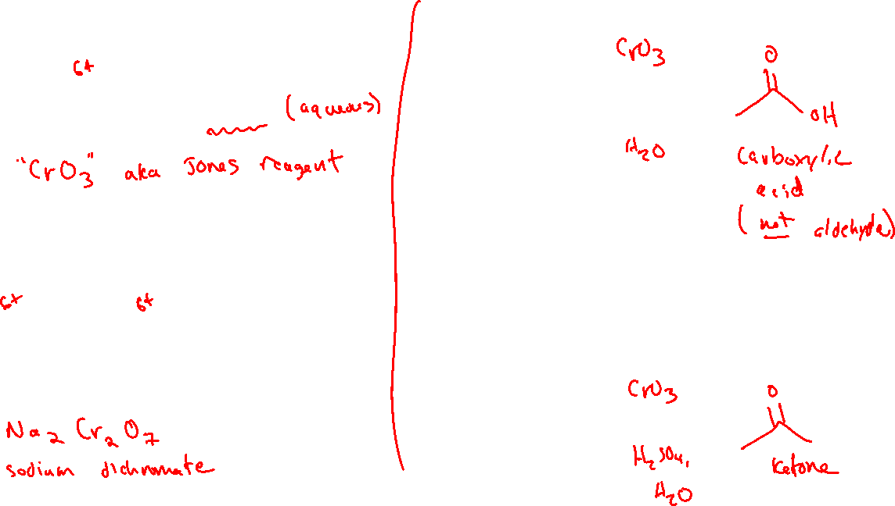





Chromium-based Reagents for Oxidizing Alcohols (12.10)

Slide 4



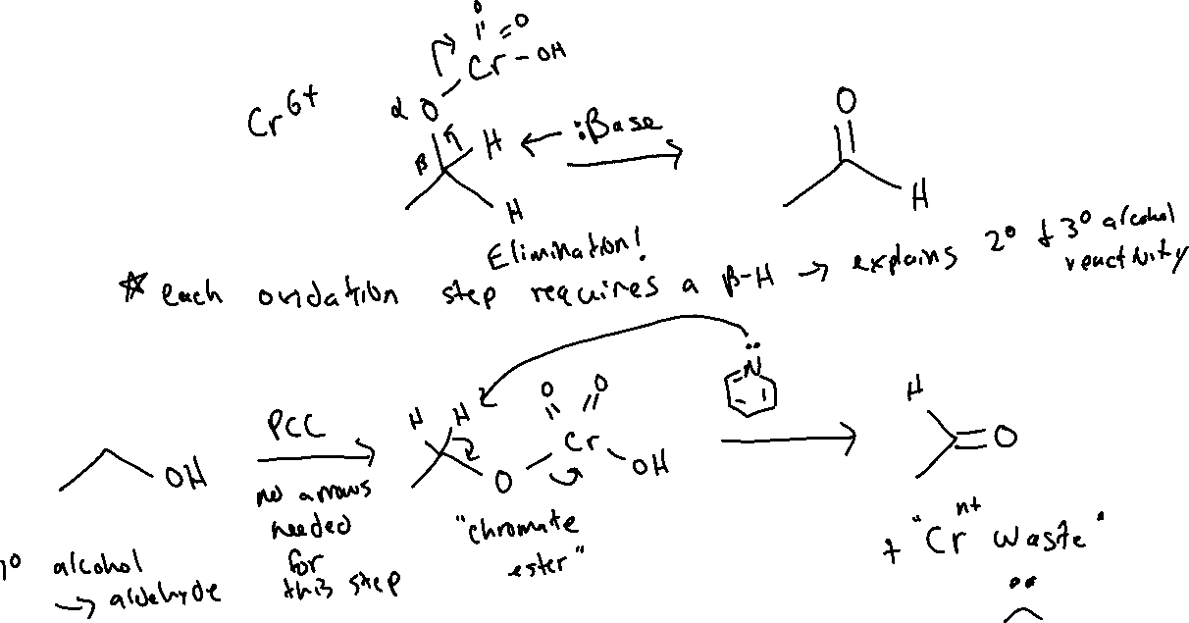
Oxidizing Alcohols with Chromium: Mechanism

Slide 5
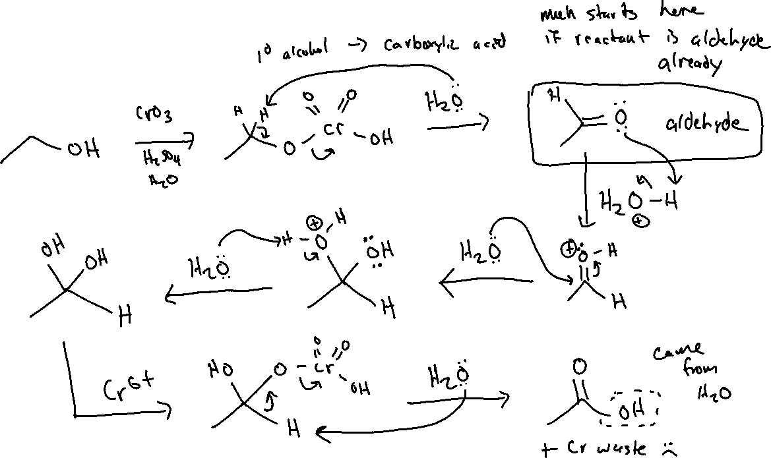
Oxidizing Alcohols with Chromium: Mechanism

Slide 6

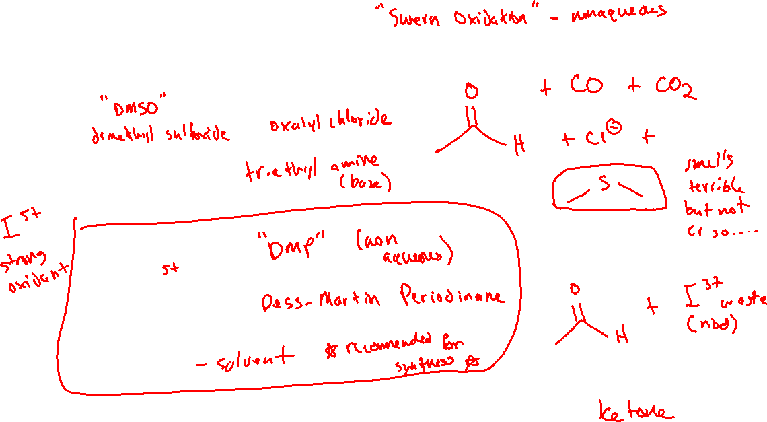



Organic Oxidizing Agents: “Greener” Alternatives

Slide 7
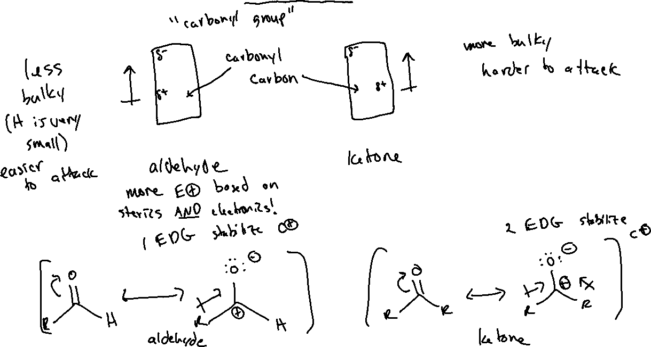

Aldehydes and Ketones as Electrophiles (19.4)

Slide 8


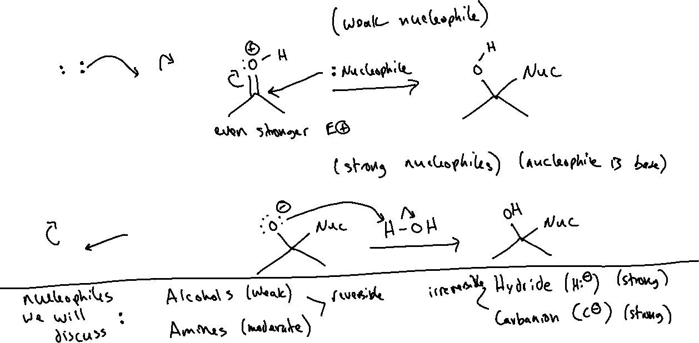

Nucleophilic Addition to Aldehydes and Ketones

Slide 9





Oxygen Nucleophiles (19.5)

