Slide 1
Oxidation State & Oxidation of Alcohols
2/3/2023

Slide 2


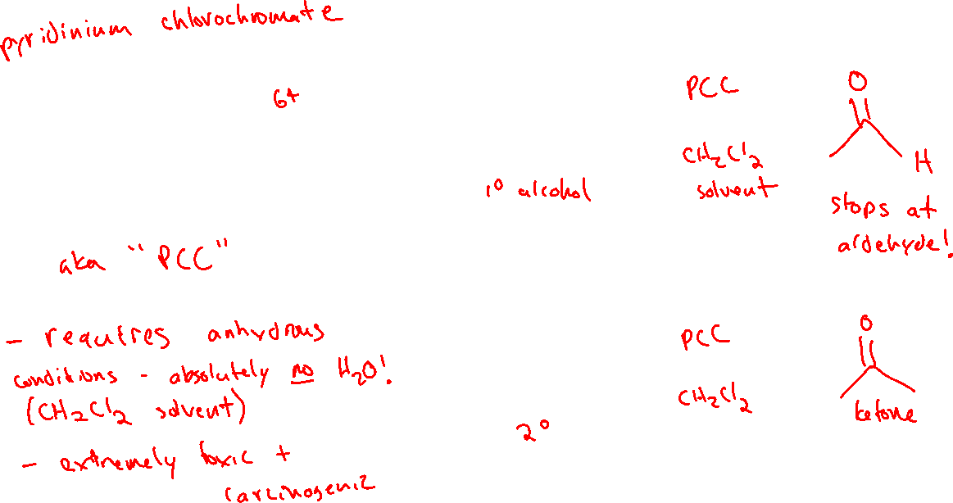
Chromium-based Reagents for Oxidizing Alcohols (12.10)

Slide 3

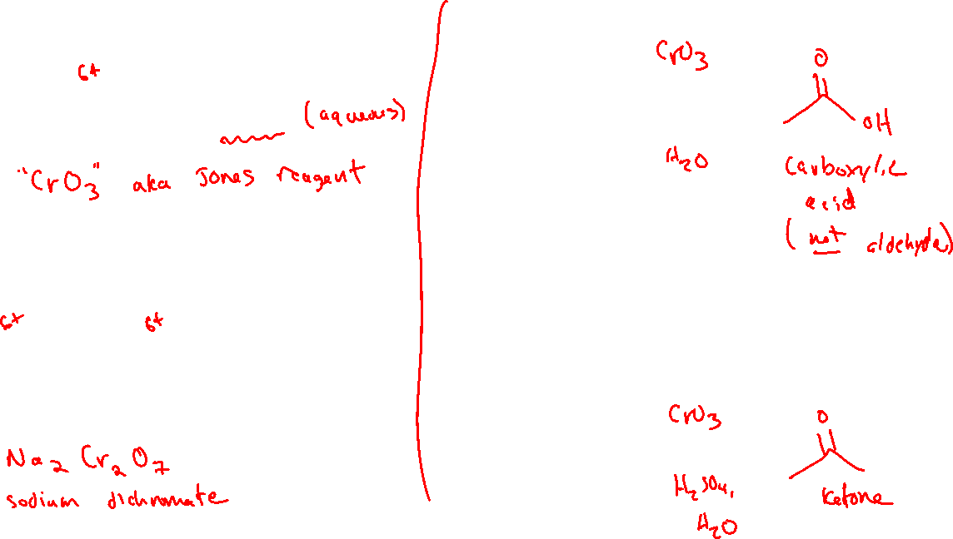





Chromium-based Reagents for Oxidizing Alcohols (12.10)

Slide 4



Oxidizing Alcohols with Chromium: Mechanism

Slide 5
Oxidizing Alcohols with Chromium: Mechanism

Slide 6




Organic Oxidizing Agents: “Greener” Alternatives

Slide 7

Aldehydes and Ketones as Electrophiles (19.4)

Slide 8



Nucleophilic Addition to Aldehydes and Ketones

Slide 9





Oxygen Nucleophiles (19.5)

