Slide 1
Aldehyde and Ketone Electrophiles with
Oxygen and Nitrogen Nucleophiles
2/6/2023

Slide 2


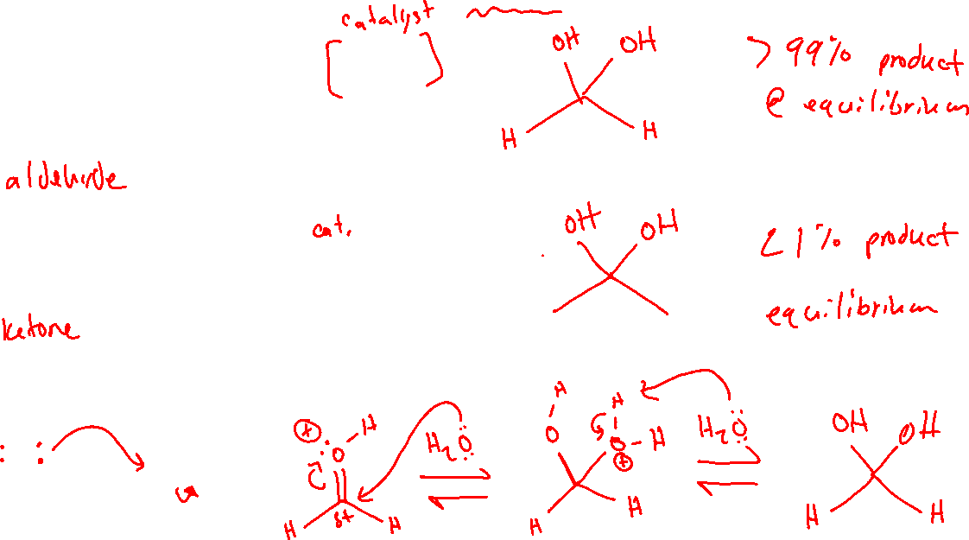



Oxygen Nucleophiles: Formation of Hydrates (gem-diols) (19.5)

Slide 3

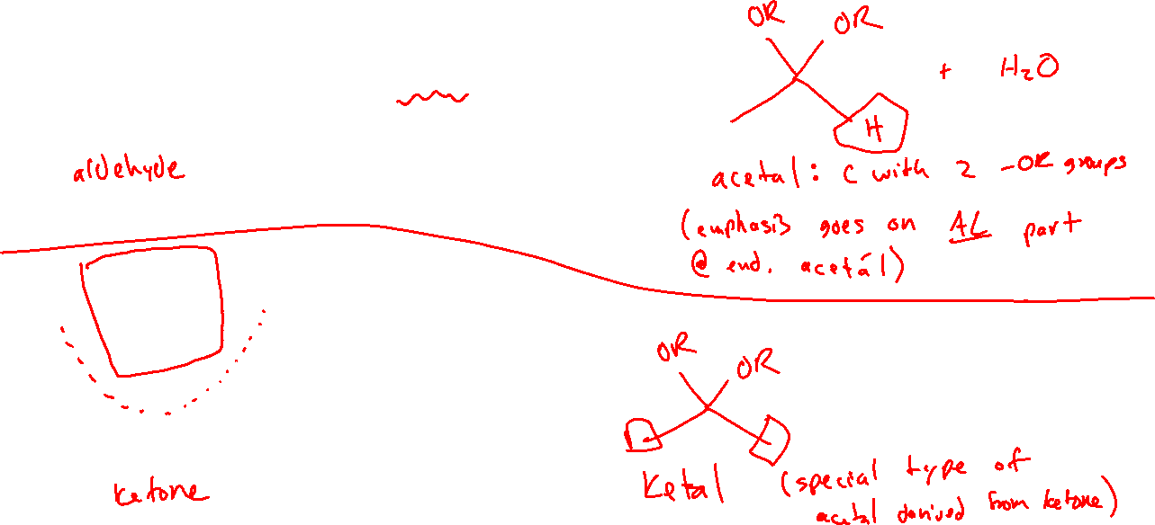





Oxygen Nucleophiles: Formation of Acetals (19.5)

Slide 4


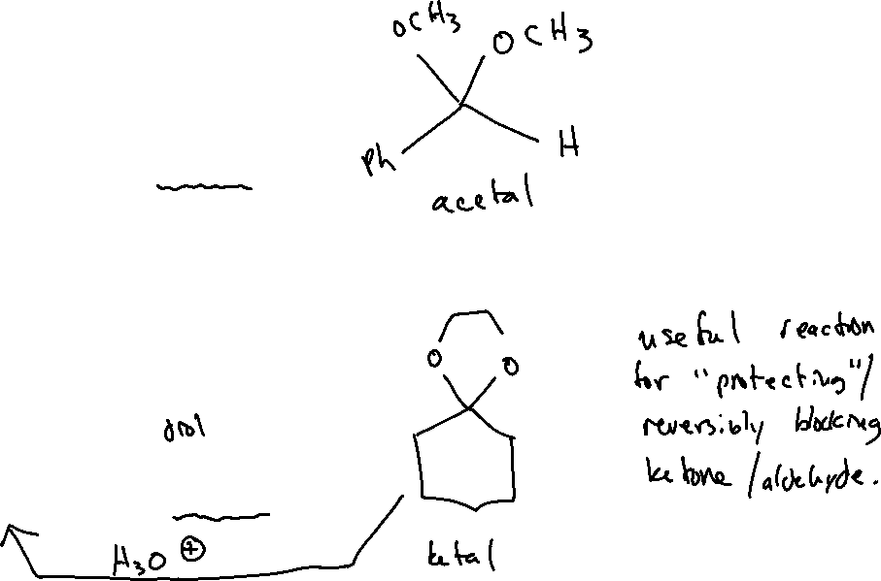


Oxygen Nucleophiles: Formation of Acetals (19.5)

Slide 5
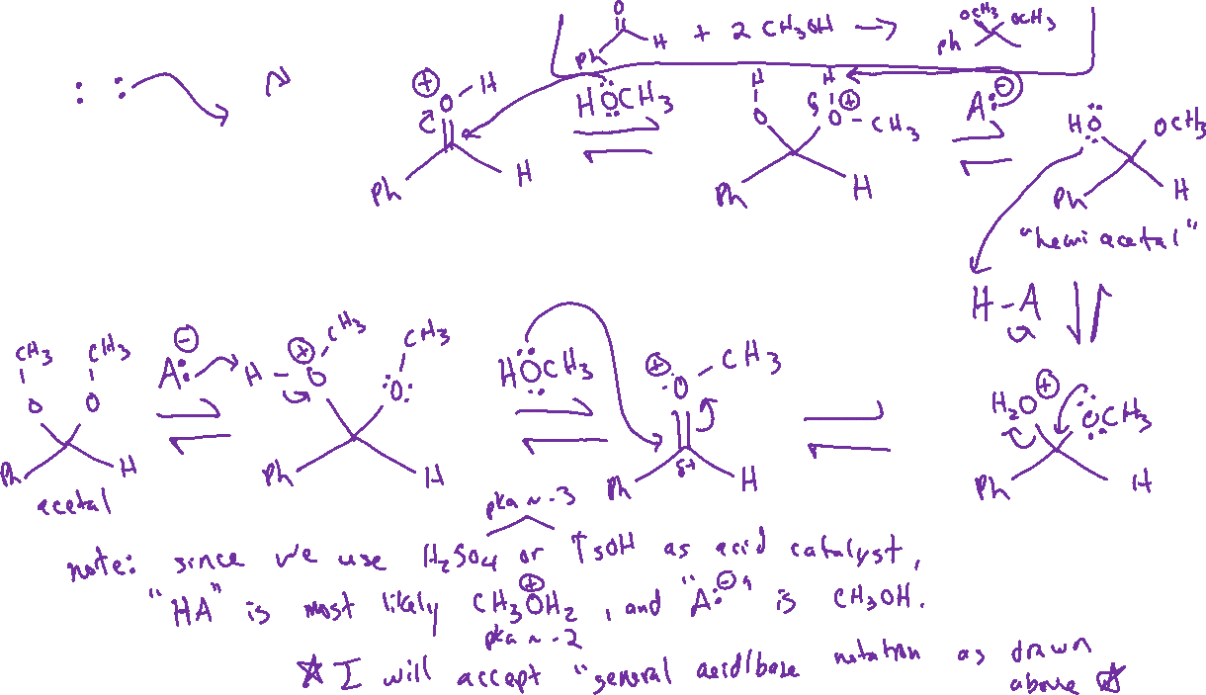


Acetal Formation: Mechanism

Slide 6
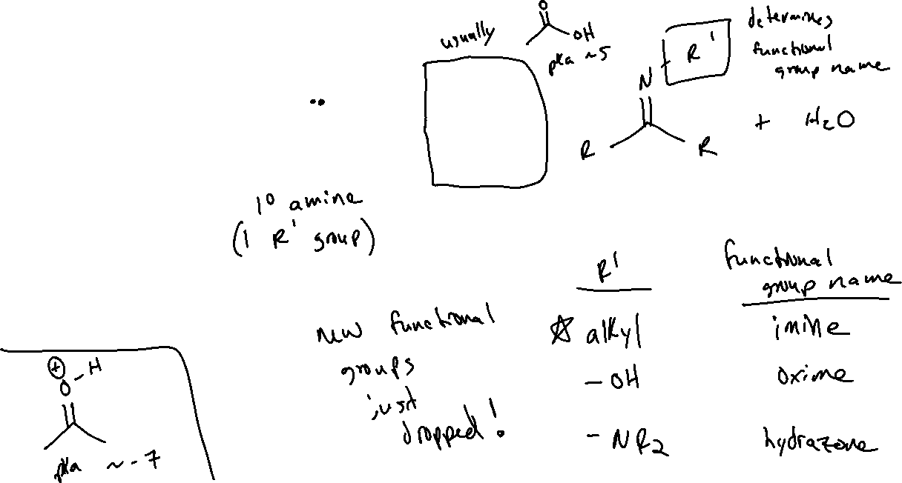


Nitrogen Nucleophiles: 1° Amines (19.6)

Slide 7

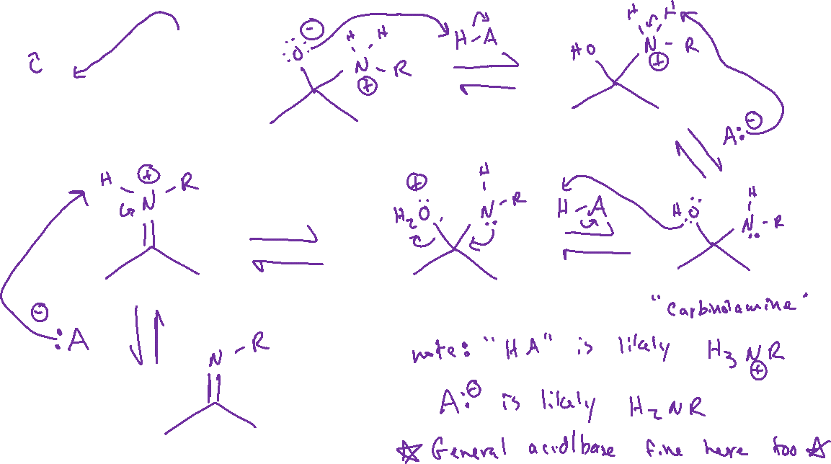
1° Amine Nucleophiles: Mechanism

Slide 8





2° Amine Nucleophiles

