Slide 1
Enamine formation
Hydrolysis of Acetals/Imines/Enamines – Reversing this week’s reactions
2/8/2023

Slide 2


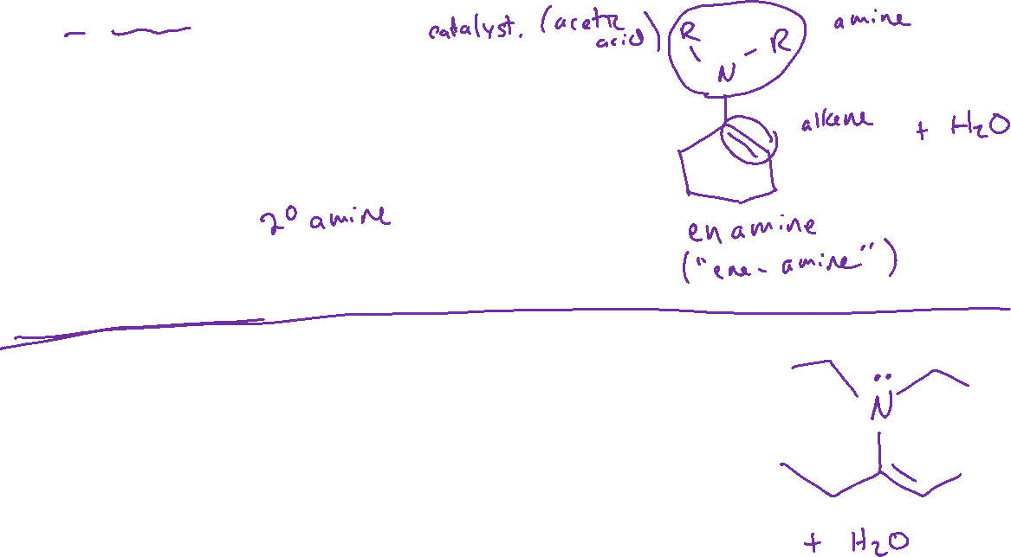



2° Amine Nucleophiles

Slide 3
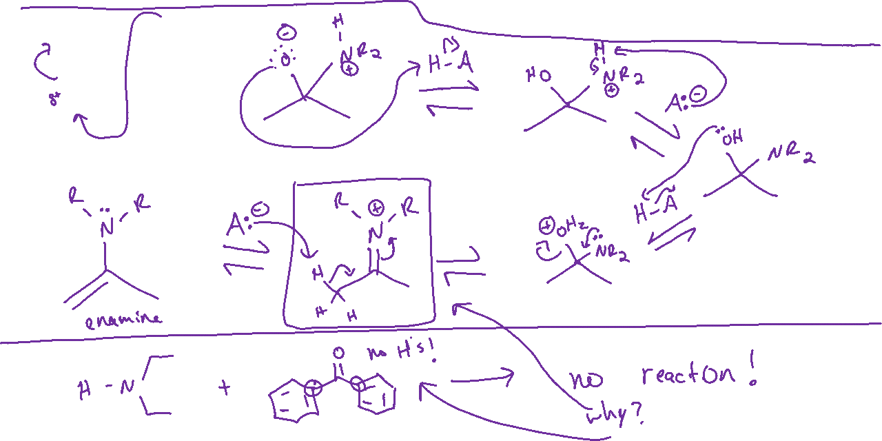

Enamine Formation: Mechanism

Slide 4




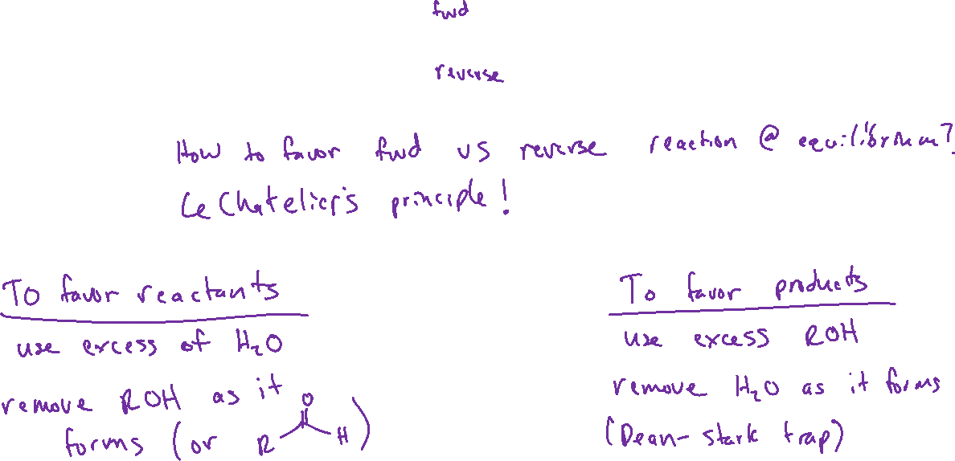
Hydrolysis of Acetals (19.7)

Slide 5

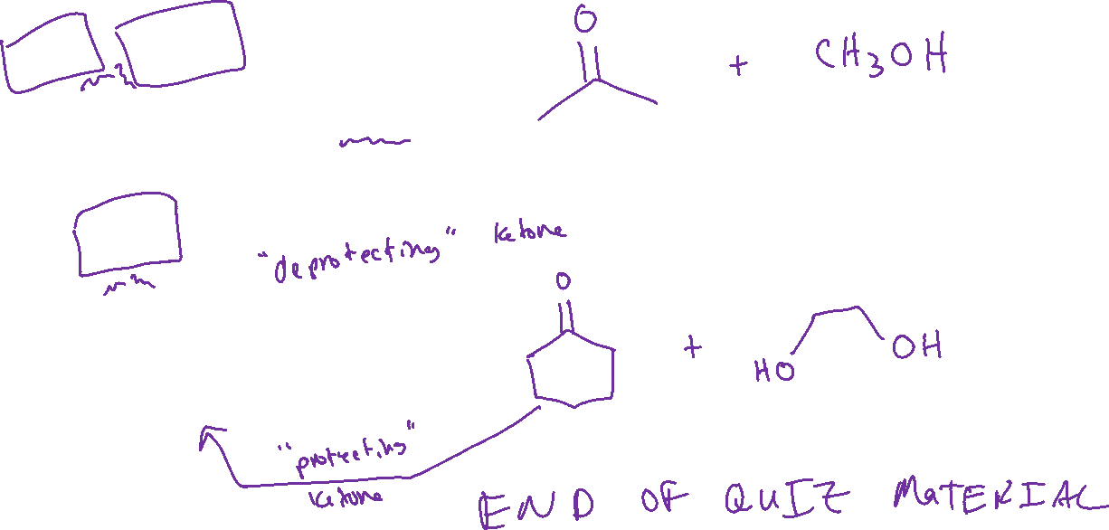





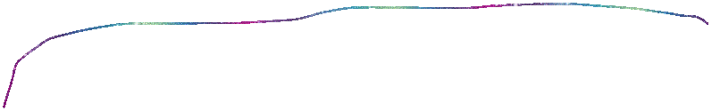
Hydrolysis of Acetals

Slide 6
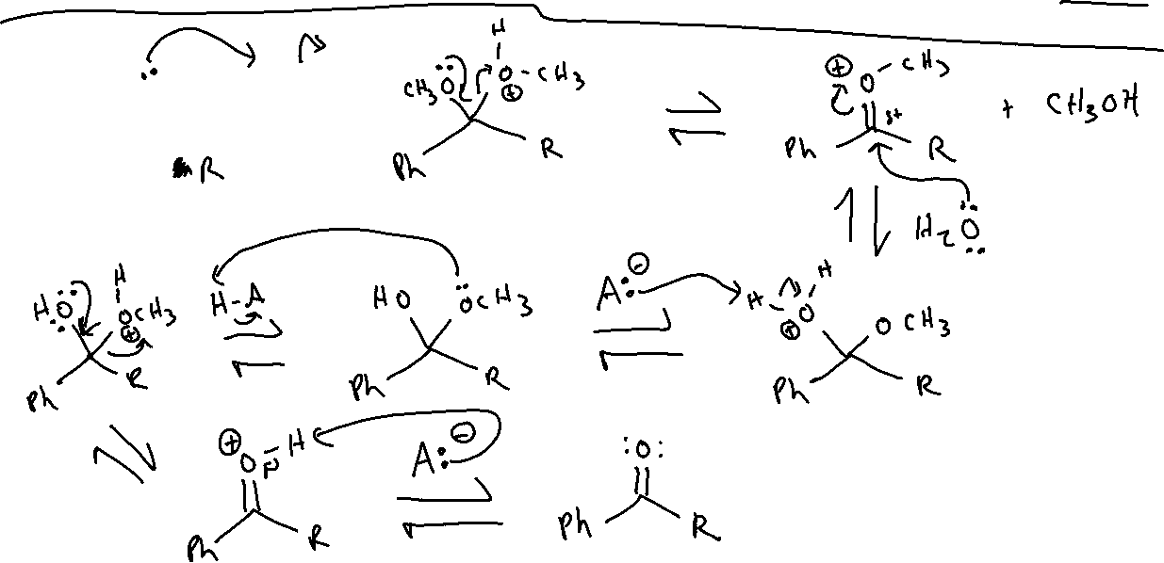


Hydrolysis of Acetals: Mechanism

Slide 7





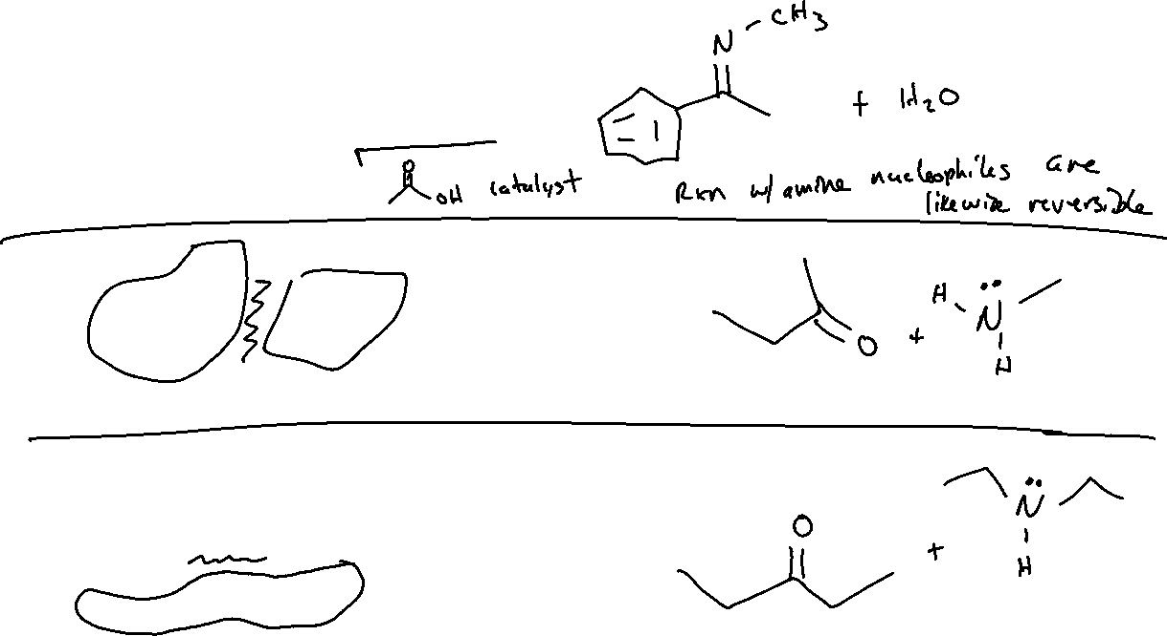



Hydrolysis of Imines/Enamines

Slide 8



Hydrolysis of Imines: Mechanism

Slide 9

Hydrogen as a Nucleophile (19.9, 12.4)

