Slide 1

Imine/Enamine Hydrolysis
Hydrogen & Carbon Nucleophiles
2/10/2023

Slide 2
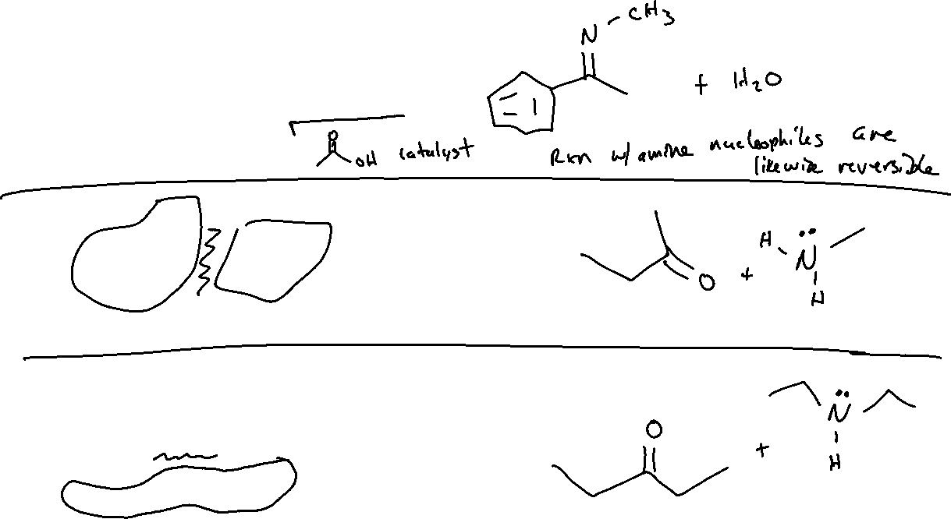
Hydrolysis of Imines/Enamines

Slide 3


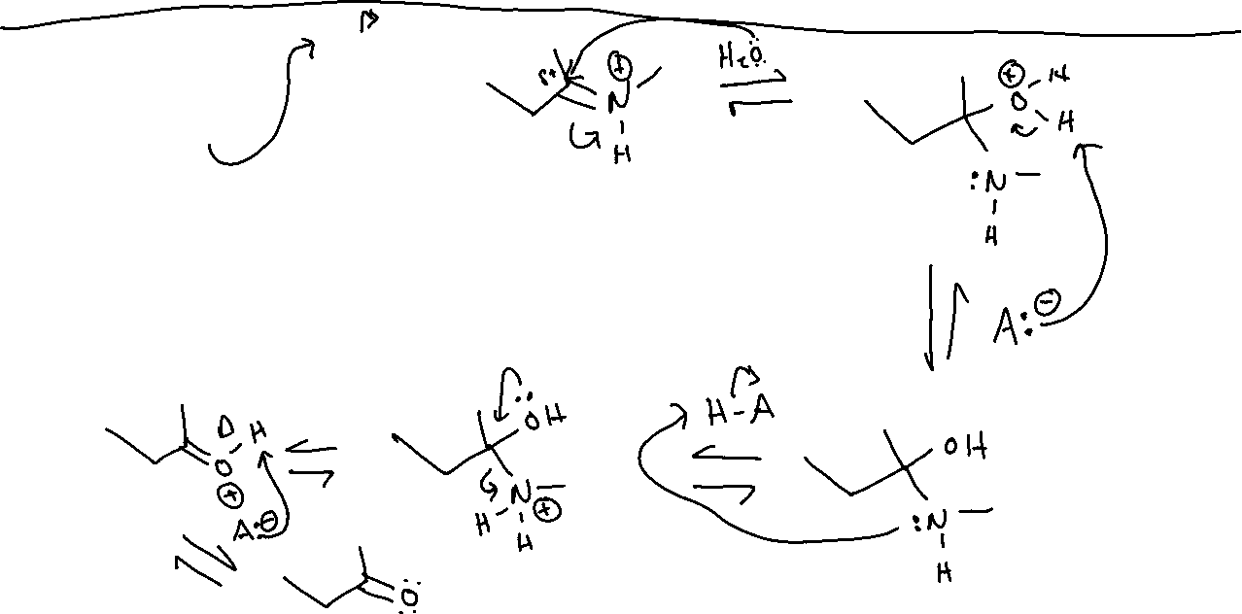

Hydrolysis of Imines: Mechanism

Slide 4

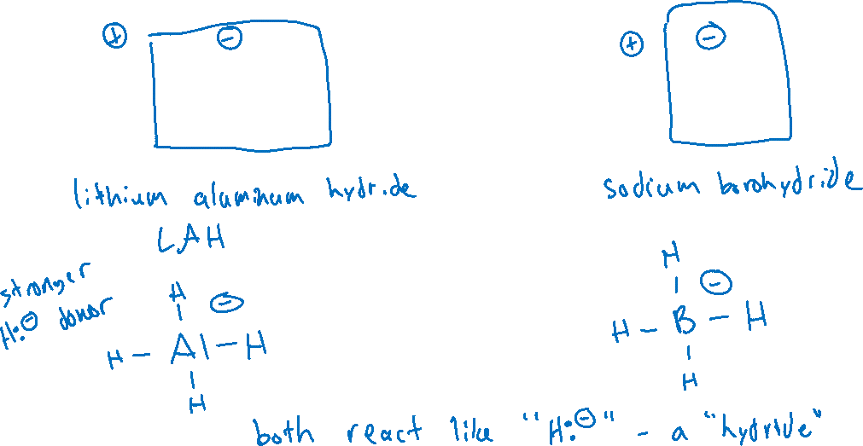
Hydrogen as a Nucleophile (19.9, 12.4)

Slide 5
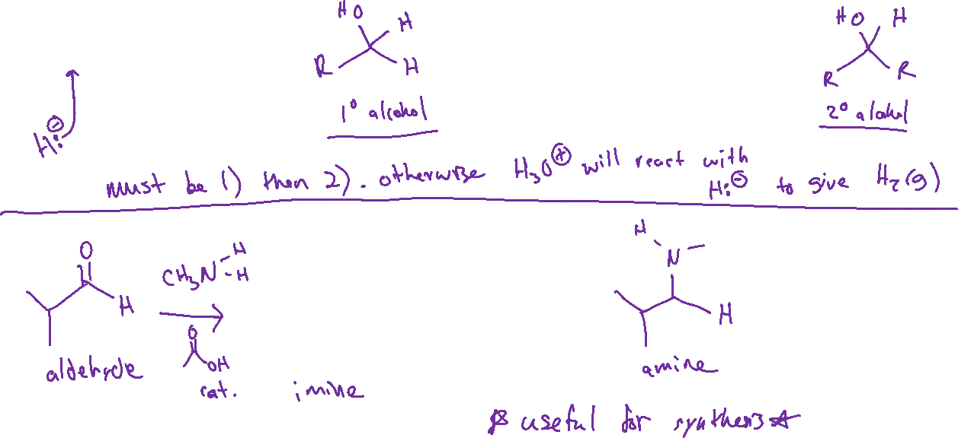


Hydrogen Nucleophiles: “Reducing” Ketones, Aldehydes, and Imines

Slide 6


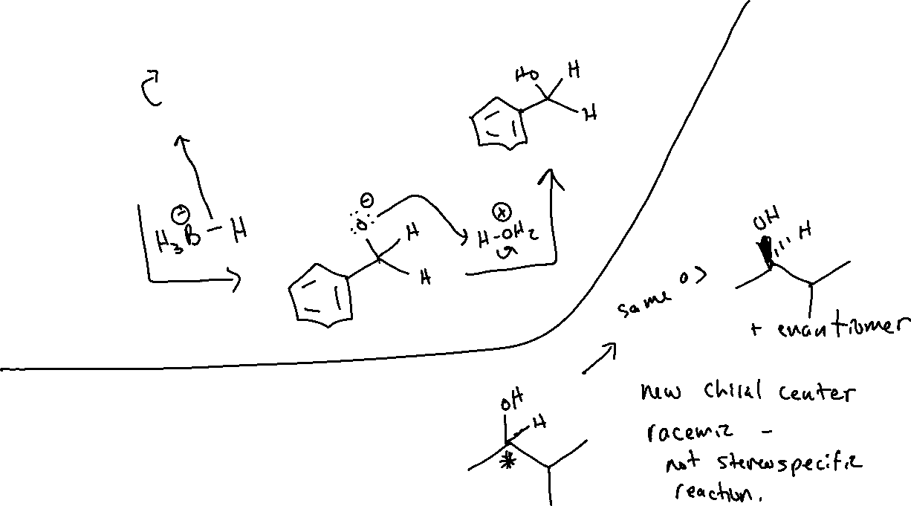

Hydrogen Nucleophiles: Mechanism and Stereochemistry

Slide 7
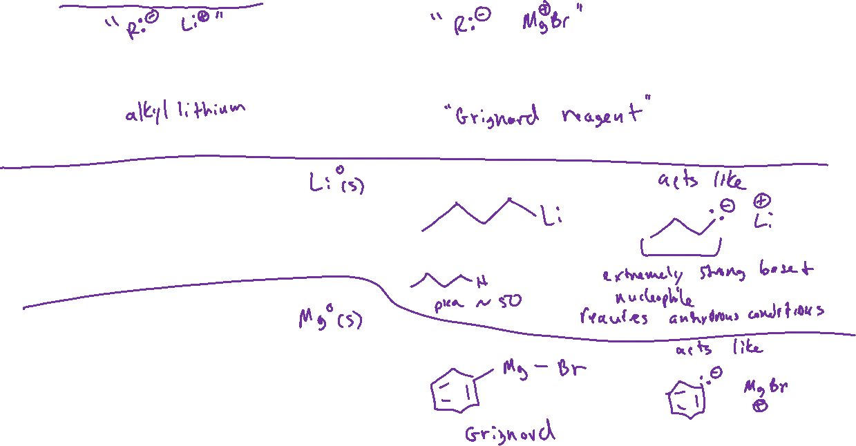





Carbon Nucleophiles: Alkyllithium and Grignard Reagents

Slide 8

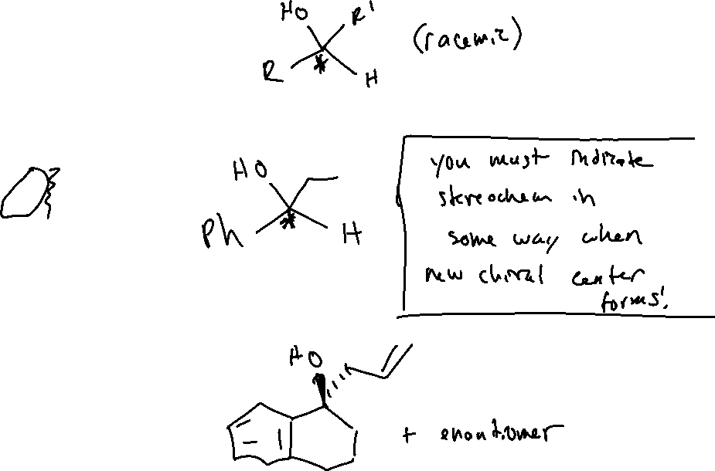



Carbon Nucleophiles

Slide 9




Carbon Nucleophiles: Mechanism and Stereochemistry

Slide 10


Carbon Nucleophiles: Other Notes

