Slide 1
Imine/Enamine Hydrolysis
Hydrogen & Carbon Nucleophiles
2/10/2023

Slide 2
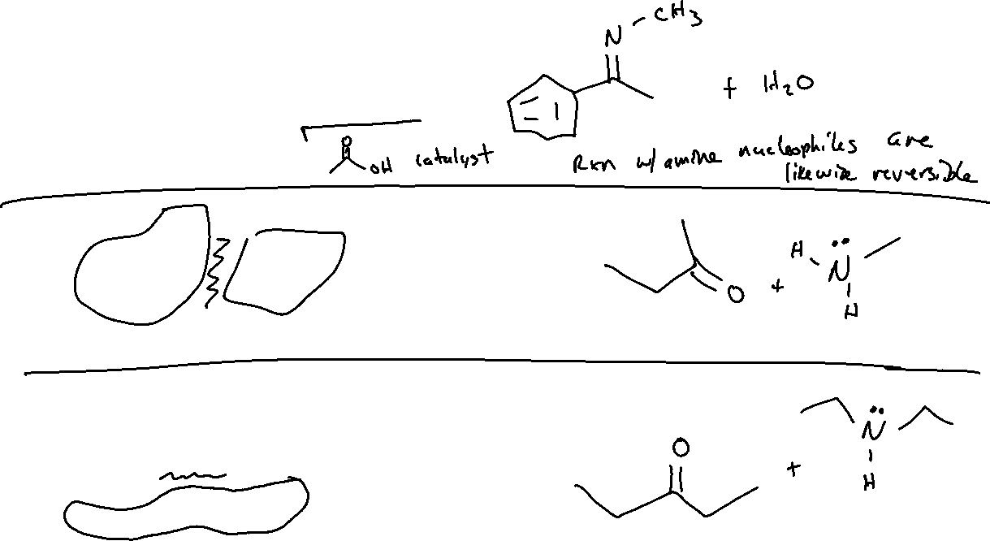
Hydrolysis of Imines/Enamines

Slide 3



Hydrolysis of Imines: Mechanism

Slide 4

Hydrogen as a Nucleophile (19.9, 12.4)

Slide 5


Hydrogen Nucleophiles: “Reducing” Ketones, Aldehydes, and Imines

Slide 6



Hydrogen Nucleophiles: Mechanism and Stereochemistry

Slide 7





Carbon Nucleophiles: Alkyllithium and Grignard Reagents

Slide 8




Carbon Nucleophiles

Slide 9





Carbon Nucleophiles: Mechanism and Stereochemistry

Slide 10

Carbon Nucleophiles: Other Notes

