Slide 1
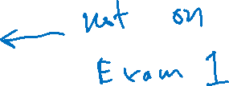
Carbon Nucleophiles
Wittig Reaction
2/13/2023

Slide 2

Carbon Nucleophiles

Slide 3




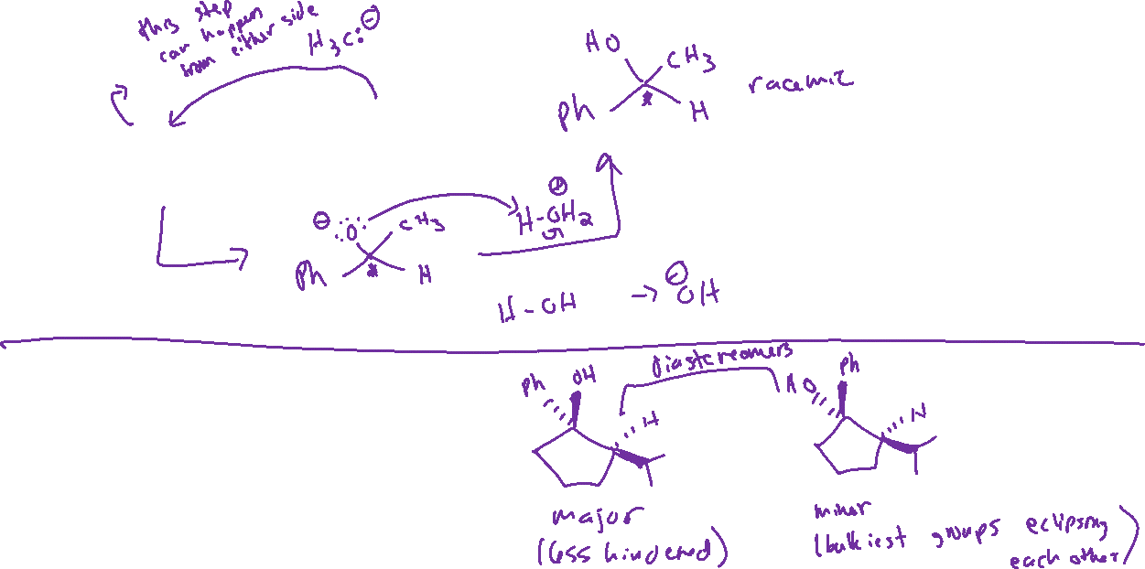
Carbon Nucleophiles: Mechanism and Stereochemistry

Slide 4

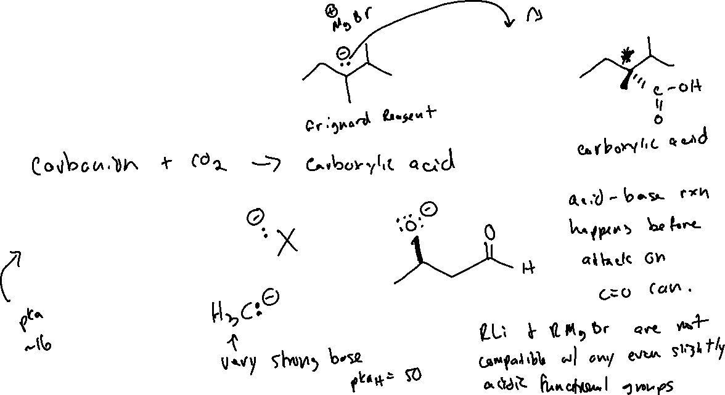

Carbon Nucleophiles: Other Notes

Slide 5

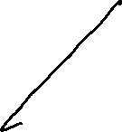





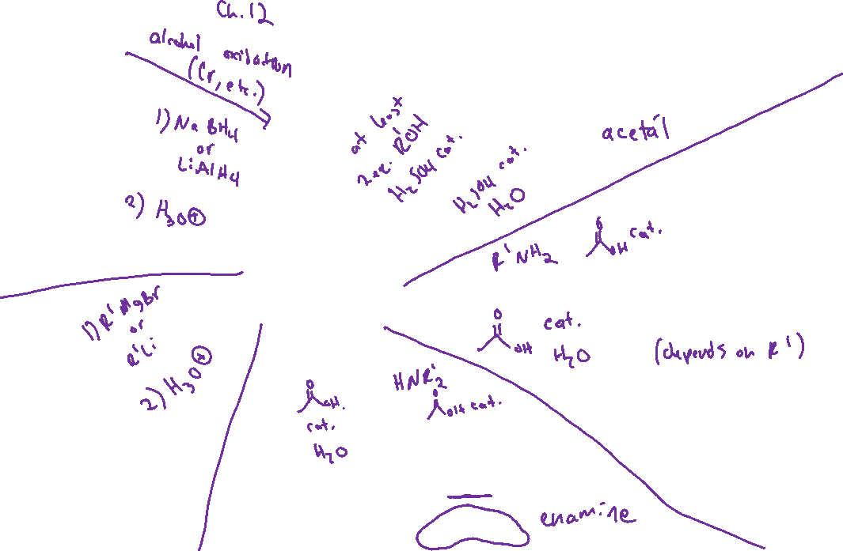


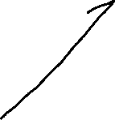




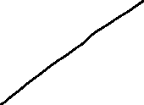
Ch 19: Recap

Slide 6
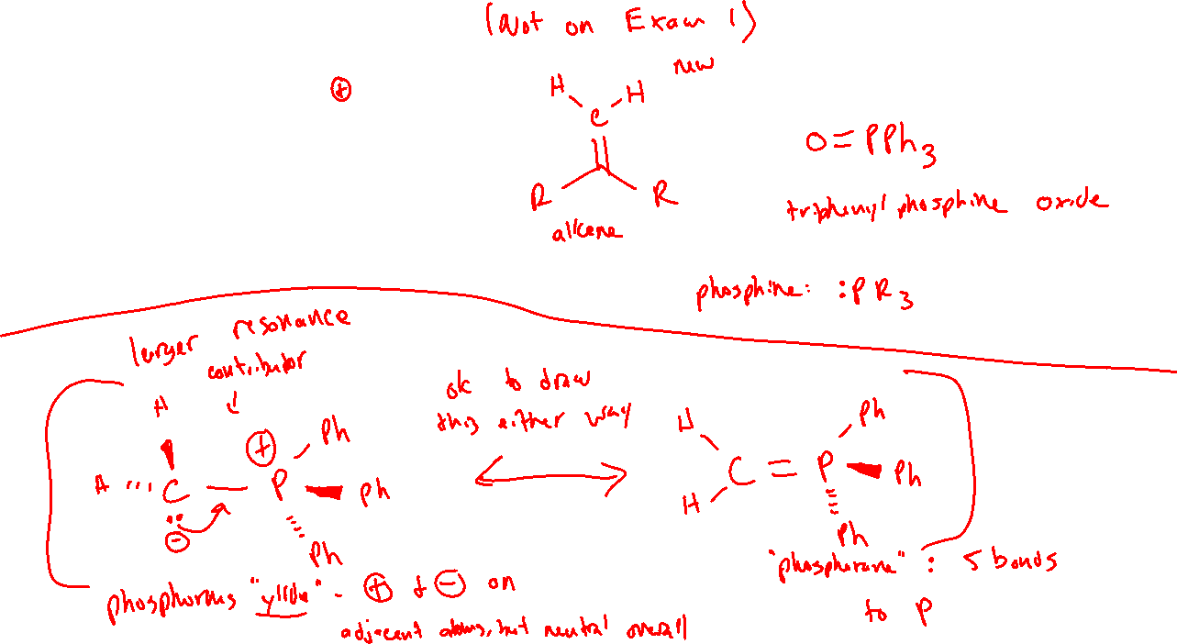
Wittig Reaction (19.10)

Slide 7
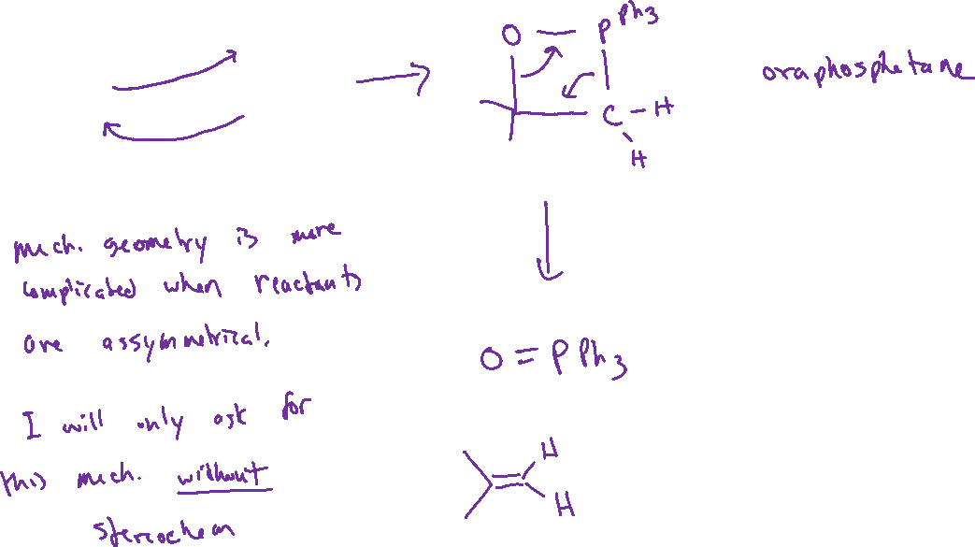
Wittig Reaction: Mechanism

Slide 8
Synthesizing the Ylide Reagent

Slide 9





Wittig Reaction: Stereoselectivity

