Slide 1
Carbon Nucleophiles
Wittig Reaction
2/13/2023

Slide 2
Carbon Nucleophiles

Slide 3




Carbon Nucleophiles: Mechanism and Stereochemistry

Slide 4


Carbon Nucleophiles: Other Notes

Slide 5

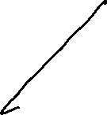







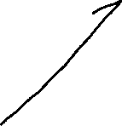




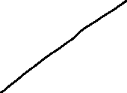
Ch 19: Recap

Slide 6
Wittig Reaction (19.10)

Slide 7
Wittig Reaction: Mechanism

Slide 8
Synthesizing the Ylide Reagent

Slide 9





Wittig Reaction: Stereoselectivity

