Slide 1
Carboxylic Acids & Their Derivatives
2/20/2023

Slide 2

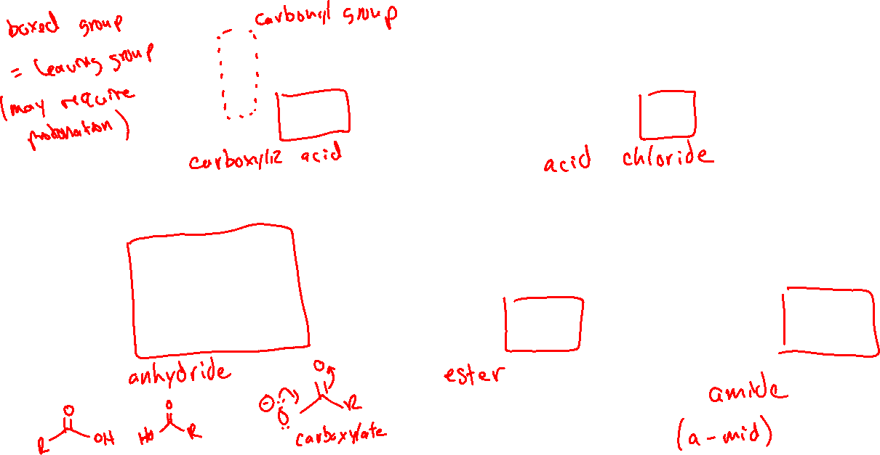




Ch. 20: Carboxylic Acids and Their Derivatives (20.6)

Slide 3
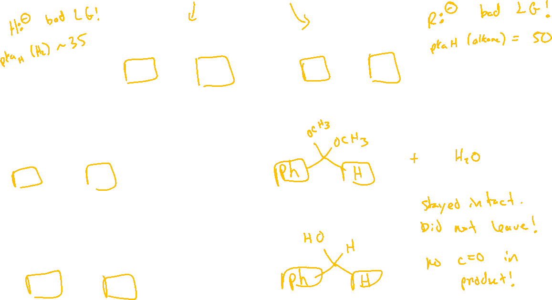






Comparison with Aldehyde and Ketone Reactivity

Slide 4

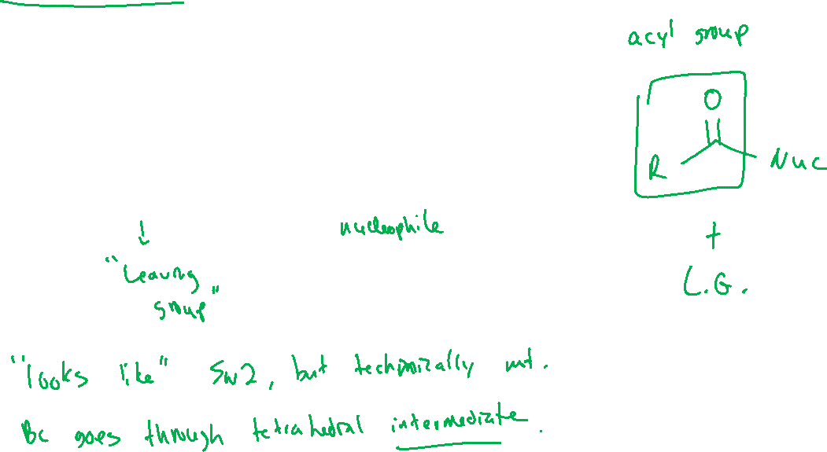

Acyl Transfer Reaction (general)

Slide 5
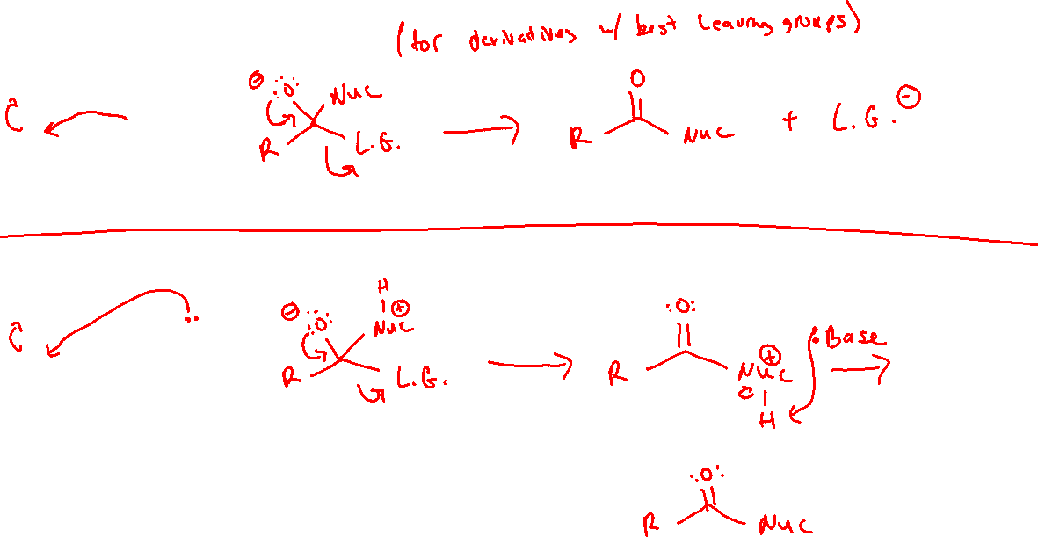
Acyl Transfer Mechanisms (General) (20.7)
With an anionic nucleophile:
With a neutral nucleophile + a weak base

Slide 6
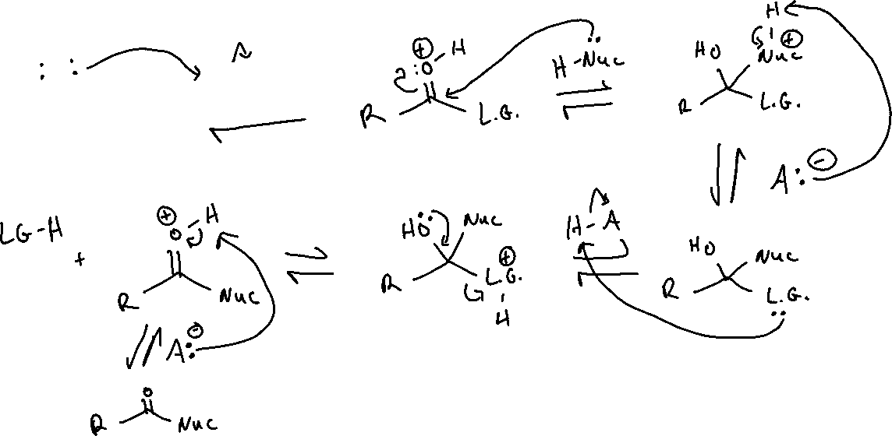
Acyl Transfer Mechanisms (General) (20.7)
With a neutral nucleophile + an acid:

Slide 7
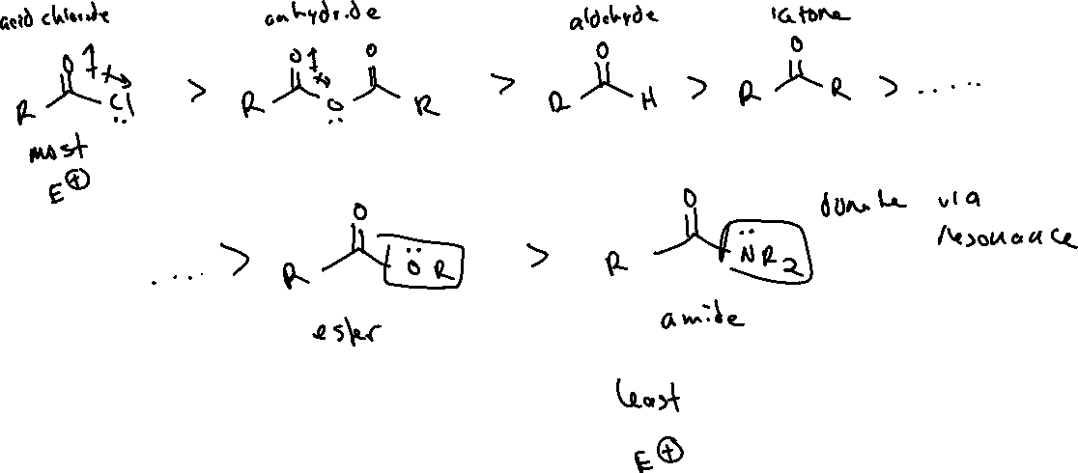
Ranking Electrophilicity of Carbonyl Functional Groups (20.7)

Slide 8

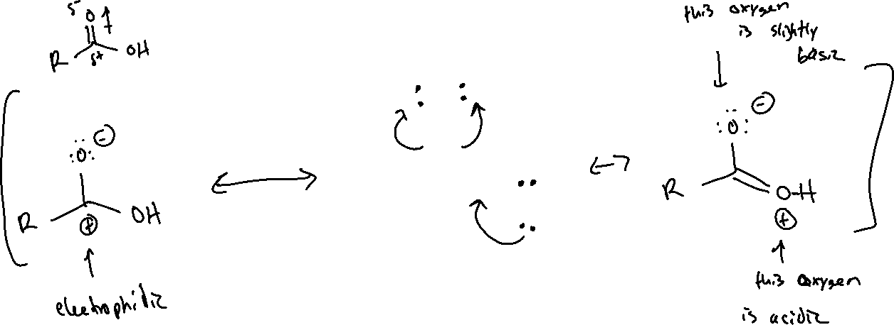


Carboxylic Acids (20.3)

Slide 9

Synthesis of Carboxylic Acids

