Slide 1
Carboxylic Acids
2/22/2023

Slide 2
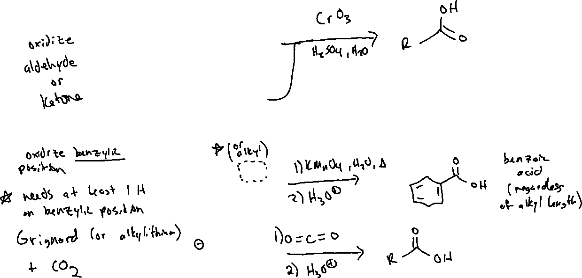

Synthesis of Carboxylic Acids

Slide 3
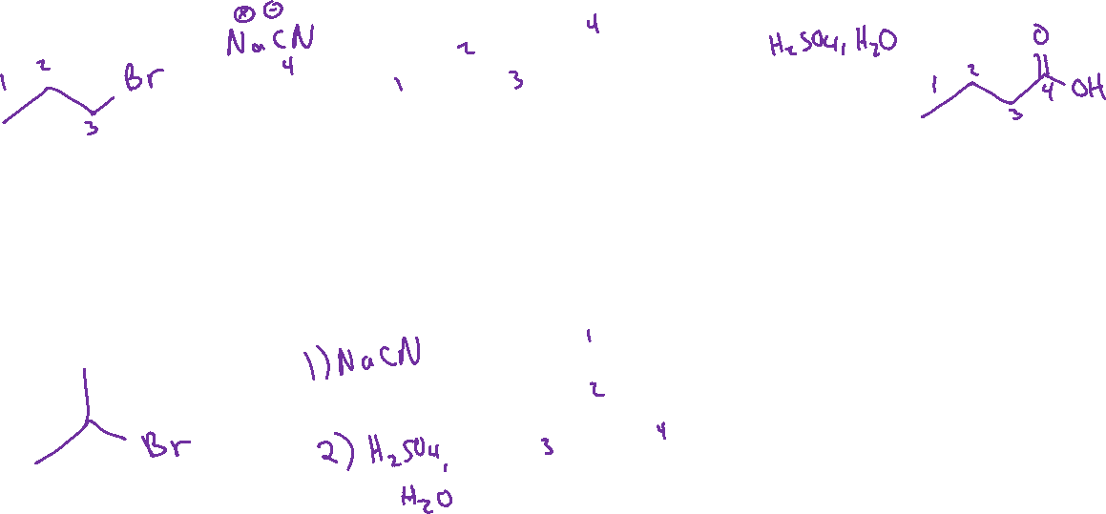




Synthesis of Carboxylic Acids via Nitriles

Slide 4
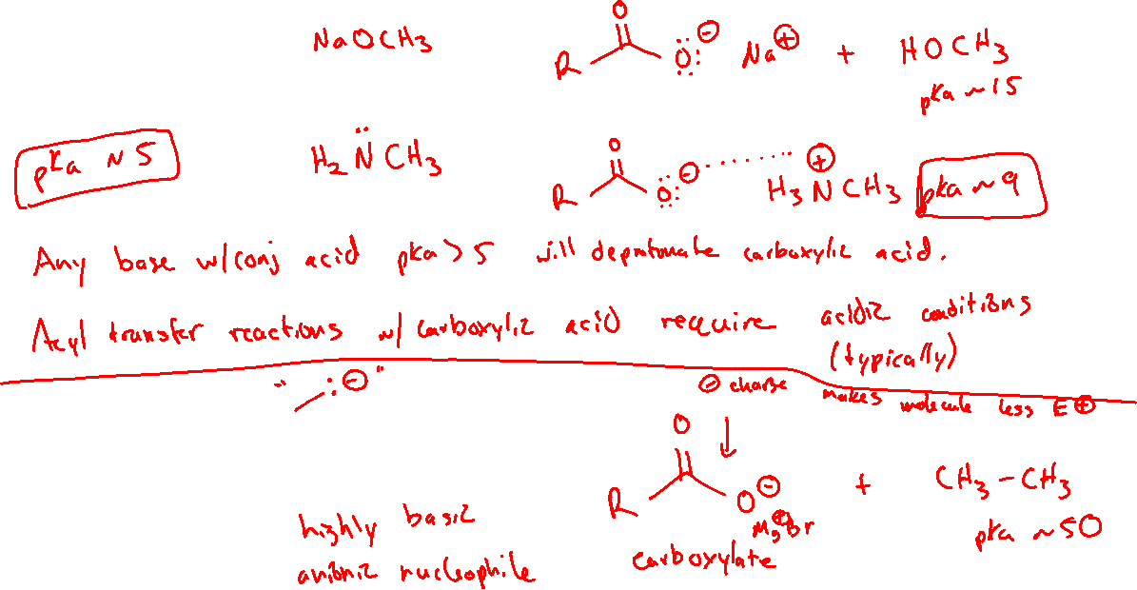





Reactivity of Carboxylic Acids: Acid-Base (20.5)

Slide 5

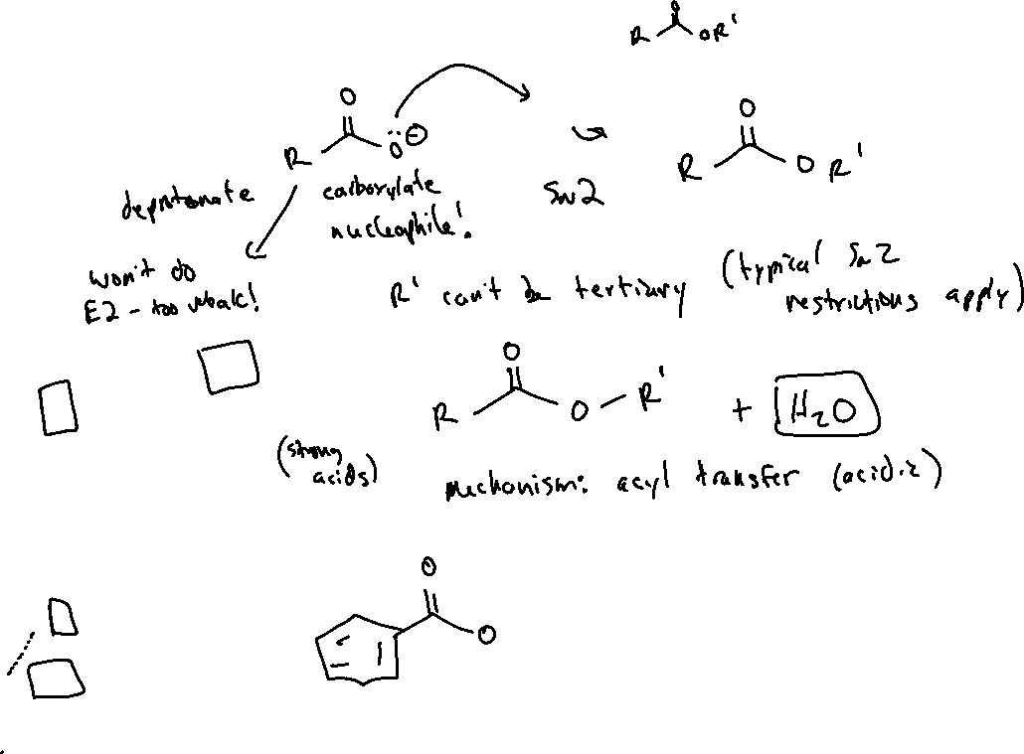
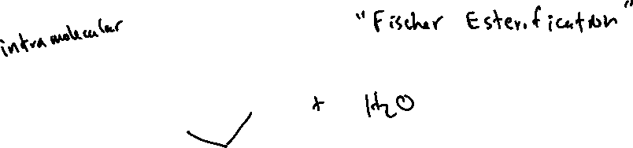
Reactivity of Carboxylic Acids: Forming Esters (20.10)

Slide 6
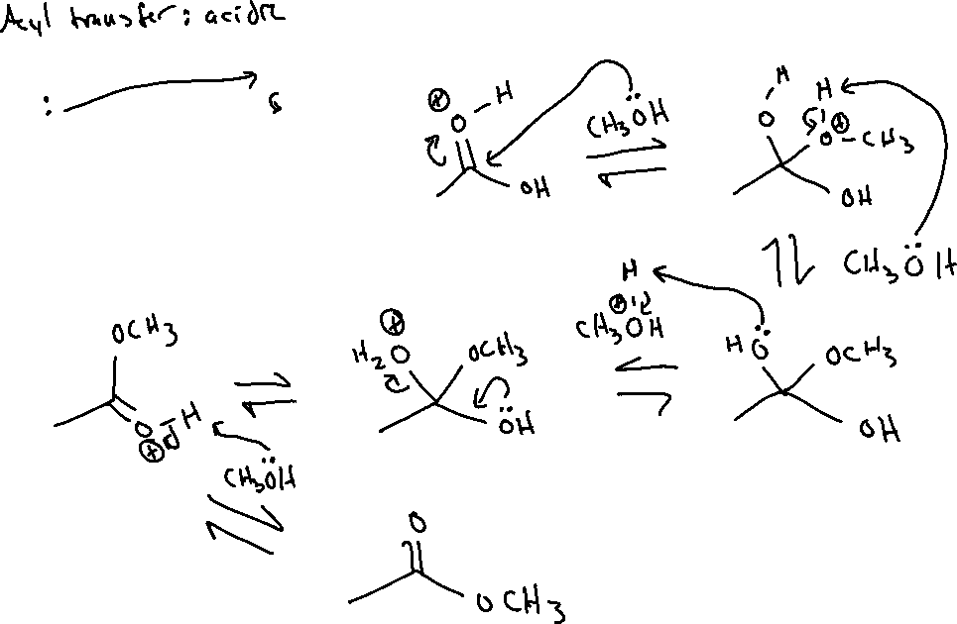
Fischer Esterification: Mechanism

Slide 7



Reduction of Carboxylic Acids (20.5)

Slide 8
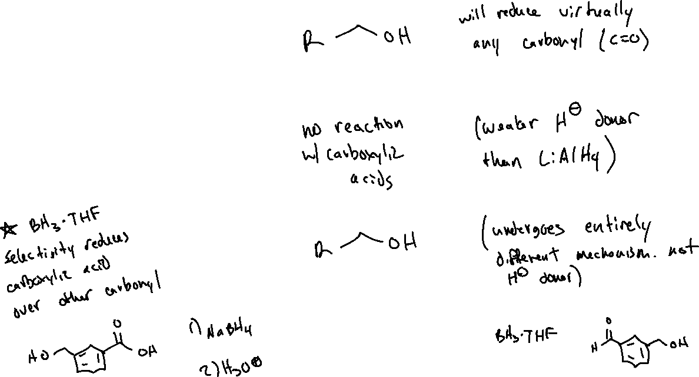



Selective Reduction of Carboxylic Acids (20.5)

