Slide 1
Acid Chlorides
2/24/2023

Slide 2
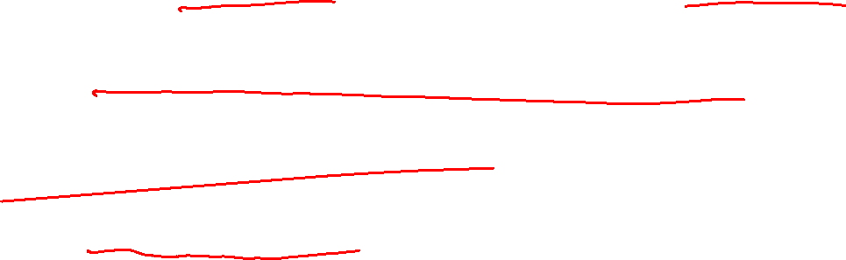
Exam 1 Corrections
Will be posted as a Moodle assignment
Correct EVERYTHING you missed, and get (up to) 5 points back!
Scan and upload your exam to the Moodle assignment, as well as your corrections.
The deadline will be mid-late March (definitely before next exam!)
Talk to me or a TA if you need help figuring out what you did wrong, or what the correct answer should have been!

Slide 3


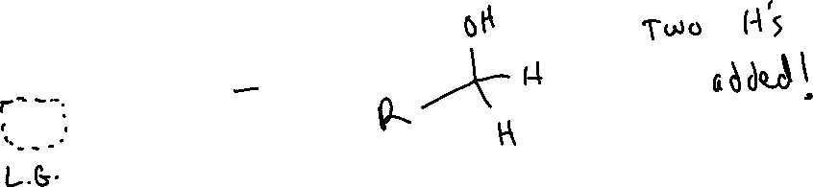
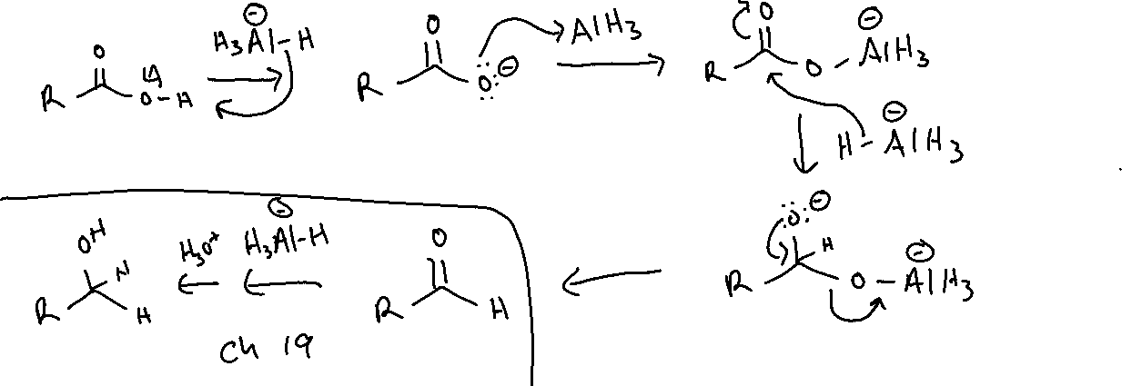
Reduction of Carboxylic Acids (20.5)

Slide 4
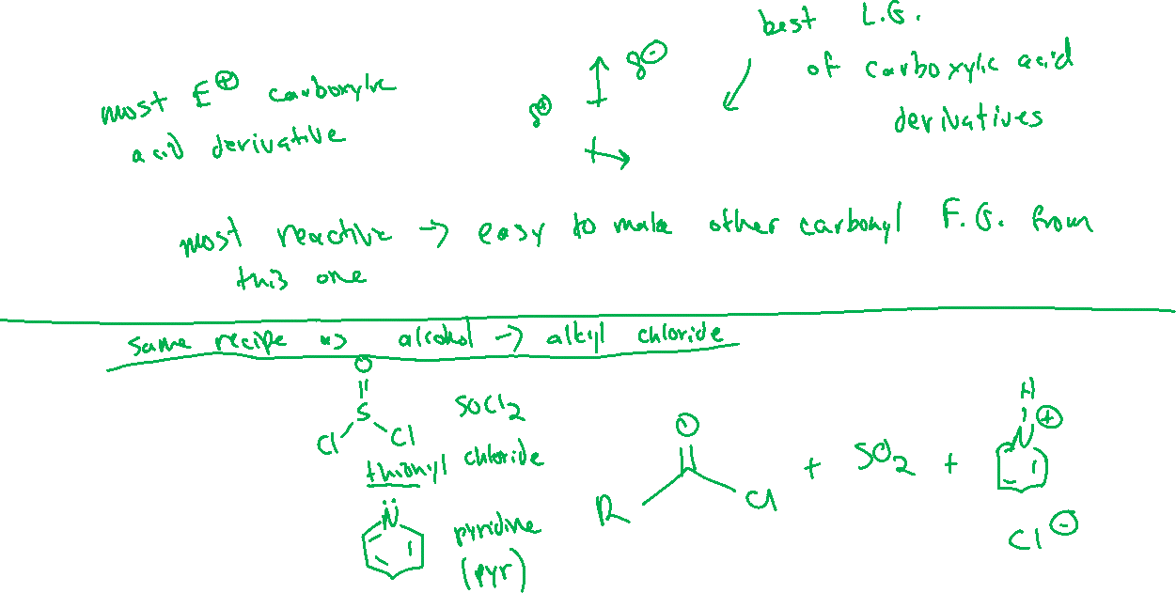





Synthesis of Acid Chlorides (20.8)

Slide 5
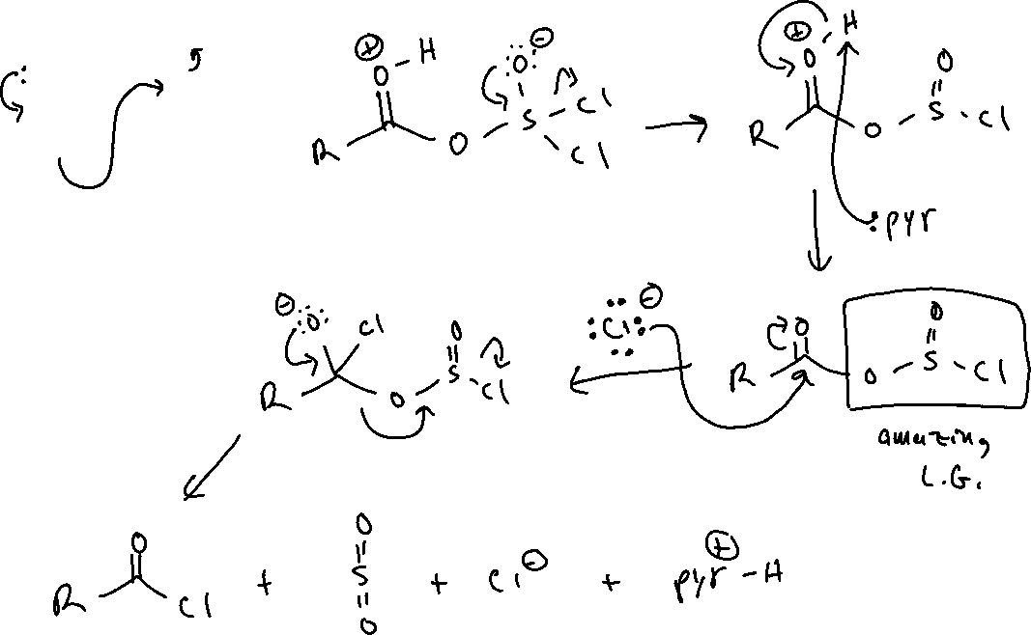
Carboxylic Acid → Acid Chloride: Mechanism

Slide 6
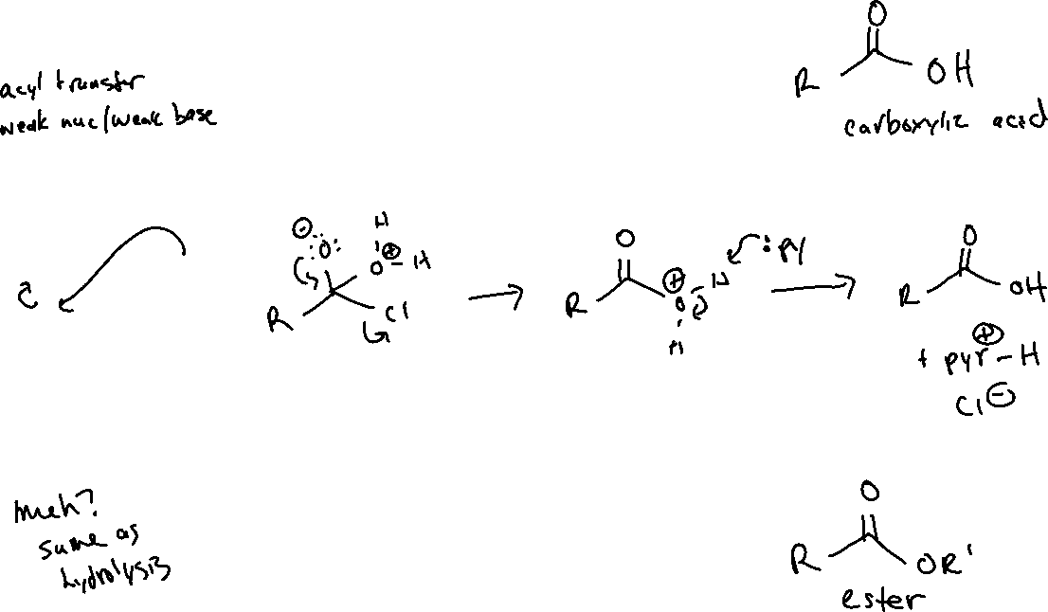




Reactions of Acid Chlorides
Hydrolysis:
Alcoholysis:

Slide 7

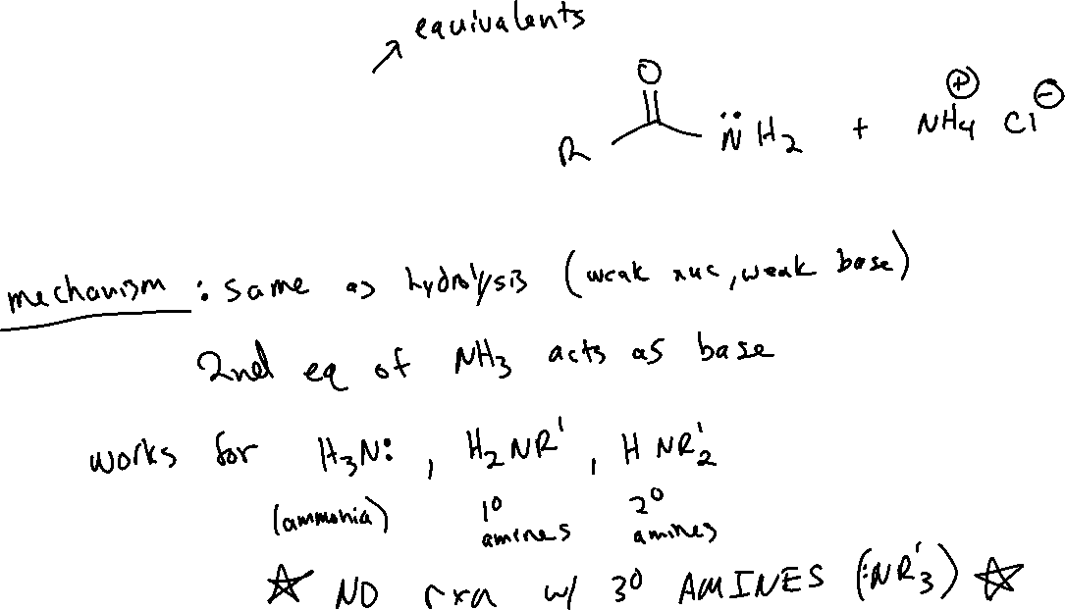
Reactions of Acid Chlorides
Aminolysis:

Slide 8


Reactions of Acid Chlorides
With Reducing Agents:

Slide 9

Reactions of Acid Chlorides
With Grignard Reagents

Slide 10



Reactions of Acid Chlorides
With Organocuprates (“Gilman Reagents”):

