Slide 1
Acid Chlorides & Anhydrides
Esters
2/27/2023

Slide 2

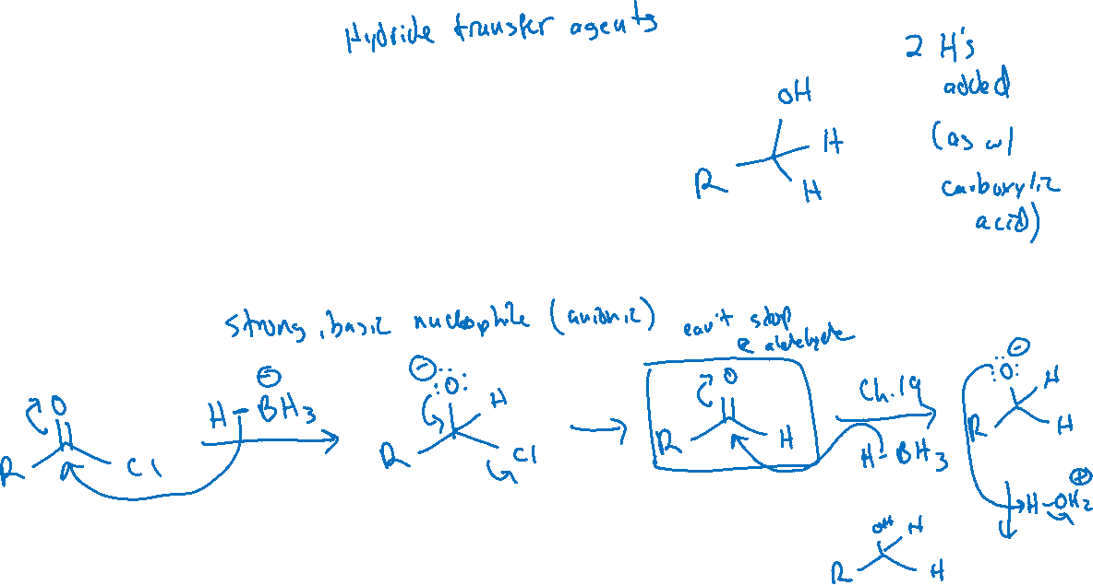
Reactions of Acid Chlorides
With Reducing Agents:

Slide 3

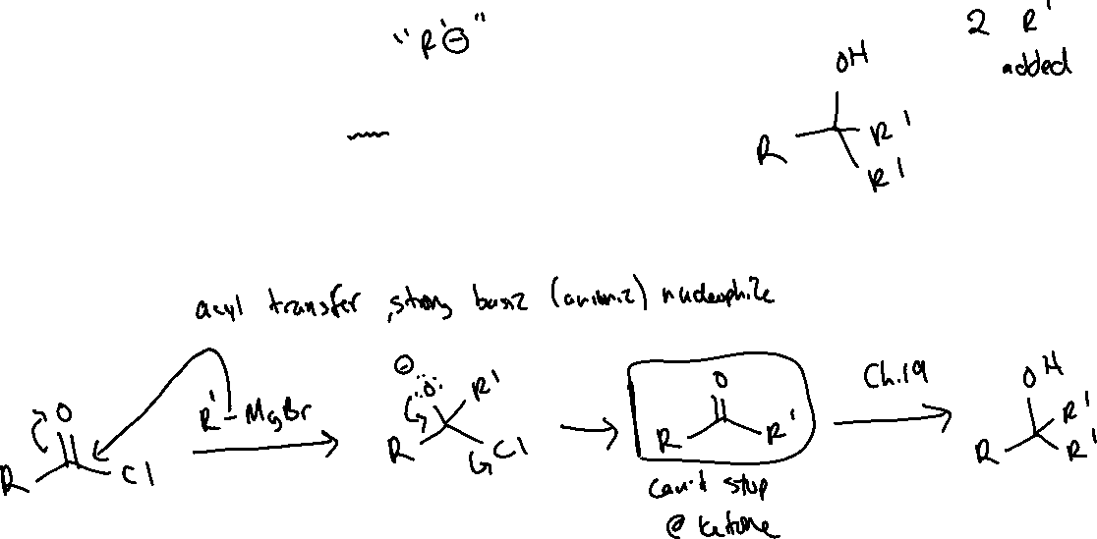
Reactions of Acid Chlorides
With Grignard Reagents

Slide 4
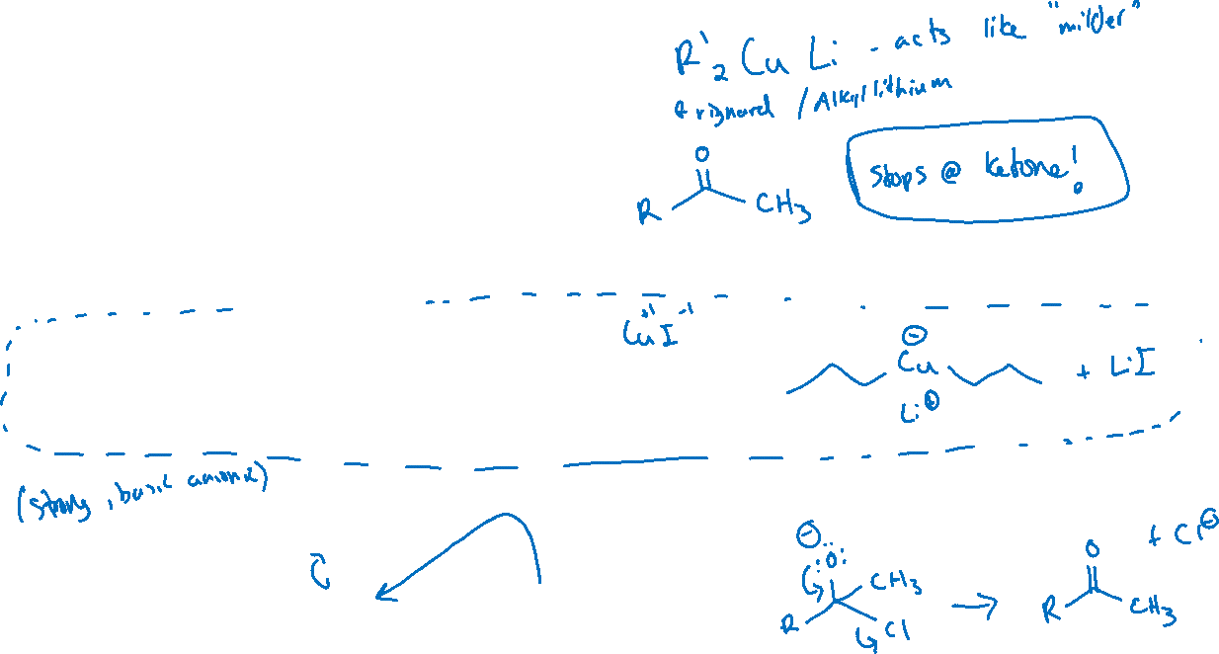



Reactions of Acid Chlorides
With Organocuprates (“Gilman Reagents”):

Slide 5
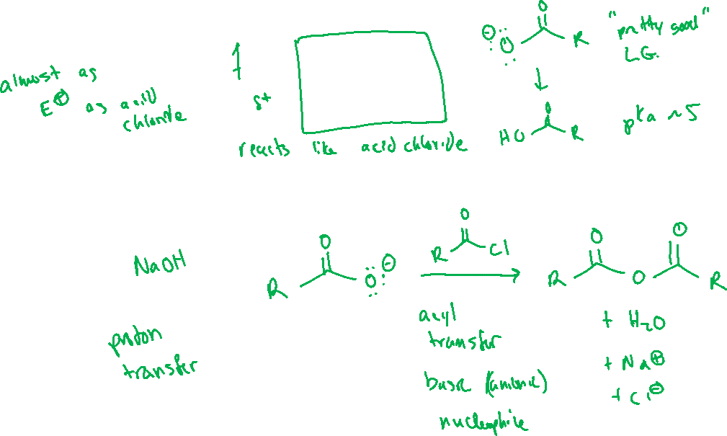


Anhydrides (20.9)

Slide 6





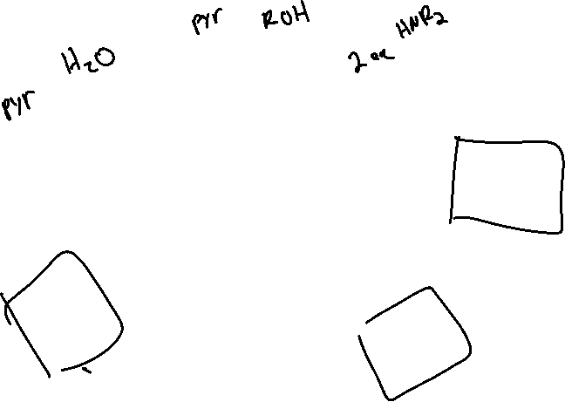



Reactions of Anhydrides & Acid Chlorides: Recap

Slide 7
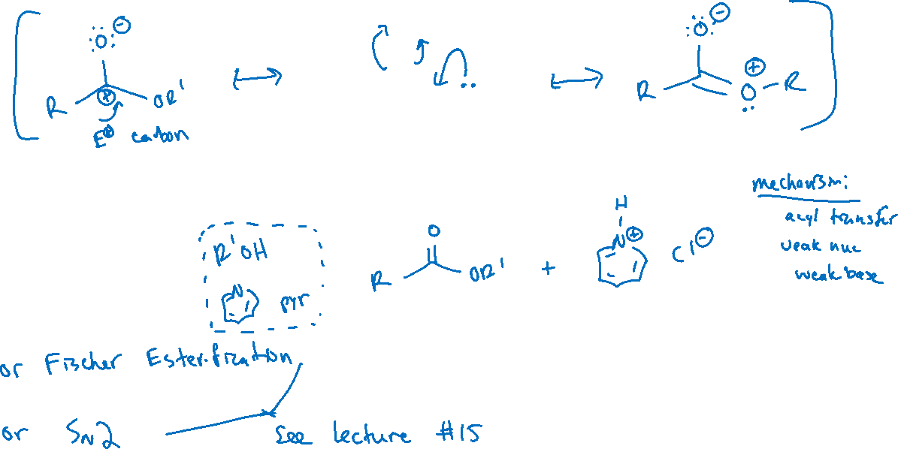

Esters (20.10-11)

Slide 8
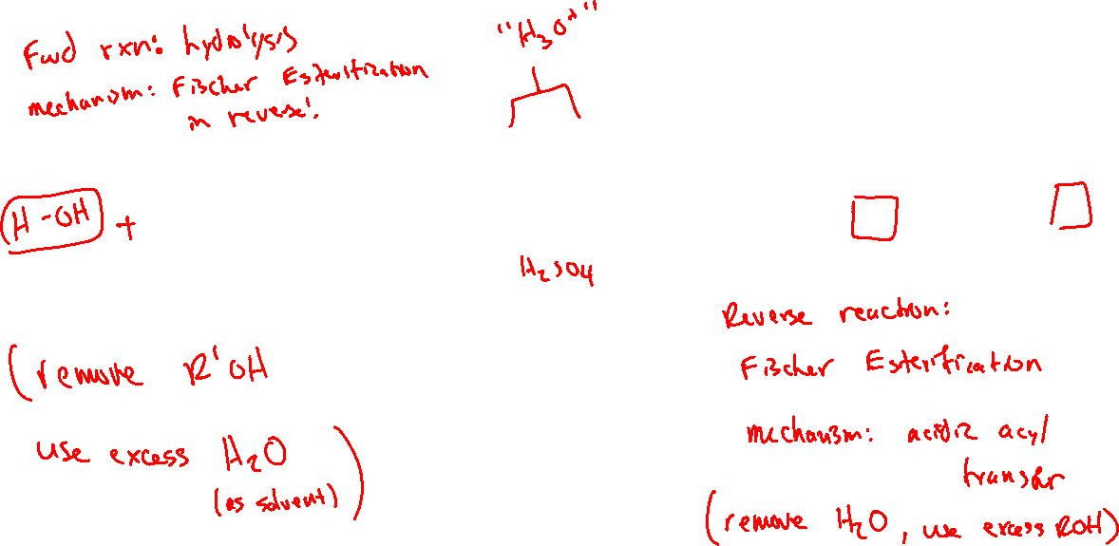
Hydrolysis of Esters: Acidic Conditions

Slide 9

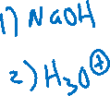
Hydrolysis of Esters: Basic Conditions

