Slide 1

Esters
Amides
Jacqueline OH poll on Moodle!!
3/1/2023

Slide 2

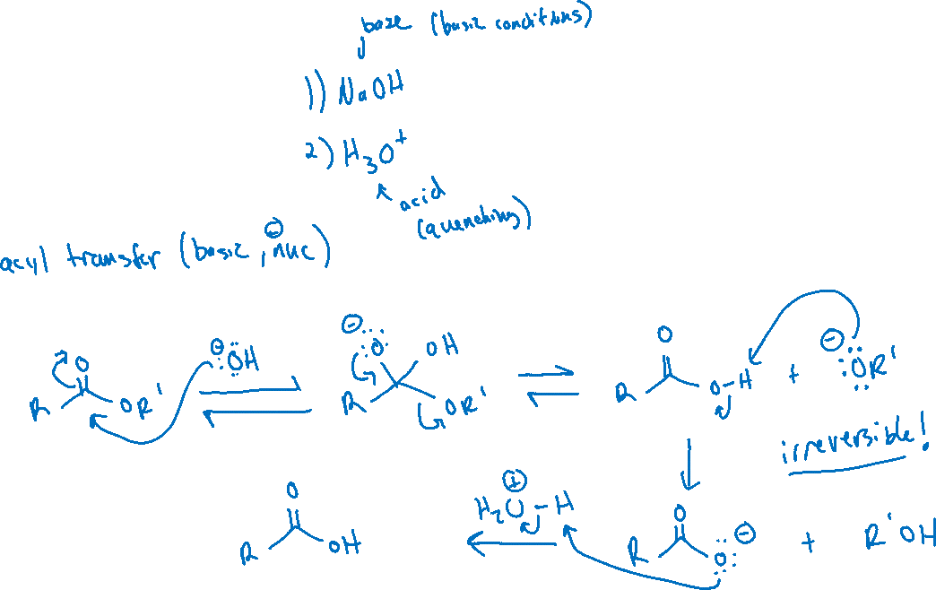
Hydrolysis of Esters: Basic Conditions

Slide 3
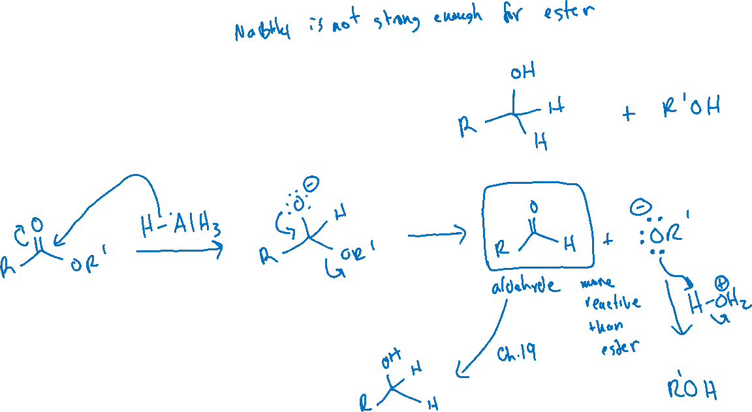

Reduction of Esters

Slide 4

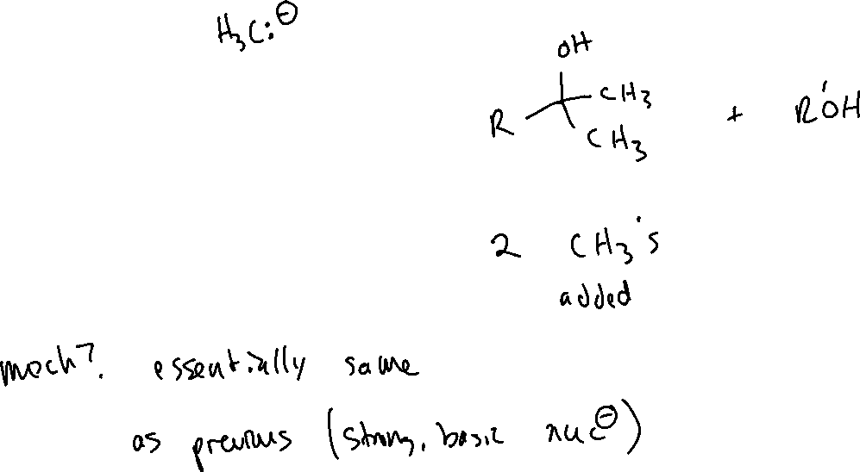
Esters and Grignard Reagents

Slide 5

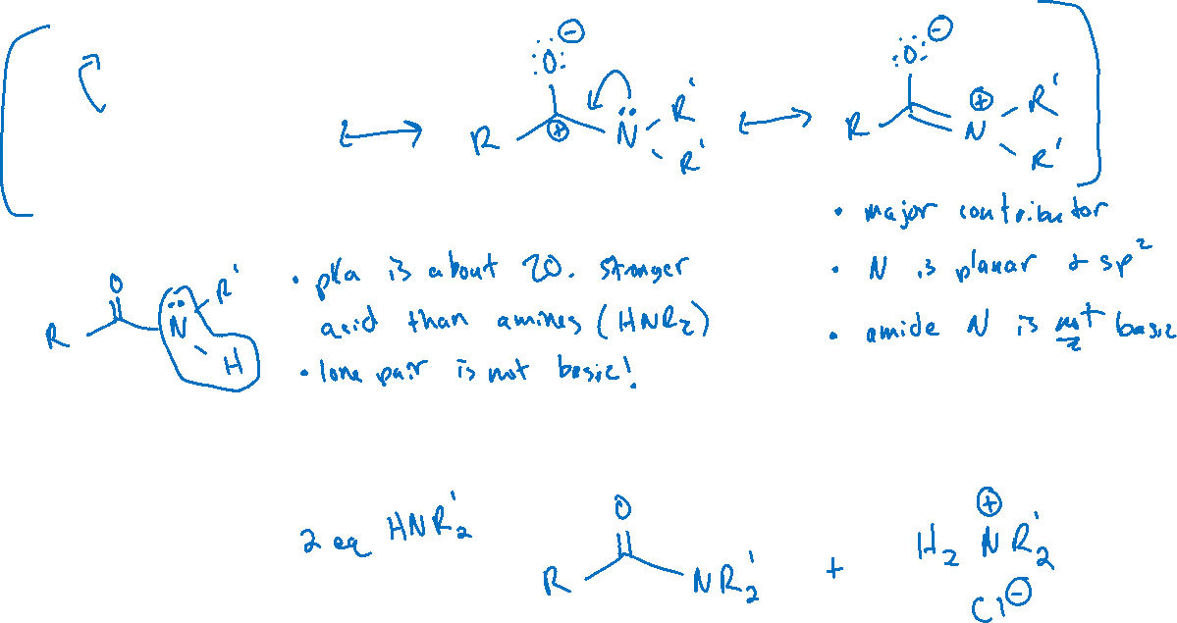
Amides (20.12)

Slide 6
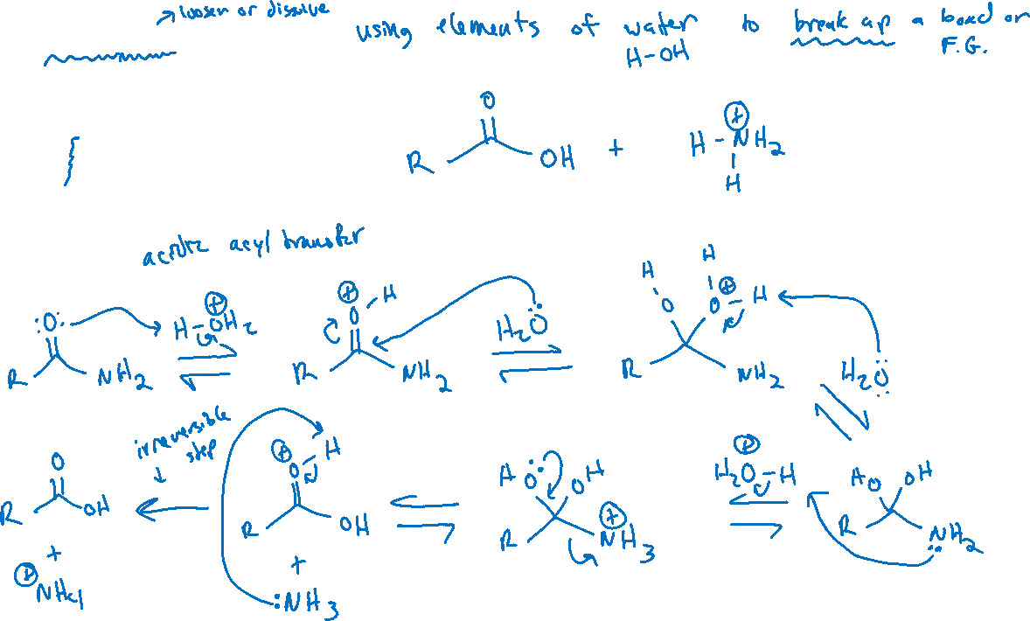
Hydrolysis of Amides

Slide 7
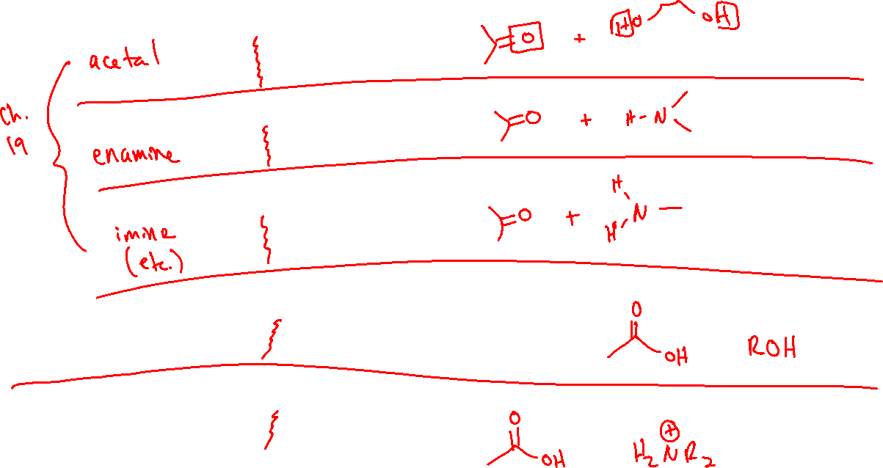
Hydrolysis of various functional groups: recap

Slide 8
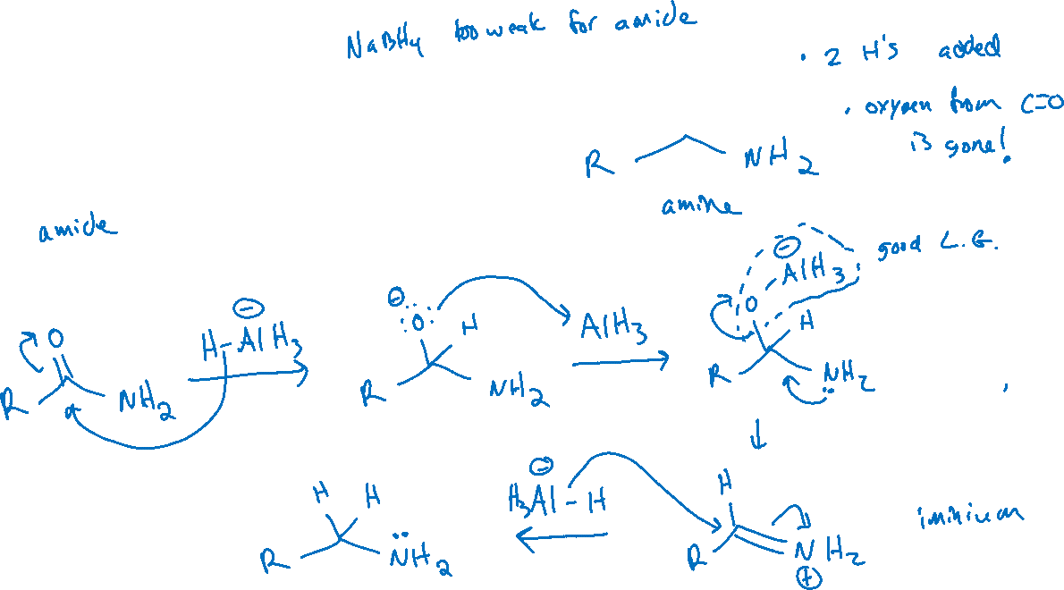


Reduction of Amides

Slide 9
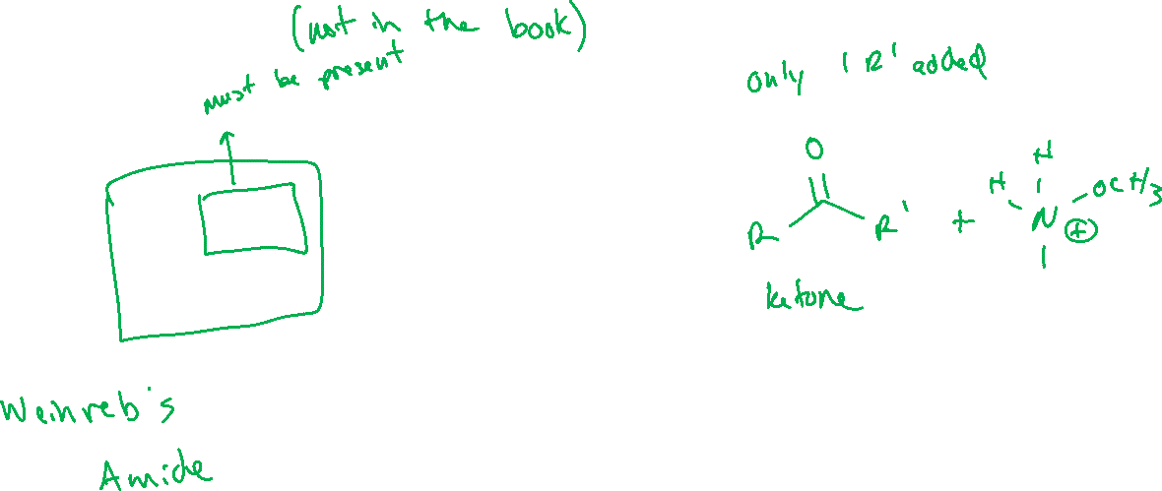
Weinreb Amides

Slide 10


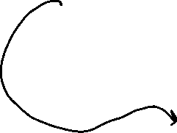





Reduction of Weinreb Amides: Mechanism

Slide 11




Reduction of Weinreb Amides

Slide 12






Reduction (hydride transfer) of various functional groups: recap

