Slide 1

Acid/Base Review
Acidity of C-H Bonds
3/13/2023

Slide 2
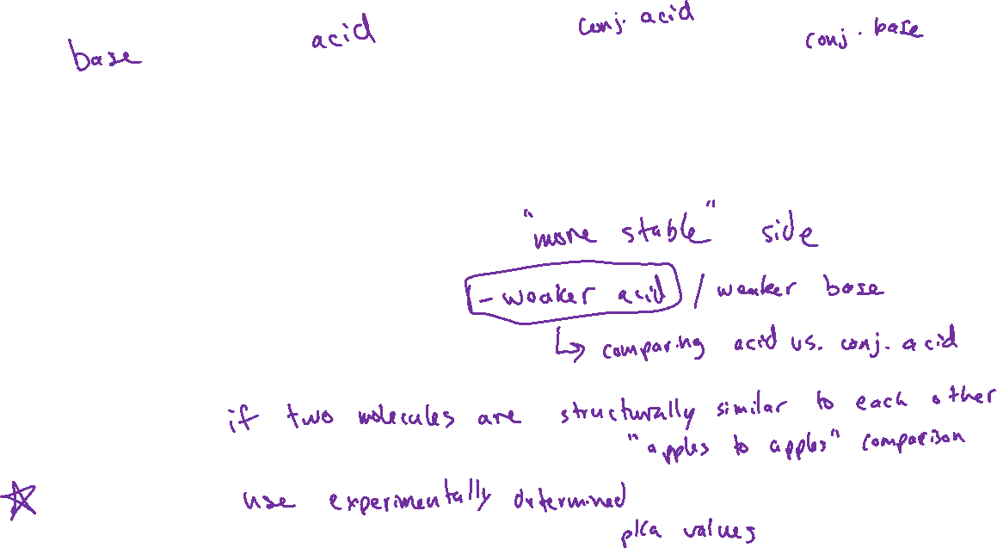
Acid-Base Reactions (Ch. 3)
Which side is favored at equilibrium?
Two ways to approach…
Qualitative:
Quantitative:

Slide 3
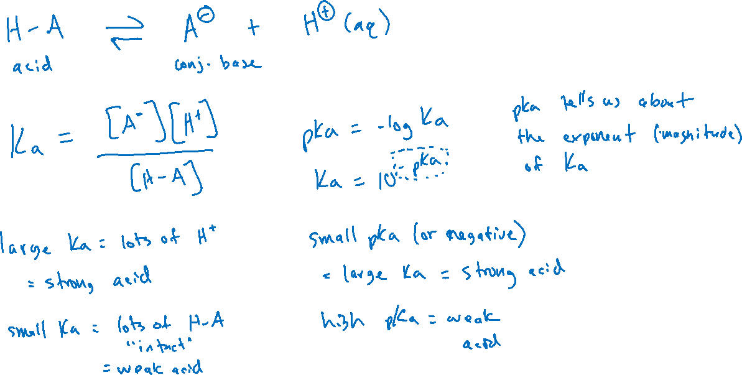
Quantifying Acid Strength

Slide 4
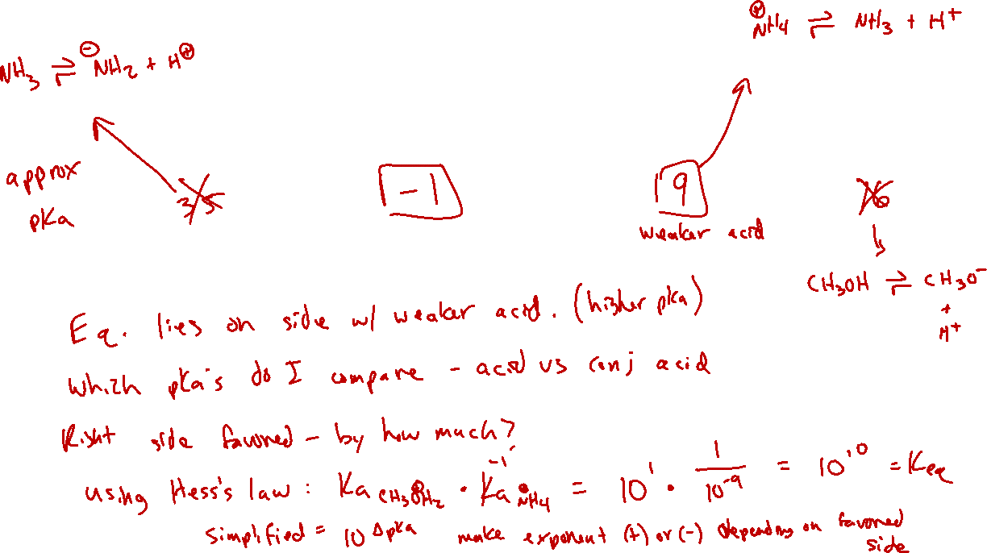
How to use pKa values (to predict an acid-base reaction)

Slide 5
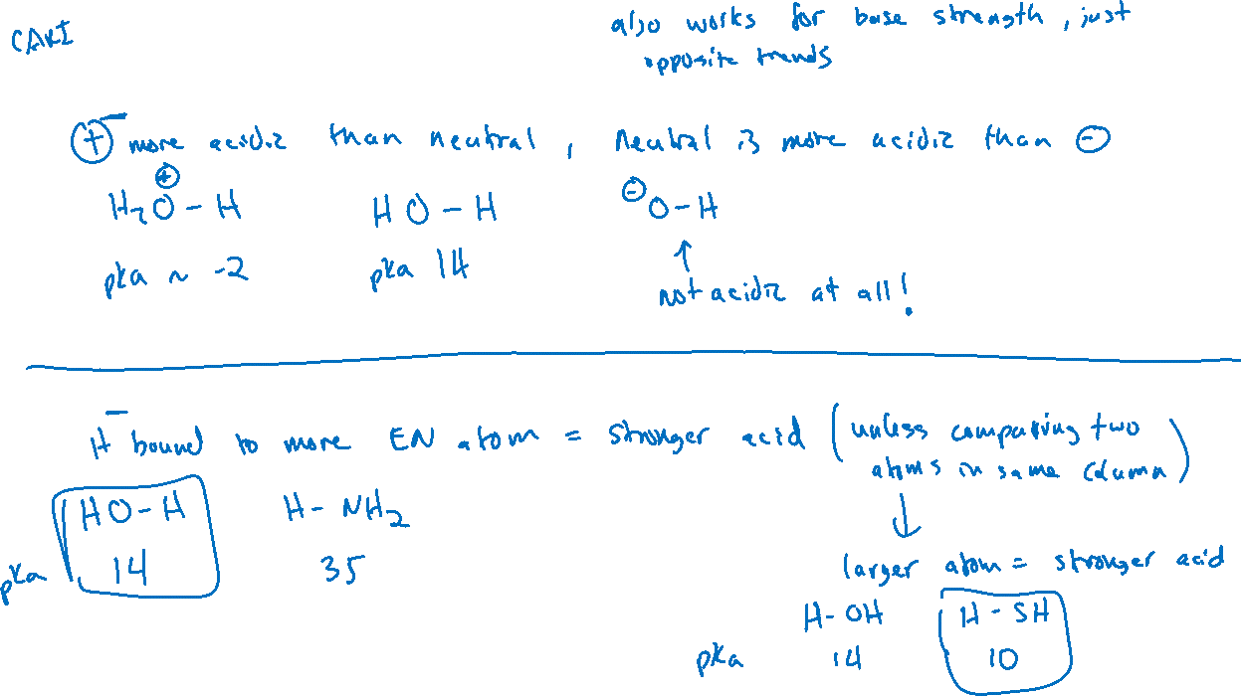
Comparing Acidity: Qualitatively
1. Charge of molecule
2. Atom bound to H

Slide 6
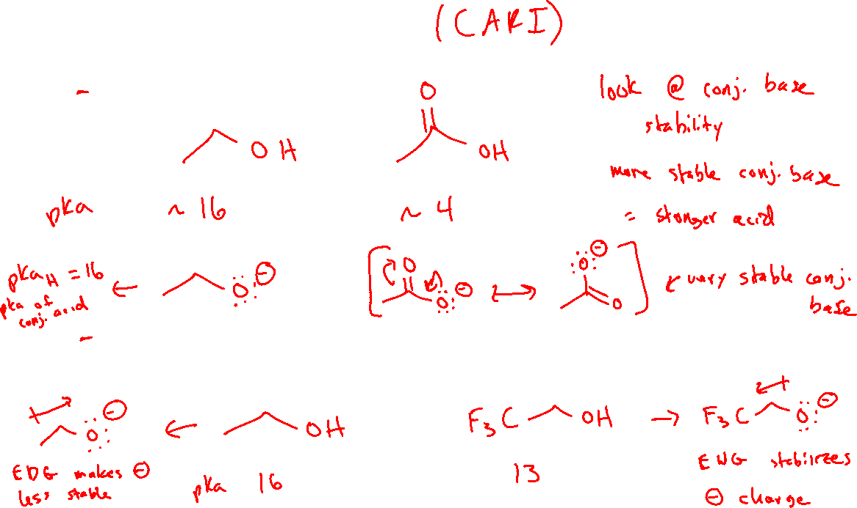
Comparing Acidity: Qualitatively
3. Resonance
4. Induction (e⁻ donating/withdrawing effects of nearby groups)

Slide 7
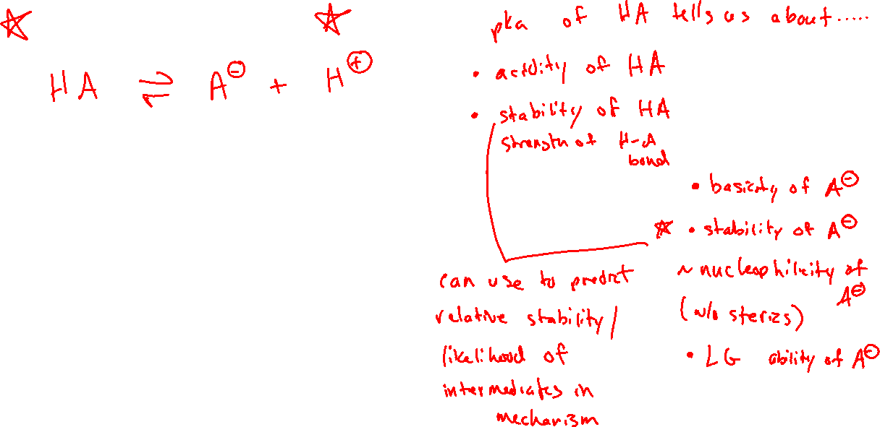
What a pKa can tell you

Slide 8



Acidity of C-H bonds

Slide 9











Ch 21: “Alpha Carbon” Chemistry

