Slide 1

Enols and Enolates
3/15/2023

Slide 2


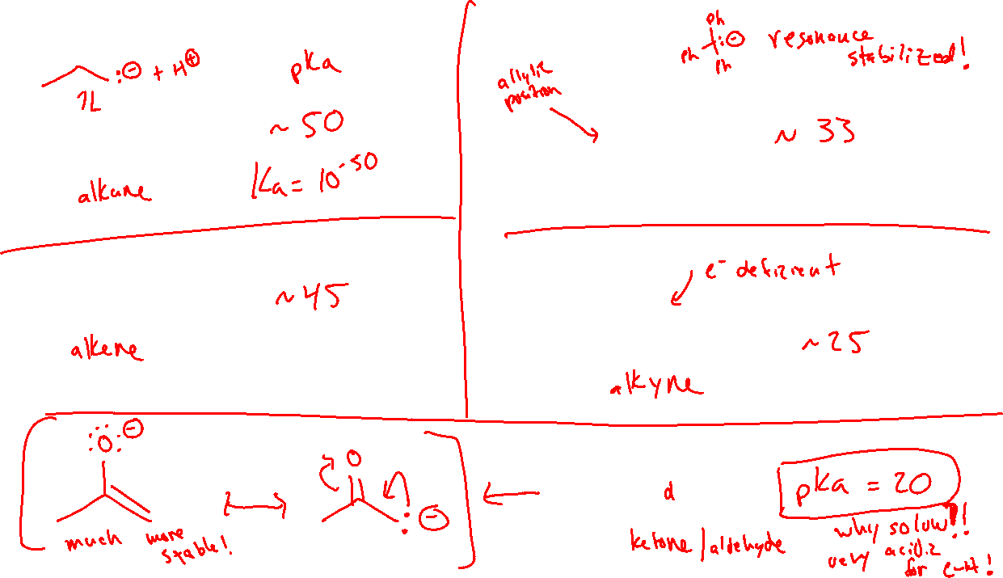

Acidity of C-H bonds

Slide 3









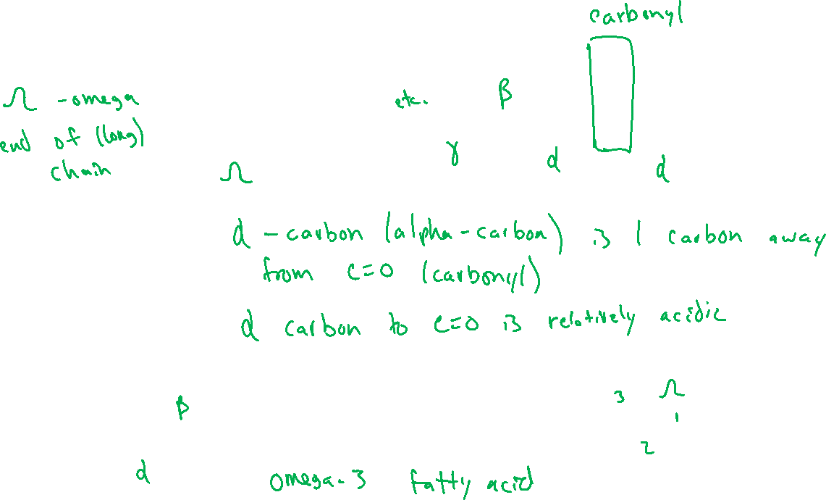

Ch 21: “Alpha Carbon” Chemistry

Slide 4
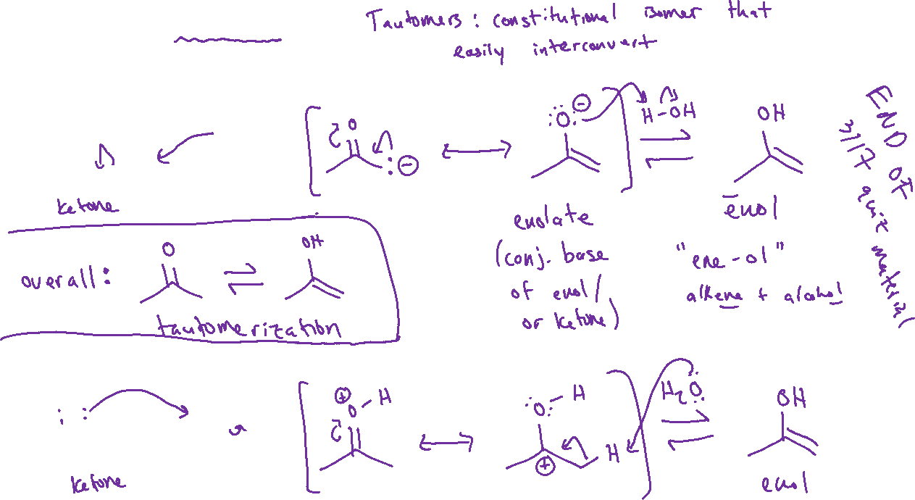

Keto-enol Tautomerism (21.1)
In basic conditions (base-catalyzed):
In acidic conditions (acid-catalyzed):

Slide 5
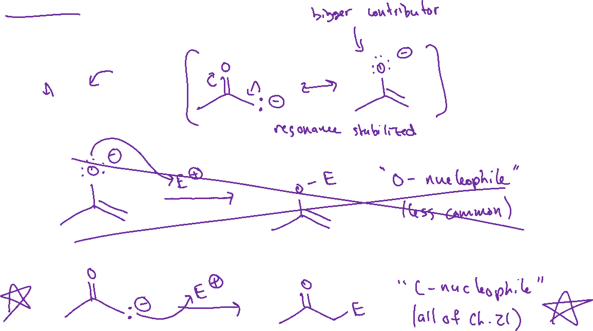
Enolates: Formation and Reactivity

Slide 6
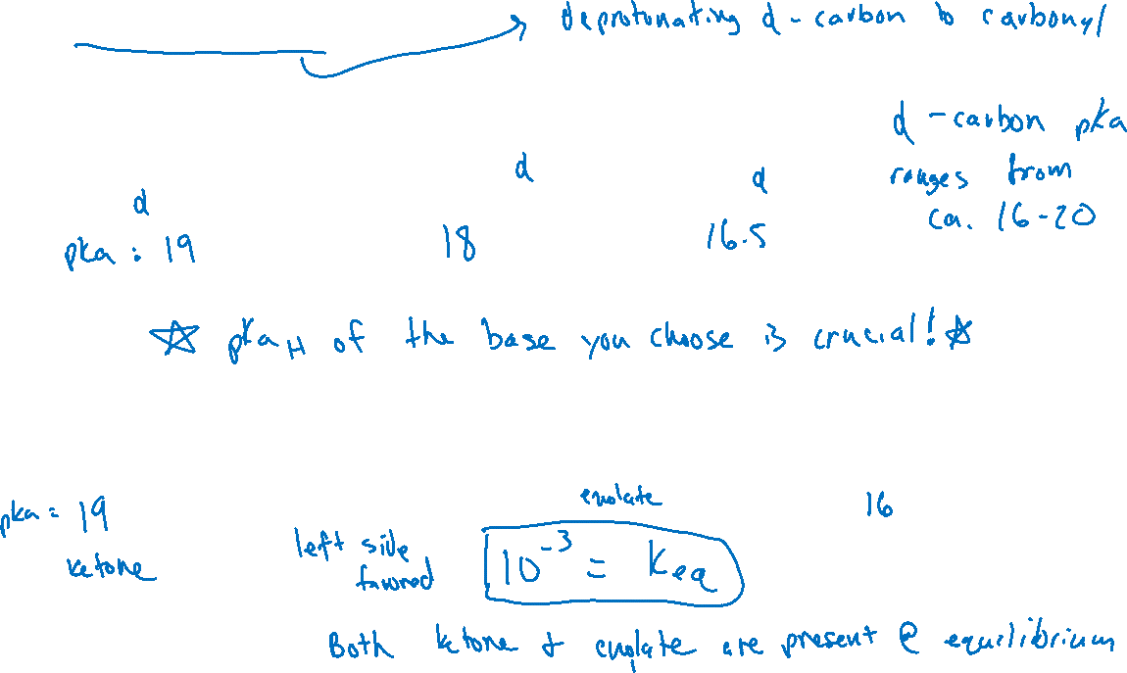


Forming Enolates Reversibly

Slide 7

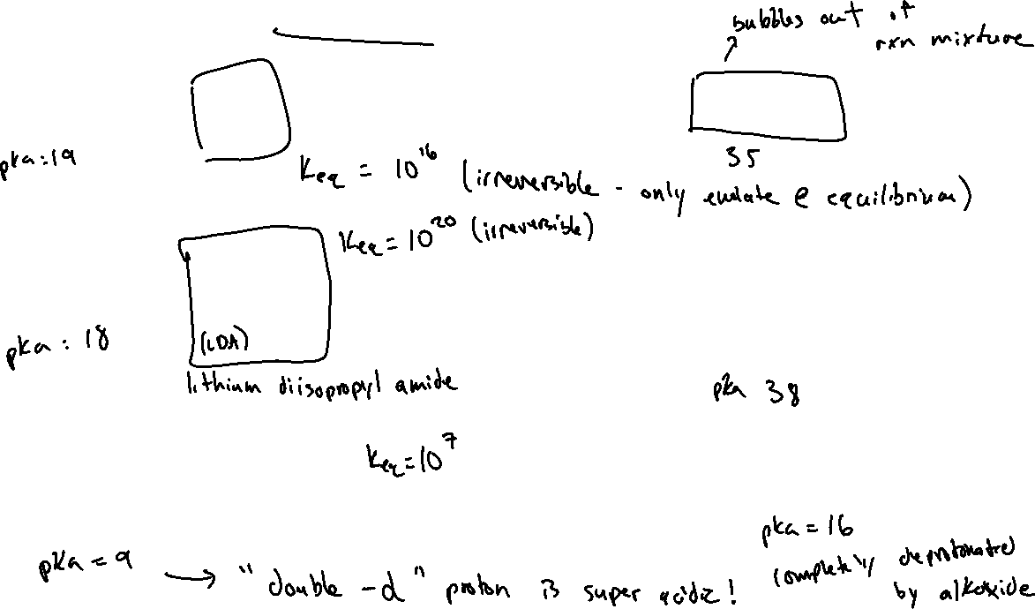



Forming Enolates Irreversibly

Slide 8

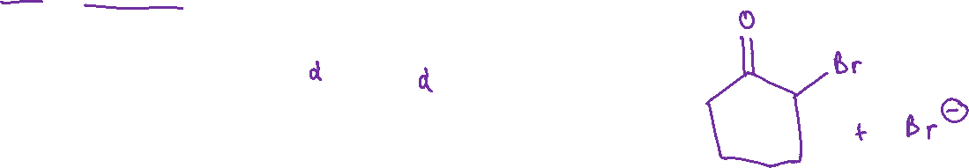


Alpha-halogenation (21.2)

