Slide 1
Alpha-halogenation
Aldol Reactions
3/17/2022

Slide 2

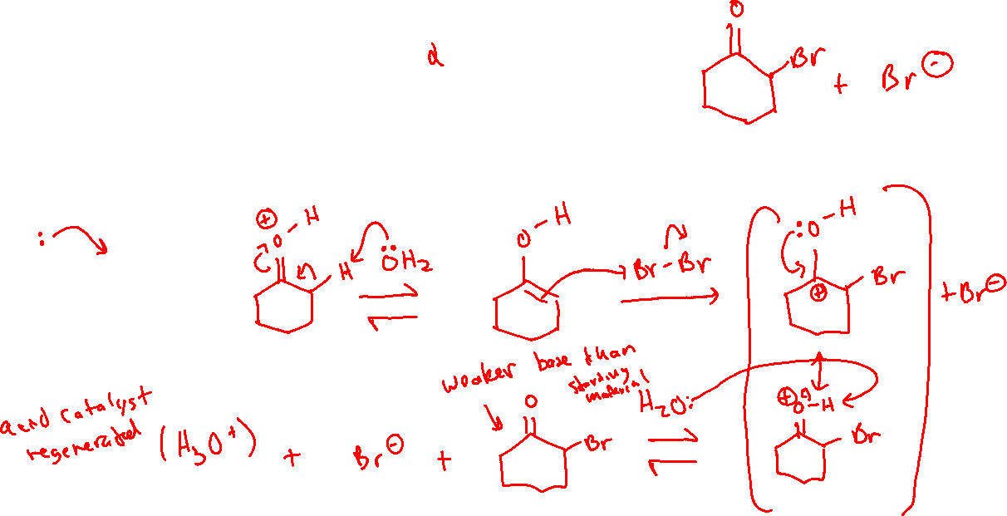


Alpha-halogenation: Acidic Conditions (21.2)

Slide 3

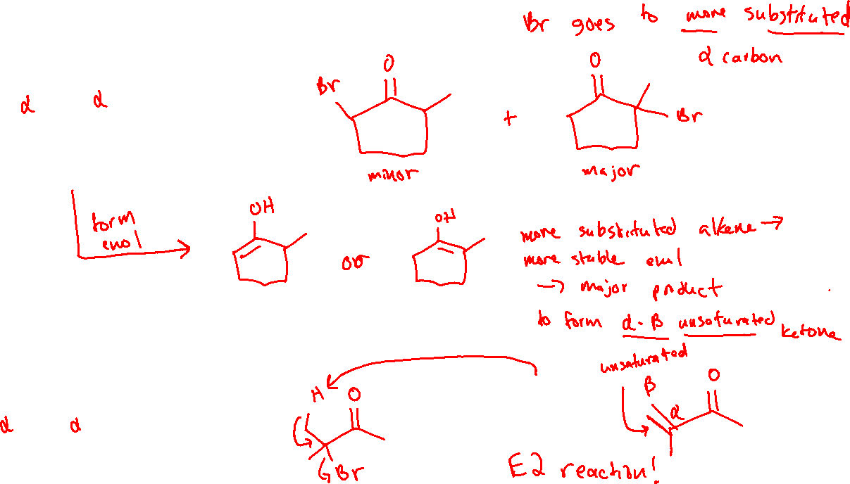
Alpha-halogenation: Regioselectivity

Slide 4
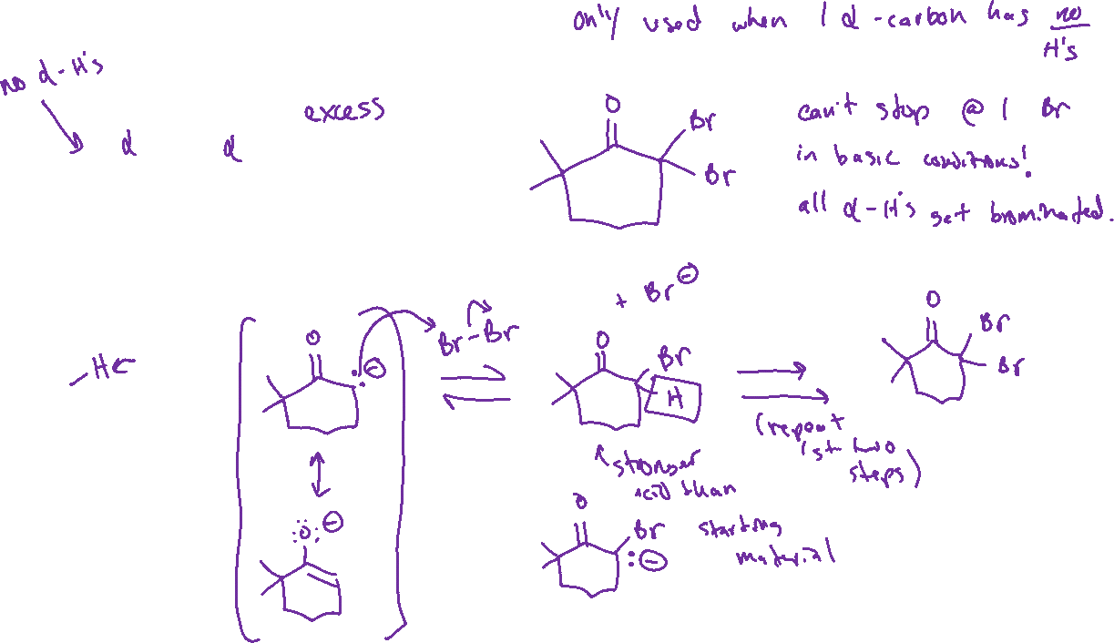


Alpha-halogenation: Basic Conditions

Slide 5

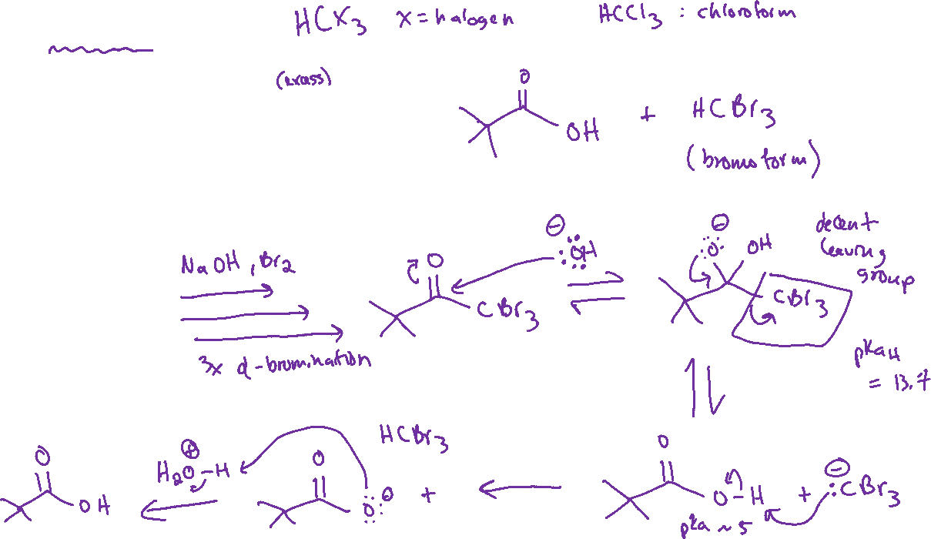
Haloform Reaction

Slide 6
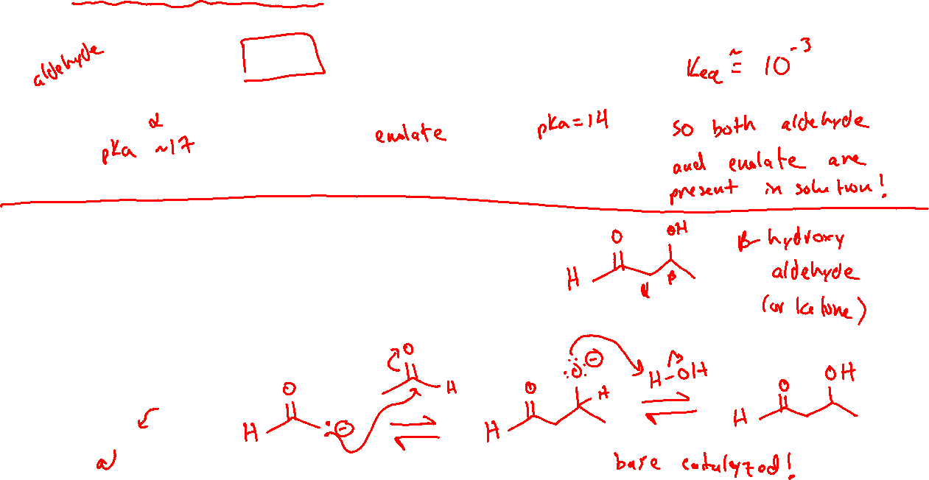
Reversibly Deprotonating Alpha-Carbons & the Aldol Reaction (20.3)

Slide 7


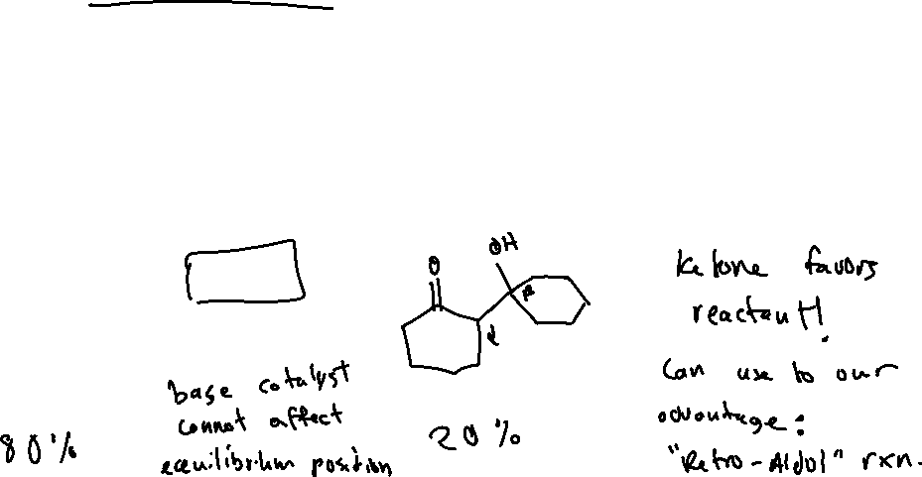


Aldol Reaction: Equilibrium Position & Retro-Aldol

Slide 8

Retro-Aldol: Mechanism

