Slide 1
More Aldol Reactions
3/20/2022

Slide 2


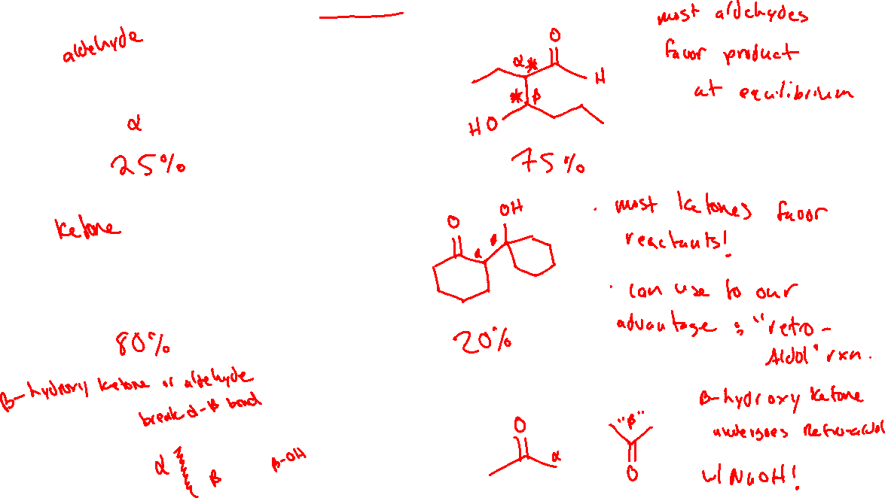


Aldol Reaction: Equilibrium Position & Retro-Aldol

Slide 3

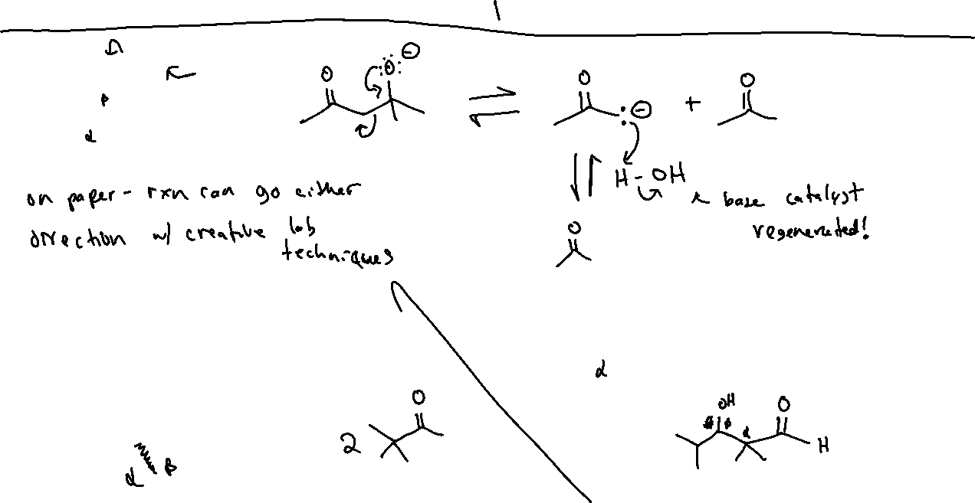
Retro-Aldol: Mechanism

Slide 4

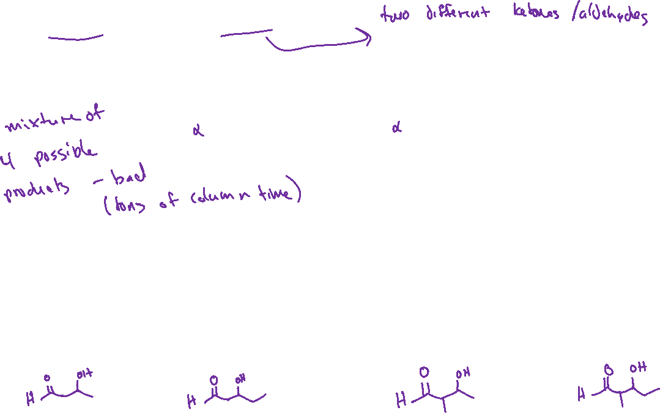

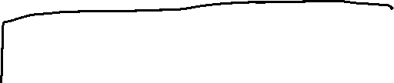
“Crossed” Aldol (or “mixed” Aldol)

Slide 5
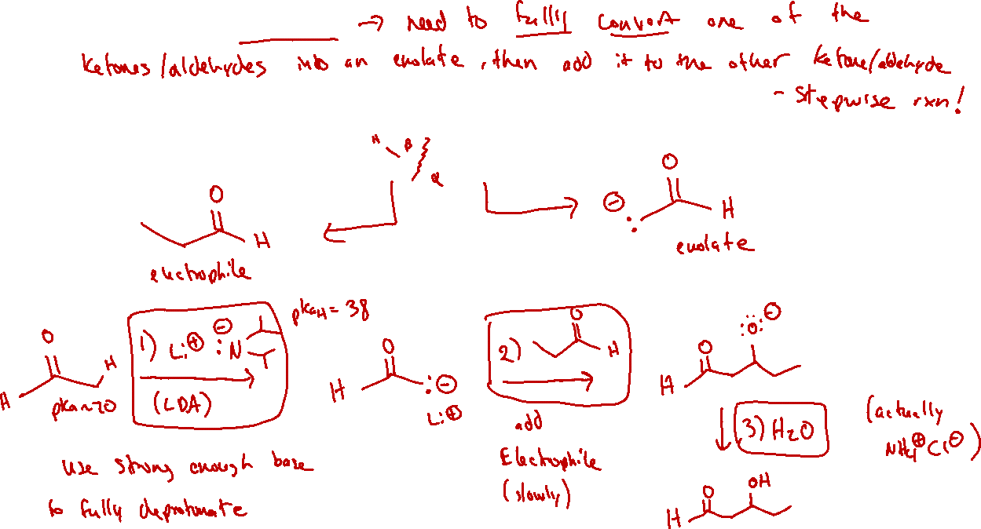
Crossed Aldol: Strategy

