Slide 1
Aldol and Claisen Condensations
3/22/2022

Slide 2
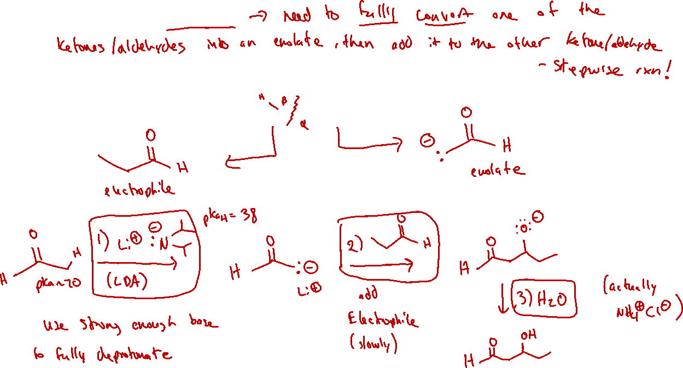

Crossed Aldol: Strategy

Slide 3
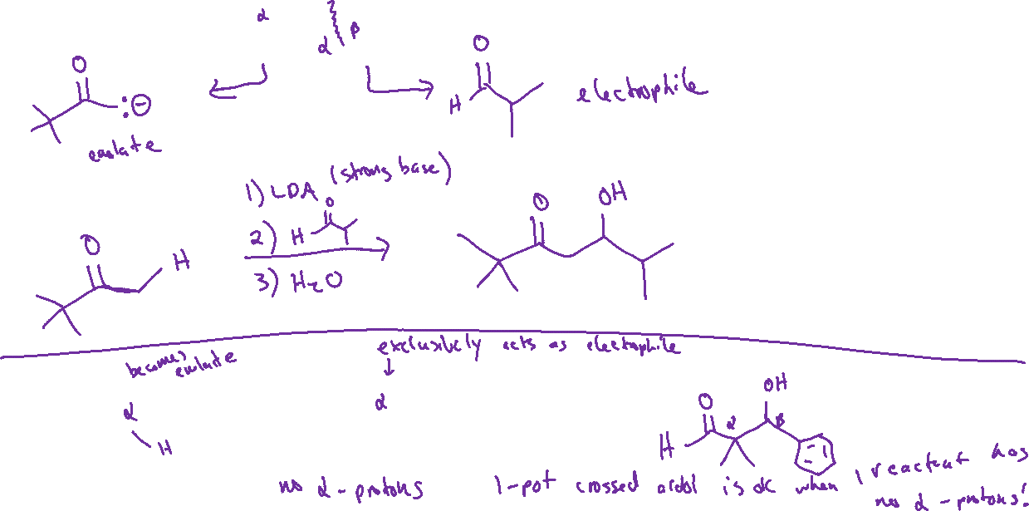

Crossed Aldol: Examples

Slide 4

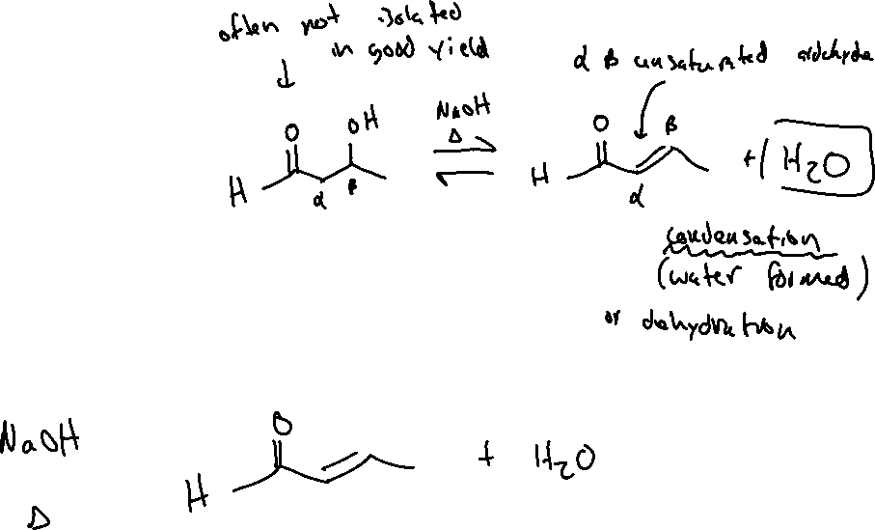


Aldol Condensation

Slide 5
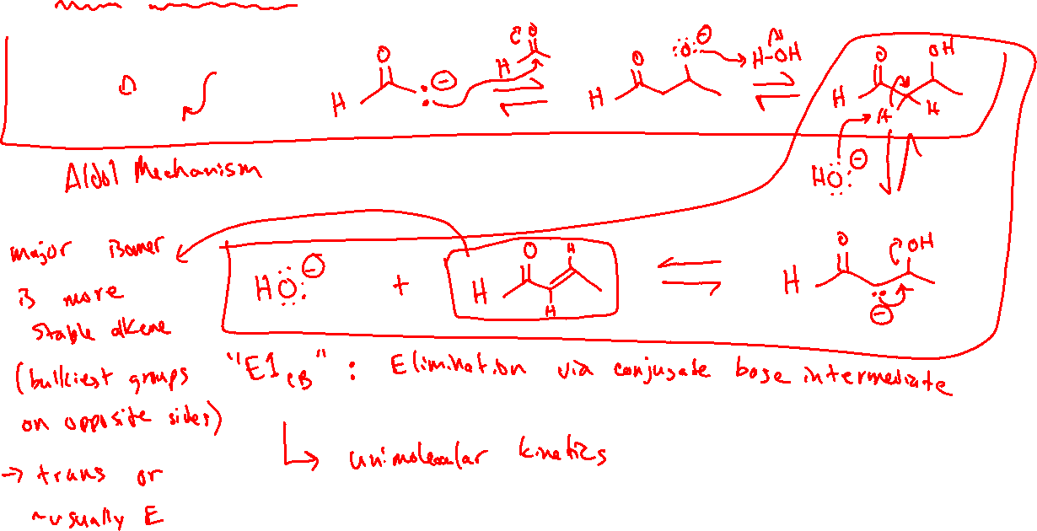
Aldol Condensation: Mechanism and Stereochemistry

Slide 6
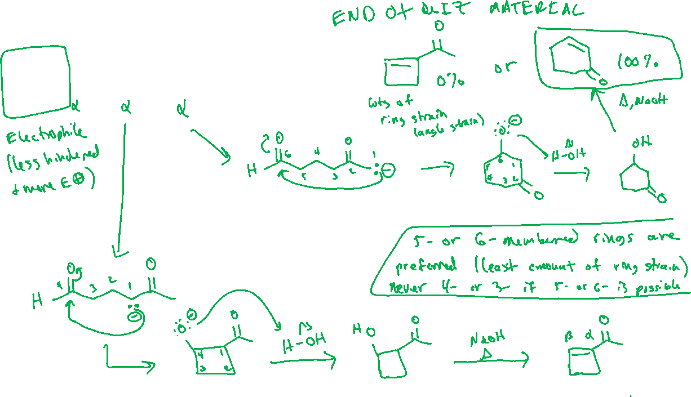
Intramolecular Aldol Condensation (21.3)

Slide 7
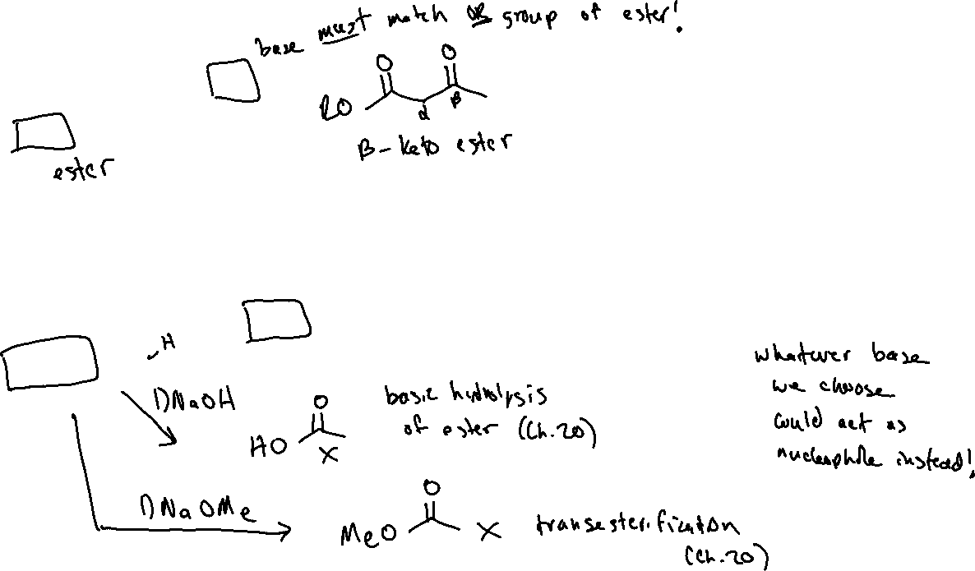

Claisen Condensation (21.4)

