Slide 1
Aldol and Claisen Condensations
3/22/2022

Slide 2
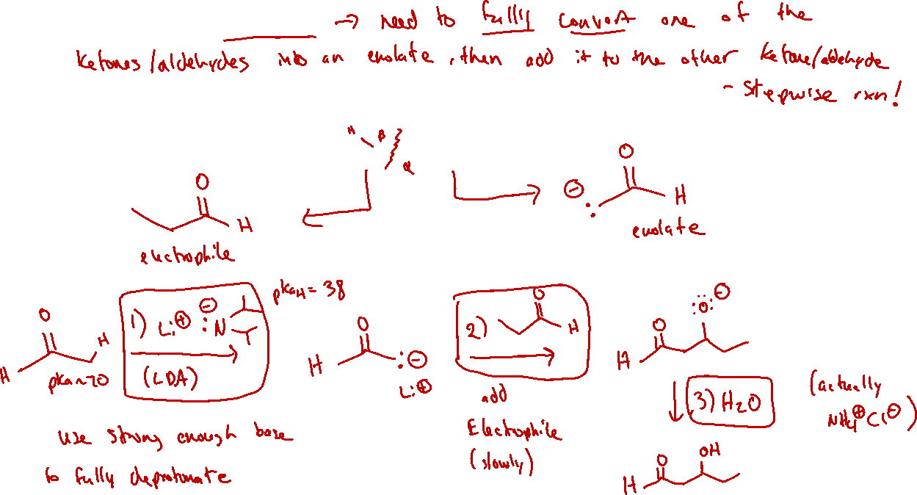
Crossed Aldol: Strategy

Slide 3

Crossed Aldol: Examples

Slide 4



Aldol Condensation

Slide 5
Aldol Condensation: Mechanism and Stereochemistry

Slide 6
Intramolecular Aldol Condensation (21.3)

Slide 7

Claisen Condensation (21.4)

Slide 8
Claisen Condensation: Mechanism

Slide 9


Crossed Claisen (or mixed Claisen)

