Slide 1
Aldol and Claisen Condensations
3/22/2022

Slide 2
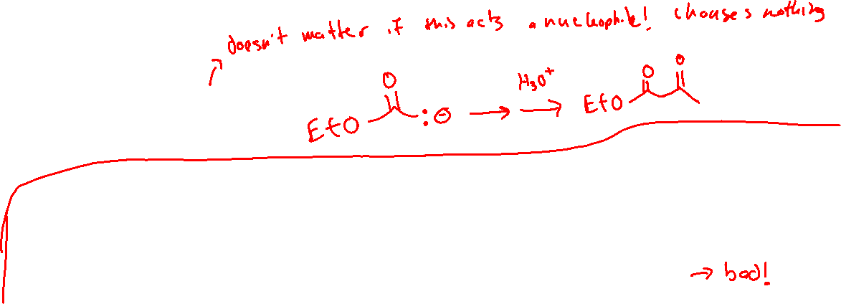
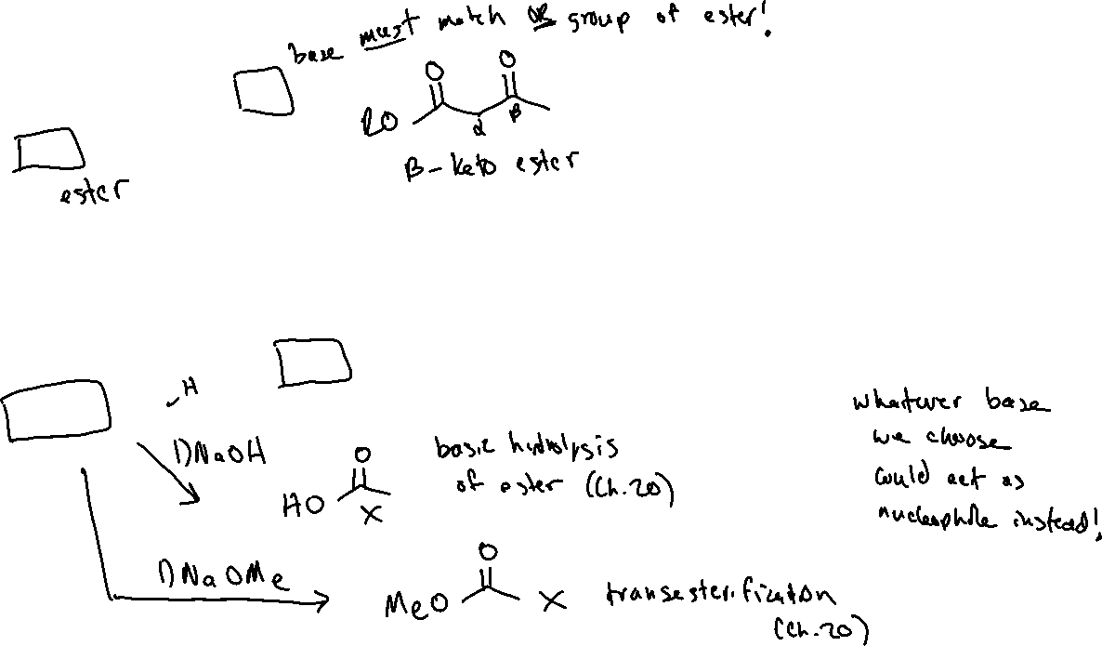

Claisen Condensation (21.4)

Slide 3
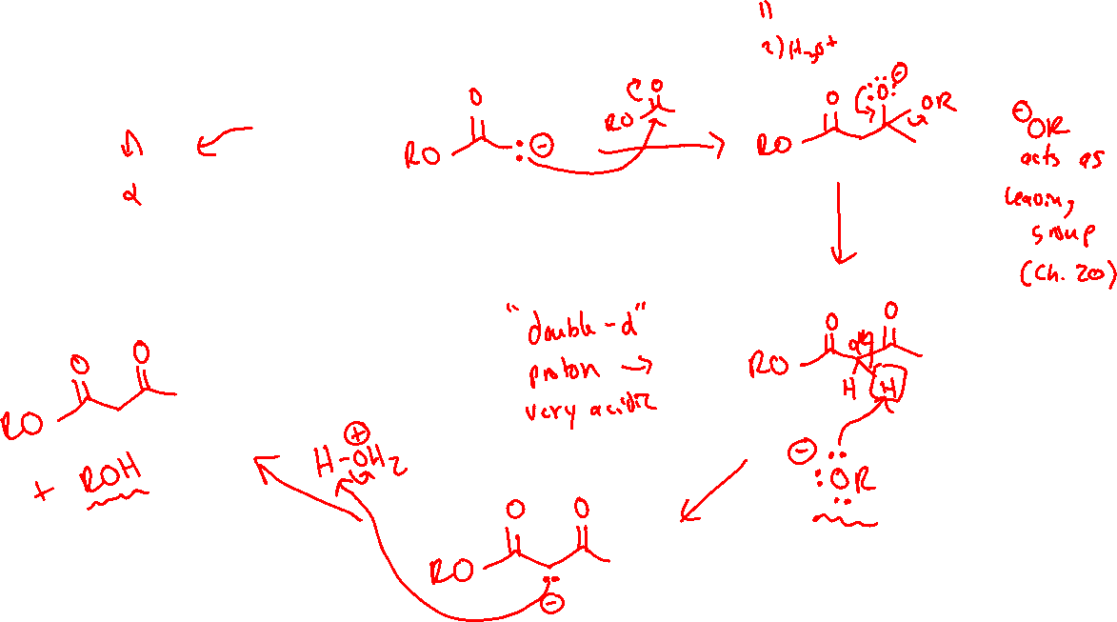
Claisen Condensation: Mechanism

Slide 4
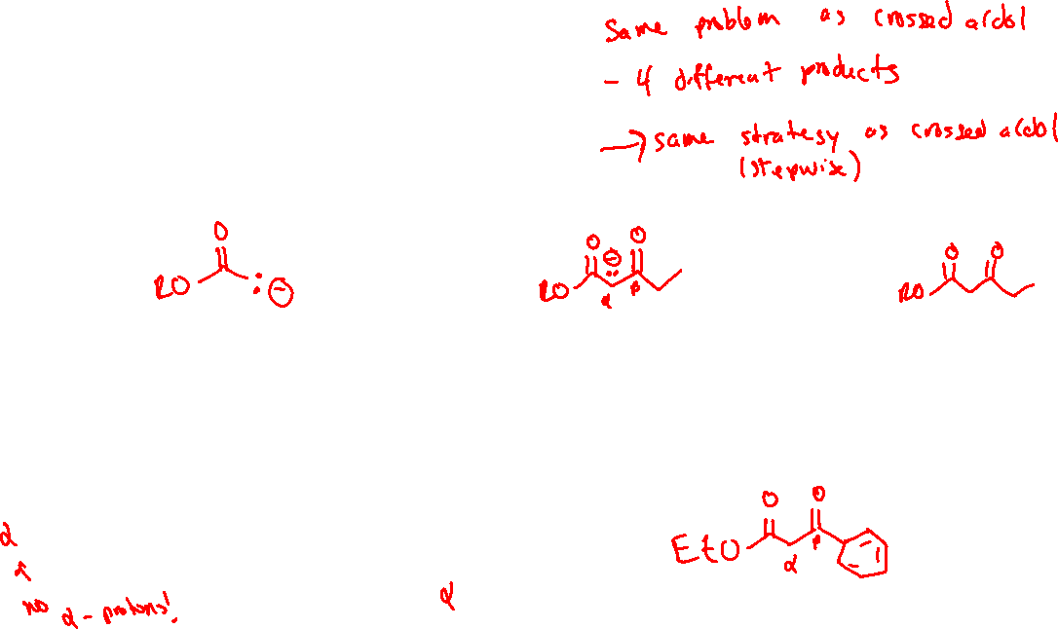


Crossed Claisen (or mixed Claisen)

Slide 5
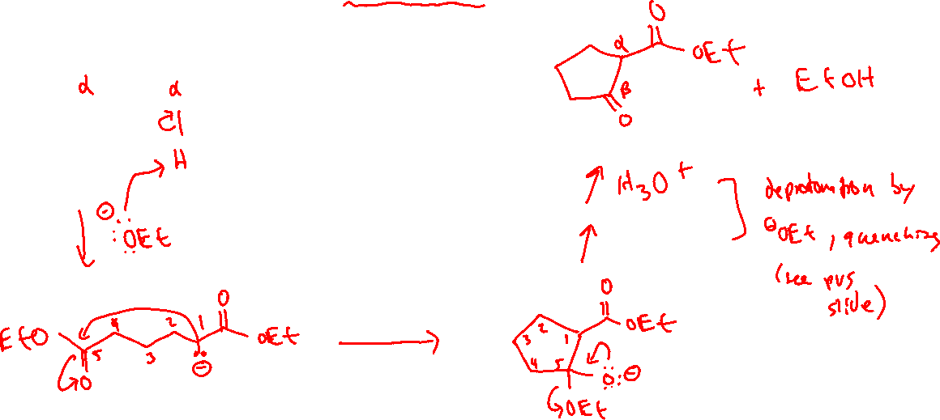
Intramolecular Claisen – “Dieckmann Cyclization”

Slide 6


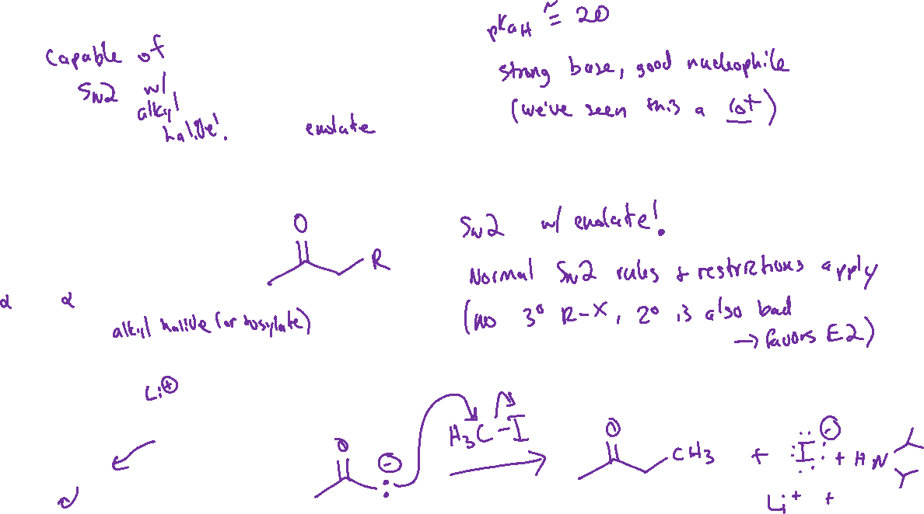

Alpha-Alkylation of Enolates (21.5)

Slide 7
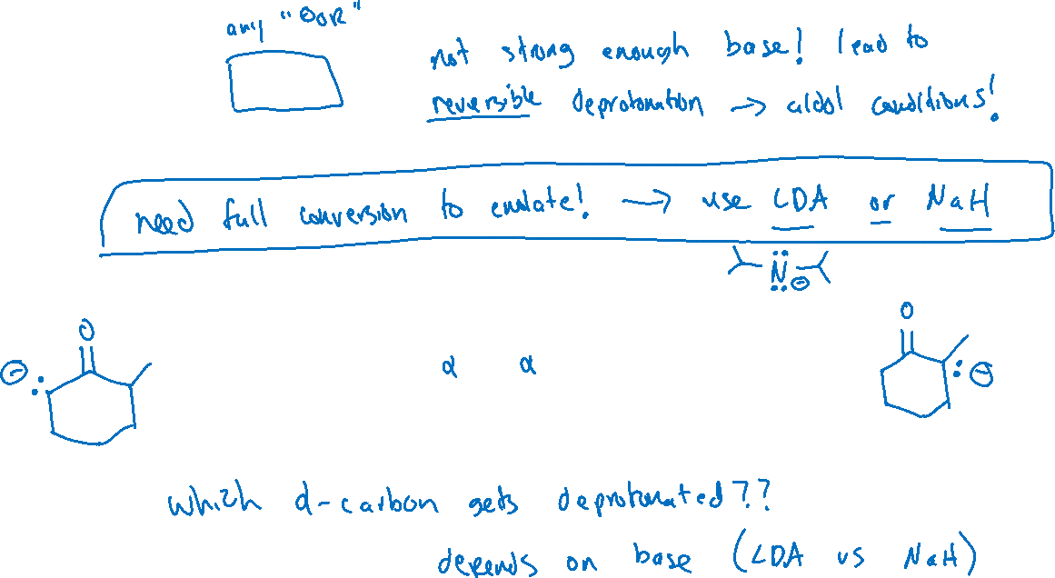

Alpha-Alkylation: Choosing a Base

Slide 8
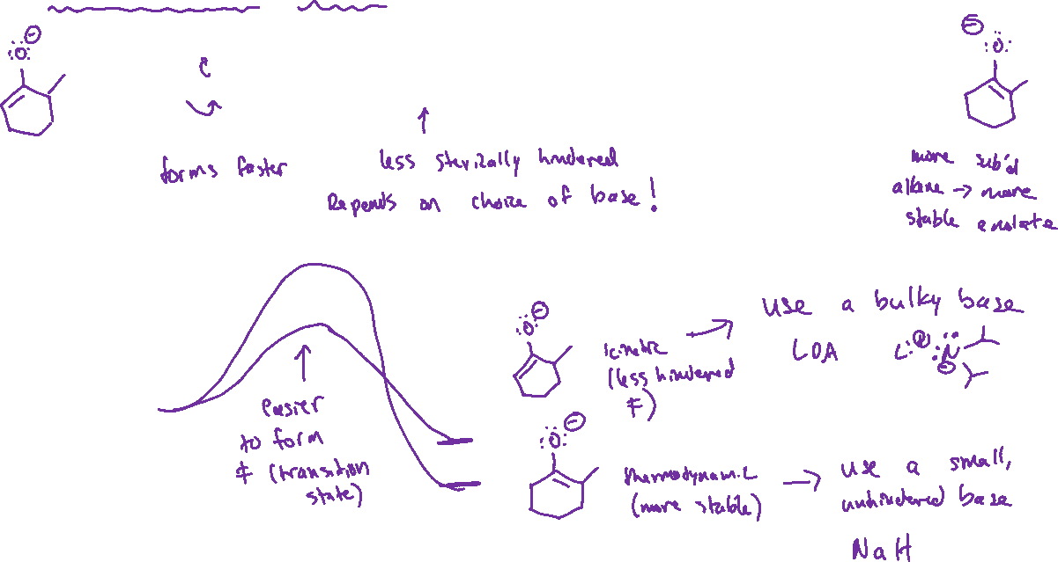





Thermodynamic vs Kinetic Enolate: Choosing the right base

Slide 9



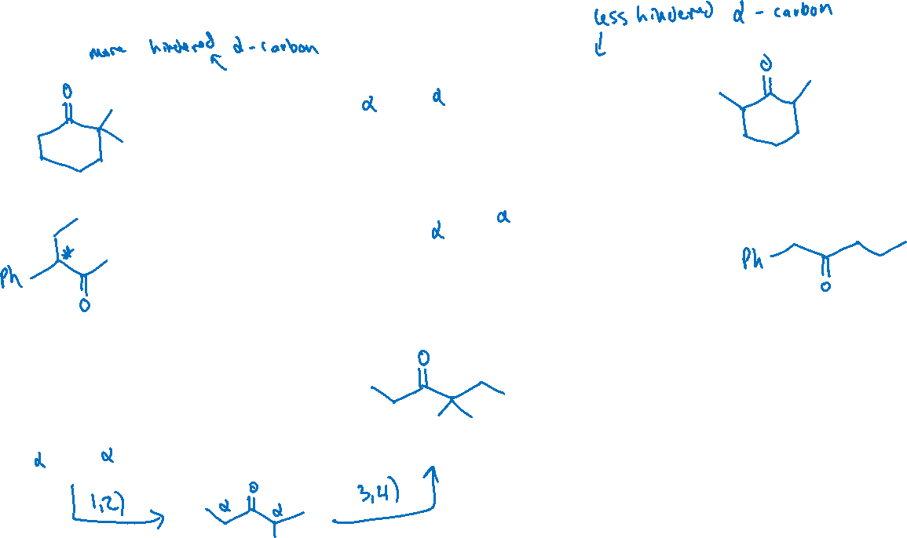
Thermodynamic vs Kinetic Enolate: Examples

