Slide 1
Aldol and Claisen Condensations
3/22/2022

Slide 2
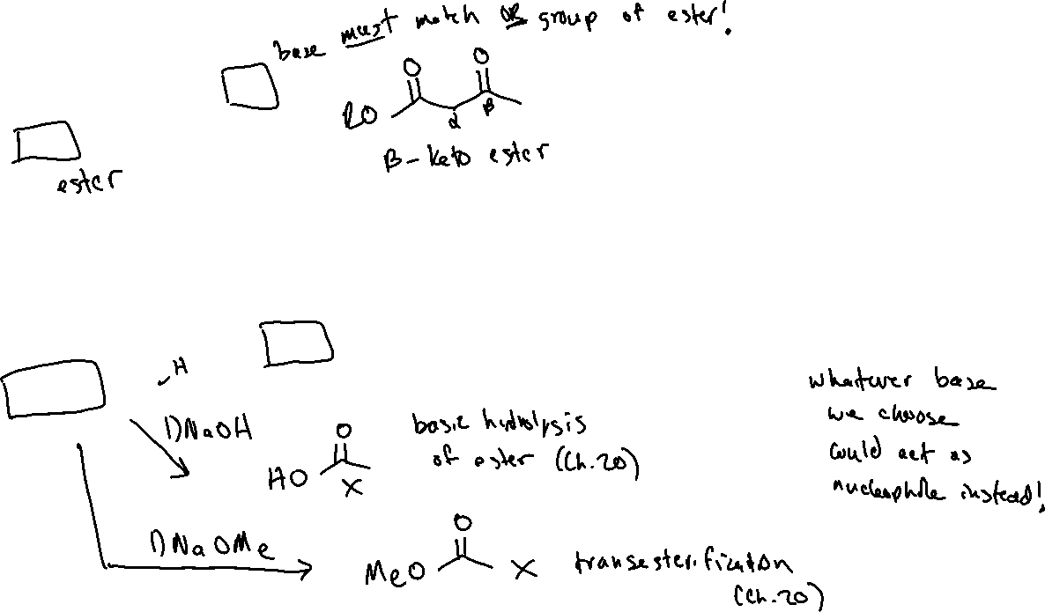

Claisen Condensation (21.4)

Slide 3
Claisen Condensation: Mechanism

Slide 4


Crossed Claisen (or mixed Claisen)

Slide 5
Intramolecular Claisen – “Dieckmann Cyclization”

Slide 6



Alpha-Alkylation of Enolates (21.5)

Slide 7

Alpha-Alkylation: Choosing a Base

Slide 8





Thermodynamic vs Kinetic Enolate: Choosing the right base

Slide 9



Thermodynamic vs Kinetic Enolate: Examples

