Slide 1

More Alpha-alkylation:
Malonic Ester Synthesis
Acetoacetic Ester Synthesis
3/27/2022

Slide 2
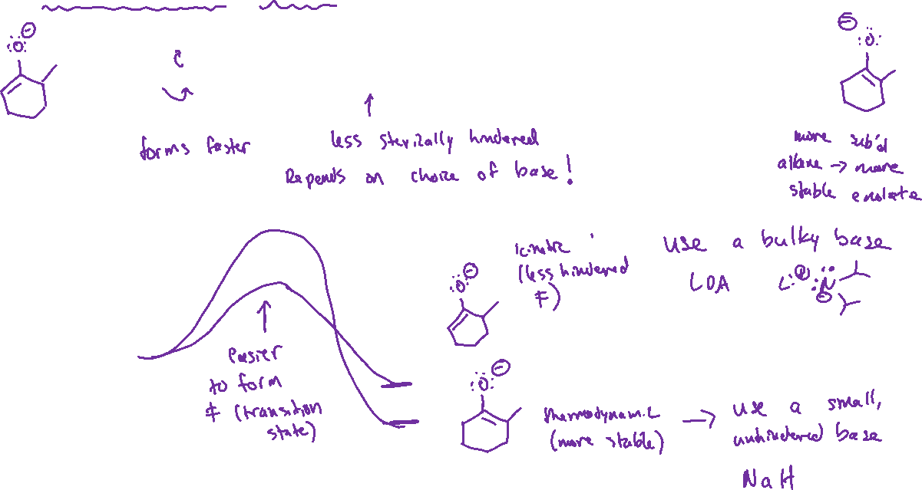






Thermodynamic vs Kinetic Enolate: Choosing the right base

Slide 3


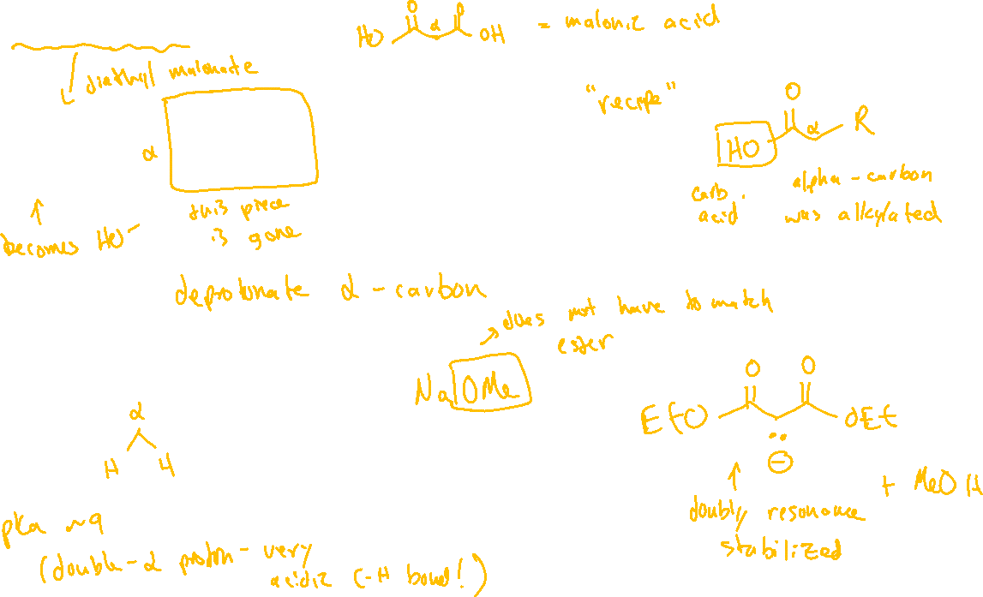

Malonic Ester Synthesis (20.5)

Slide 4
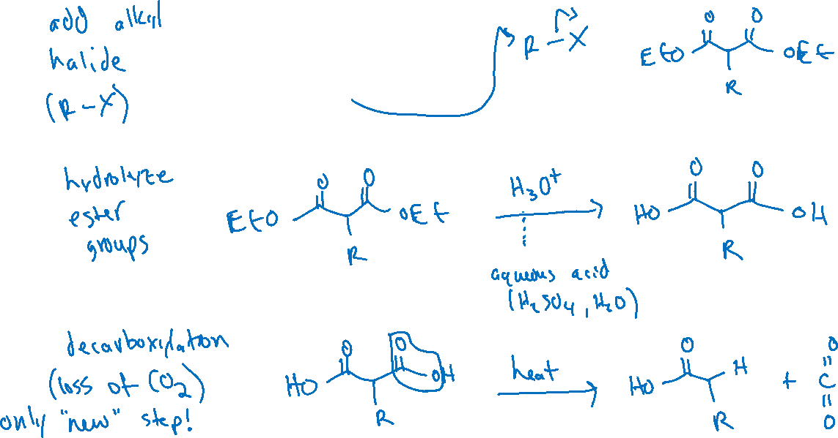

Malonic Ester Synthesis, continued

Slide 5

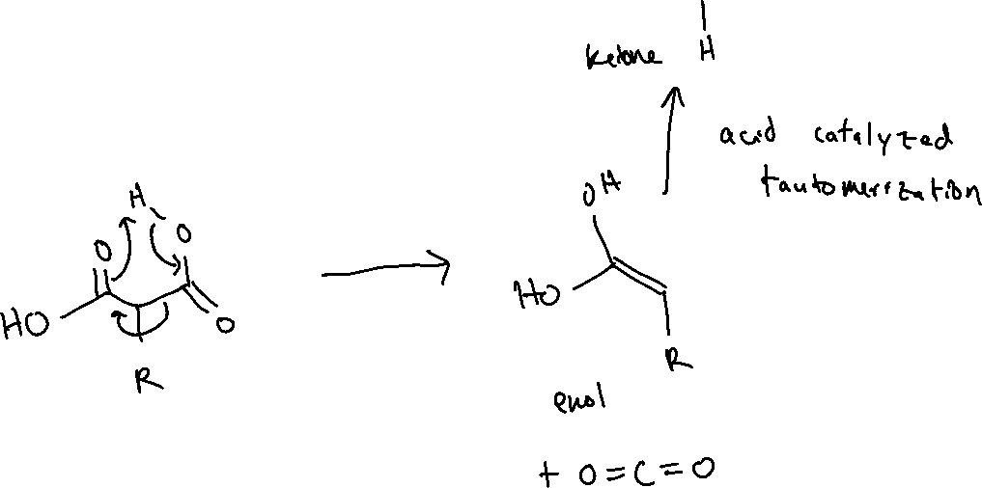

Decarboxylation: Mechanism

Slide 6
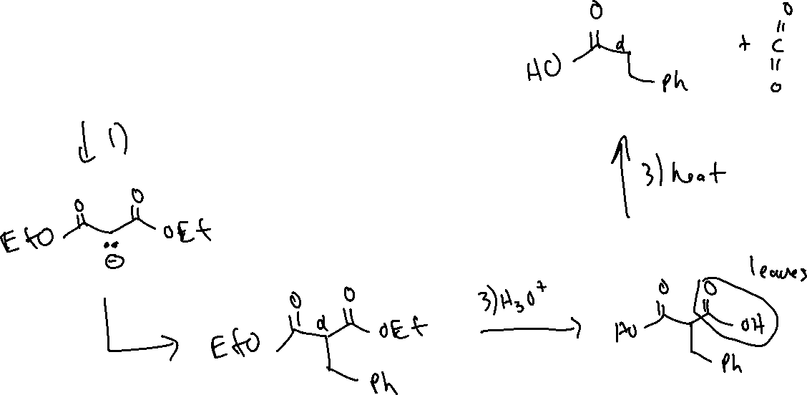
Malonic Ester Synthesis: Putting the Steps Together

Slide 7

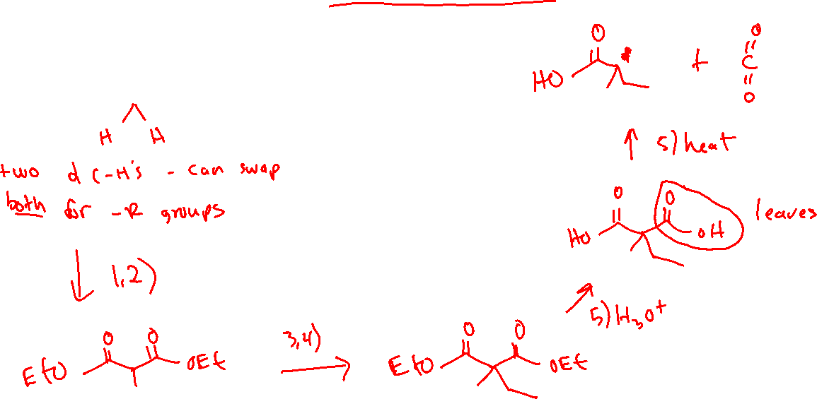
Malonic Ester Synthesis with Two Alpha-Alkylations

Slide 8
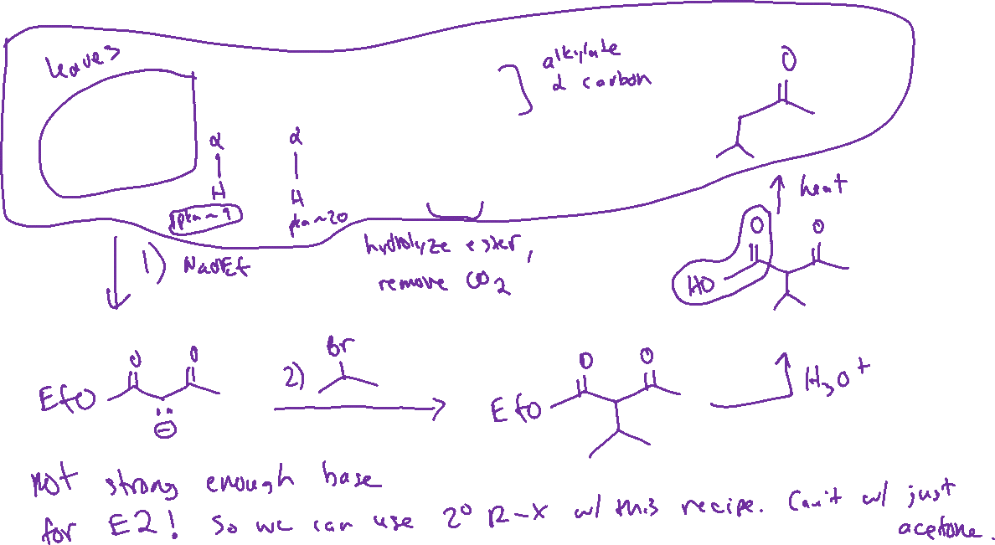

Acetoacetic Ester Synthesis

Slide 9
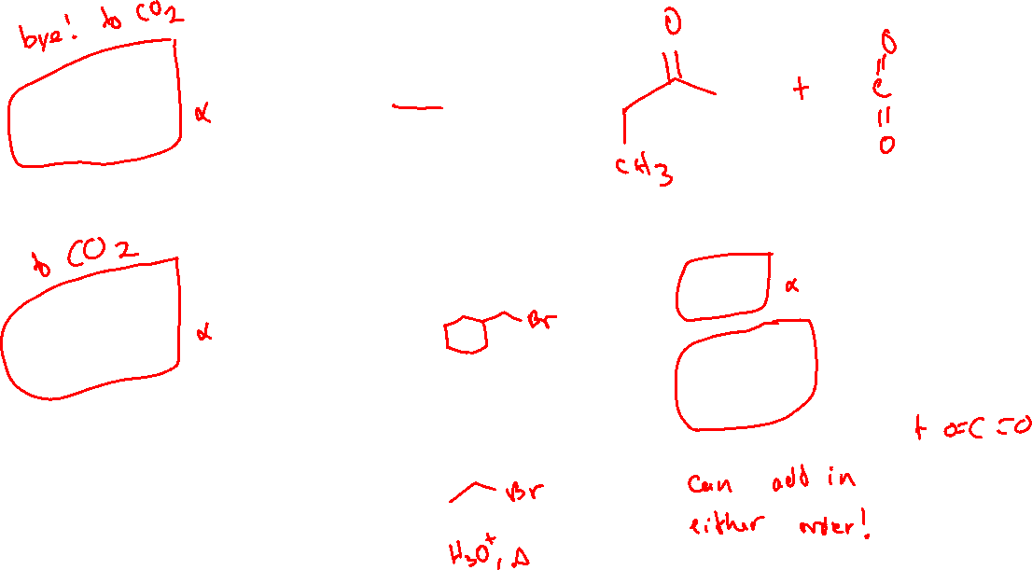


Acetoacetic Ester Synthesis: Examples

