Slide 1
More Alpha-alkylation:
Malonic Ester Synthesis
Acetoacetic Ester Synthesis
3/27/2022

Slide 2
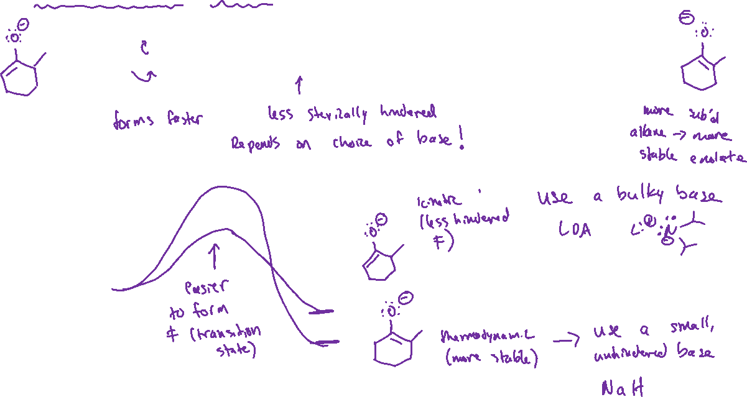





Thermodynamic vs Kinetic Enolate: Choosing the right base

Slide 3



Malonic Ester Synthesis (20.5)

Slide 4

Malonic Ester Synthesis, continued

Slide 5


Decarboxylation: Mechanism

Slide 6
Malonic Ester Synthesis: Putting the Steps Together

Slide 7

Malonic Ester Synthesis with Two Alpha-Alkylations

Slide 8

Acetoacetic Ester Synthesis

Slide 9


Acetoacetic Ester Synthesis: Examples

