Slide 1

Conjugate Addition
Exam 2 Review
3/29/2023

Slide 2
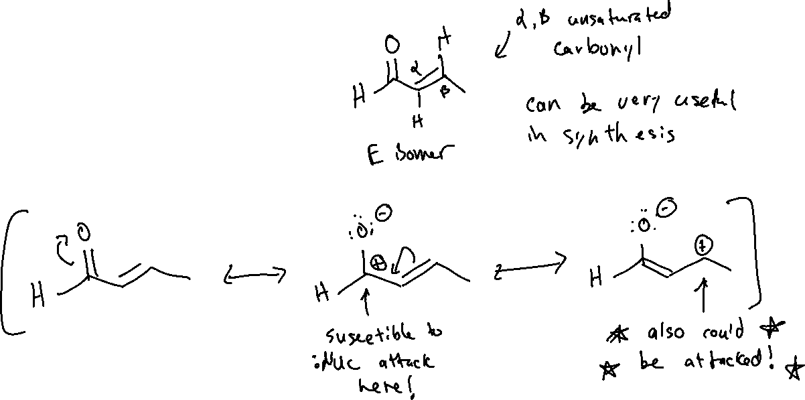

Conjugate Addition (21.6)

Slide 3

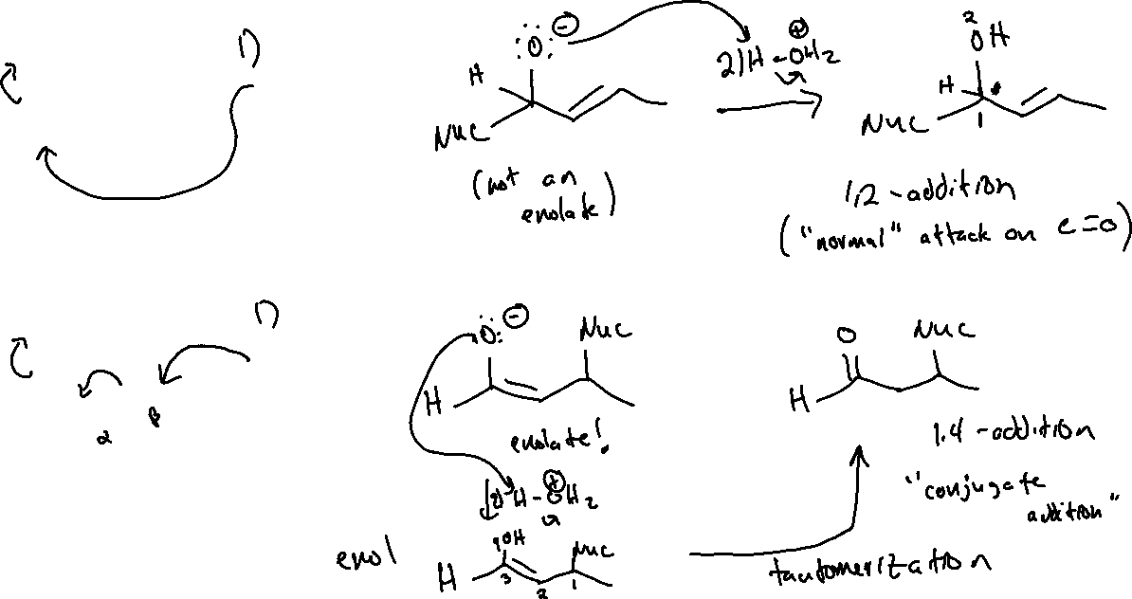
1,2- vs 1,4-addition

Slide 4
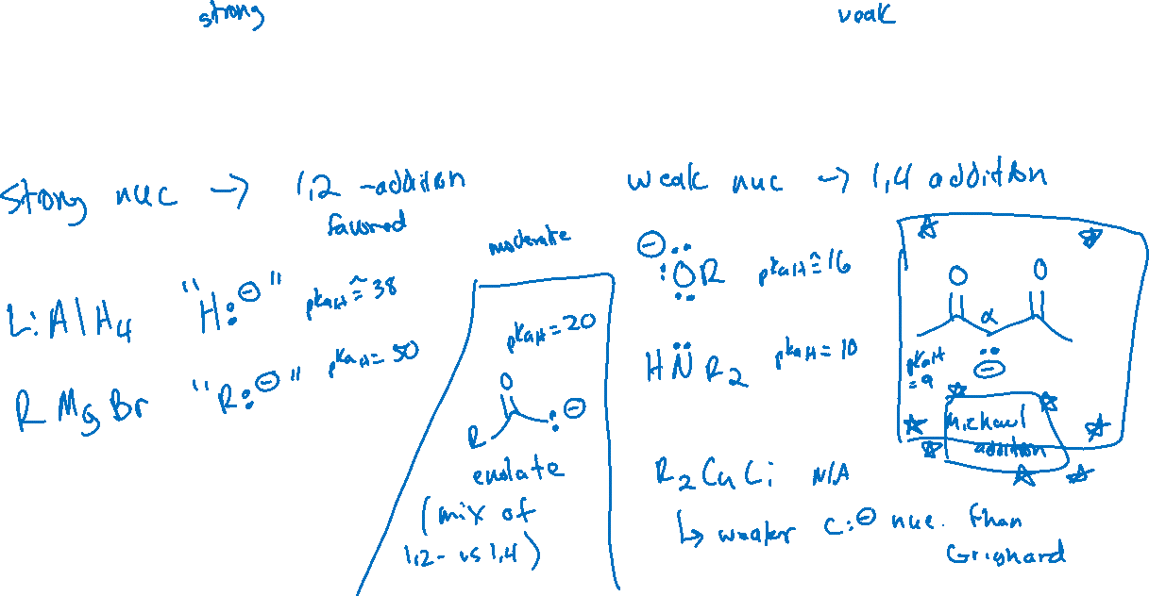
1,2- vs 1,4-addition: Strength of Nucleophiles and Regioselectivity

Slide 5
Ch 19: Wittig Reaction
Overall reaction/recipe
Stereochemistry (E vs Z) and dependence on ylide structure
Reduction (Hydride transfer) & reaction of Grignard reagents with aldehydes and ketones may be relevant!

Slide 6

Ch 20: Carboxylic Acid Derivatives
Synthesis of carboxylic acids (including oxidation of alcohols, hydrolysis of nitriles, & haloform reaction)
Acyl transfer reaction mechanisms (general)
  Neutral nucleophile + weak acid
  Neutral nucleophile + weak base
  Anionic nucleophile
  I will not ask about any of the “weird” mechanisms with carboxylic acids – (BH₃-THF, LiAlH₄, and SOCl₂)
Synthesis of Esters (via Sn2, Fischer Esterification, alcoholysis)
Synthesis of Acid Chlorides
Synthesis of Anhydrides
Reactions of Acid Chlorides/Acid Chlorides (react in the same way)
  Hydrolysis, alcoholysis, aminolysis

Slide 7
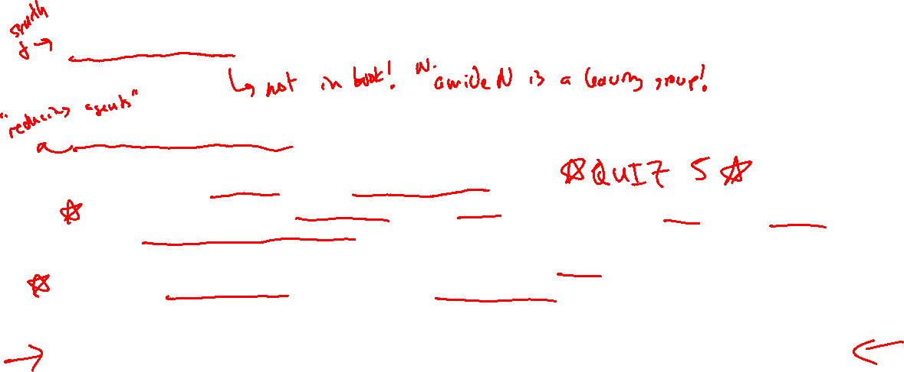
Ch 20: Carboxylic Acid Derivatives
Hydrolysis of Esters (acidic and basic conditions)
LeChatelier’s principle
Synthesis (ammonolysis of Acid Chloride/Anhydride) and hydrolysis of Amides
Weinreb Amides – reactions with hydride and carbon nucleophiles and difference vs regular Amide
Hydride transfer reagents with: Aldehyde/ketone, Amide, Weinreb Amide, Acid chloride/Anhydride, Ester, and Carboxylic Acid
  Know which F.G.’s use which reducing reagents
  Know the difference in outcomes for each F.G.! They don’t all have C=O become C-OH….
    Final slide of 3/1 handout (Friday before spring break)
Grignard and Gilman reagents with all of the above F.G.’s
  Except Carboxylic Acids (why not?) and regular Amides
  Know the difference in outcomes! The F.G.’s don’t all react the same way!
I will not count off for leaving out the quenching step “ 2)H₃O⁺ “ only if it doesn’t actually show up in the mechanism (i.e. with a Gilman reagent)

Slide 8

Ch 21: Alpha-carbon reactions (all mechanisms are fair game)
Using pKa table to compare acidity of various functional groups
Using pKa table to predict K_{eq} of an acid-base reaction
Comparing acidity: qualitatively
Keto-enol tautomerism (acidic and basic conditions)
Alpha-halogenation (acidic and basic conditions)
  Regioselectivity under acidic conditions
  E2 reaction of mono-halogenated product from acidic conditions
  Difference in outcomes acidic vs basic mechanism (and why)
  Haloform reaction & mechanism
Acidity of alpha-carbons (and “double-alpha” protons between two C=O groups)

Slide 9
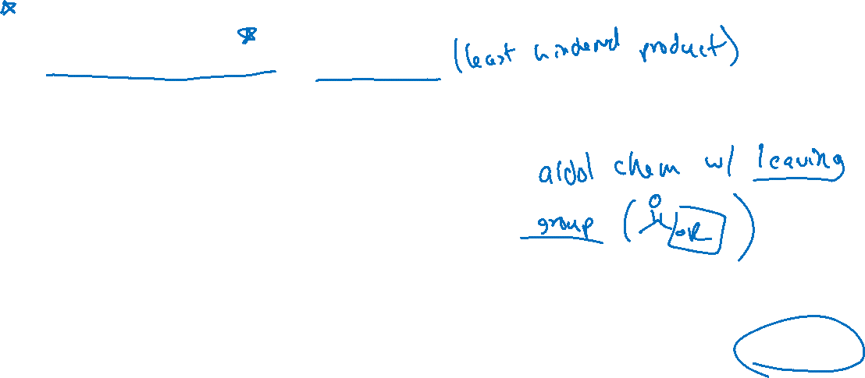
Ch 21: Alpha-carbon reactions (all mechanisms are fair game)
(“self”)-Aldol and retro-Aldol reactions
  Choice of base and why
Cross-Aldol reactions and mechanism
  Backtracking steps from product (who was enolate, who was electrophile etc)
  Choice of base and why
Aldol condensation reaction and stereochem
Intramolecular Aldol
  Ring strain! 5- or 6- member rings are the least strained
Claisen Condensation – all the same things as Aldol
  Reaction, mechanism, backtracking from product
  Choice of base and why
  Crossed-Claisen and Intramolecular Claisen
Alpha-alkylation
  Choice of base – regioselectivity and why
  Malonic Ester Synthesis and why we care about it (alpha-alkylated carboxylic acid)
  Acetoacetic ester synthesis and why we care about it (alpha-alkylated acetone but with 2º R-X)

Slide 10
Exam Format
A bunch of fill-in-the-blank reaction schemes
1-2 Flawed Synthesis
2-3 Mechanisms* (see previous slides)
Guided and less-guided synthesis
  No fully “open ended” synthesis – closest I would give to that is like the practice exam question
Random assorted conceptual things
Approx 5-6 pages, designed to be completed in about 1 hr 20 minutes total.

