Slide 1

Conjugate Addition & Michael Addition
Diels Alder intro
4/3/2023

Slide 2
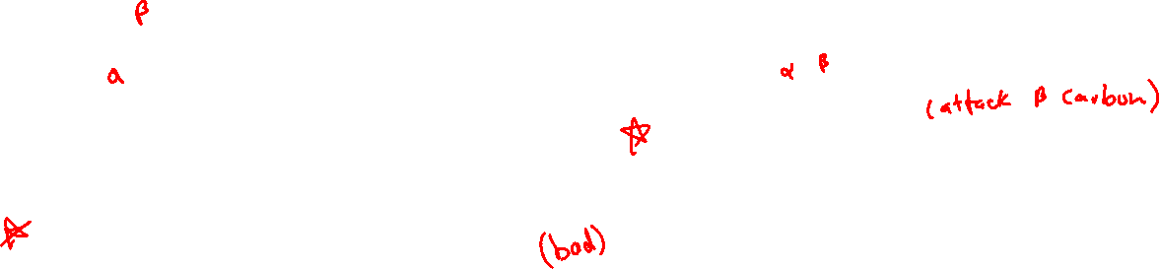
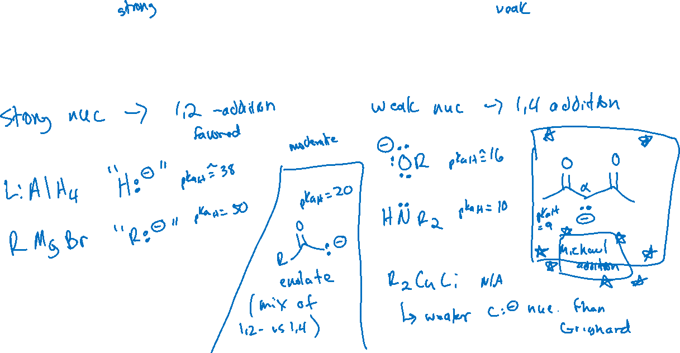
1,2- vs 1,4-addition: Strength of Nucleophiles and Regioselectivity

Slide 3

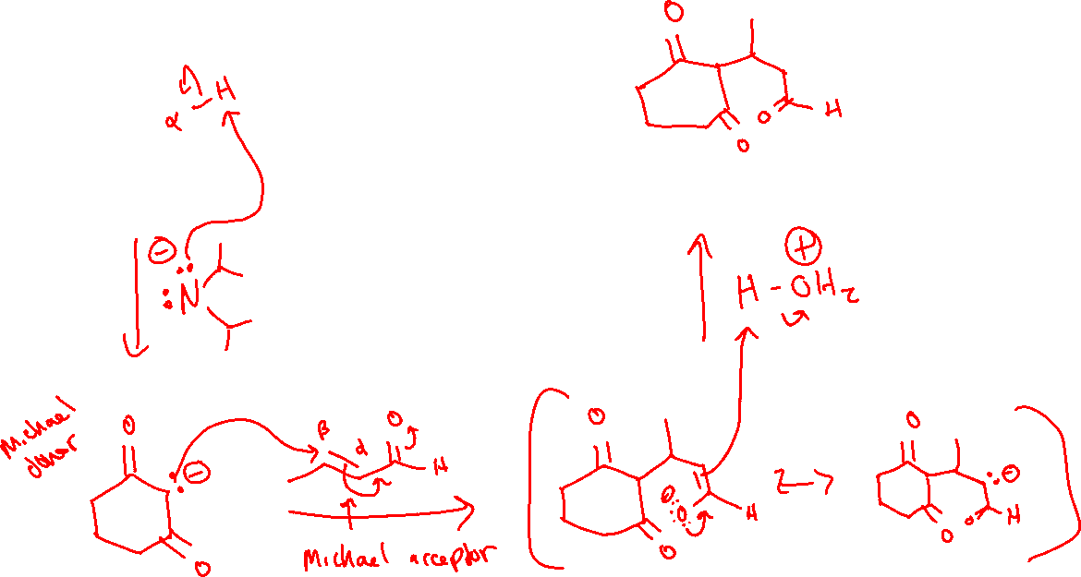
Michael Addition

Slide 4
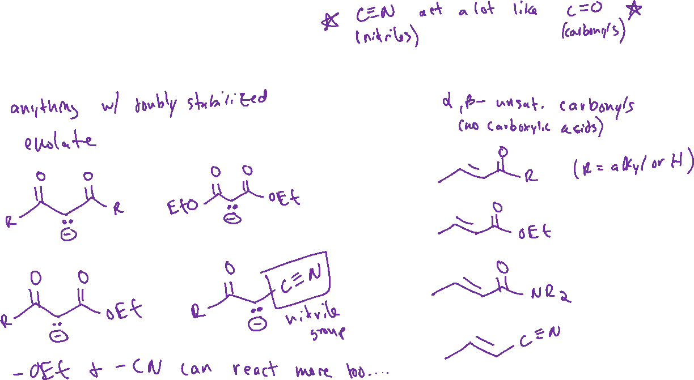
Michael Donors and Acceptors

Slide 5
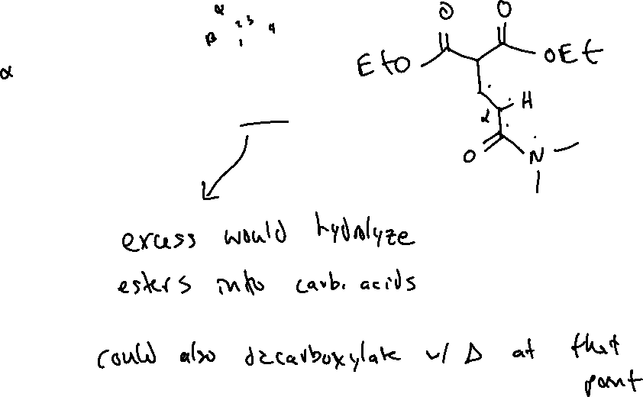
Michael Addition: Examples

Slide 6
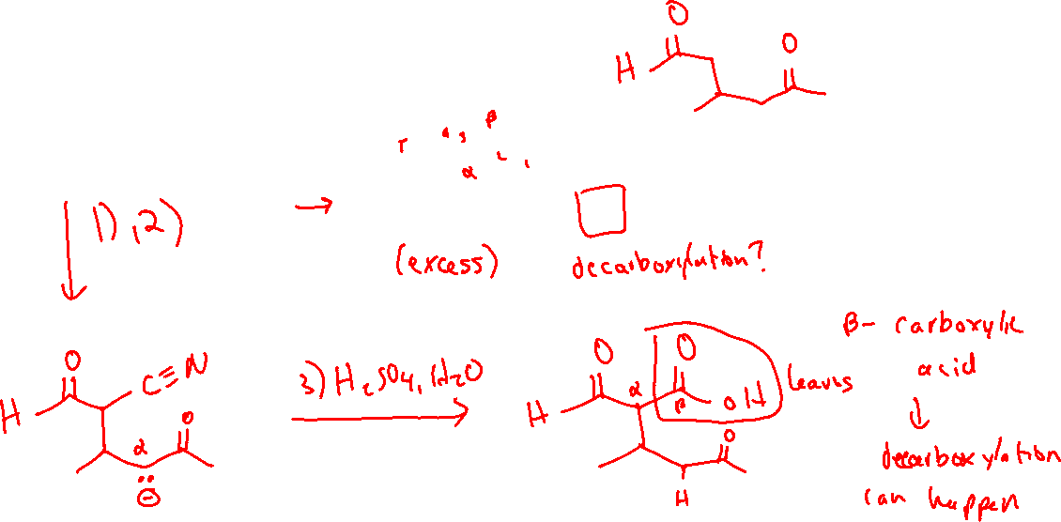
Michael Addition: Examples

Slide 7

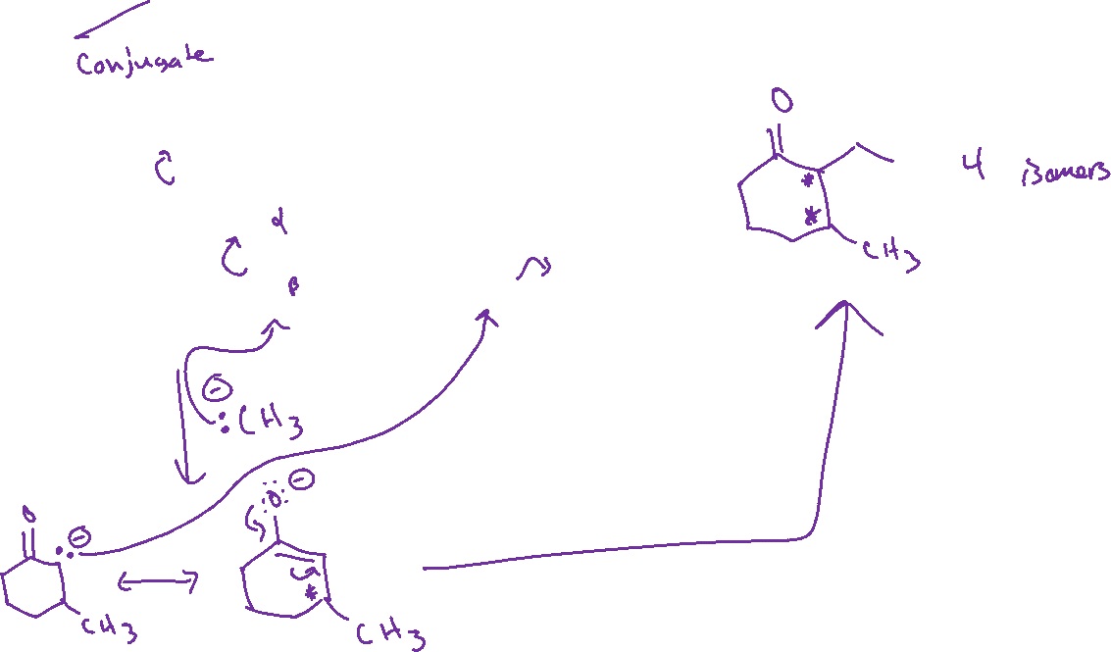

Michael Addition: Examples

Slide 8
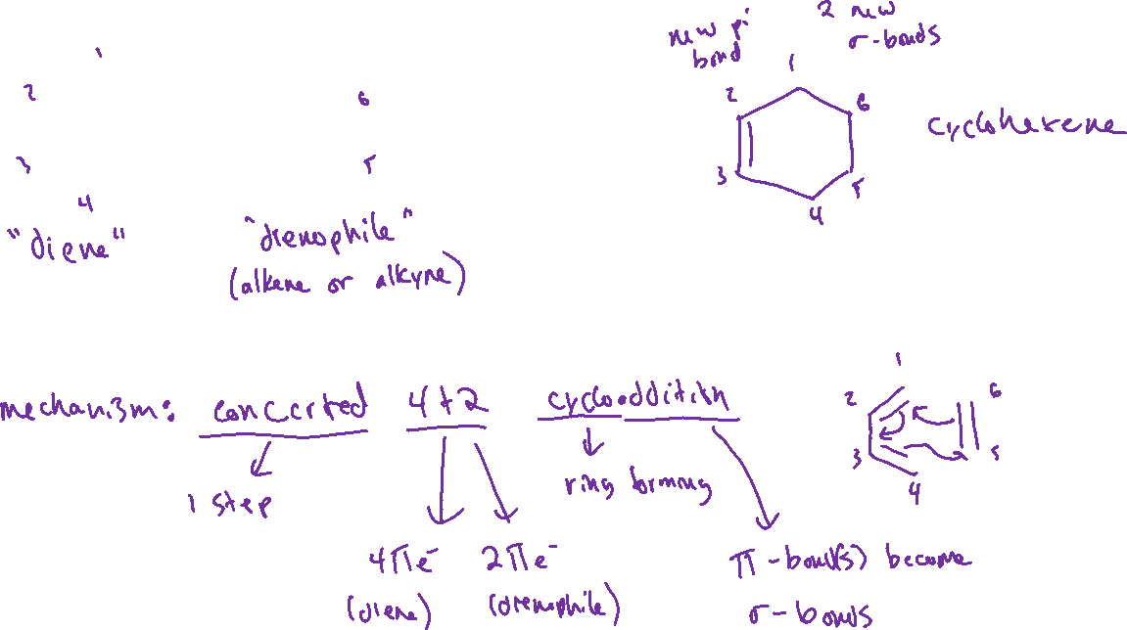


Diels-Alder Reaction (16.7)

Slide 9






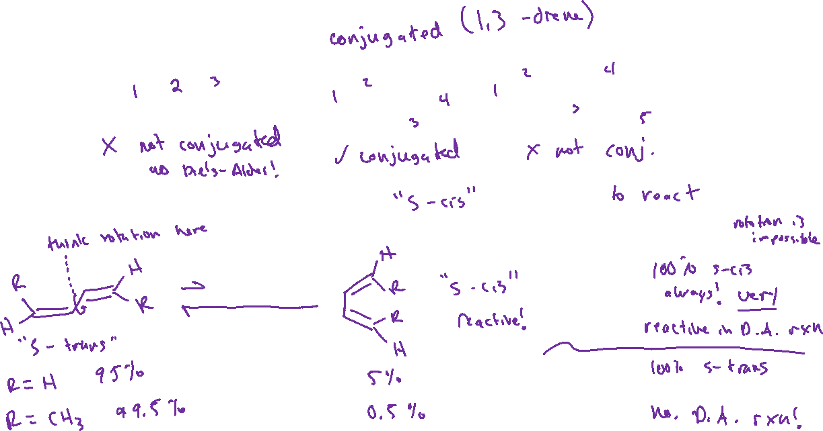





Requirements of the Diene

