Slide 1
Conjugate Addition & Michael Addition
Diels Alder intro
4/3/2023

Slide 2
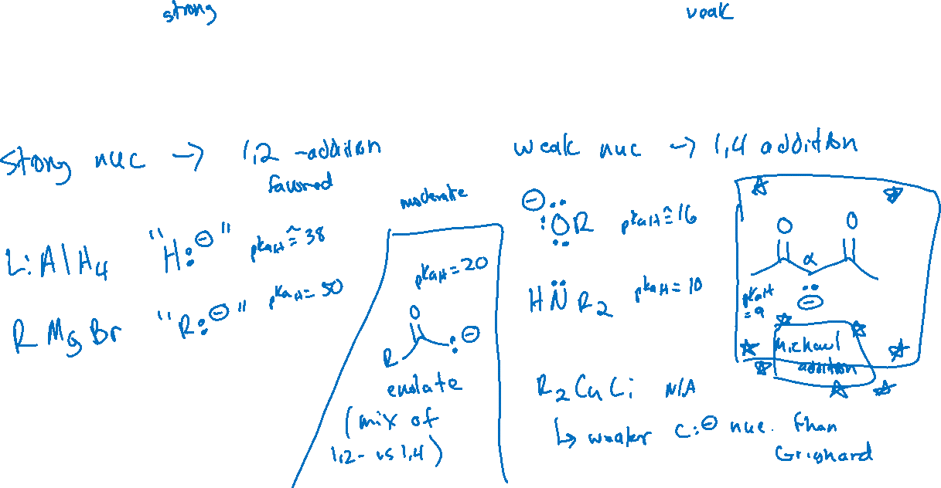
1,2- vs 1,4-addition: Strength of Nucleophiles and Regioselectivity

Slide 3
Michael Addition

Slide 4
Michael Donors and Acceptors

Slide 5
Michael Addition: Examples

Slide 6
Michael Addition: Examples

Slide 7


Michael Addition: Examples

Slide 8


Diels-Alder Reaction (16.7)

Slide 9











Requirements of the Diene

