Slide 1
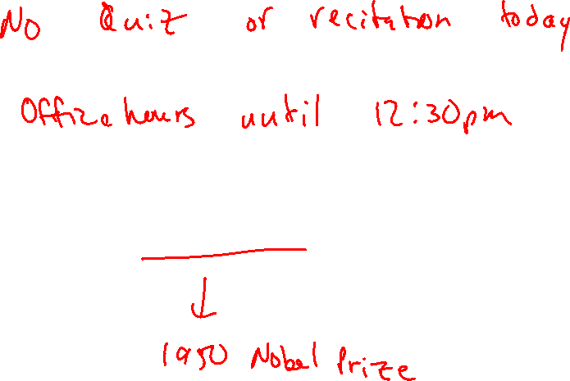
Diels-Alder: Regiochemistry
4/7/2023

Slide 2

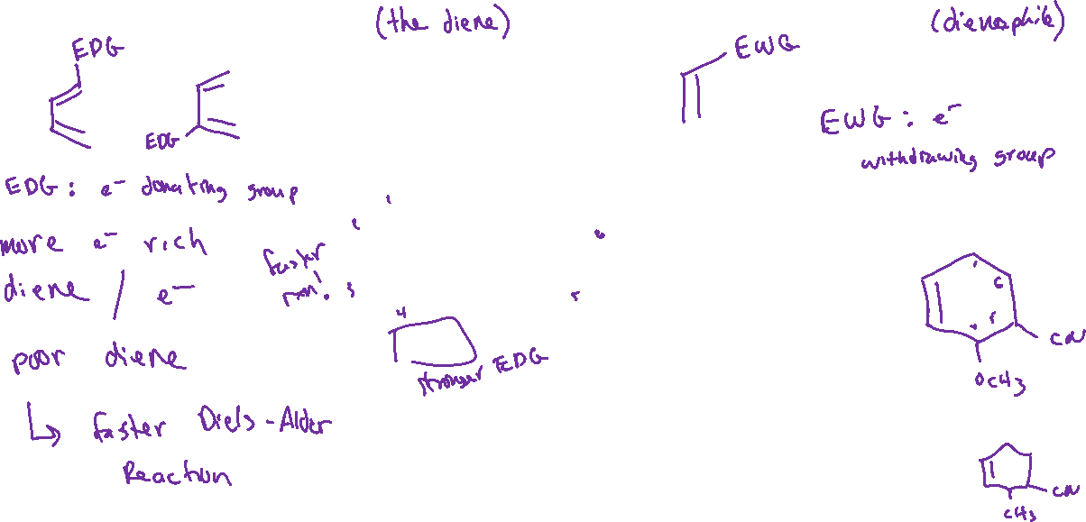
Electronics of Diels Alder

Slide 3

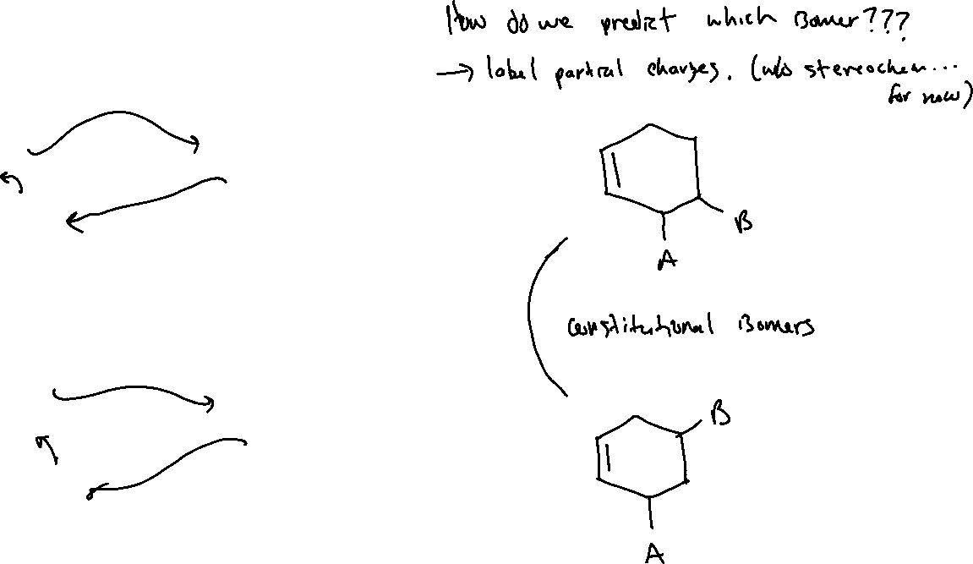







Regiochemistry of Diels-Alder

Slide 4

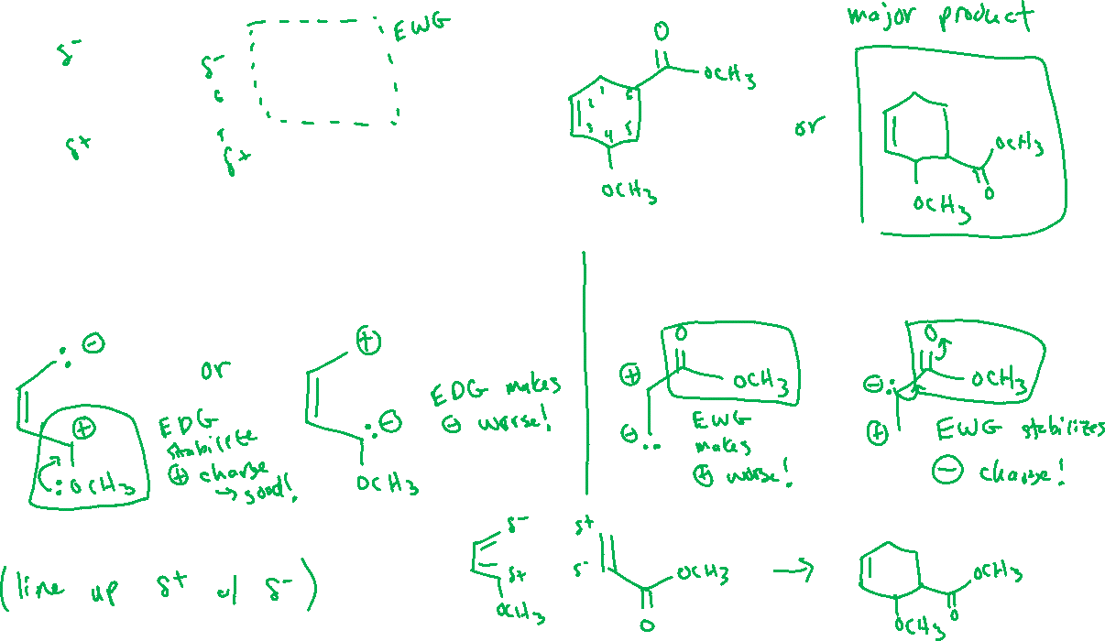


Regiochemistry of Diels-Alder

Slide 5




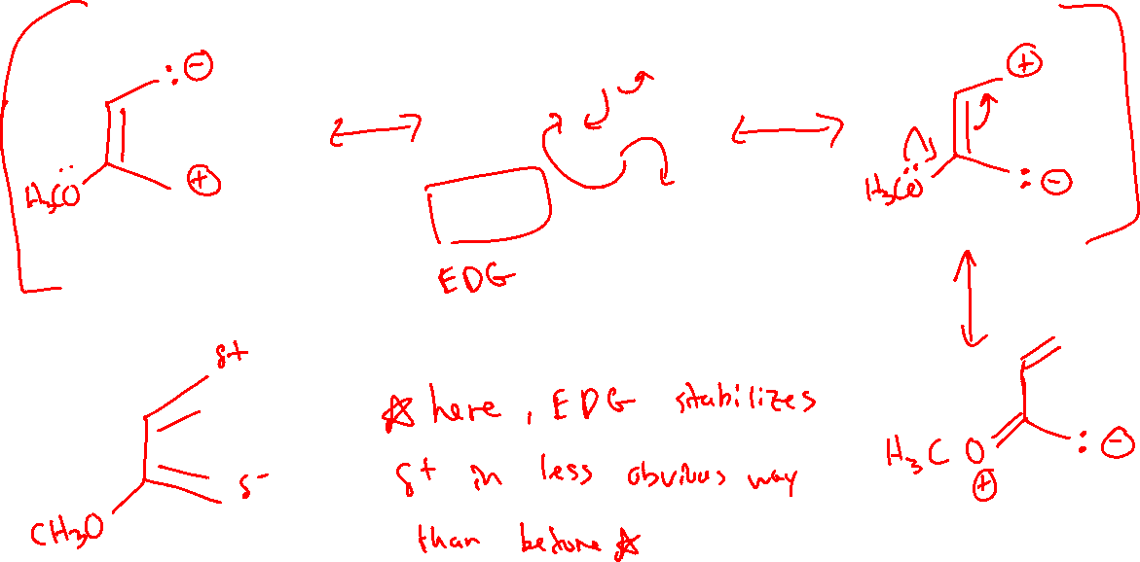
Changing Position of Electron Donating Group (EDG) on Diene

Slide 6
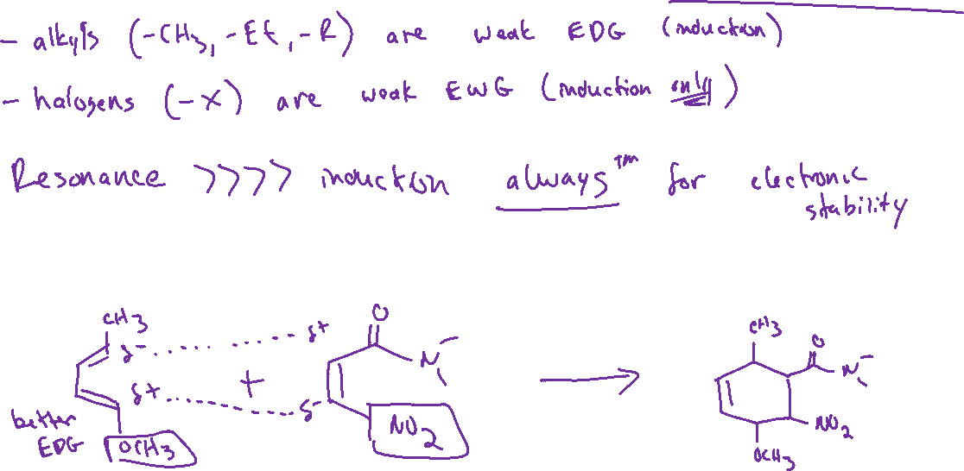
Diels-Alder Regiochemistry: Other Notes

Slide 7





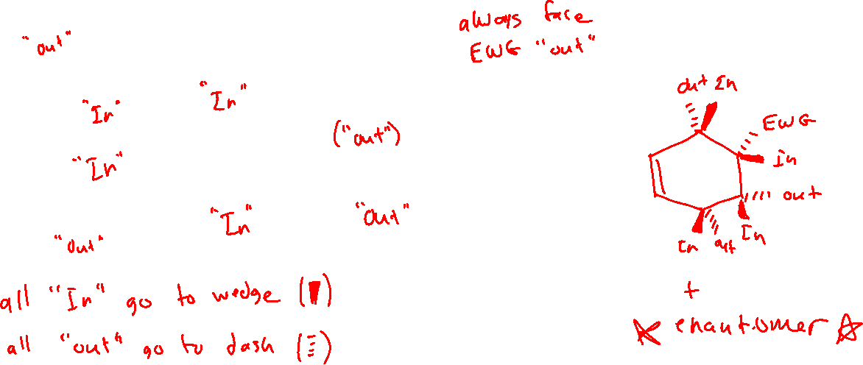

Stereochemistry of Diels-Alder

Slide 8








Drawing Diels-Alder Products: Strategy

