Slide 1
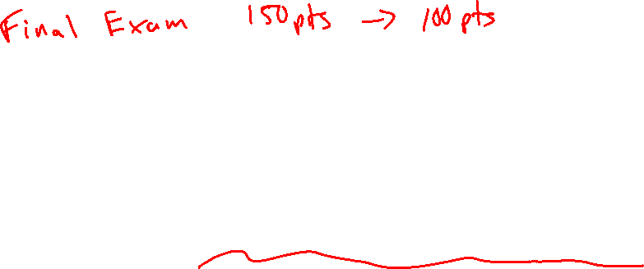
Diels-Alder: Stereochemistry
Practice with Diels-Alder
4/10/2023

Slide 2
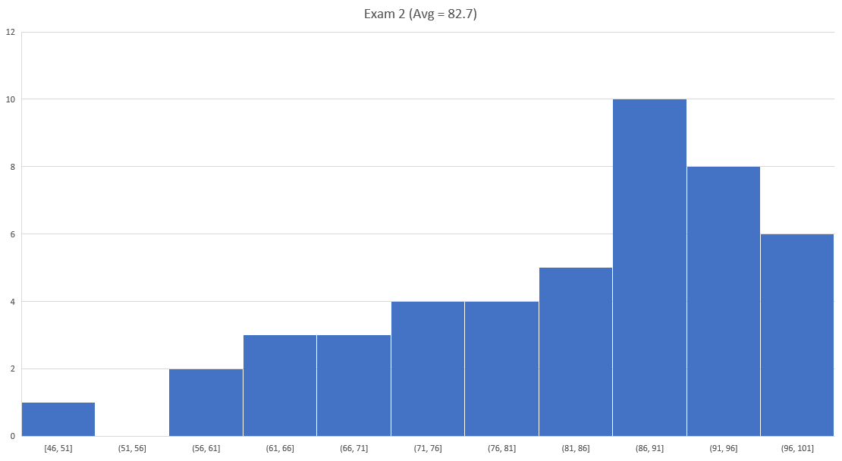
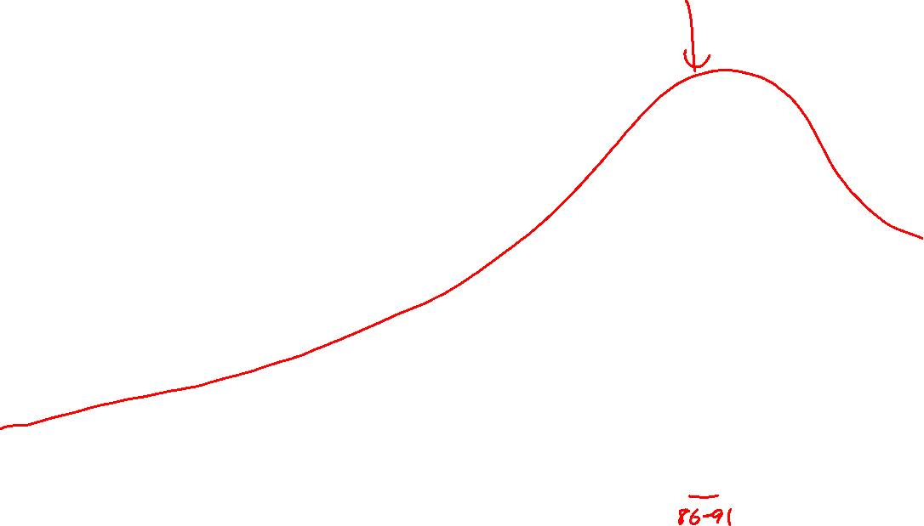

Slide 3





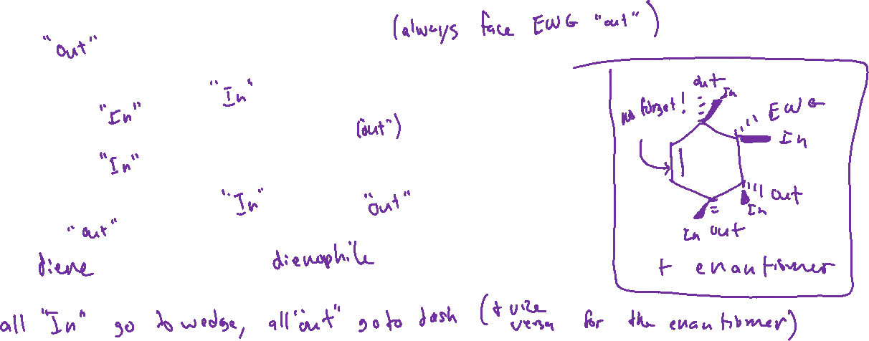

Stereochemistry of Diels-Alder

Slide 4









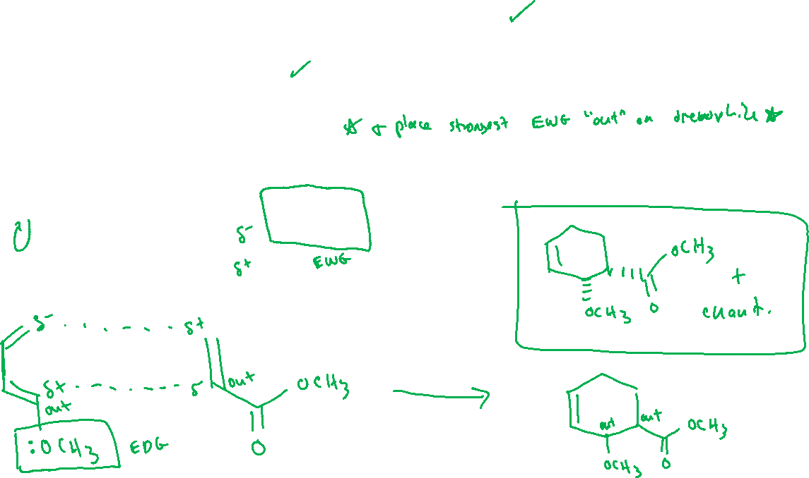
Drawing Diels-Alder Products: Strategy

Slide 5


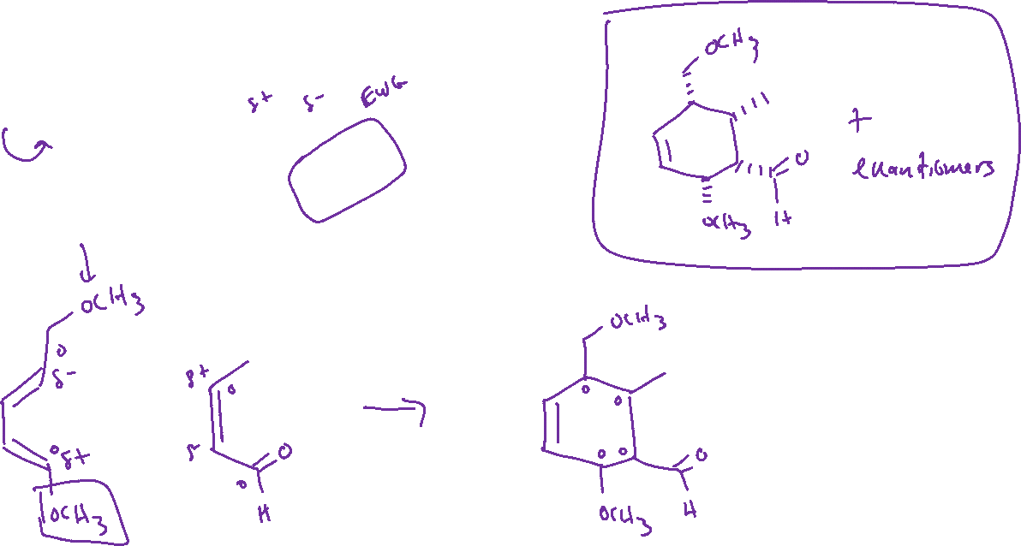

Diels-Alder Examples

Slide 6
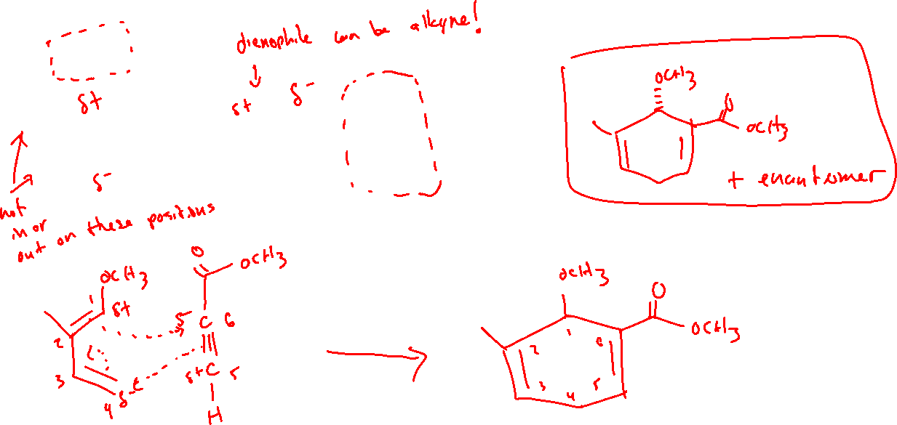


Diels-Alder Examples

Slide 7
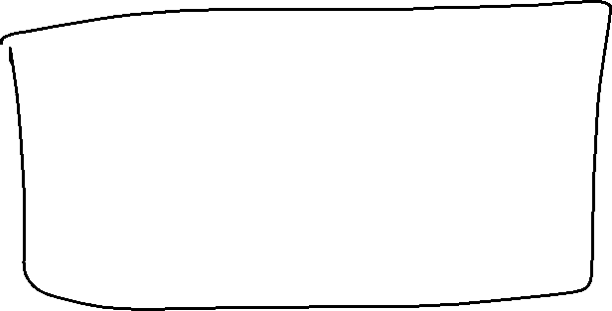
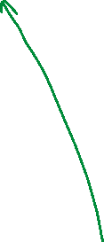


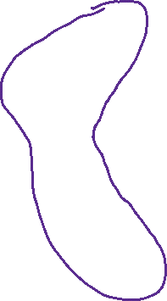

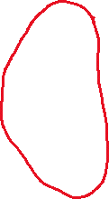



Diels-Alder Examples

Slide 8

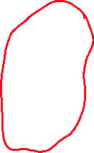

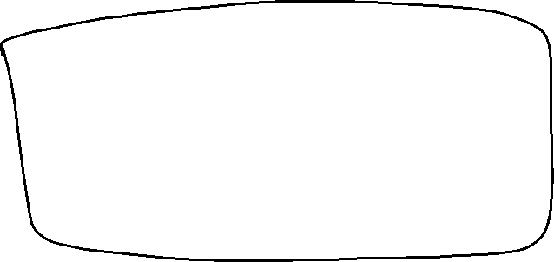




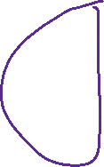




Diels-Alder Examples
“retro” Diels-Alder reactions are sometimes possible. We will just do this as “fill in the missing starting material” style question.

Slide 9







Diels-Alder Examples

Slide 10

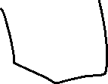

















Diels-Alder Examples

