Slide 1
Diels-Alder: Stereochemistry
Practice with Diels-Alder
4/10/2023

Slide 2

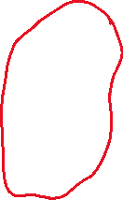

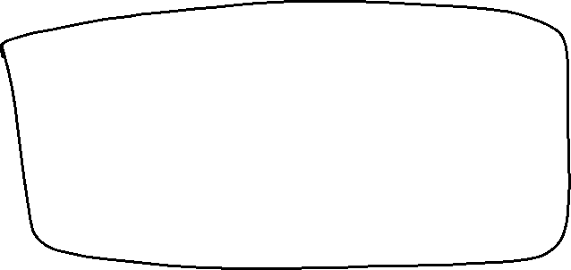




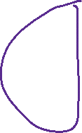




Diels-Alder Examples
“retro” Diels-Alder reactions are sometimes possible. We will just do this as “fill in the missing starting material” style question.

Slide 3








Intro to Carbohydrates (24.1-24.2)

Slide 4








Fischer Projections (5.7)

Slide 5








Converting Between Fischer Projections and “Normal” Bond-Line Structures

Slide 6






Converting Between Fischer Projections and “Normal” Bond-Line Structures

Slide 7





Classifying Carbohydrates: “D-” vs “L-”

Slide 8





Classifying Carbohydrates: “D-” vs “L-”

Slide 9



Aldose Sugars (24.3)

Slide 10
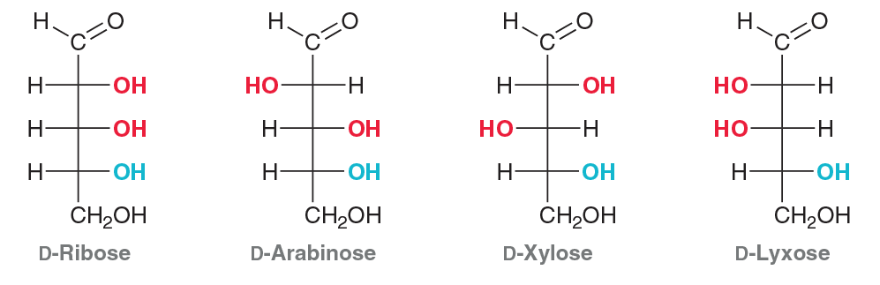
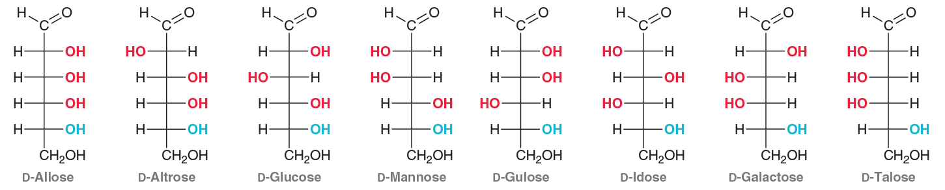

Aldose Sugars (24.3)

Slide 11










Epimers

