Slide 1
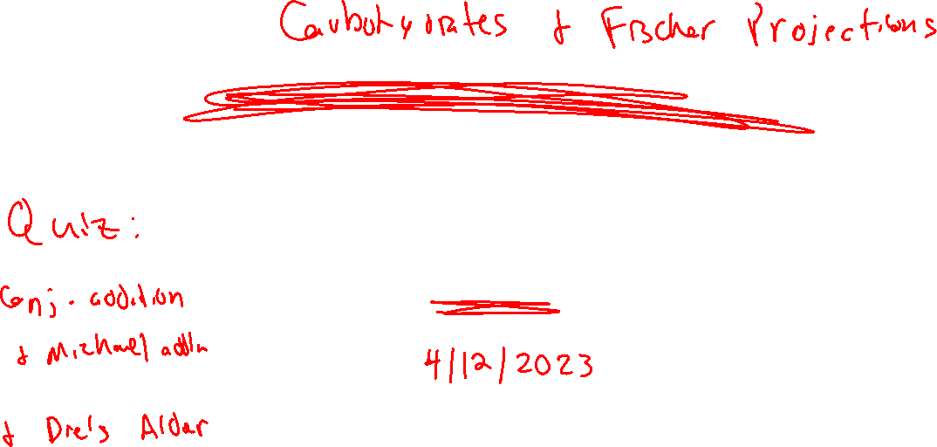
Diels-Alder: Stereochemistry
Practice with Diels-Alder
4/10/2023

Slide 2

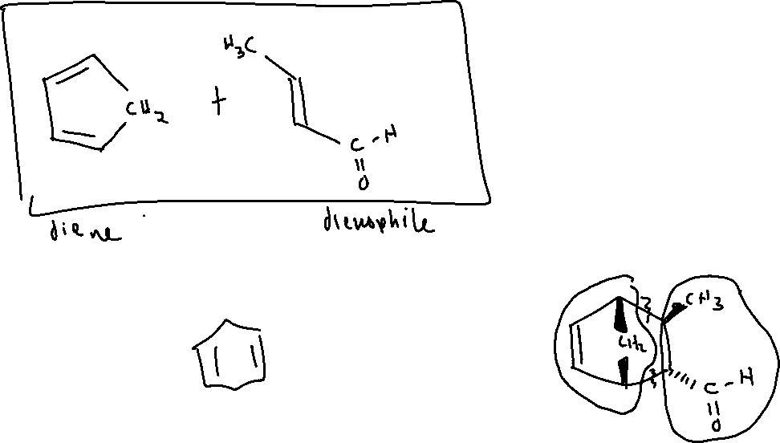


Diels-Alder Examples

Slide 3
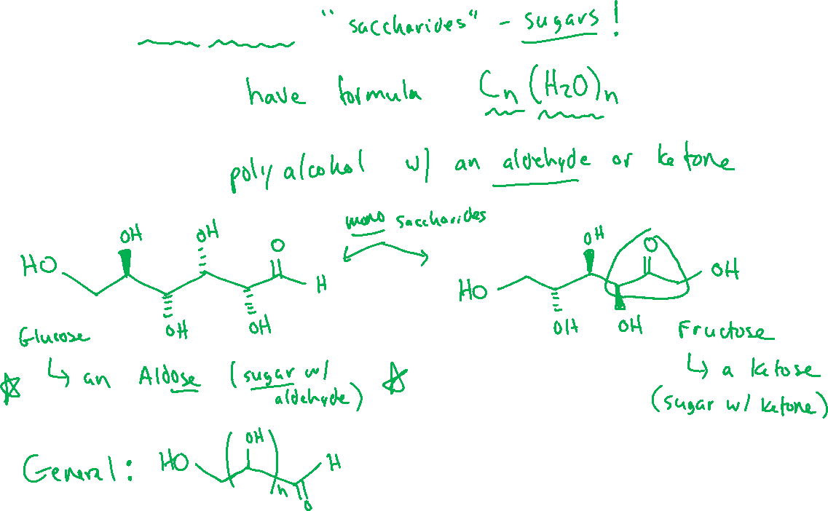
Intro to Carbohydrates (24.1-24.2)

Slide 4
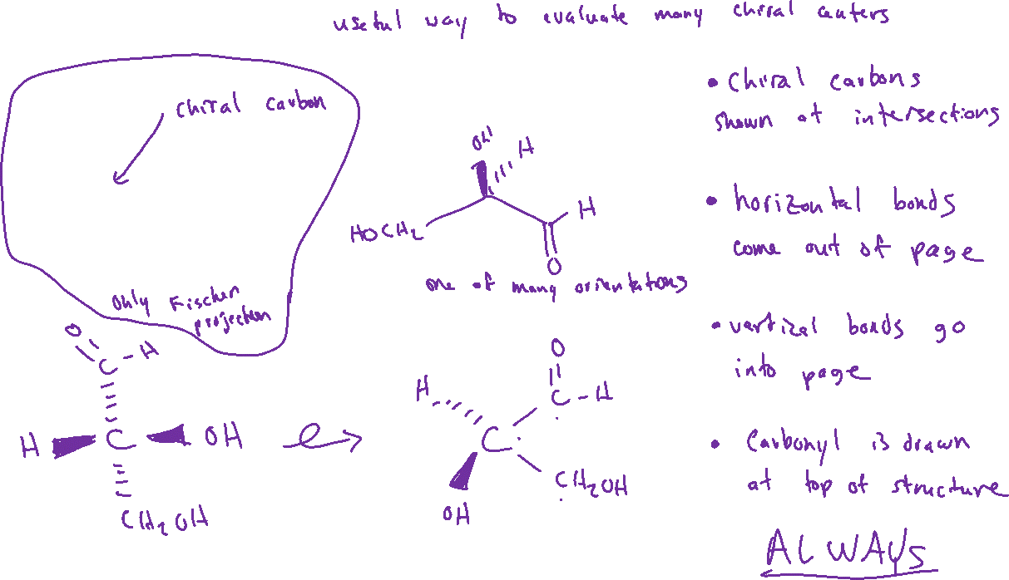
Fischer Projections (5.7)

Slide 5


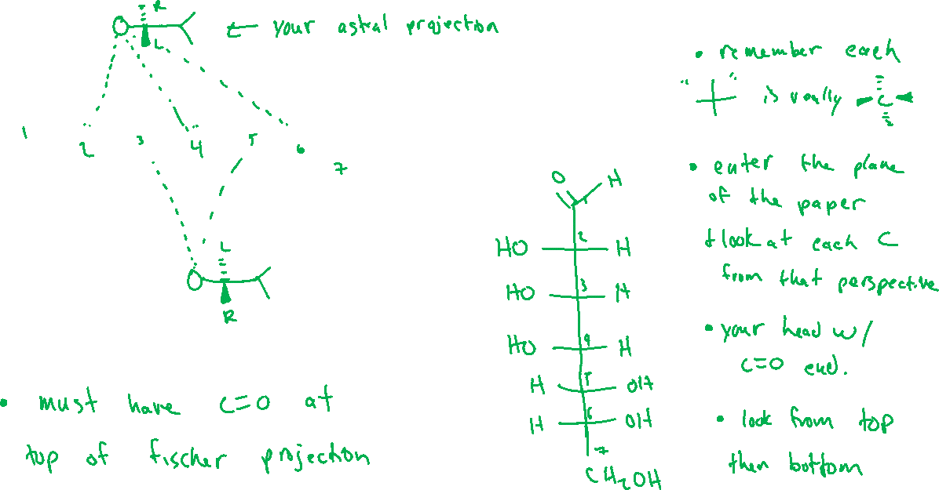




Converting Between Fischer Projections and “Normal” Bond-Line Structures

Slide 6
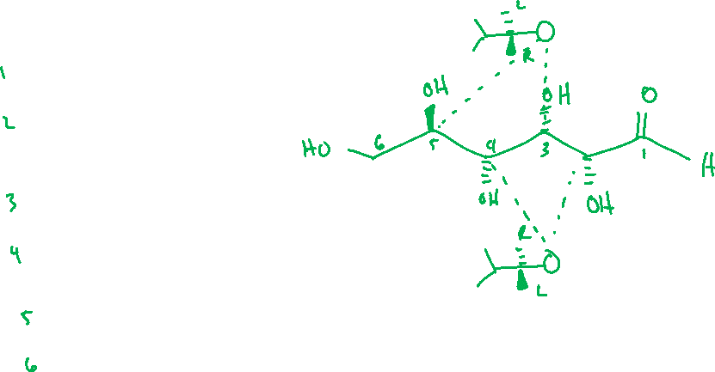
Converting Between Fischer Projections and “Normal” Bond-Line Structures

Slide 7
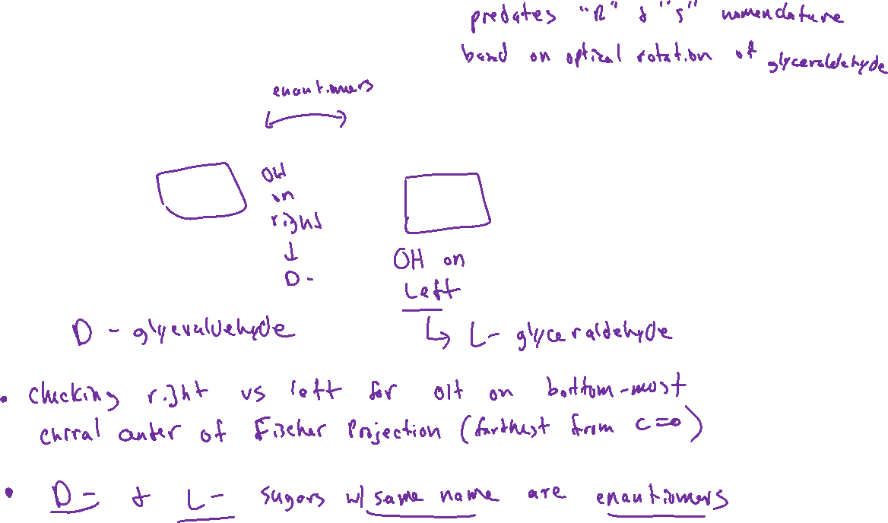

Classifying Carbohydrates: “D-” vs “L-”

Slide 8
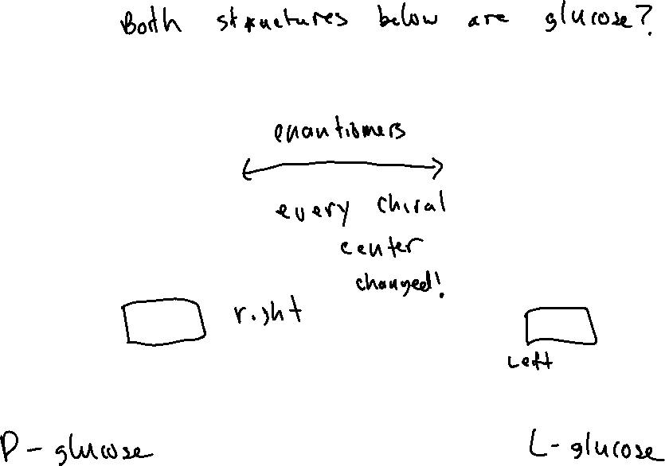


Classifying Carbohydrates: “D-” vs “L-”

Slide 9
Aldose Sugars (24.3)

Slide 10
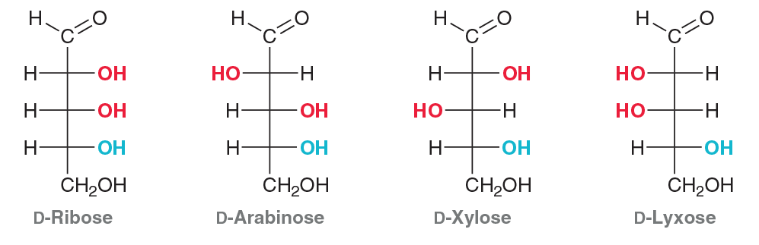
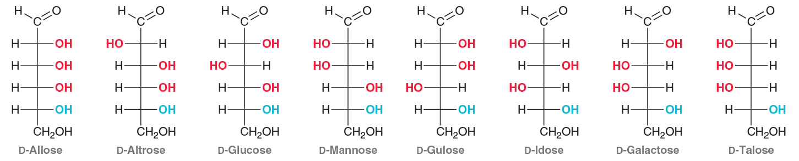
Aldose Sugars (24.3)

Slide 11

Epimers

