Slide 1
Cyclic Carbohydrates
4/14/2023

Slide 2
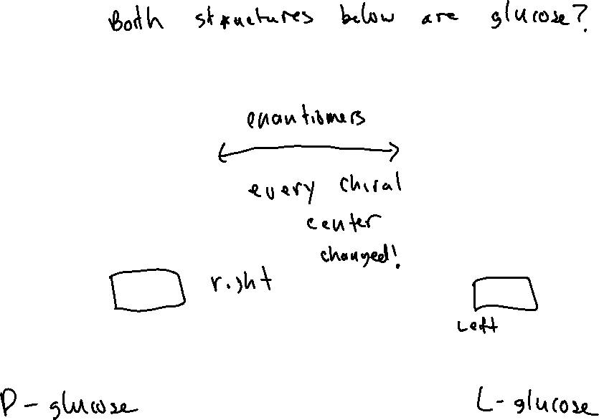



Classifying Carbohydrates: “D-” vs “L-”

Slide 3
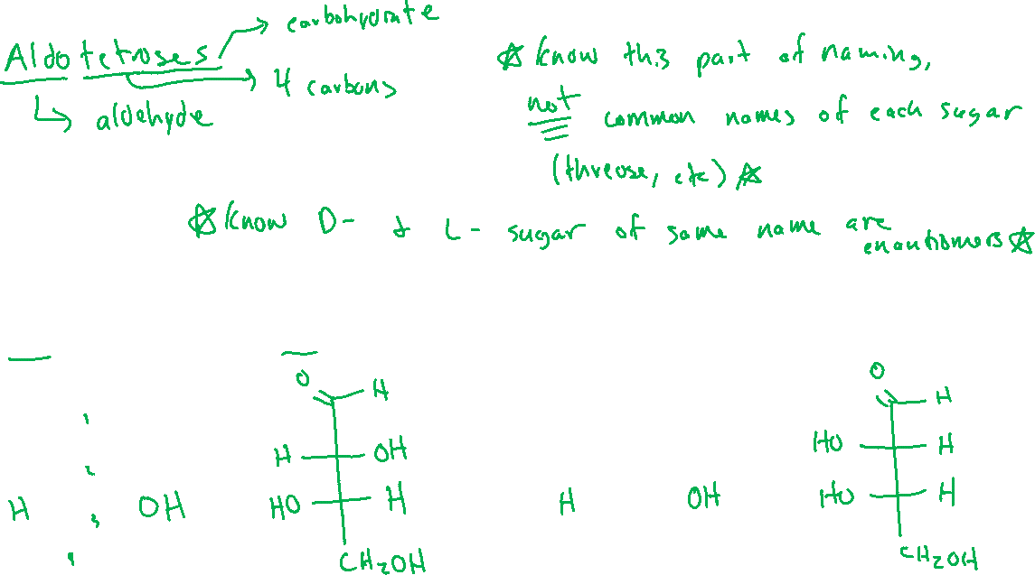
Aldose Sugars (24.3)

Slide 4
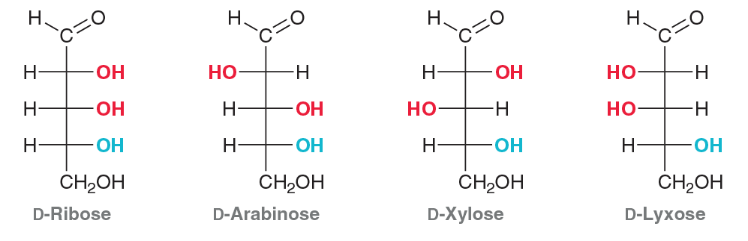
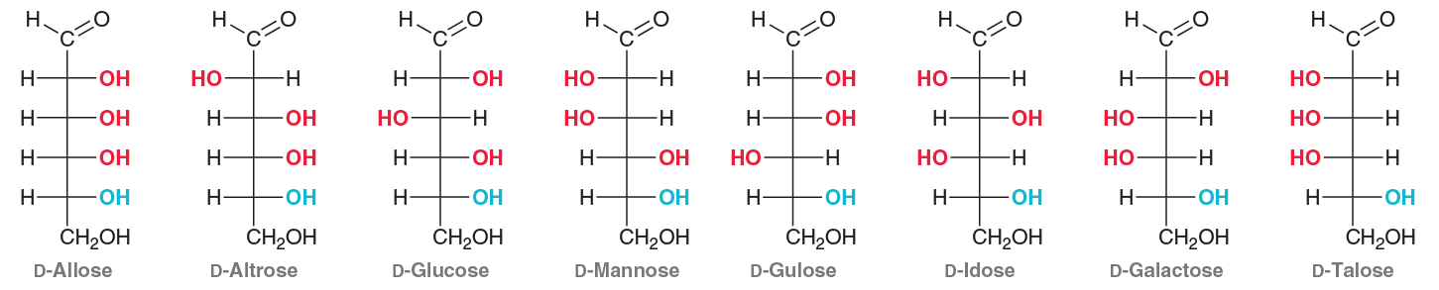
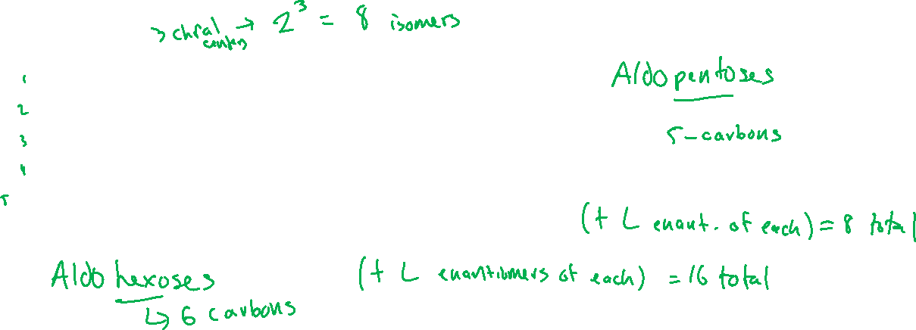
Aldose Sugars (24.3)

Slide 5
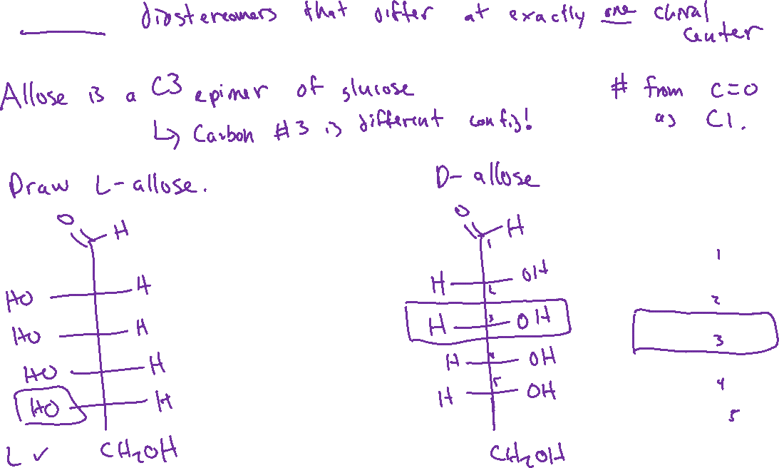

Epimers

Slide 6
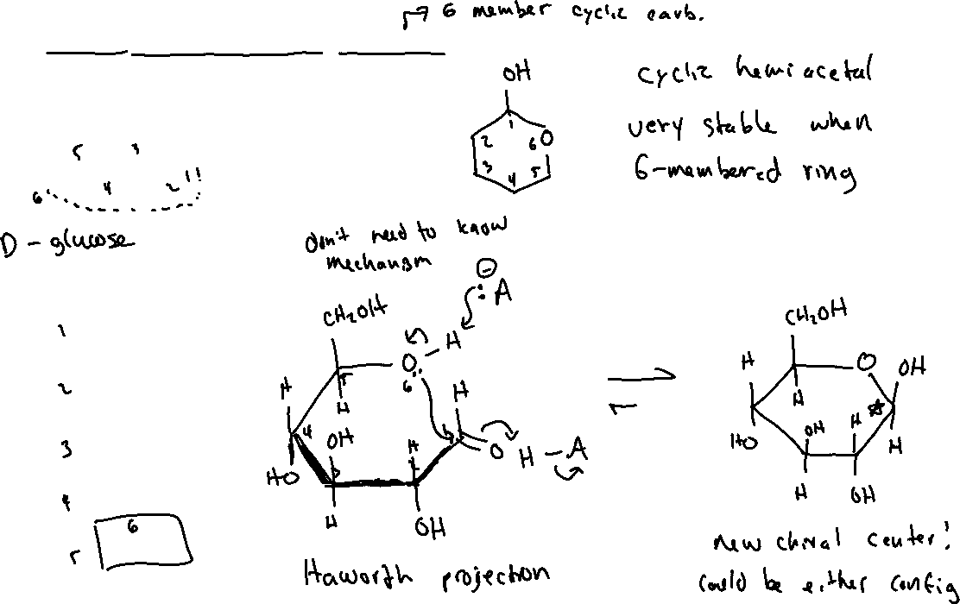
Cyclic Carbohydrates: Pyranose Rings (24.5)

Slide 7


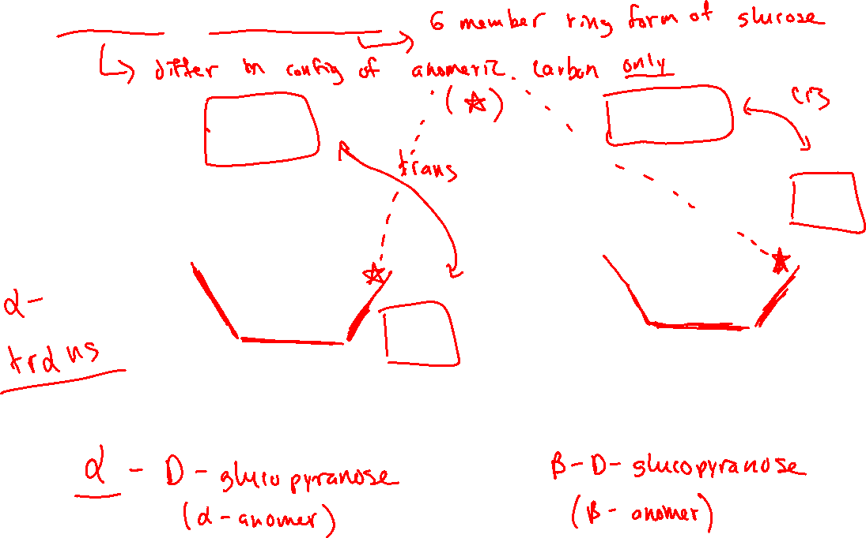


Anomers of Glucopyranose

Slide 8
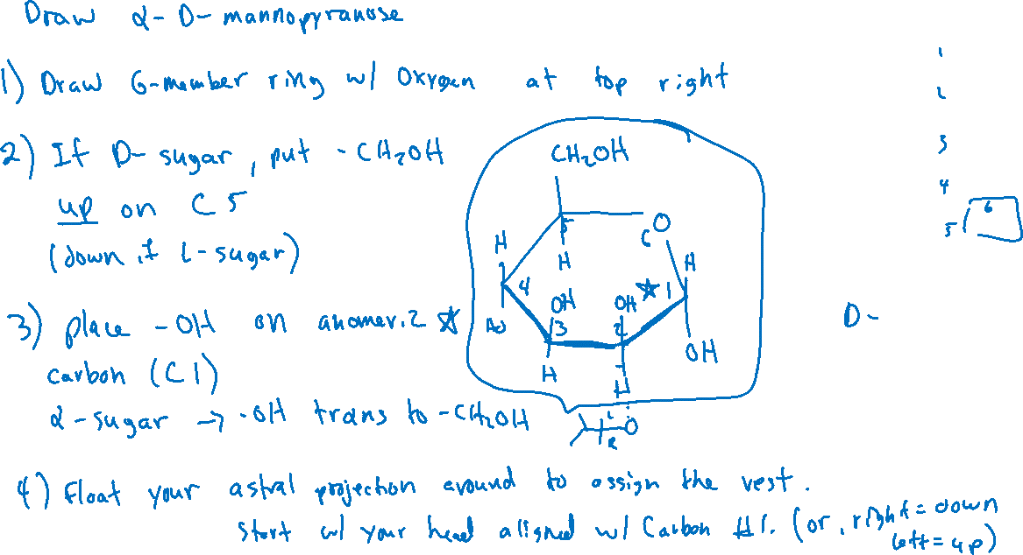
Converting Fischer Projection into Haworth Projection (of the Pyranose)

