Slide 1
Cyclic Carbohydrates
4/14/2023

Slide 2
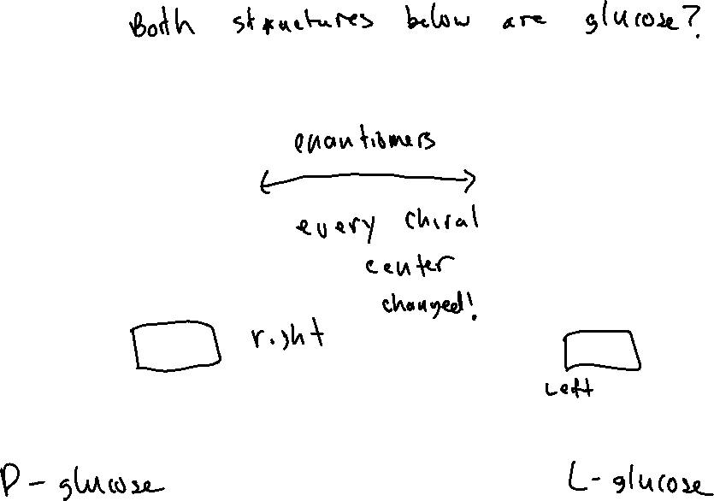


Classifying Carbohydrates: “D-” vs “L-”

Slide 3
Aldose Sugars (24.3)

Slide 4
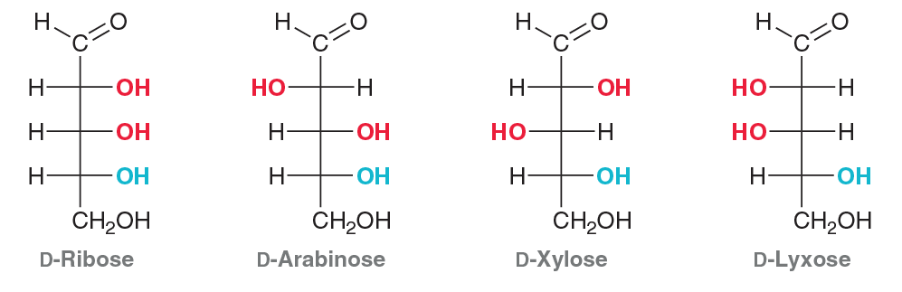
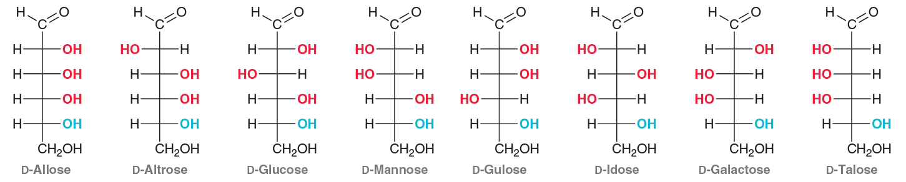
Aldose Sugars (24.3)

Slide 5

Epimers

Slide 6
Cyclic Carbohydrates: Pyranose Rings (24.5)

Slide 7




Anomers of Glucopyranose

Slide 8
Converting Fischer Projection into Haworth Projection (of the Pyranose)

Slide 9




Chair Structures of Pyranoses

