Slide 1
Reactions of Carbohydrates
4/17/2023

Slide 2




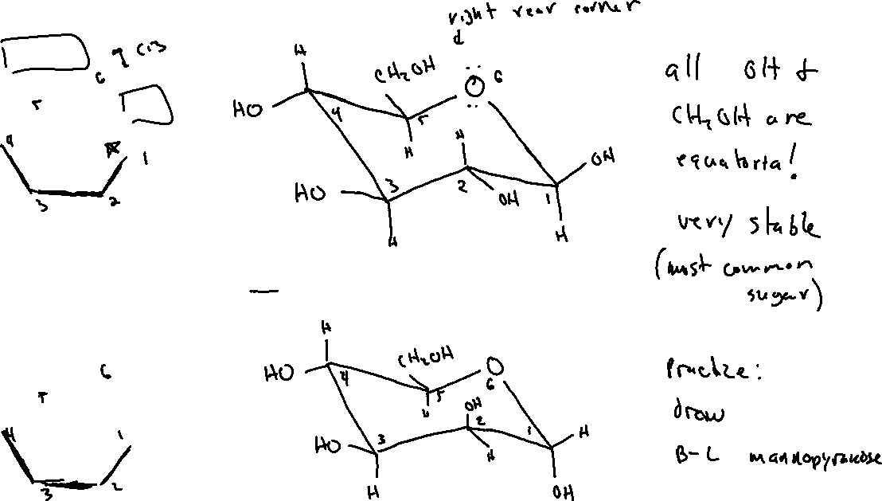

Chair Structures of Pyranoses

Slide 3




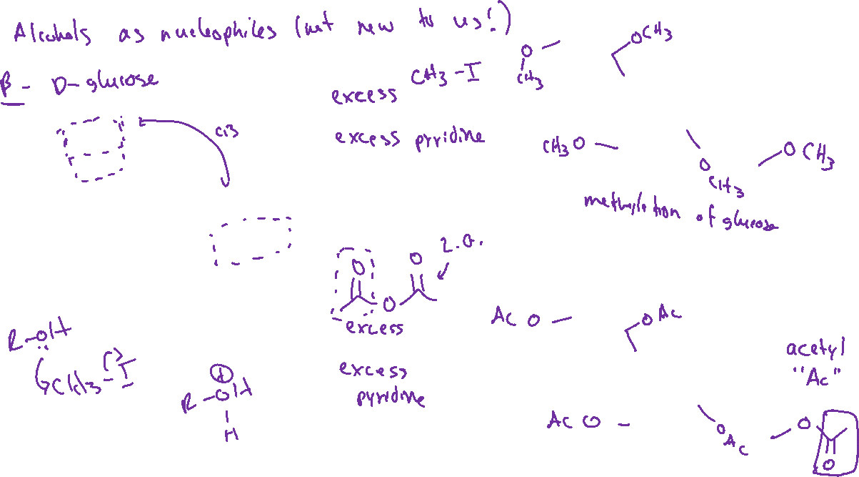









Reactions of Carbohydrates (24.6)

Slide 4




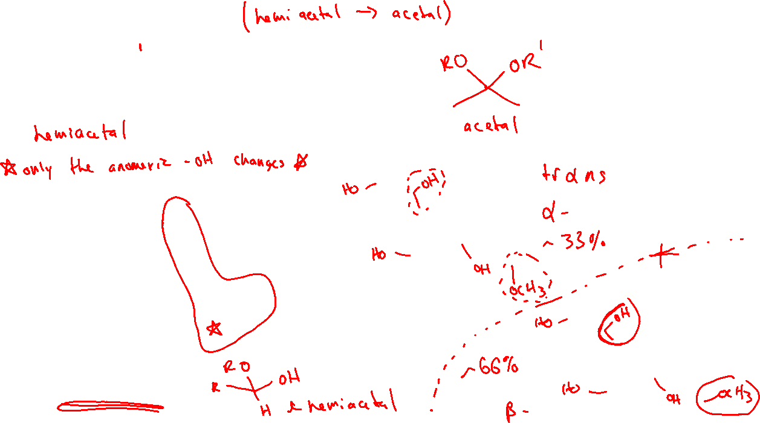








Glycoside Formation

Slide 5
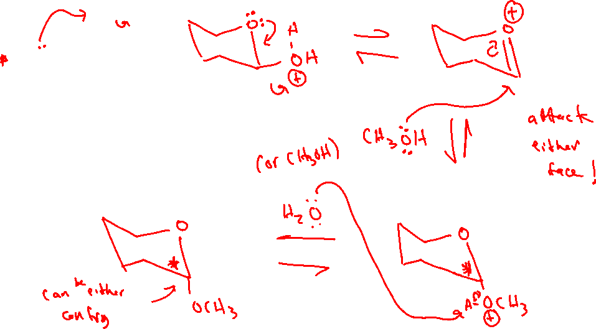


Glycoside Formation: Mechanism

Slide 6
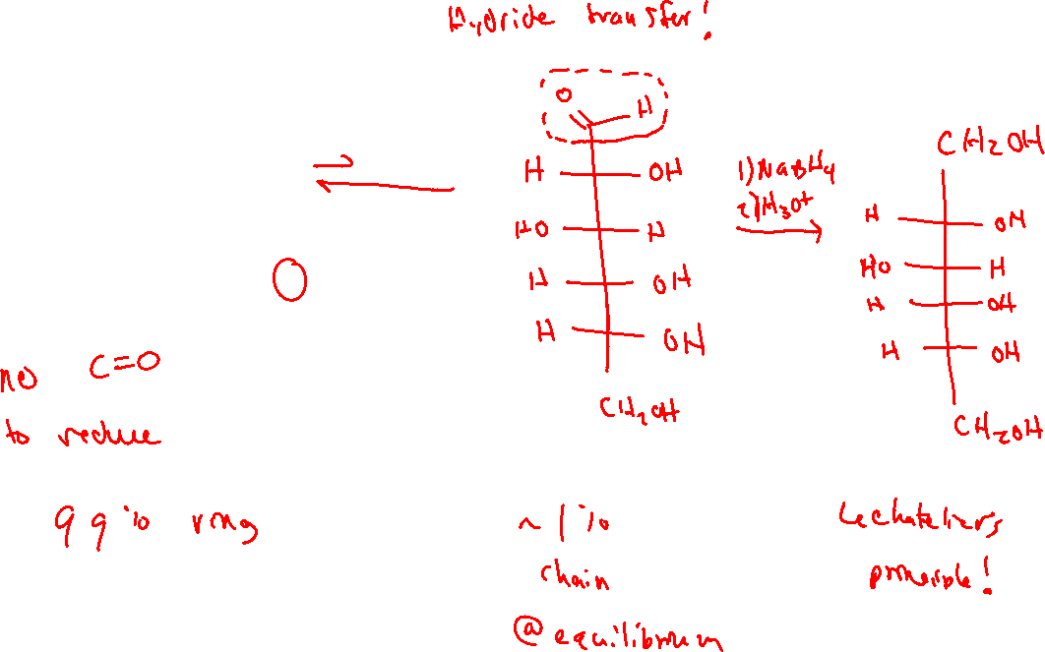
Reduction of Carbohydrates

Slide 7
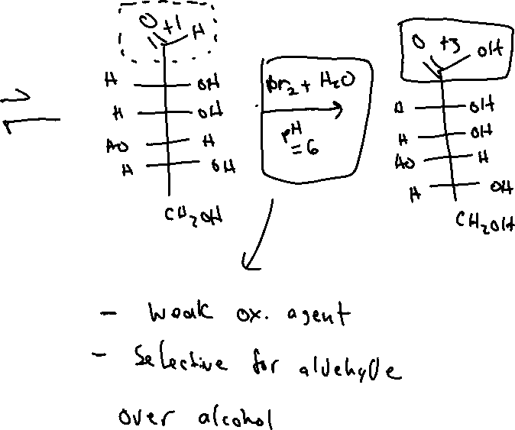
Oxidation of Carbohydrates

Slide 8

Chain Lengthening: Kiliani-Fischer Synthesis

Slide 9

Chain Lengthening: Kiliani-Fischer Synthesis

Slide 10
Chain Lengthening: Kiliani-Fischer Synthesis

