Slide 1
Carbohydrates: Chain Lengthening
Amino Acid Intro
4/19/2023

Slide 2

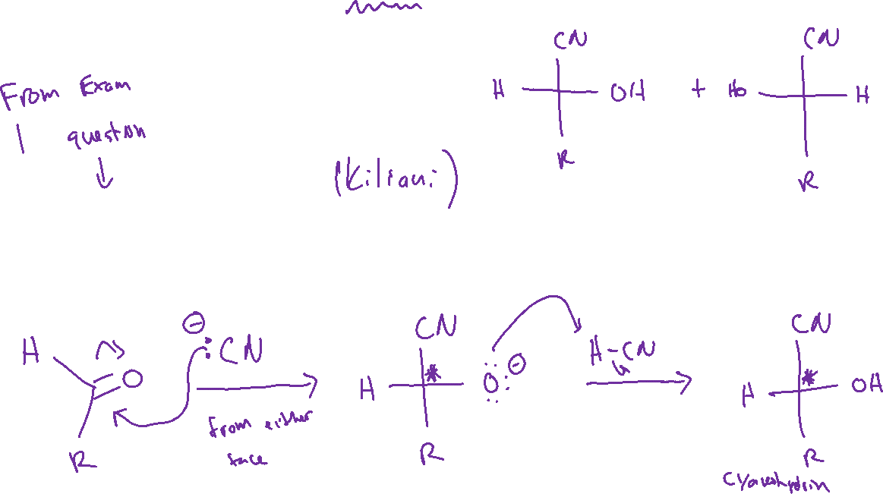
Chain Lengthening: Kiliani-Fischer Synthesis

Slide 3

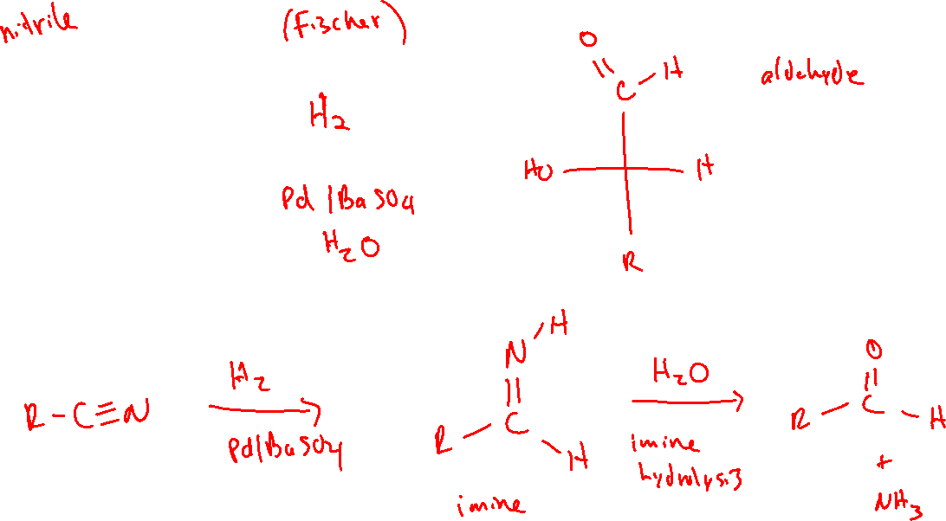
Chain Lengthening: Kiliani-Fischer Synthesis

Slide 4
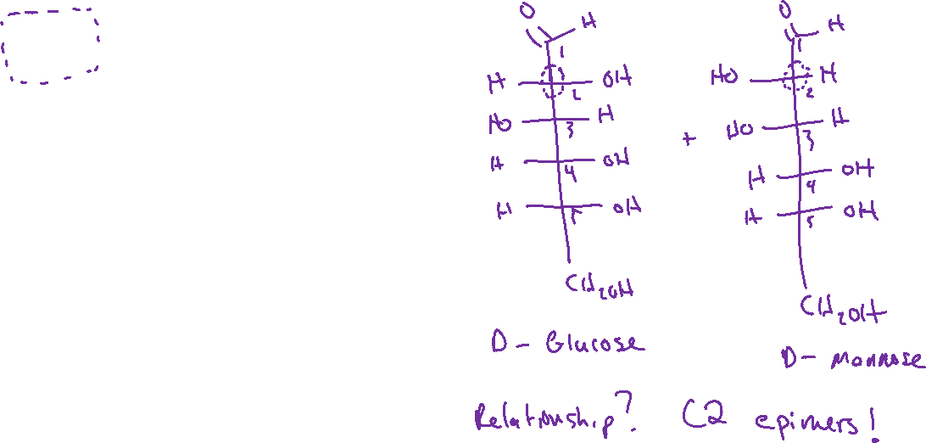
Chain Lengthening: Kiliani-Fischer Synthesis

Slide 5





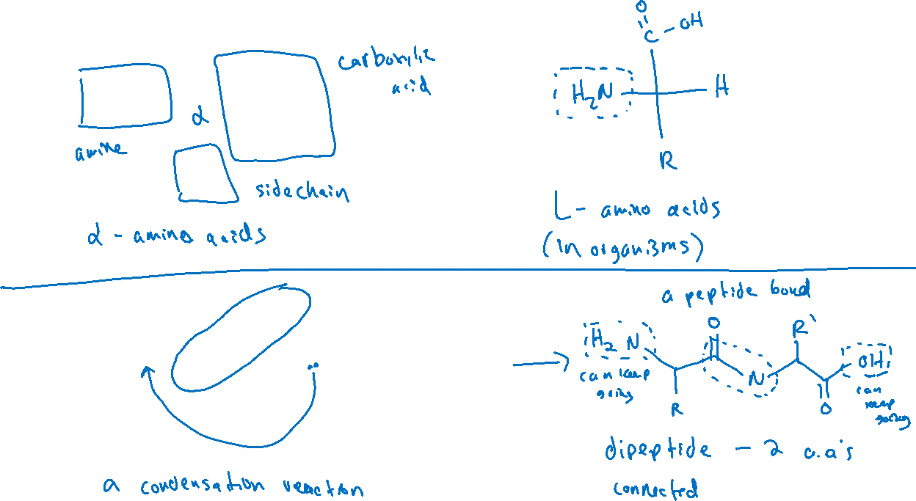


Amino Acids and Peptides (25.1)

Slide 6

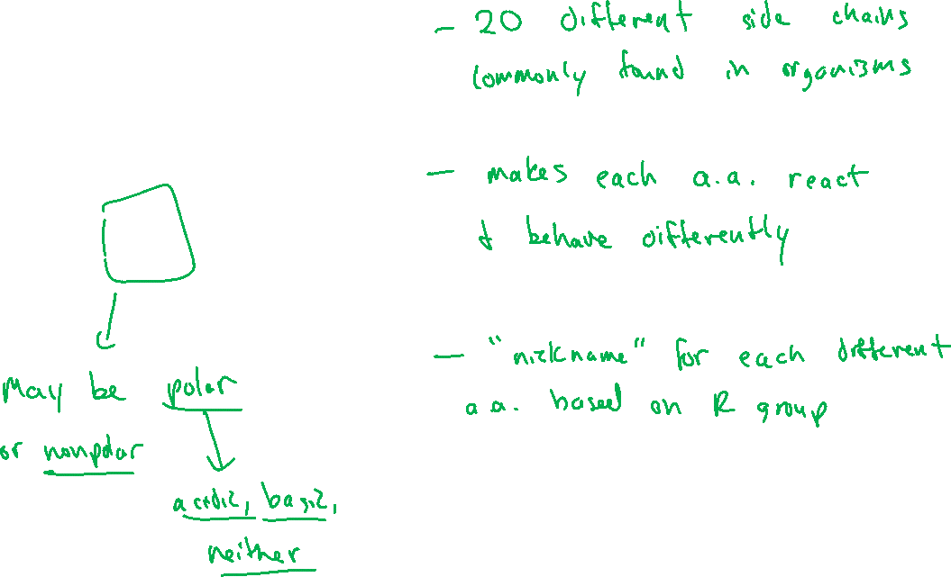



Amino Acid Side Chains

Slide 7
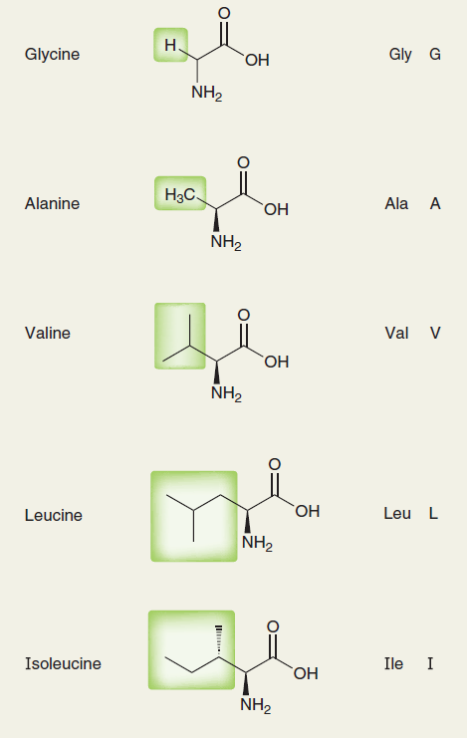
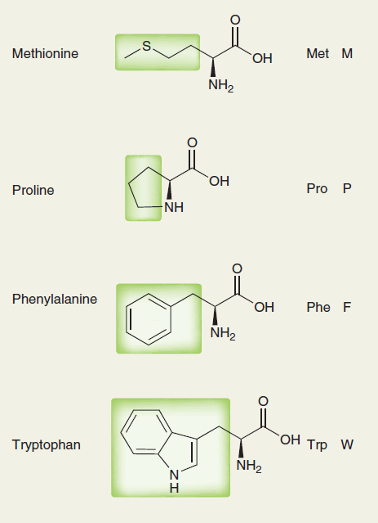

Amino Acid Side Chains

Slide 8
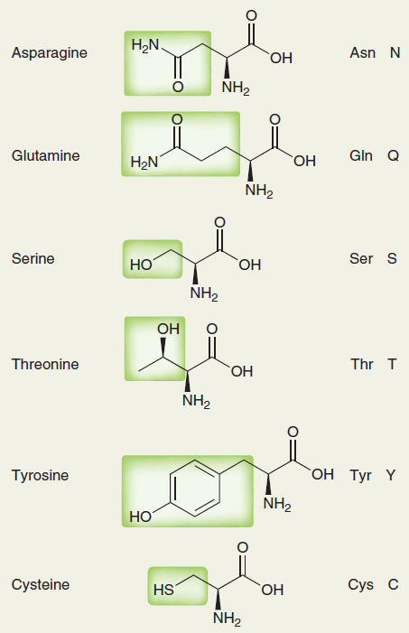
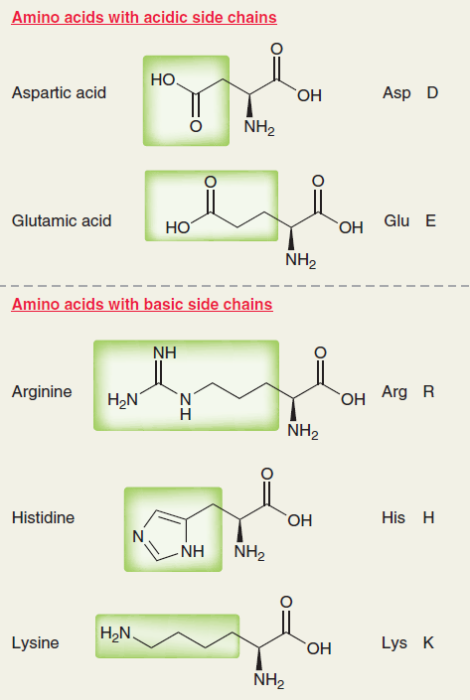
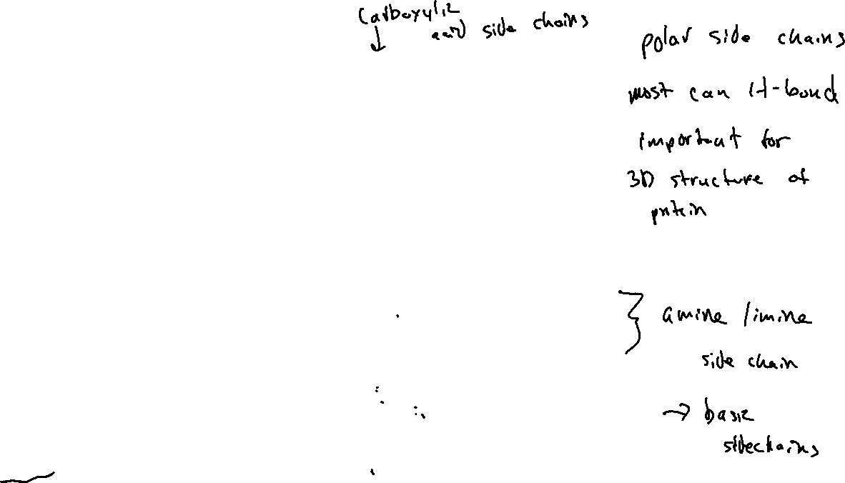
Amino Acid Side Chains

Slide 9

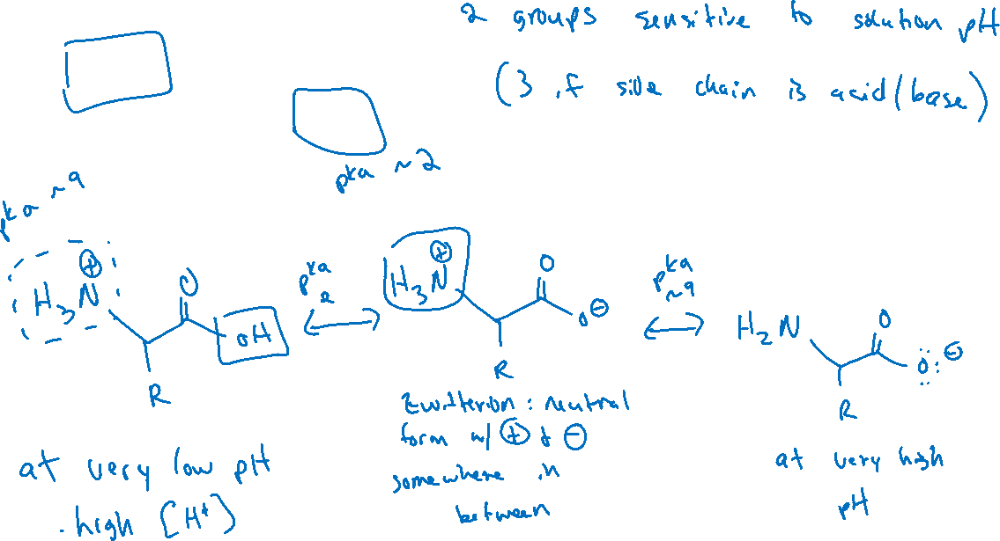


Acid/Base Properties of Amino Acids

Slide 10
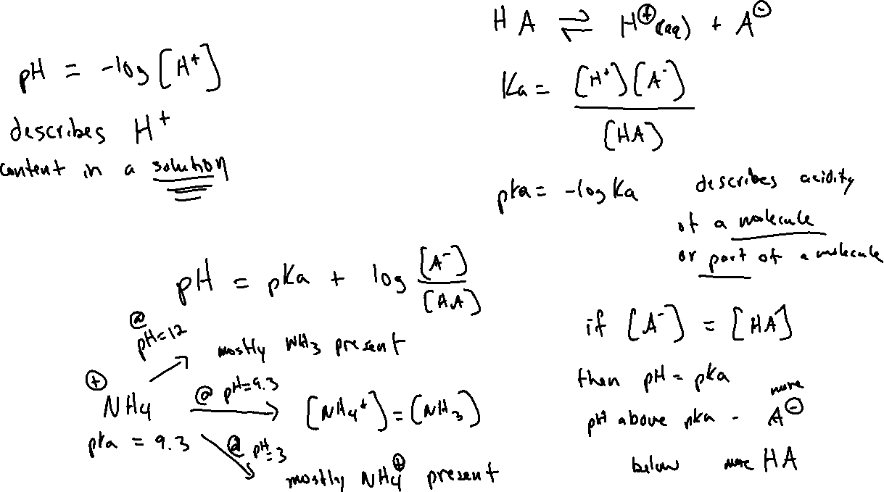
A Brief Reminder about pH and pKa

