Slide 1
Carbohydrates: Chain Lengthening
Amino Acid Intro
4/19/2023

Slide 2

Chain Lengthening: Kiliani-Fischer Synthesis

Slide 3

Chain Lengthening: Kiliani-Fischer Synthesis

Slide 4
Chain Lengthening: Kiliani-Fischer Synthesis

Slide 5







Amino Acids and Peptides (25.1)

Slide 6




Amino Acid Side Chains

Slide 7
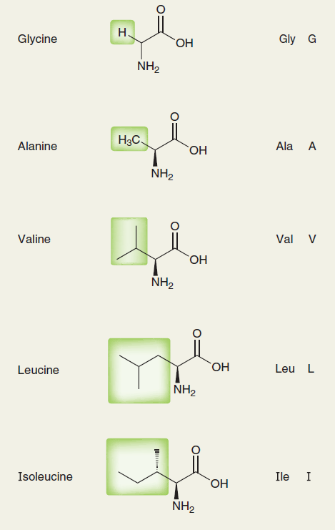
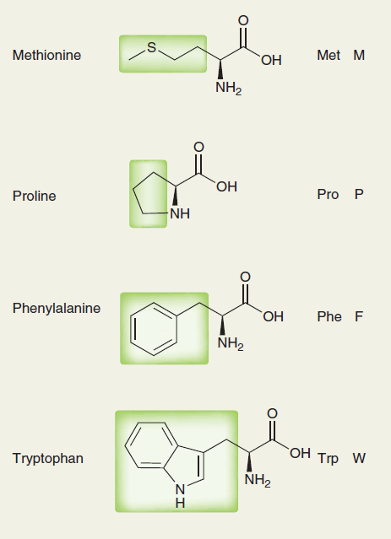
Amino Acid Side Chains

Slide 8
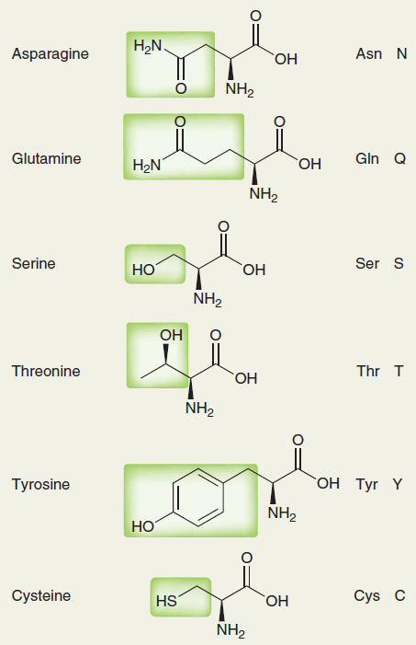
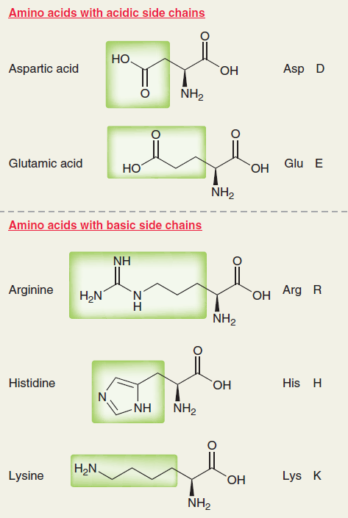
Amino Acid Side Chains

Slide 9



Acid/Base Properties of Amino Acids

Slide 10
A Brief Reminder about pH and pKa

Slide 11
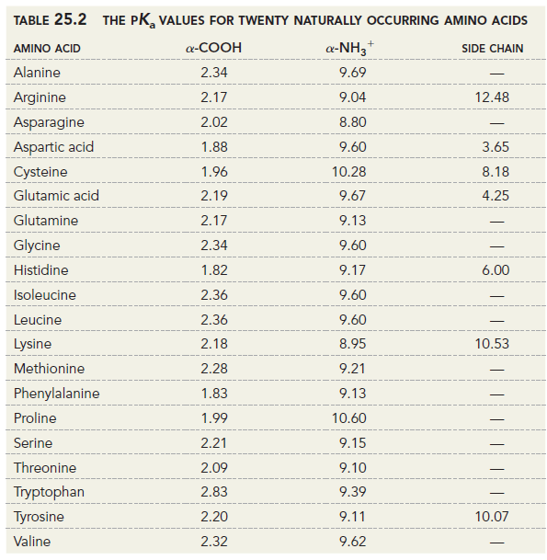
Amino Acid pKa Table

Slide 12
Isoelectric Point

Slide 13
Isoelectric Point

Slide 14
Isoelectric Point

