Slide 1
Isoelectric Point (pI)
Peptide Synthesis
4/21/2023

Slide 2

A Brief Reminder about pH and pKa

Slide 3
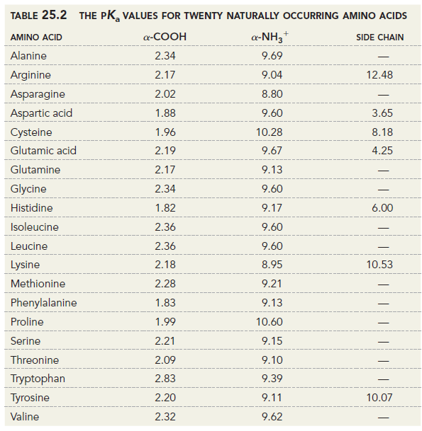

Amino Acid pKa Table

Slide 4
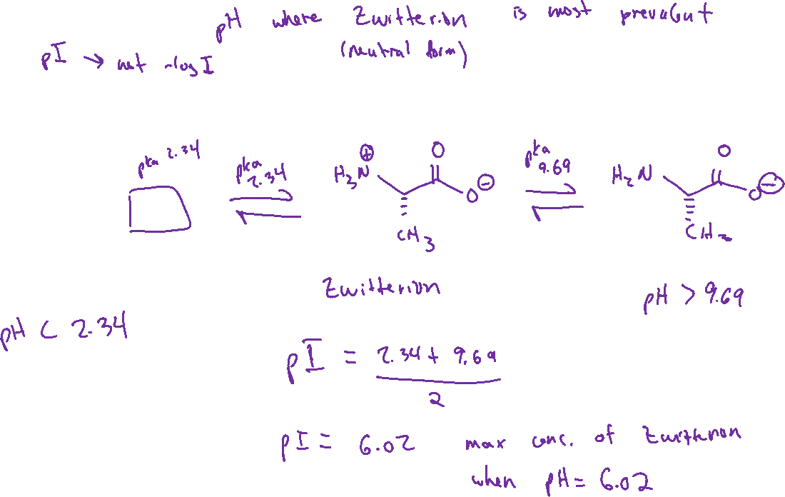
Isoelectric Point

Slide 5
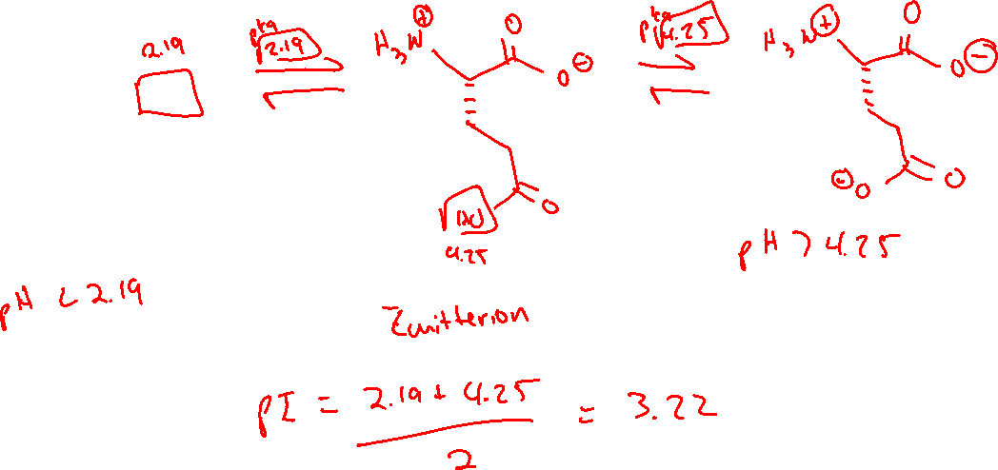
Isoelectric Point

Slide 6
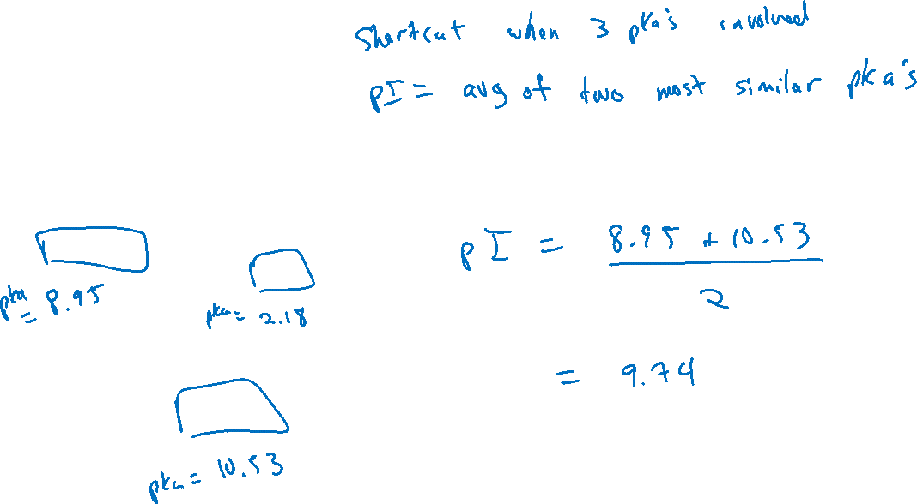
Isoelectric Point

Slide 7
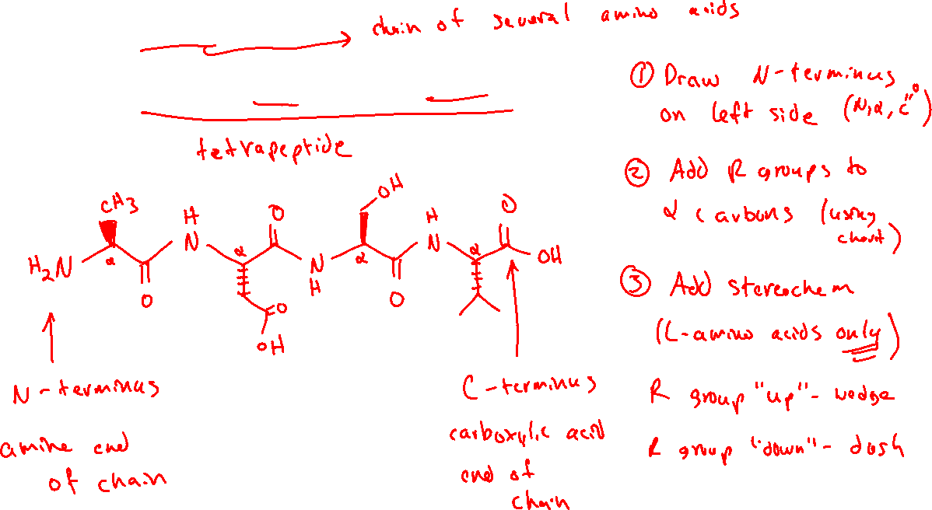
Drawing Peptide Chains (25.4)

Slide 8
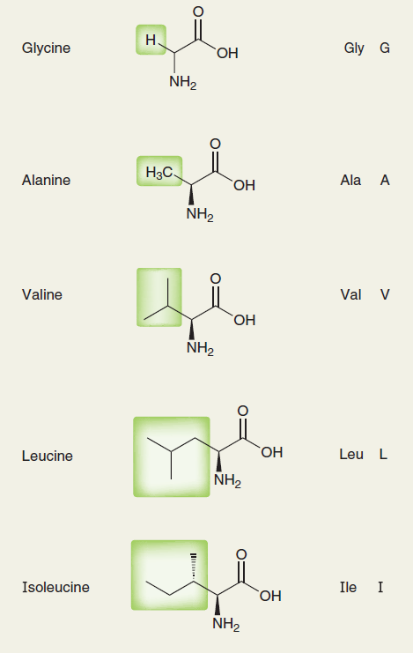
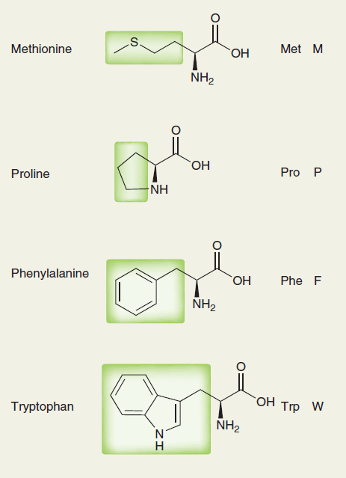
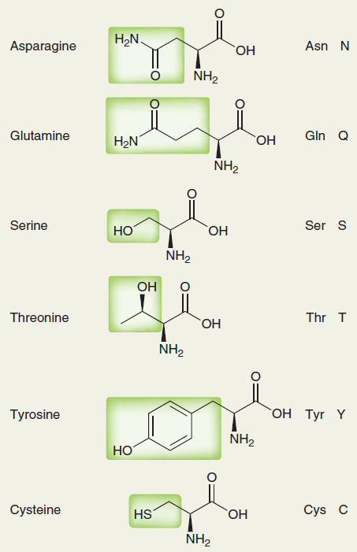
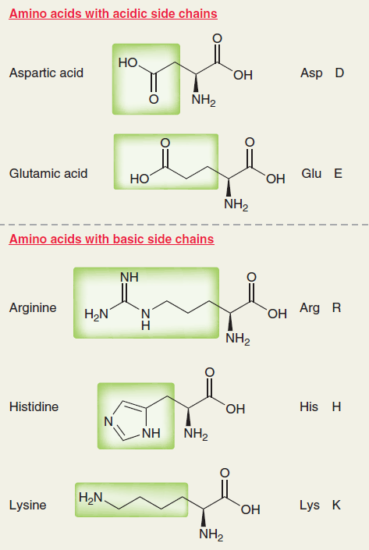
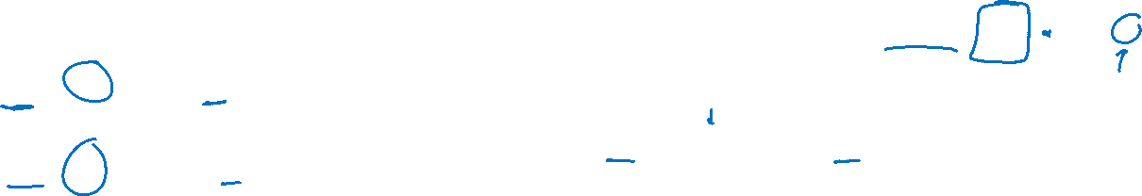

Slide 9
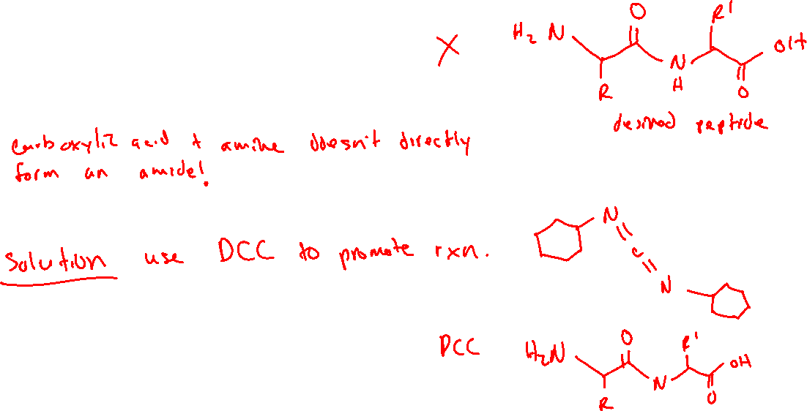
Synthesis of Peptides: Linking Amino Acids Together (25.6)

Slide 10
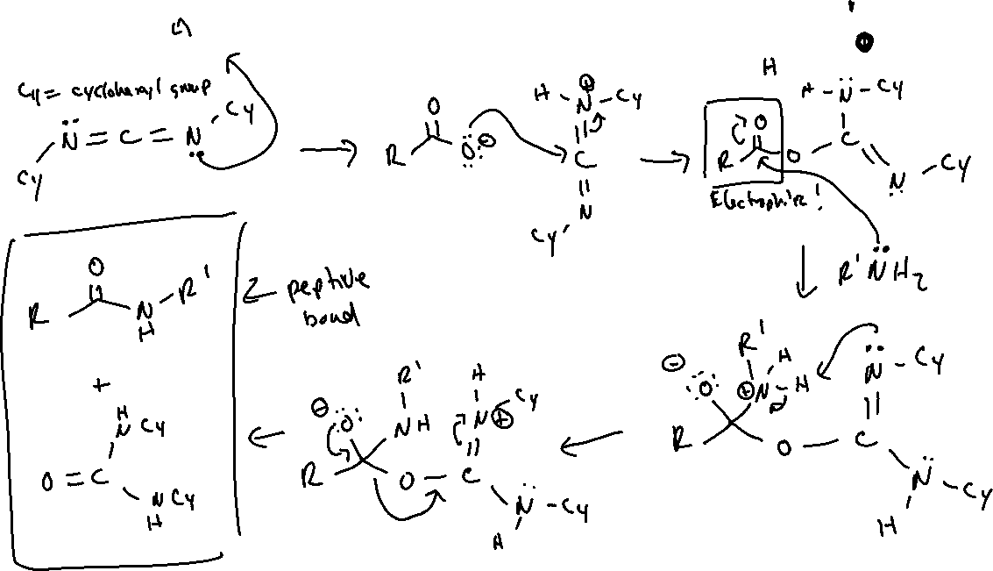
Peptide Bond Formation with DCC: Mechanism

Slide 11
Peptide Synthesis: Protecting Groups

Slide 12






Protecting the Amine Group with “Boc”

