Slide 1
Isoelectric Point (pI)
Peptide Synthesis
4/21/2023

Slide 2
A Brief Reminder about pH and pKa

Slide 3
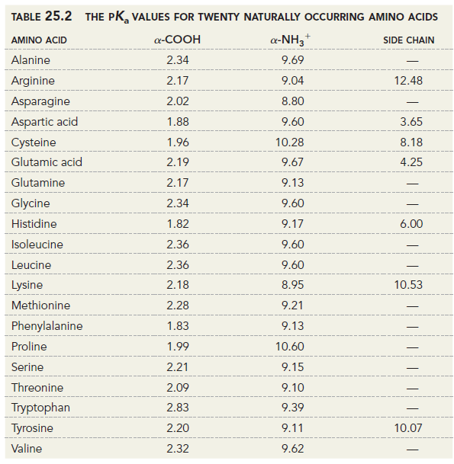
Amino Acid pKa Table

Slide 4
Isoelectric Point

Slide 5
Isoelectric Point

Slide 6
Isoelectric Point

Slide 7
Drawing Peptide Chains (25.4)

Slide 8
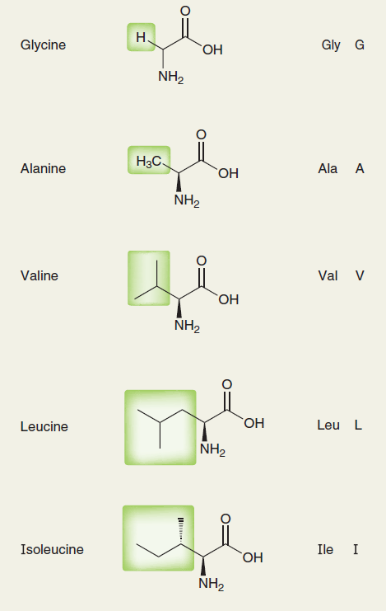
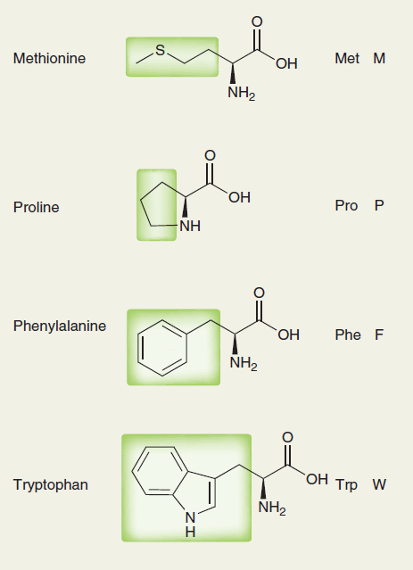
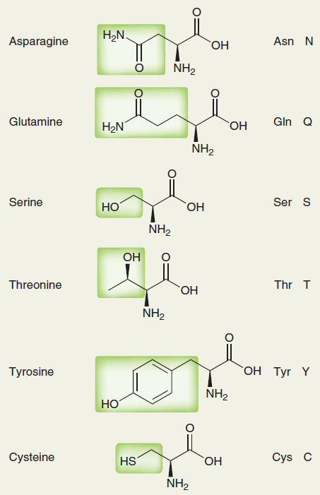
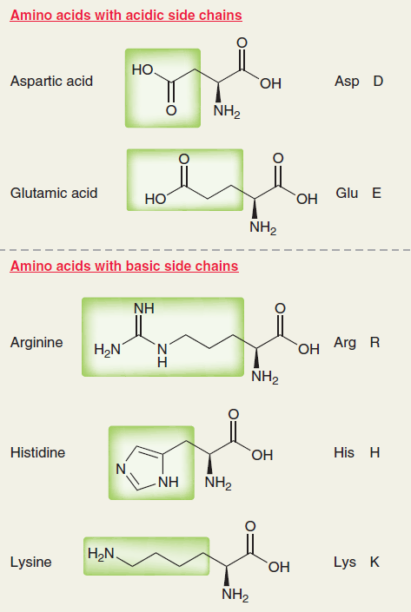

Slide 9
Synthesis of Peptides: Linking Amino Acids Together (25.6)

Slide 10
Peptide Bond Formation with DCC: Mechanism

Slide 11
Peptide Synthesis: Protecting Groups

Slide 12






Protecting the Amine Group with “Boc”

