Slide 1
Peptide Synthesis
4/24/2023

Slide 2
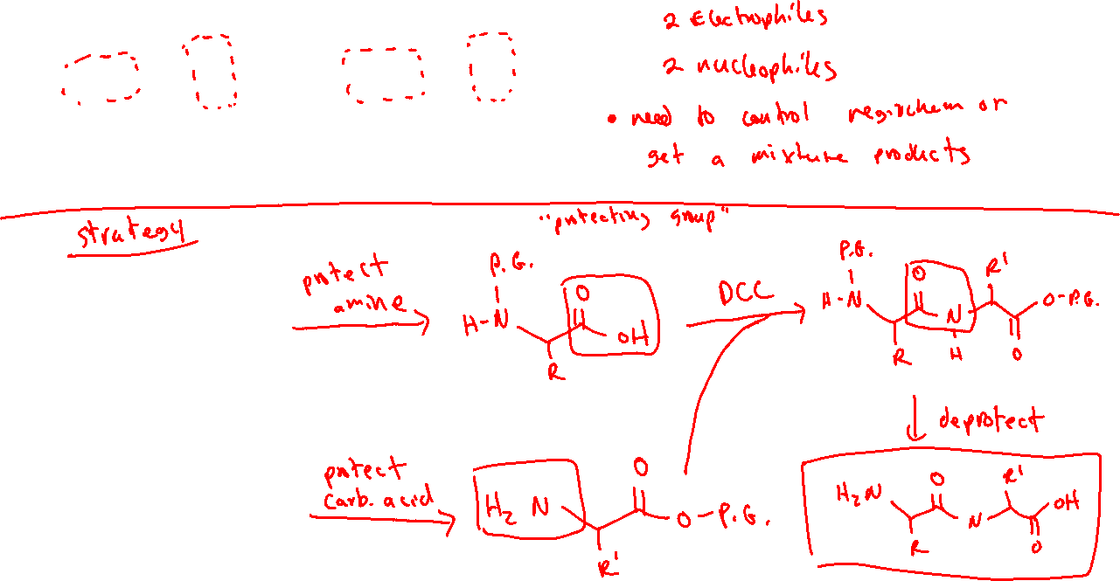
Peptide Synthesis: Protecting Groups

Slide 3





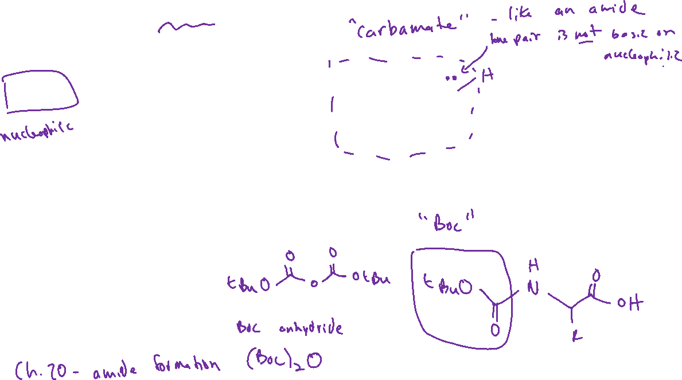

Protecting the Amine Group

Slide 4

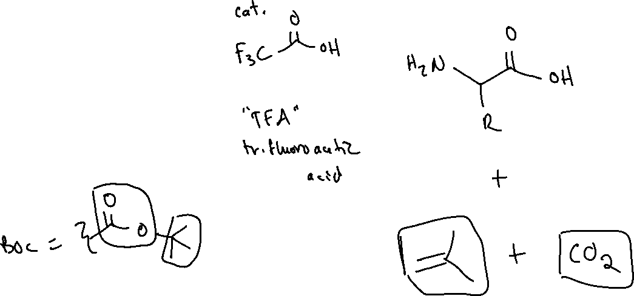
“Deprotecting” the Amine: Removing Boc

Slide 5
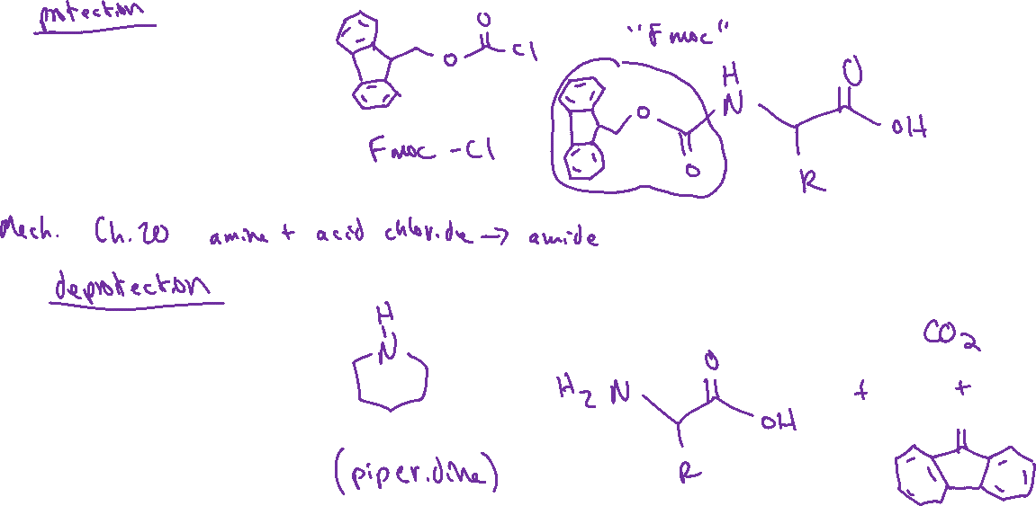




Amine Protection and Deprotection with “Fmoc”

Slide 6



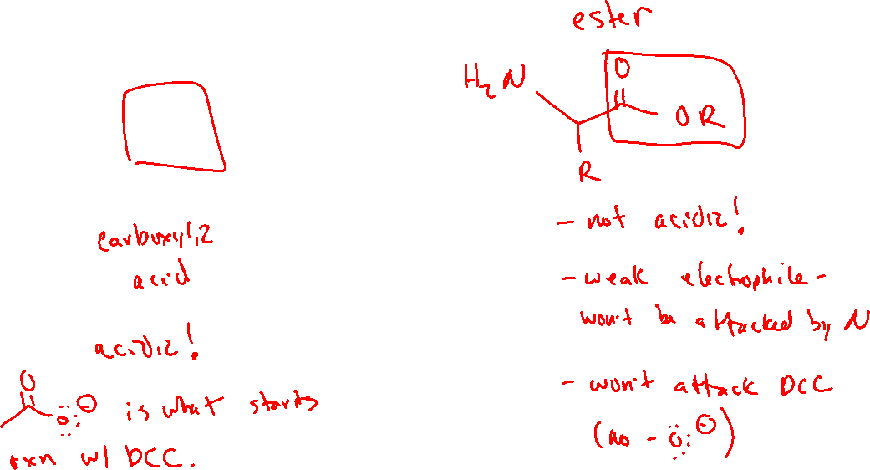
Protecting the Carboxylic Acid (25.6)

Slide 7
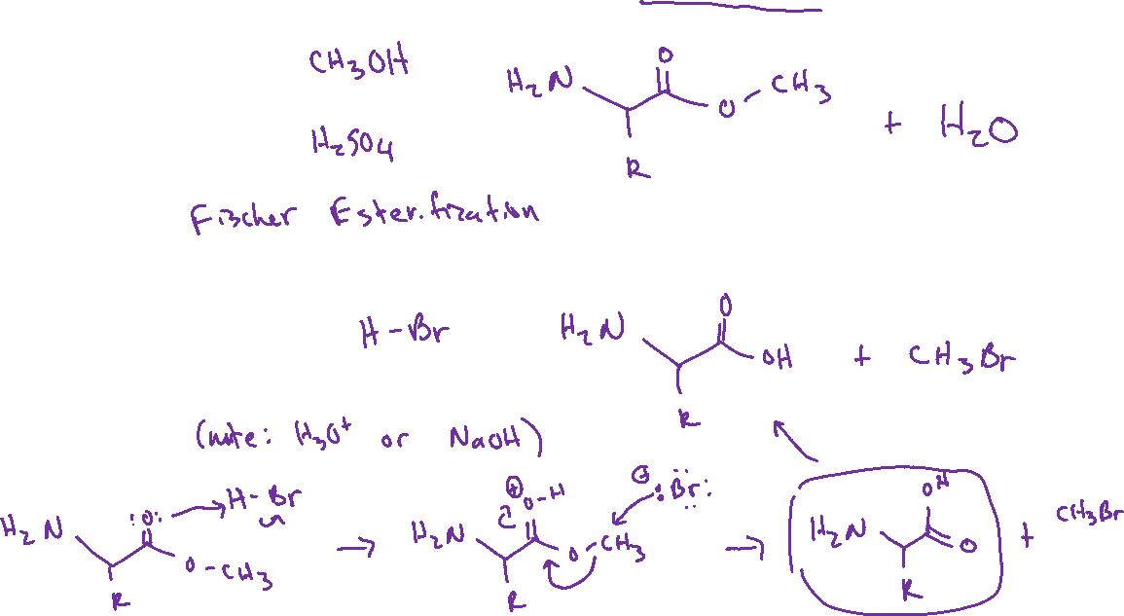




Protecting/Deprotecting the Carboxylic Acid: Methyl Ester

Slide 8
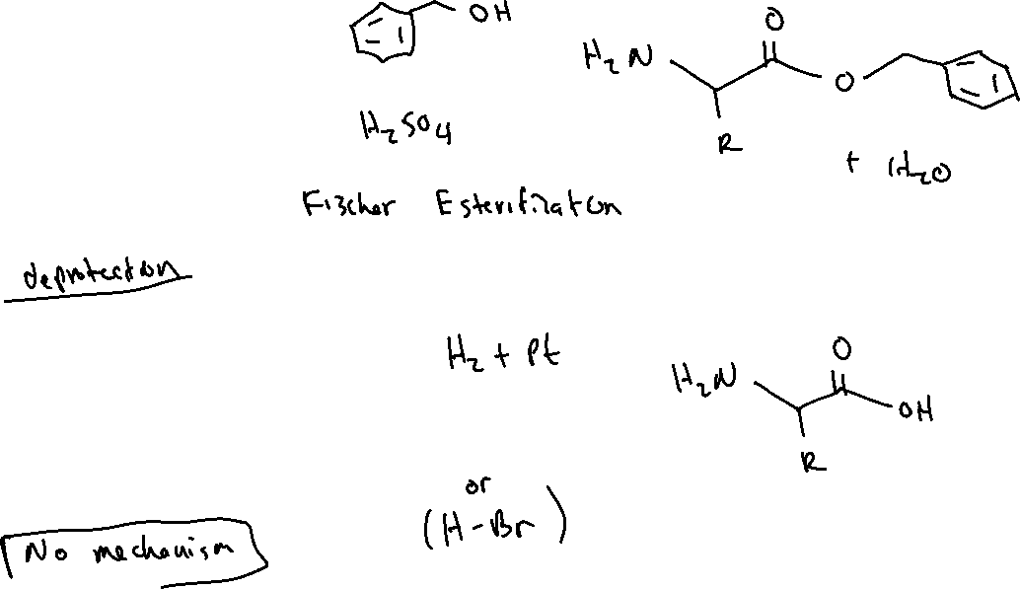

Protecting/Deprotecting the Carboxylic Acid: Benzyl Ester

Slide 9
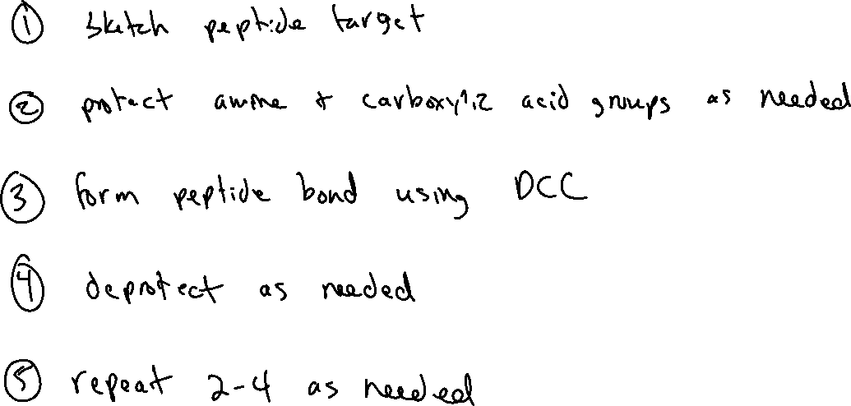
Synthesizing Peptides: General Strategy

Slide 10
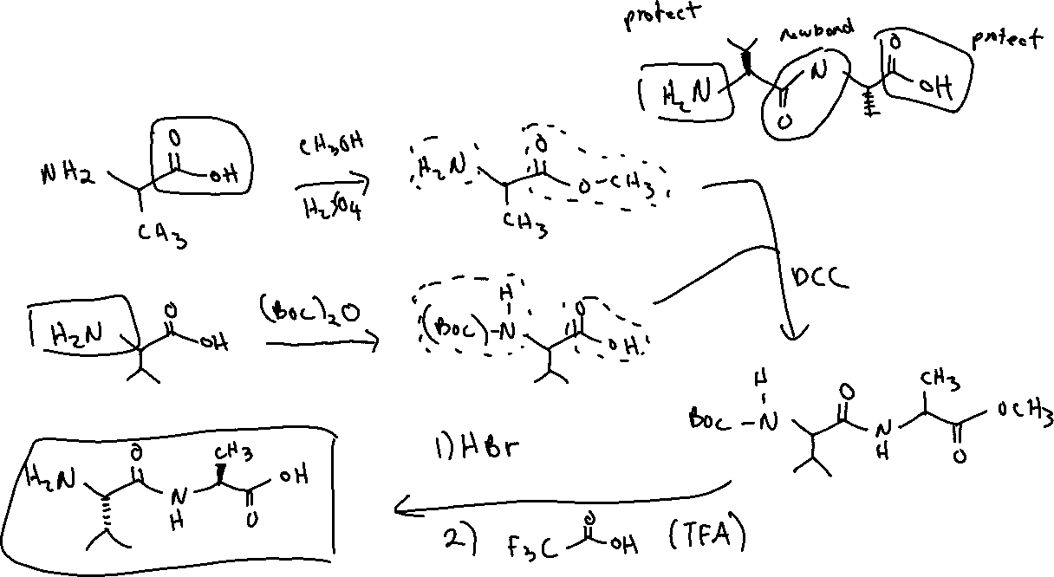
Synthesizing Peptides: Example

Slide 11
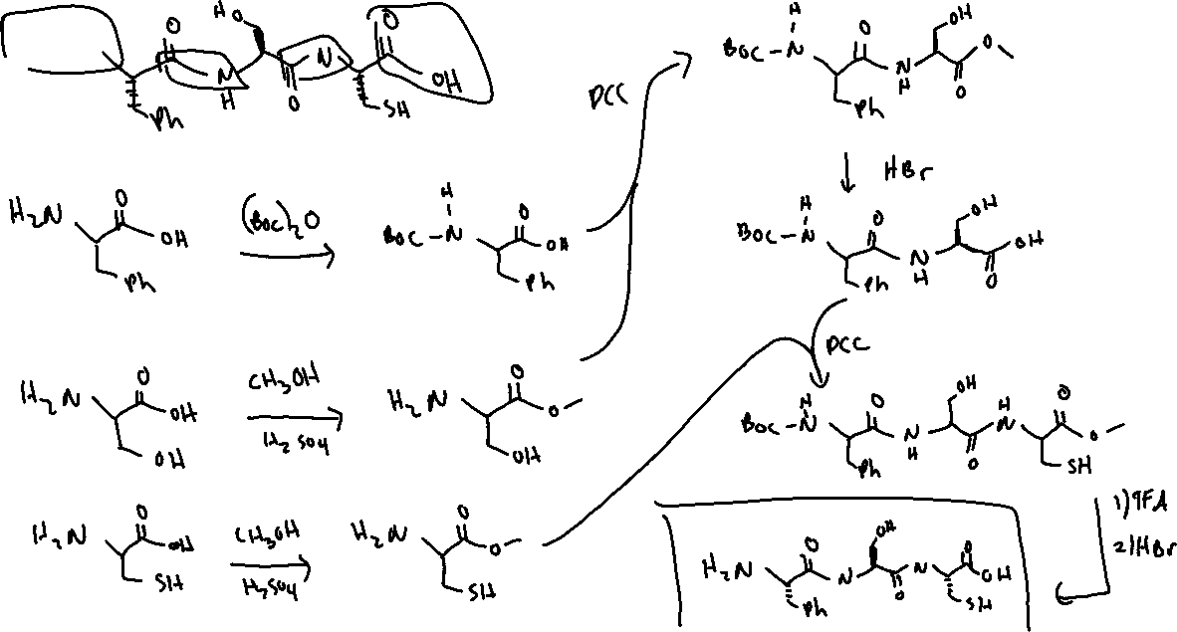
Synthesizing Peptides: Example

